Slide 1

VS Toolbox is a collection of scripts,
Used for automating some of the steps in the store build process.
This document shows the basic functionality of each of the scripts
Currently available in the toolbox

Slide 2
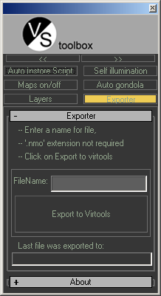
This part of the toolbox had been added in the current its version (0.9)
These buttons control the docking and undocking of the toolbox. The button on the left will dock the toolbox to the left of the screen, the one on the right will undock it.
These buttons control the visibility of the scripts. Clicking on a button for a script will hide/unhide it. You can click on multiple buttons to make them all visible at once

Slide 3
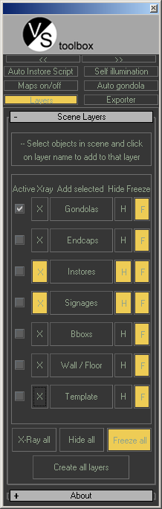

This scripts allows the user to manage the 3d store file more systematically with the ‘layers’ feature of 3ds max
Usage-
- Select the objects in the viewport and click on the respective layer names to add them to the layer
- If the layer is not already created for the element type then it will be automatically created by the script and the selected objects will be added to it
Use Hide, freeze, x-ray buttons toggle buttons to hide/freeze/x-ray everything in the layer
These are toggle buttons to hide/freeze/xray all layers at once.

Slide 4
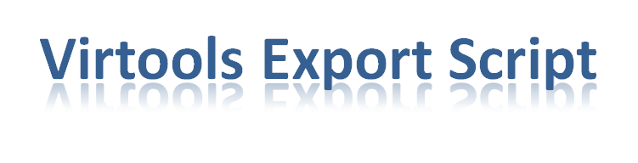
This Script will help in speeding up the exporting of .nmo virtools files from 3ds max
Usage-
Select the objects that need to be exported
Specify a name for the file being exported
Click the ‘export to virtools’ button
The nmo will be exported to the ‘exports’ folder of the currently specified project folder.
If the project folder is not specified the file will be saved to
D:\Documents and Settings\<user profile>\My Documents\3dsmax\export\
This field will display the path to which the last file was saved

Slide 5
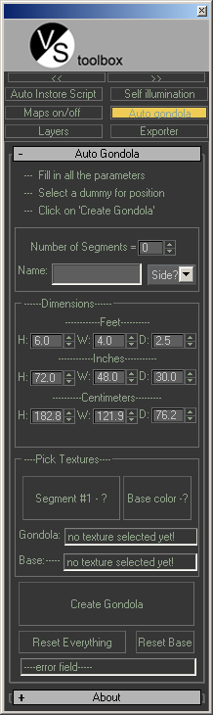

This script probably offers biggest time saving among these scripts. It allows the user to create entire gondolas with texturing already done with just a few clicks.
Usage –
Create and select a dummy, placed where you want the gondola to be created.
Enter a name for the new gondola
Specify how many segments the gondola should have
Enter which side of the gondola you are creating
Specify the dimensions of the gondola, can be specified in ft/inches/cms.
Pick a texture for the first segment of the gondola. The name should end with ‘01’ so that the script can load the rest of the textures in the series
Pick a texture for the base color
Click on ‘create gondola’
These fields will display the path to the textures that have been picked
Incase a parameter is missing when the user presses ‘create gondola’, the error message will be displayed here.

Slide 6
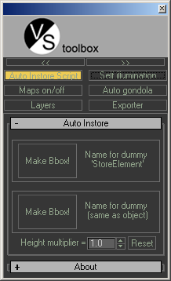

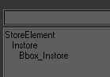
This script takes care of the bbox creation and hierarchy for instore objects to make them ready for export to virtools and virtual views store
Usage-
-Select the instore object
-click on either of the two ‘Make bbox’ buttons
-The first one will keep the name of the dummy object(created as the parent of the instore and the bbox) as ‘StoreElement’
-The other button will name the dummy object same as the name of the selected instore object
This will control the height of the bounding box created for the instore. At 1 it will be same as the height of the selected object, at 5 it will be 5 times.
Useful for preventing the camera jumping over short objects in walkthrough mode in virtual views store

Slide 7
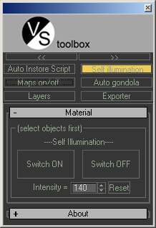

This script gives the user the ability to apply self
Illumination to multiple objects at once.
Usage-
-Select all the objects that need self illumination applied to them.
-Set the intensity to the required value (0-255)
-Click on ‘switch on’

Slide 8
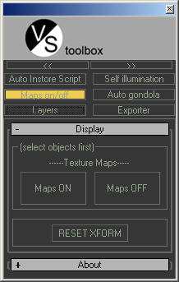

This script gives the user the ability to Turn on/off the visibility of textures on multiple objects at once.
This is helpful for keeping the scene light and preventing max from crashing.
Usage-
-Select all the objects that you want to turn of texture visibility for
-click on ‘Maps OFF’
This button will reset the xform for the selected objects if they have been accidentally scaled out of sub poly mode.

Slide 9
Send suggestions for new functionality, bug reports to nishil.kohli@accenture.com

