Slide 1
Re-envisioning a future in scholarly communication chris hartgerink
@chartgerink

Slide 2
Re-envisioning a future in scholarly communication chris hartgerink
@chartgerink
Ps. yes, this is the xkcd font.

Slide 3
Thought exercise:
What scholarly communications system could we come up with today?

Slide 4
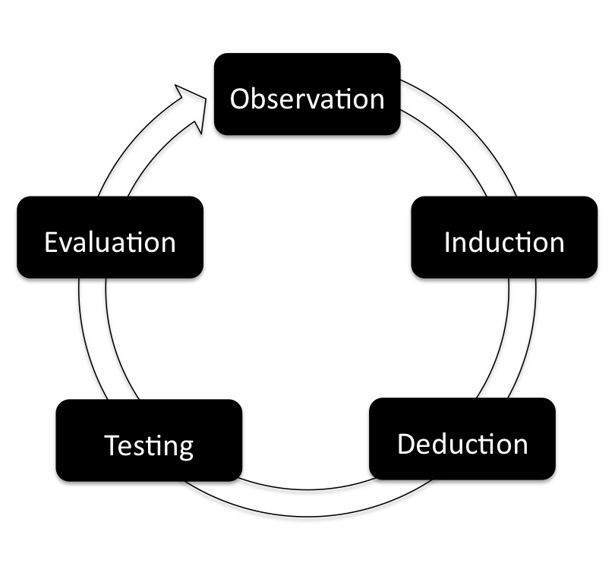

Slide 5
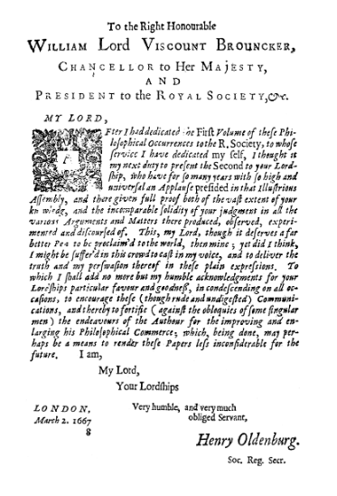
1 666

Slide 6
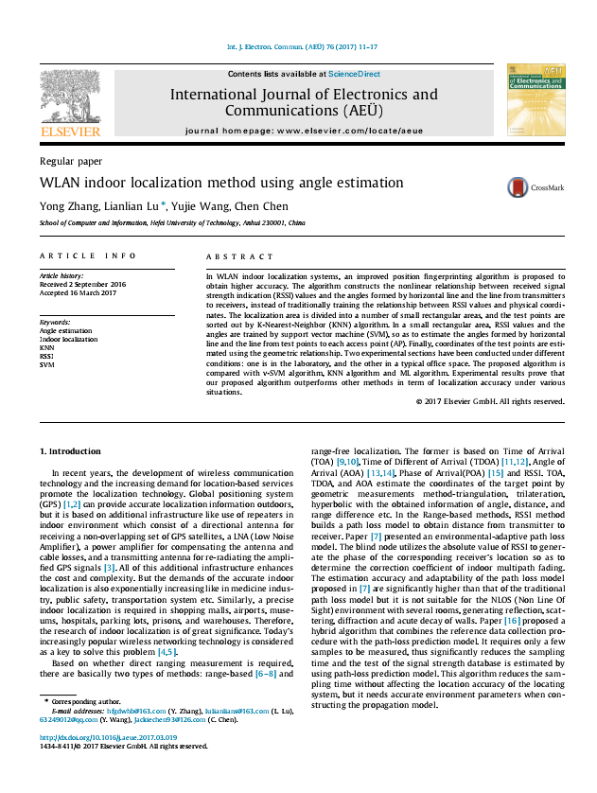
1 666
2017
Notes:
Subtle improvements
1.

Slide 7
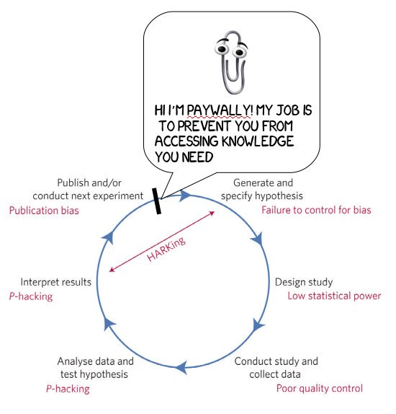

Slide 8


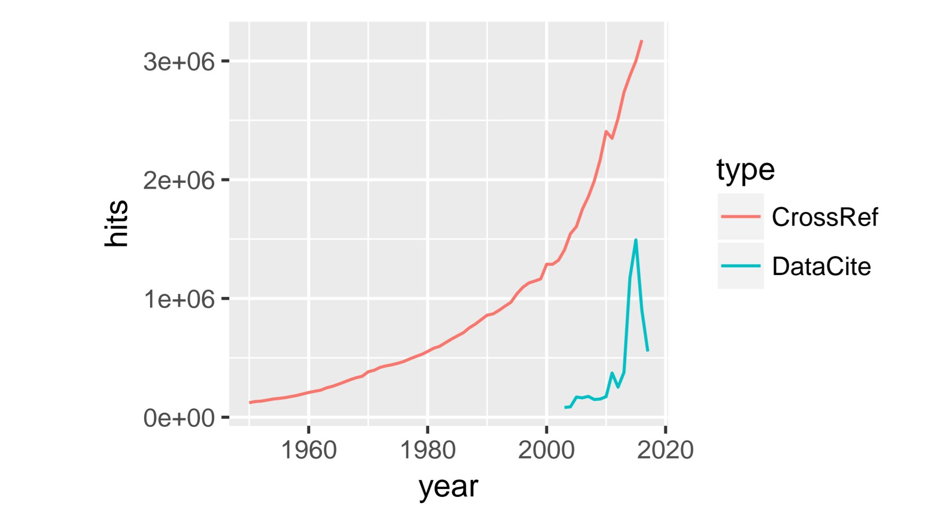

Slide 9
Access
Preregistration
Reviews
Data
Preservation
Protocols
Materials
Replication
etc
Notes:
We’re trying to duct tape too many things to the paper. Preregistration of hypotheses are modularized, not embedded. Neither are data, materials --- they are modular

Slide 10
Access
Preregistration
Reviews
Data
Duct tape solutions won’t last
Preservation
Protocols
Materials
Replication
etc
Notes:
We’re trying to duct tape too many things to the paper. Preregistration of hypotheses are modularized, not embedded. Neither are data, materials --- they are modular

Slide 11
Access
Preregistration
Reviews
Data
Duct tape solutions won’t last
Because they don’t solve the problem
Preservation
Protocols
Materials
Replication
etc
Notes:
We’re trying to duct tape too many things to the paper. Preregistration of hypotheses are modularized, not embedded. Neither are data, materials --- they are modular

Slide 12
Notes:
We’re trying to duct tape too many things to the paper. Preregistration of hypotheses are modularized, not embedded. Neither are data, materials --- they are modular

Slide 13
Notes:
We’re trying to duct tape too many things to the paper. Preregistration of hypotheses are modularized, not embedded. Neither are data, materials --- they are modular

Slide 14
Single point of failure
Notes:
We’re trying to duct tape too many things to the paper. Preregistration of hypotheses are modularized, not embedded. Neither are data, materials --- they are modular

Slide 15

Single point of failure
Ahem...
Notes:
We’re trying to duct tape too many things to the paper. Preregistration of hypotheses are modularized, not embedded. Neither are data, materials --- they are modular

Slide 16
Single point of failures removed by increasing inclusiveness, redistribution!
Censorship and adjustment of chronology, evidence NOT possible when everyone can verify
This is why transparency goes beyond ideals, it is about rigour
Notes:
We’re trying to duct tape too many things to the paper. Preregistration of hypotheses are modularized, not embedded. Neither are data, materials --- they are modular

Slide 17
theory
hypotheses
materials
data
Time ------------------>
Notes:
We’re trying to duct tape too many things to the paper. Preregistration of hypotheses are modularized, not embedded. Neither are data, materials --- they are modular

Slide 18
theory
hypotheses
materials
data
data
Time ------------------>
Notes:
We’re trying to duct tape too many things to the paper. Preregistration of hypotheses are modularized, not embedded. Neither are data, materials --- they are modular

Slide 19
Direct replications
theory
hypotheses
materials
data
data
Time ------------------>
Notes:
We’re trying to duct tape too many things to the paper. Preregistration of hypotheses are modularized, not embedded. Neither are data, materials --- they are modular

Slide 20
Preregistration
“conceptual” replications
Direct replications
theory
hypotheses
materials
data
data
Time ------------------>
Notes:
We’re trying to duct tape too many things to the paper. Preregistration of hypotheses are modularized, not embedded. Neither are data, materials --- they are modular

Slide 21
Preregistration
“conceptual” replications
Direct replications
hypotheses
materials
data
data
Time ------------------>
Notes:
We’re trying to duct tape too many things to the paper. Preregistration of hypotheses are modularized, not embedded. Neither are data, materials --- they are modular

Slide 22
Put all of this on p2p network dat append only!
Don’t need blockchain for integrity

Slide 23
Put all of this on p2p network dat append only!
Don’t need blockchain for integrity
+ integrates access for all

Slide 24
Preregistration
“conceptual” replications
Direct replications
Reanalysis
hypotheses
materials
data
results
data
results
Time ------------------>
Notes:
We’re trying to duct tape too many things to the paper. Preregistration of hypotheses are modularized, not embedded. Neither are data, materials --- they are modular

