Slide 1

Detecting data fabrication
Chris Hartgerink | @chartgerink with
Jan voelkel jelte wicherts marcel van assen http://bit.ly/wcri2017 working manuscript http://bit.ly/wcri2017-manuscript
Funded by

Slide 2
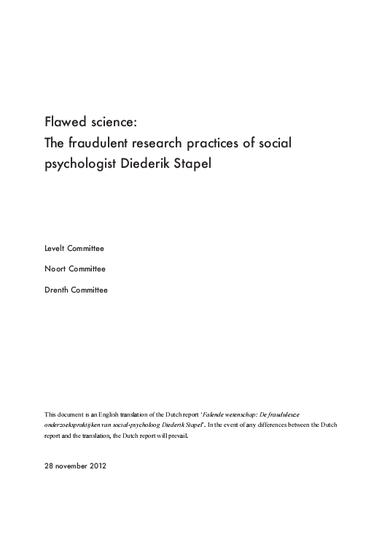
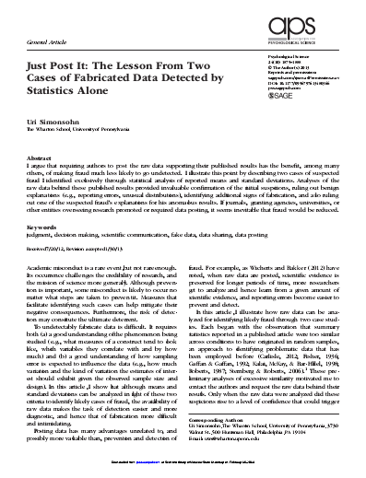
Funded by

Slide 3
Methods developed in casu
Applicable as generic methods?
Funded by

Slide 4
 | Genuine | Fabricated
“genuine”
“fabricated”
Funded by

Slide 5
 | Genuine | Fabricated
“genuine” | ?? | ??
“fabricated” | ?? | ??
Funded by

Slide 6
How can data be fabricated?
Funded by

Slide 7
Many labs (n=36)
 | Genuine | Fabricated
“genuine” | ?? | ??
“fabricated” | ?? | ??
Funded by

Slide 8
Many labs (n=36)
We asked researchers
(n=36)
 | Genuine | Fabricated
“genuine” | ?? | ??
“fabricated” | ?? | ??
Funded by

Slide 9
Yes, we asked researchers to fabricate data
Funded by

Slide 10
Yes, we asked researchers to fabricate data and we even paid them
Funded by

Slide 11
Yes, we asked researchers to fabricate data and we even paid them and we paid them even more if they were top 3
Funded by

Slide 12
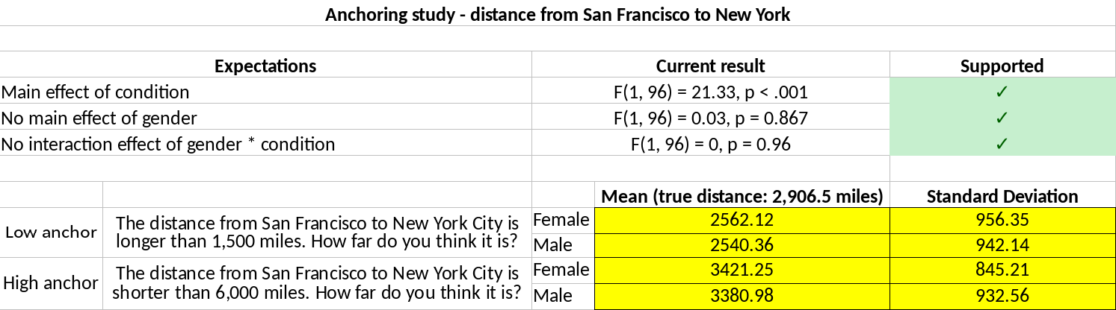
Funded by

Slide 13
Funded by

Slide 14
Fabrication Hypotheses
1. Significant condition effect
2. Nonsignificant gender effect
3. Nonsignificant interaction effect
Funded by

Slide 15
Funded by

Slide 16
Want to try it yourself?
http://bit.ly/try-fabrication
Funded by

Slide 17
Data
Each of four studies provides
1. Four variances
2. Two nonsignificant results
3. One significant result
Funded by

Slide 18
Data
Each of four studies provides
1. Four variances
2. Two nonsignificant results
3. One significant result
Per respondent:
1. Sixteen variances
2. Eight nonsignificant results
3. Four significant results
Funded by

Slide 19
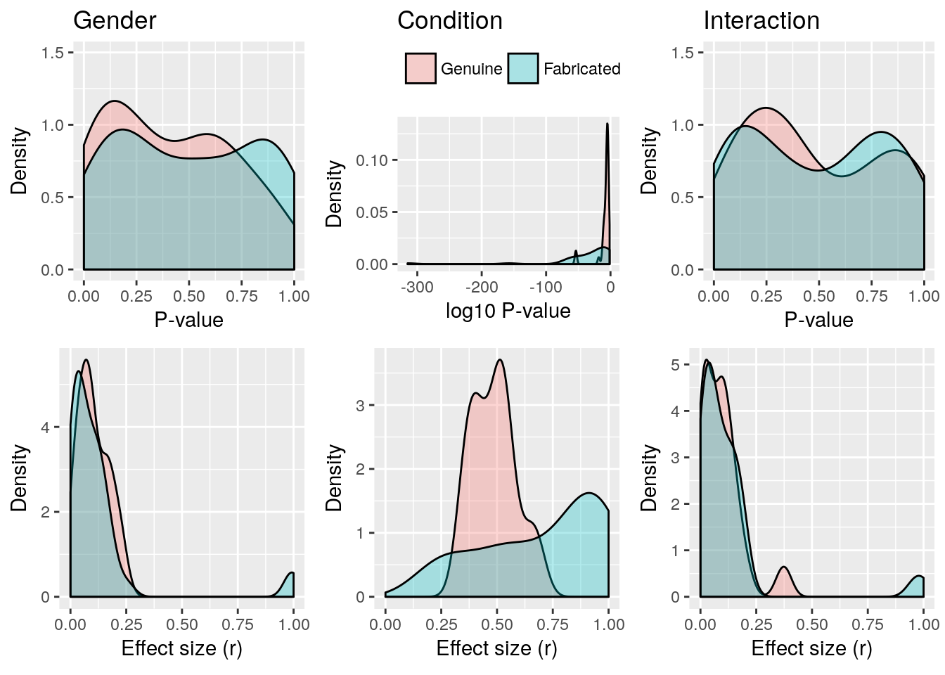
Funded by

Slide 20
Funded by

Slide 21
Effectiveness methods
Method | AUROC
Variance analysis, assumes = variance across conditions | .423
Variance analysis, assumes != variance across conditions | .770
Nonsignificant p-values gender effect | .521
Nonsignificant p-values interaction effect | .535
Effect size (1- correlation) | .744
Funded by

Slide 22
Effectiveness methods
Method | AUROC
Variance analysis, assumes = variance across conditions | .423
Variance analysis, assumes != variance across conditions | .770
Nonsignificant p-values gender effect | .521
Nonsignificant p-values interaction effect | .535
Effect size (1- correlation) | .744
Funded by

Slide 23
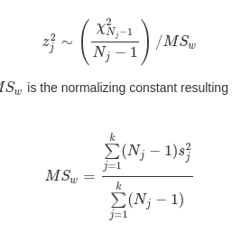
Effectiveness methods
Method | AUROC
Variance analysis, assumes = variance across conditions | .423
Variance analysis, assumes != variance across conditions | .770
Nonsignificant p-values gender effect | .521
Nonsignificant p-values interaction effect | .535
Effect size (1- correlation) | .744
Funded by

Slide 24
Effectiveness methods
Method | AUROC
Variance analysis, assumes = variance across conditions | .423
Variance analysis, assumes != variance across conditions | .770
Nonsignificant p-values gender effect | .521
Nonsignificant p-values interaction effect | .535
Effect size (1- correlation) | .744
Funded by

Slide 25

Effectiveness methods
Method | AUROC
Variance analysis, assumes = variance across conditions | .423
Variance analysis, assumes != variance across conditions | .770
Nonsignificant p-values gender effect | .521
Nonsignificant p-values interaction effect | .535
Effect size (1- correlation) | .744
Funded by

Slide 26
Effectiveness methods
Method | AUROC
Variance analysis, assumes = variance across conditions | .423
Variance analysis, assumes != variance across conditions | .770
Nonsignificant p-values gender effect | .521
Nonsignificant p-values interaction effect | .535
Effect size (1- correlation) | .744
Funded by

Slide 27
But assumes 50/50 prevalence
Funded by

Slide 28
But assumes 50/50 prevalence so only use as flag, not evidence of
Funded by

Slide 29
Dual use problem
Funded by

Slide 30
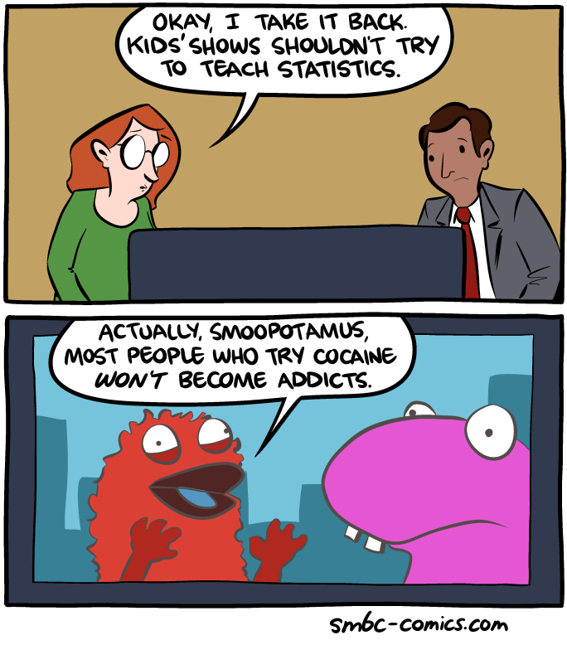
Funded by

Slide 31
Lessons
1. Fabricated nonsignificant data look rather genuine
2. Variance analysis sensitive to population variances being hetero- or homogeneous (important in application)
3. Large effect sizes easy indicator (r>.7)
4. Use as flag, not evidence
Funded by

Slide 32
This was just study one
Funded by

Slide 33
This was just study one study two replicates with raw data
Funded by

Slide 34
This was just study one study two replicates with raw data and adds interviews!
Funded by

Slide 35
Ongoing, but you can find incoming transcripts @ http://bit.ly/wcri2017-transcripts
Funded by

Slide 36
Ongoing, but you can find incoming transcripts @ http://bit.ly/wcri2017-transcripts feel free to use for research!
(cc 0)
Funded by

