Slide 1
The hope and despair of science and TDM
@chartgerink
(twitter and github)

Slide 2
The hope

Slide 3

Decreased mortality of the patients significantly,
F(1, 39) = 2.43, p < .05.

Slide 4
Decreased mortality of the patients significantly,
F(1, 39) = 2.43, p < .05.

Slide 5
Decreased mortality of the patients significantly,
F(1, 39) = 2.43, p < .05.
Use this information
To recalculate
p-value

Slide 6
Decreased mortality of the patients significantly,
F(1, 39) = 2.43, p < .05.
Use this information
To recalculate
p-value
P-value NOT < .05
But 0.13! → no effect
Wrong conclusion in paper

Slide 8
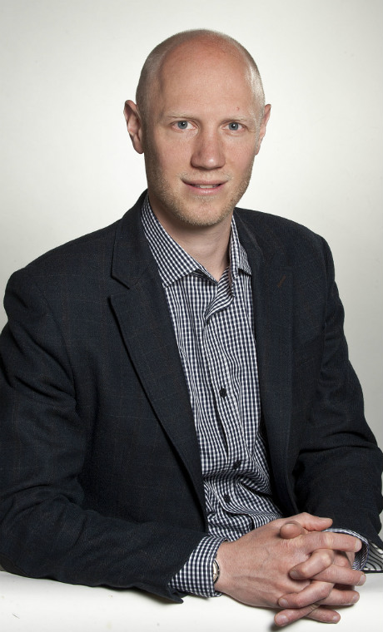
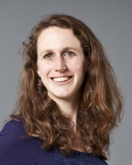

Slide 9
Marjan, please check all
these papers manually

Slide 10
PFFFfff this is taking
ages

Slide 11
~2010

Slide 12
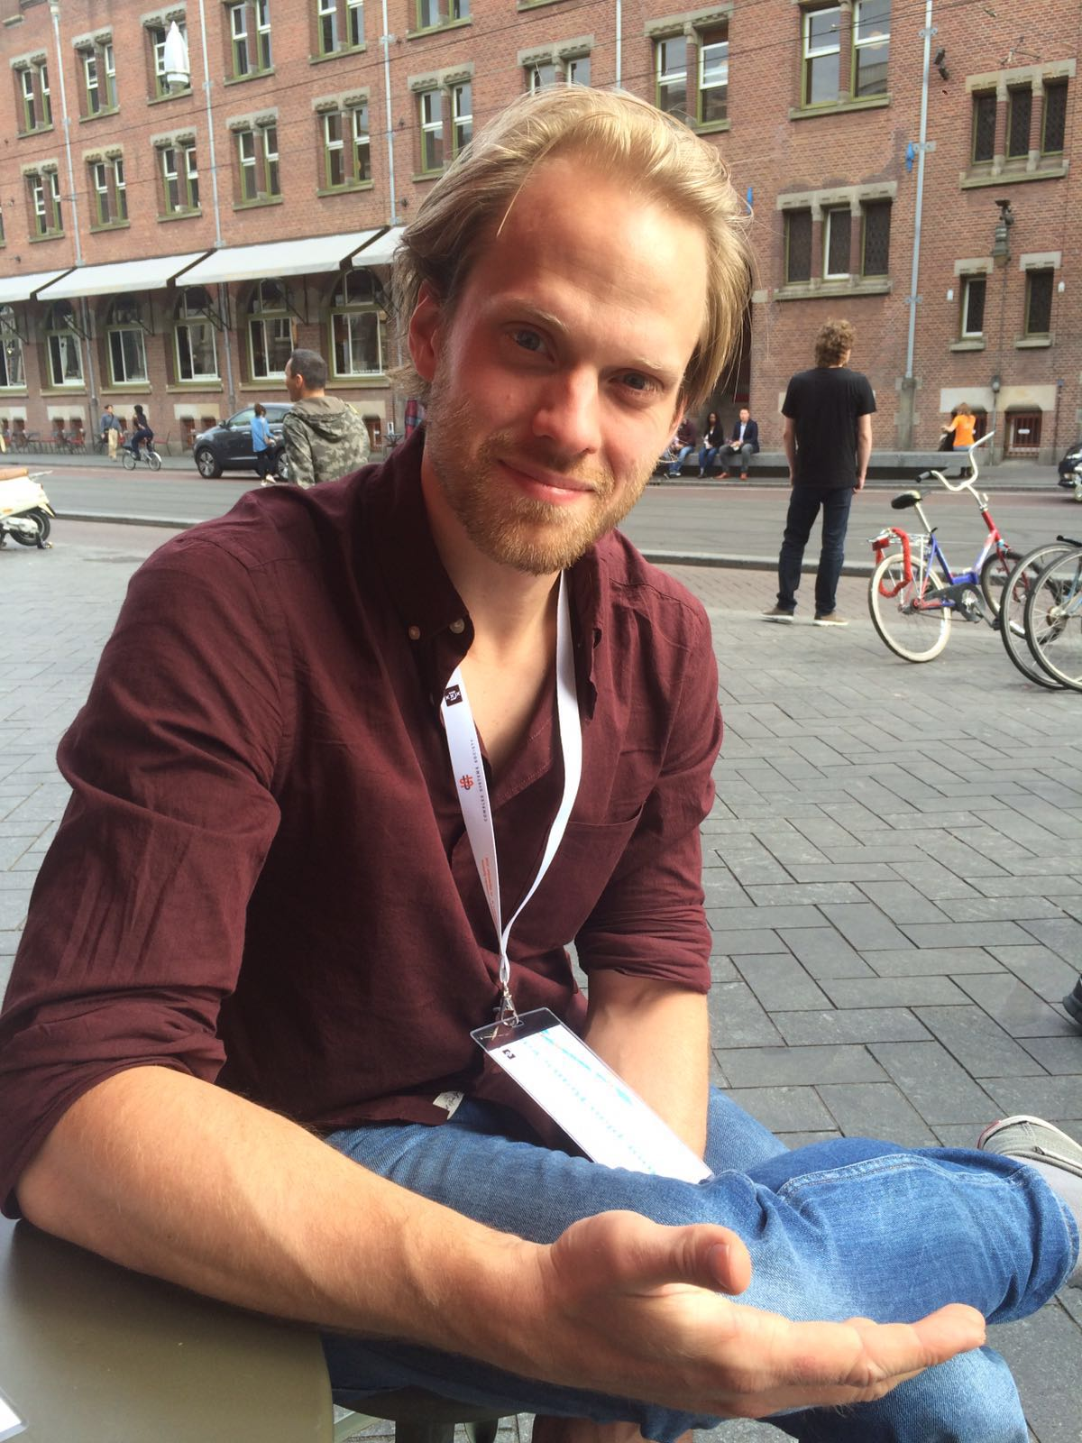

2012

Slide 13
2012
Not to worry! Computers can do it!

Slide 14

2013

Slide 15
2013
It takes only 10 seconds
for 100 papers!

Slide 16
2013
Now we just need more papers!

Slide 17

2013

Slide 18
2014
Chris, download tens of thousand
papers, manually

Slide 19
2014
*Click click download*
Times 30,000

Slide 20
2014
There must be an easier way

Slide 21
2014
AUTOMated downloading!

Slide 22
2015
Jelte, I learned how to scrape articles
And am ready to download 900,000
articles for our research

Slide 23
2015
that’s beyond a scale I ever imagined
Possible!

Slide 24
The despair

Slide 25
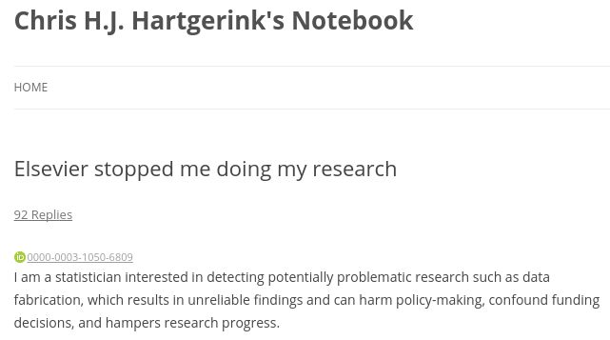
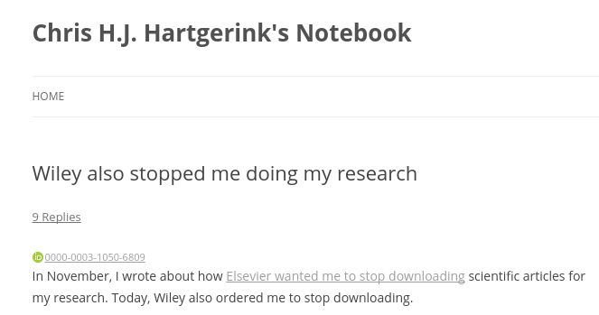

Slide 26
900,000 became
300,000

Slide 27
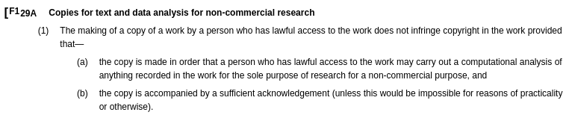
UK has an exception since 2014

Slide 28
UK has an exception since 2014
Problem solved?

Slide 29
UK has an exception since 2014
Problem solved?
I tried UK collaboration
UK uni shut us down despite exception
(management also avoids imagined risks)

Slide 30

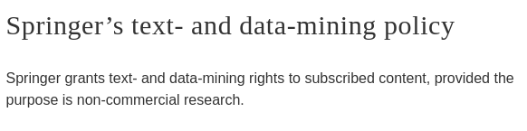
Publishers don’t hate copying but lobby against it?

Slide 31
Return of the hope

Slide 32
(the conditional)
Return of the hope

Slide 33
TDM not only has research potential

Slide 34
TDM can create the market for services on information consumption

Slide 35
TDM can create the market for services on information consumption but only with wide exception including commercial use

Slide 36
Reuse of UK
Public sector data alone has estimated market cap of
> half a billion euros

Slide 37
Wide exception for TDM allows EU to become hub of TDM innovation and economic growth

Slide 38
How many ways to capitalize on selling access to information?
How many ways to capitalize on how to consume that information

Slide 39
In long run encourages pooling of resources instead of current monopolies/islands causes richer services

Slide 40
TDM no problem in Open Access
Gives us a glimpse into the future

Slide 41

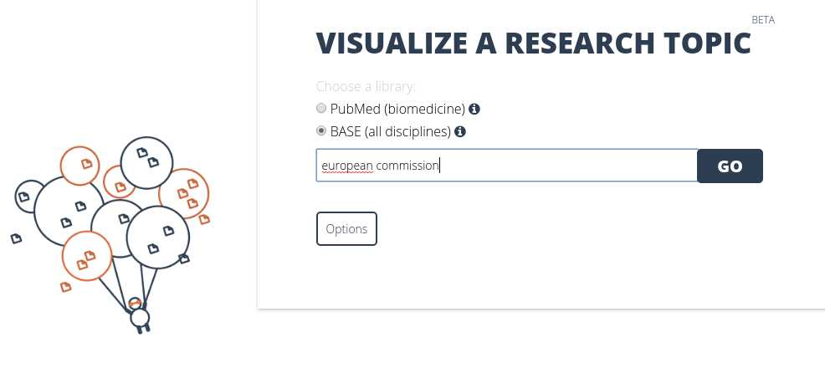

Slide 42
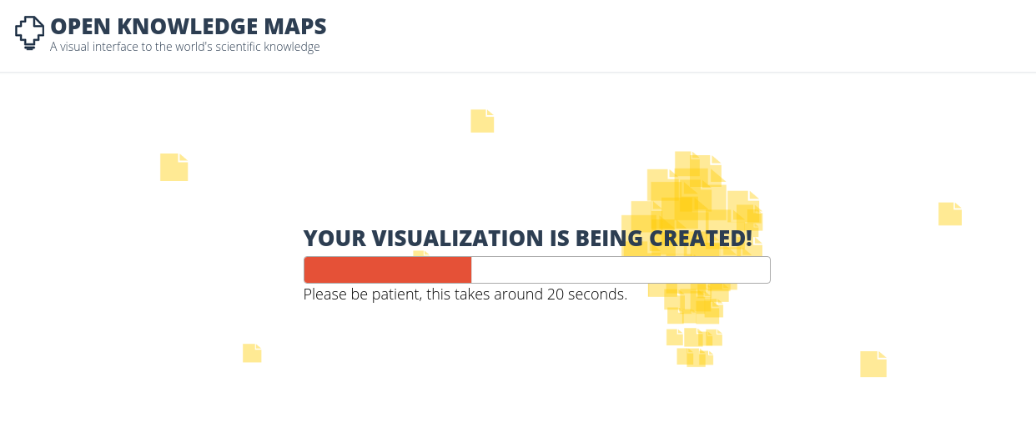

Slide 43
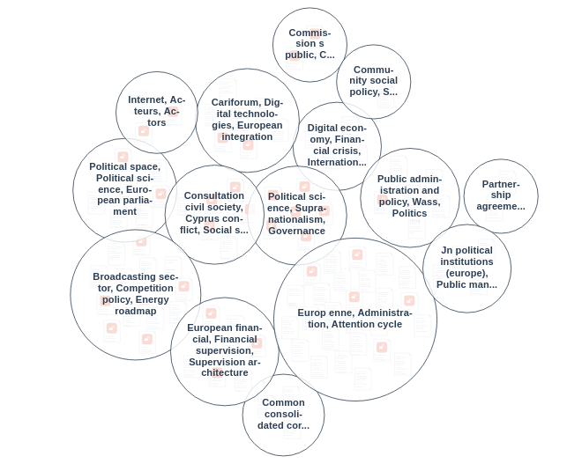

Slide 44
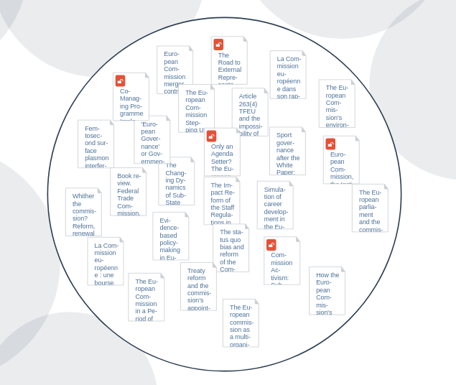

Slide 45
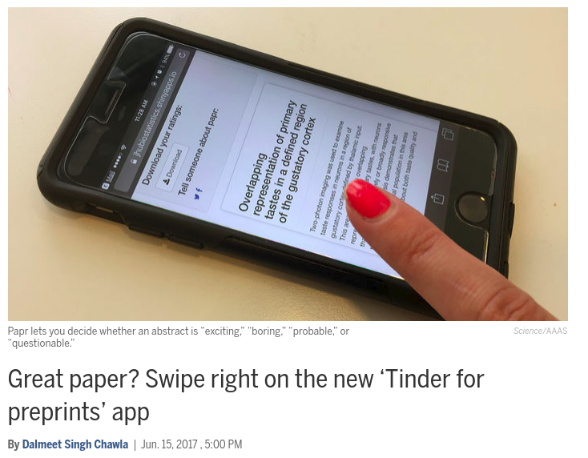

Slide 46
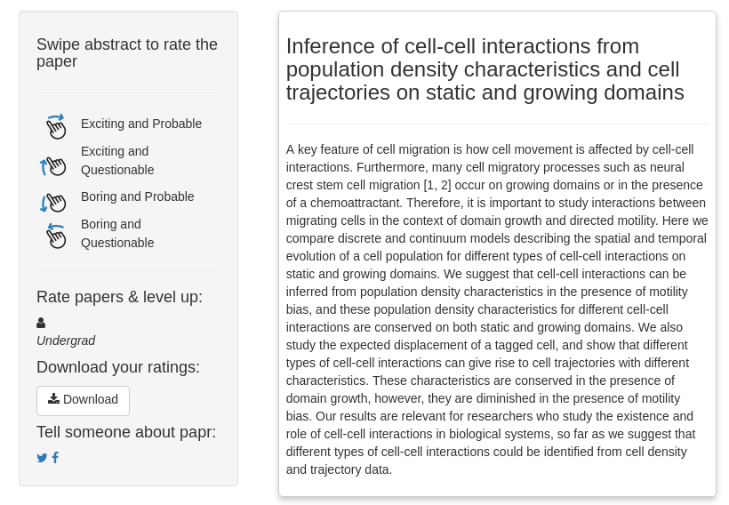

Slide 47
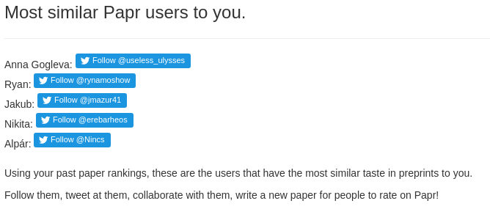

Slide 48
Thank you
Reminder:
Open content creates innovation
Slides: bit.ly/tdm-event
Twitter: @chartgerink
E-mail: chris@libscie.org
More on potential of information consumption as economic market?
bit.ly/tdm-future

