Slide 1
Modern ethics?
Chris Hartgerink
@chartgerink
Jan. 20. 2017
Notes:
Hi everyone,
I’m very happy that ILVO has initiated a day that focuses on ethics and integrity in research. Talking about what you’re struggling with is the most important thing in dealing with ethical conundrums --- we all do it in our personal lives as well, so why not in research, right?

Slide 2
Common problems

Slide 3
Common problems
Common solutions

Slide 4
INTEGRITY
Common problems
Common solutions

Slide 5
unCommon problems
unCommon solutions

Slide 6
ethics
unCommon problems
unCommon solutions

Slide 7
uncommon
common

Slide 8
ethics
INTEGRITY

Slide 9
ethics
Set the standards

Slide 10
Taught the standards

Slide 11
How to think about ethics?

Slide 12
Sociology of science

Slide 13
Mertonian norms
Norm | Counternorm

Slide 14
Mertonian norms
Norm | Counternorm
Universalism

Slide 15
Mertonian norms
Norm | Counternorm
Universalism | Particularism

Slide 16
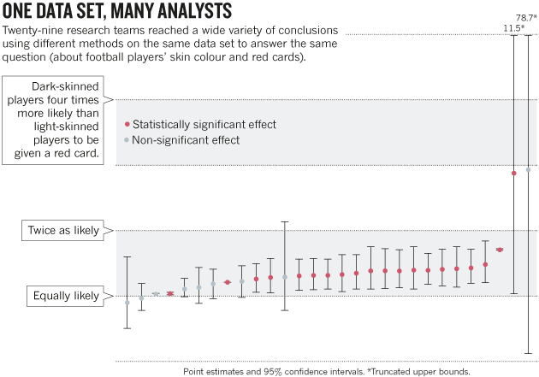
doi:10.1038/526189a

Slide 17
Mertonian norms
Norm | Counternorm
Universalism | Particularism
Communality

Slide 18
Mertonian norms
Norm | Counternorm
Universalism | Particularism
Communality | Secrecy

Slide 19
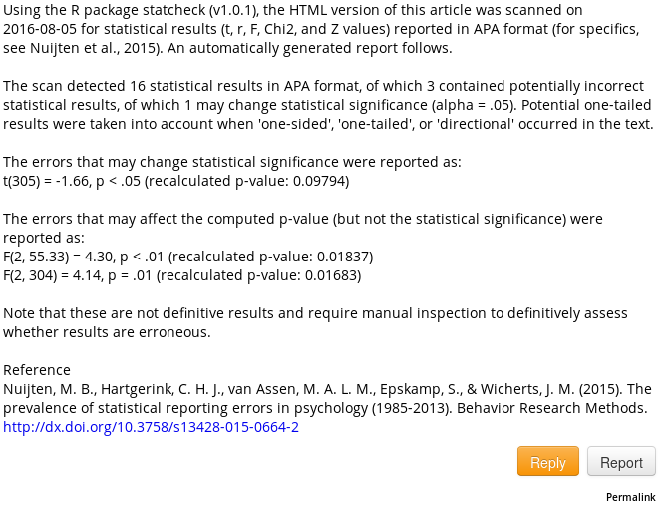


Slide 20
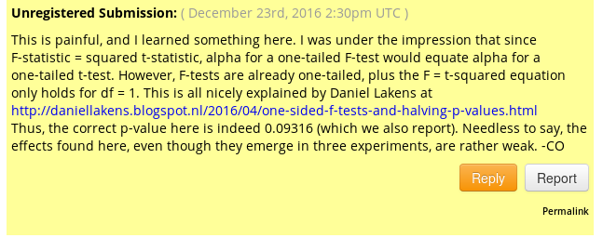

Slide 21
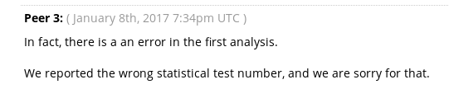

Slide 22
Mertonian norms
Norm | Counternorm
Universalism | Particularism
Communality | Secrecy
Disinterestedness

Slide 23
Mertonian norms
Norm | Counternorm
Universalism | Particularism
Communality | Secrecy
Disinterestedness | Self-interestedness

Slide 24
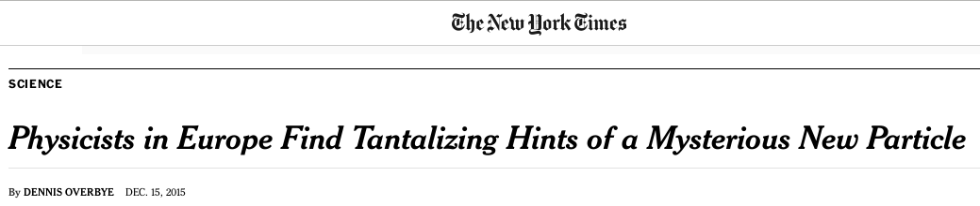

Slide 25
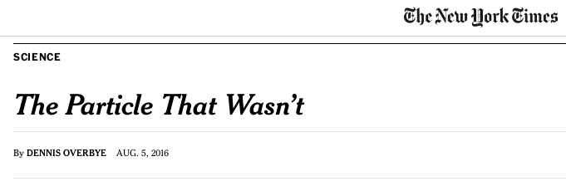

Slide 26
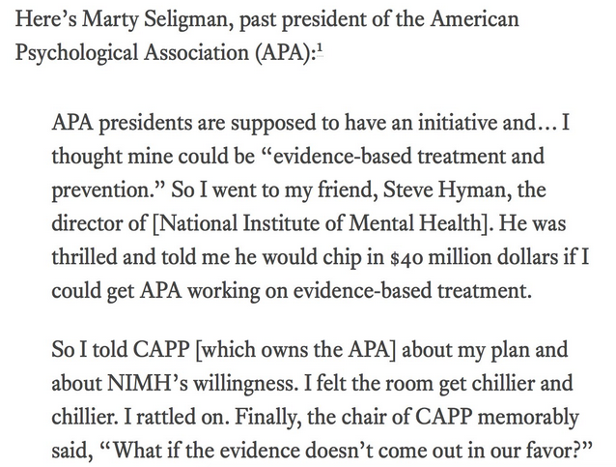

Slide 27
Mertonian norms
Norm | Counternorm
Universalism | Particularism
Communality | Secrecy
Disinterestedness | Self-interestedness
Skepticism

Slide 28
Mertonian norms
Norm | Counternorm
Universalism | Particularism
Communality | Secrecy
Disinterestedness | Self-interestedness
Skepticism | Dogmatism

Slide 29
Mertonian norms
Norm | Counternorm
Universalism | Particularism
Communality | Secrecy
Disinterestedness | Self-interestedness
Skepticism | Dogmatism
Governance

Slide 30
Mertonian norms
Norm | Counternorm
Universalism | Particularism
Communality | Secrecy
Disinterestedness | Self-interestedness
Skepticism | Dogmatism
Governance | Administration

Slide 31
(Preprint) publishing

Slide 32
(Preprint) publishing
By the scholars for the scholars by the scholars for the publishers

Slide 33

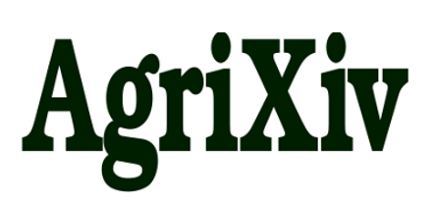
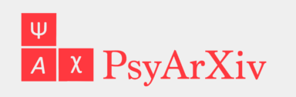


(Preprint) publishing

Slide 34
Mertonian norms
Norm | Counternorm
Universalism | Particularism
Communality | Secrecy
Disinterestedness | Self-interestedness
Skepticism | Dogmatism
Governance | Administration
Quality

Slide 35
Mertonian norms
Norm | Counternorm
Universalism | Particularism
Communality | Secrecy
Disinterestedness | Self-interestedness
Skepticism | Dogmatism
Governance | Administration
Quality | Quantity

Slide 36
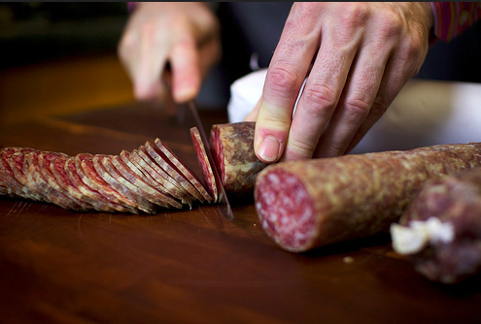

Slide 37
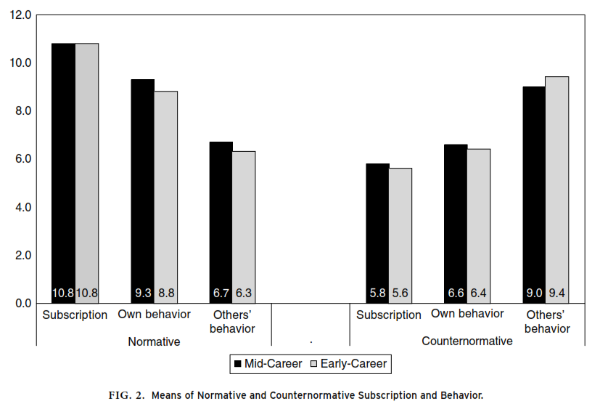

Slide 38
Open science = ethical
Norm | Transparency?
Universalism | Improved documentation
Communality
Disinterestedness
Skepticism
Governance
Quality

Slide 39
Open science = ethical
Norm | Transparency?
Universalism | Improved documentation
Communality | Publicly share all findings
Disinterestedness
Skepticism
Governance
Quality

Slide 40
Open science = ethical
Norm | Transparency?
Universalism | Improved documentation
Communality | Publicly share all findings
Disinterestedness | Increased accountability
Skepticism
Governance
Quality

Slide 41
Open science = ethical
Norm | Transparency?
Universalism | Improved documentation
Communality | Publicly share all findings
Disinterestedness | Increased accountability
Skepticism
Governance
Quality

Slide 42
Open science = ethical
Norm | Transparency?
Universalism | Improved documentation
Communality | Publicly share all findings
Disinterestedness | Increased accountability
Skepticism | Sharing promotes verification
Governance | Improve project management
Quality

Slide 43
Open science = ethical
Norm | Transparency?
Universalism | Improved documentation
Communality | Publicly share all findings
Disinterestedness | Increased accountability
Skepticism | Sharing promotes verification
Governance | Improve project management
Quality | See above!

Slide 44
Open science = ethical
Norm | Transparency?
Universalism | Improved documentation
Communality | Publicly share all findings
Disinterestedness | Increased accountability
Skepticism | Sharing promotes verification
Governance | Improve project management
Quality | See above!

Slide 45
Open science = Difficult?
Open Science Framework
Link to Dropbox/github/+more

Slide 46
Open science = Difficult?
Open Science Framework (osf.io)
Link to Dropbox/github/+more

Slide 47
urgency

Slide 48
urgency
- Publication bias (example of secrecy)
- P-hacking (example of particularism)
- Reputation arguments (example of dogmatism)
- Access to knowledge = unsustainable (example of lack of governance and communality)
- Scholars evaluated not on quality but on bad metrics (Impact Factor, h-index, # of publications)

Slide 49
Mertonian norms provide framework for thinking about ethics
Transparency fits the mertonian norms directly
Chris Hartgerink
@chartgerink
Jan. 20. 2017

