Slide 1


Slide 2
Collective notes bit.ly/oa-week

Slide 3
Science without open
=
Science without warranty

Slide 4
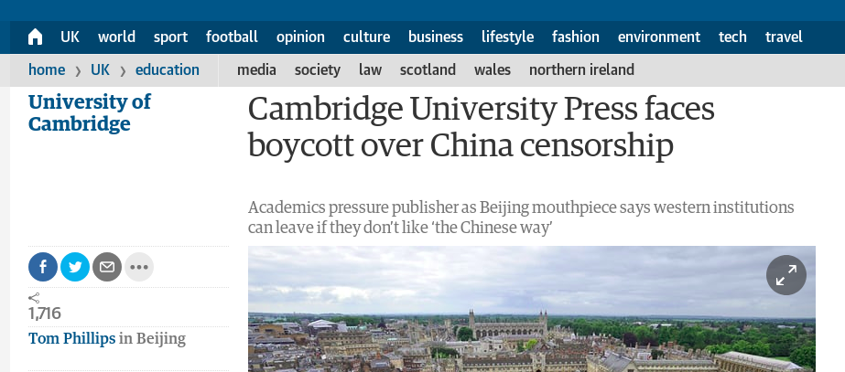

Slide 5
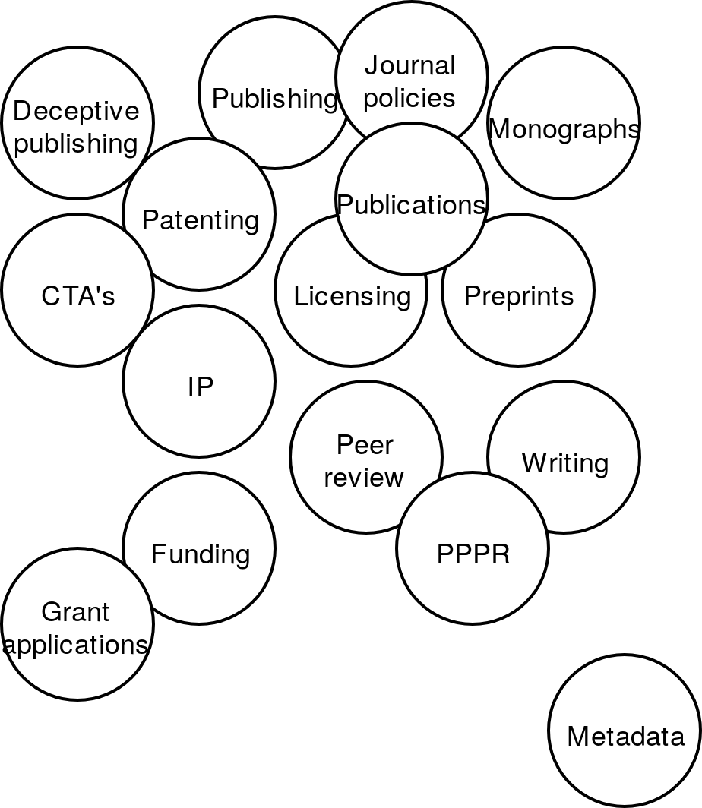
Much to learn, little education

Slide 6
Licensing in Open Access
Highly confusing
  CC 0
  CC BY
  CC BY-NC
  CC BY-NC-SA
  CC BY-NC-ND

Slide 7
Licensing in Open Access
CC WTF
Highly confusing
  CC 0
  CC BY
  CC BY-NC
  CC BY-NC-SA
  CC BY-NC-ND

Slide 8
Licensing in Open Access
Willing to use legal tools to restrict sharing and reuse?
  NO: CC 0 (next best: CC BY)
  YES, WILLING TO SUE:
    Non-commercial restricted
    Reuse restricted (Non-derivatives)
    Share alike (open stays open)

Slide 9
Importance of licensing
Sharing without licensing is just showing off

Slide 10
Science with open
=
Science with warranty

Slide 12
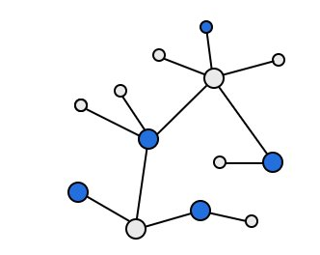
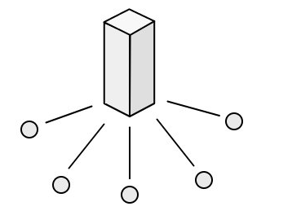
Centralized easy to control
Decentralized difficult to control

Slide 13
Centralized easy to control
Decentralized difficult to control

Slide 14
Centralized easy to control
Decentralized difficult to control

Slide 15
Science without open
=
Science without warranty

Slide 16
Access only shows the end result

Slide 17
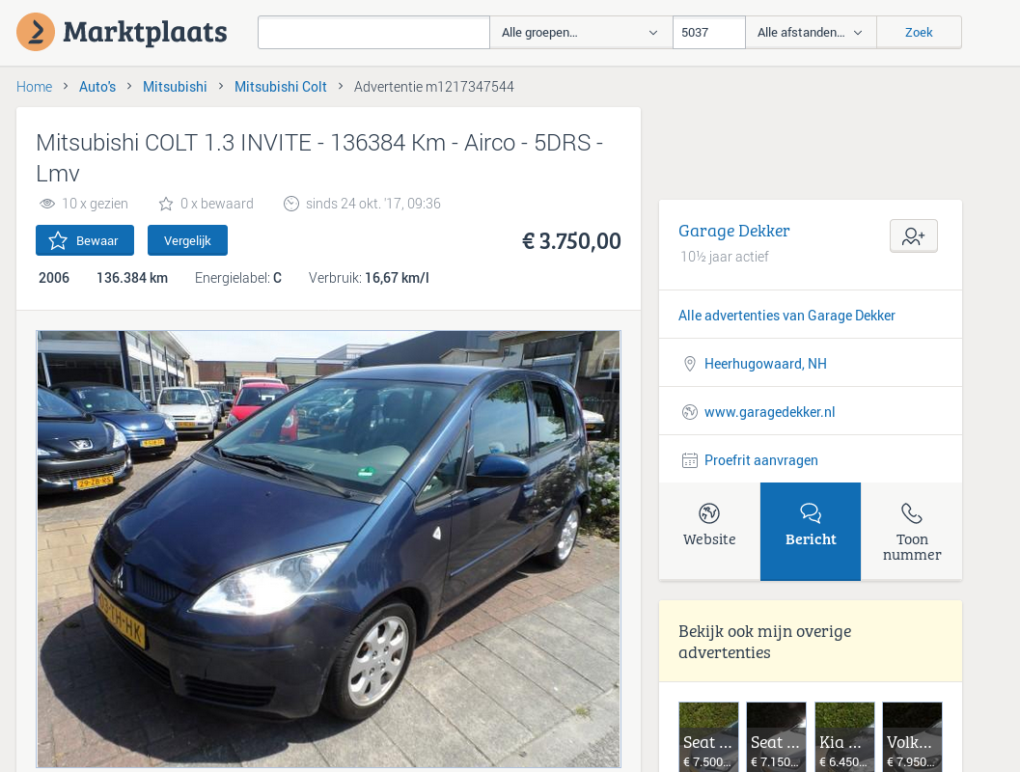

Slide 18


Slide 19


Slide 20


Slide 21
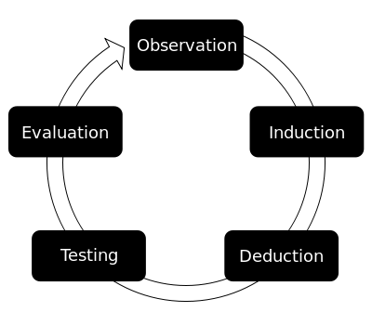

Slide 22
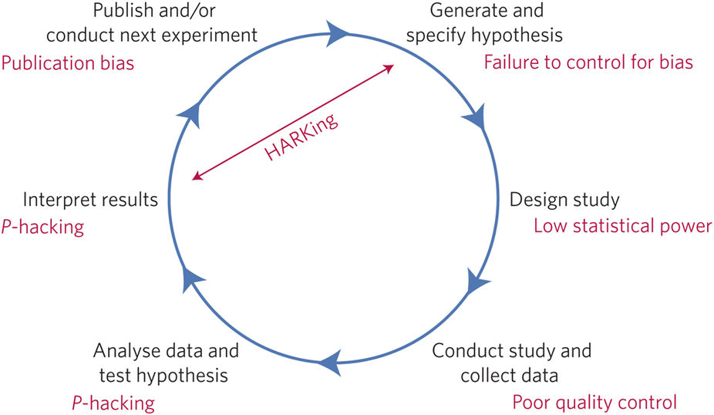

Slide 23
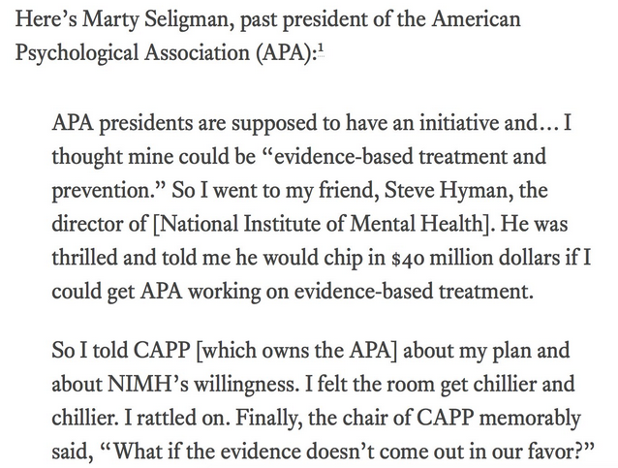

Slide 24


Slide 25
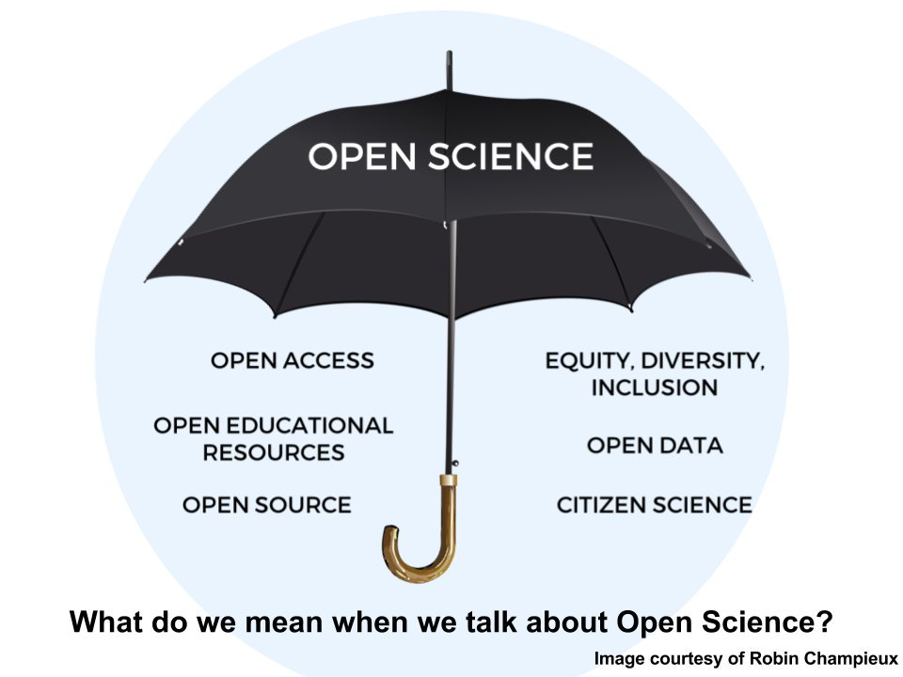

Slide 26
Why open everything!

Slide 27

Why open everything!

Slide 28
Why open everything!
Philips
Siemens
GE

Slide 29
Why open everything!
ICC = .671
ICC = .726
ICC = .961
Philips
Siemens
GE

Slide 30

Why open everything!

Slide 31

Why open everything!

Slide 32
Open = inviting other people in

Slide 33
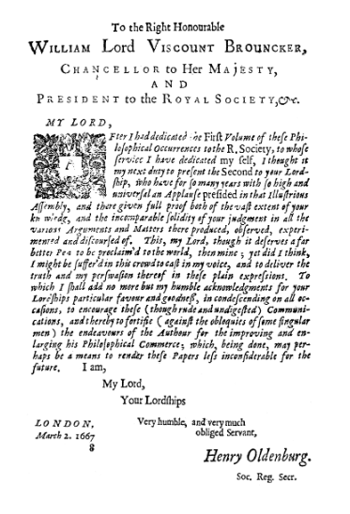
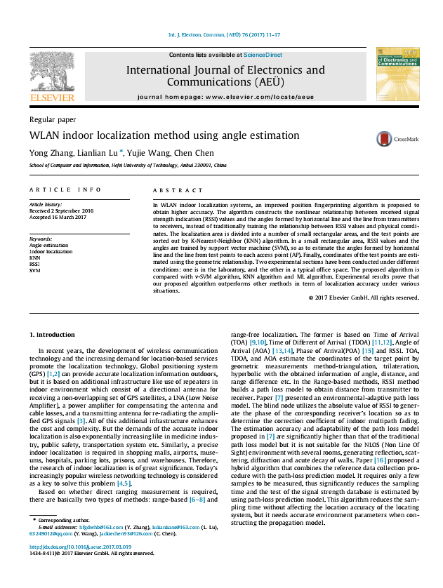

Slide 34
What do we do?
One-directional communication

Slide 35
If people want to discuss your work, do you provide them with the option?

Slide 36
If you want to discuss work, do you have the option?

Slide 37
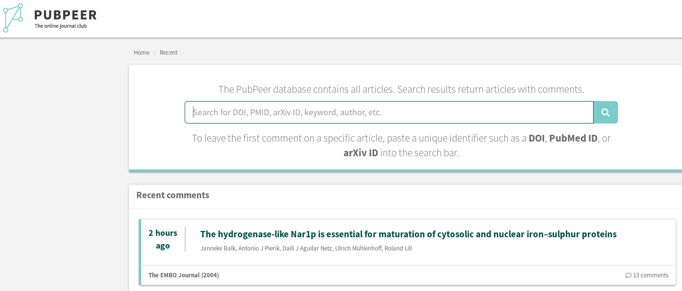

Slide 38
Open provides warranty
Working on resources to help educate and provide that warranty.
Interested? Newsletter @ libscie.org

