Slide 1
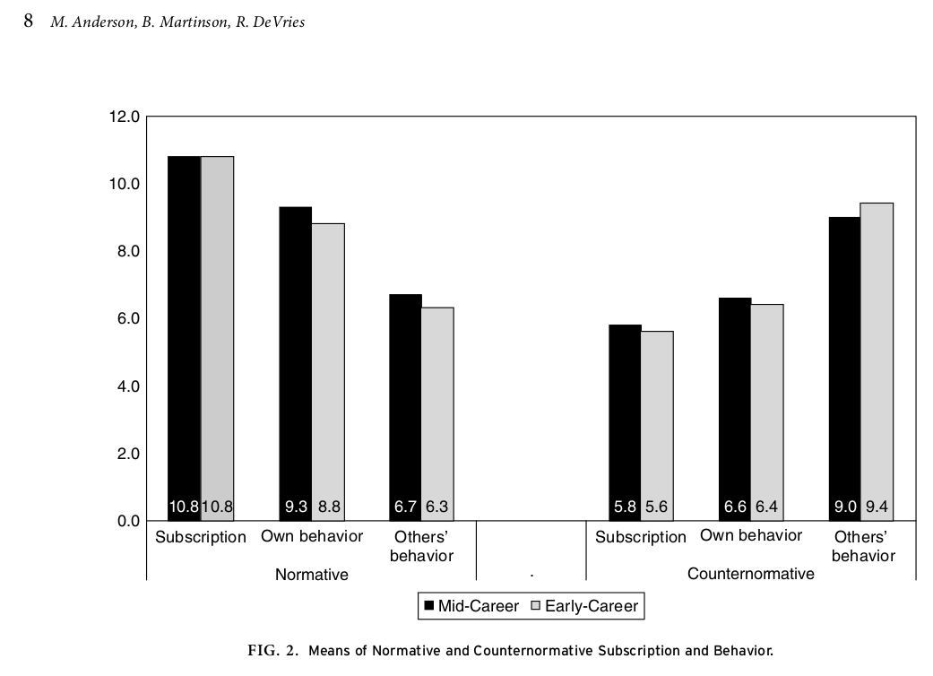
doi.org/10.1353/jhe.0.0095

Slide 2
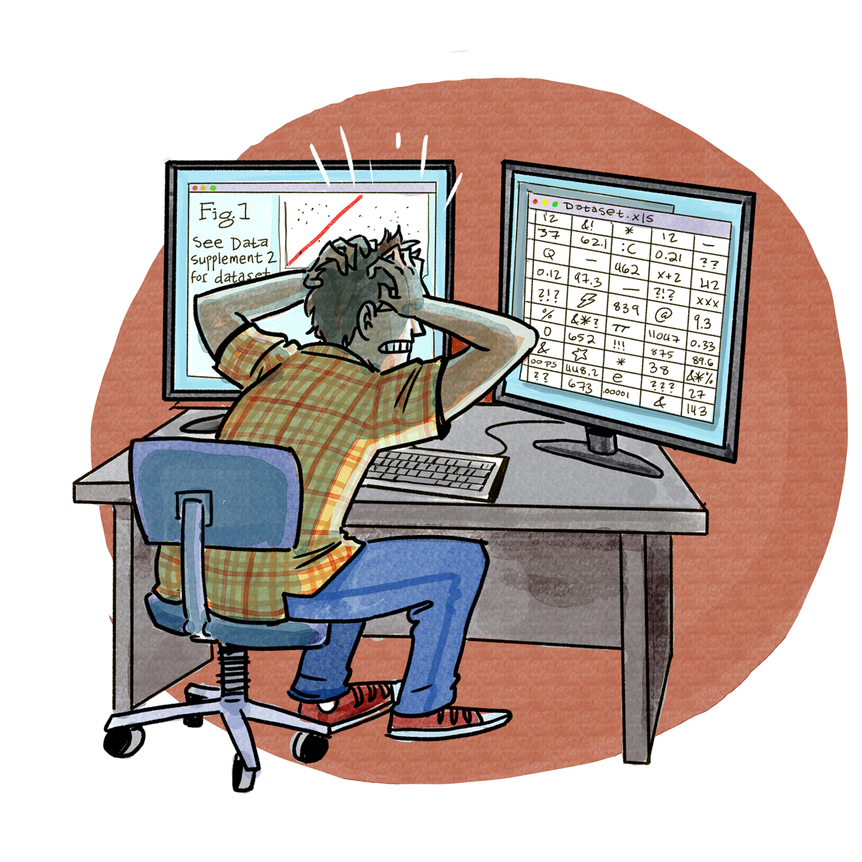
doi.org/10.1371/journal.pbio.1002295

Slide 3
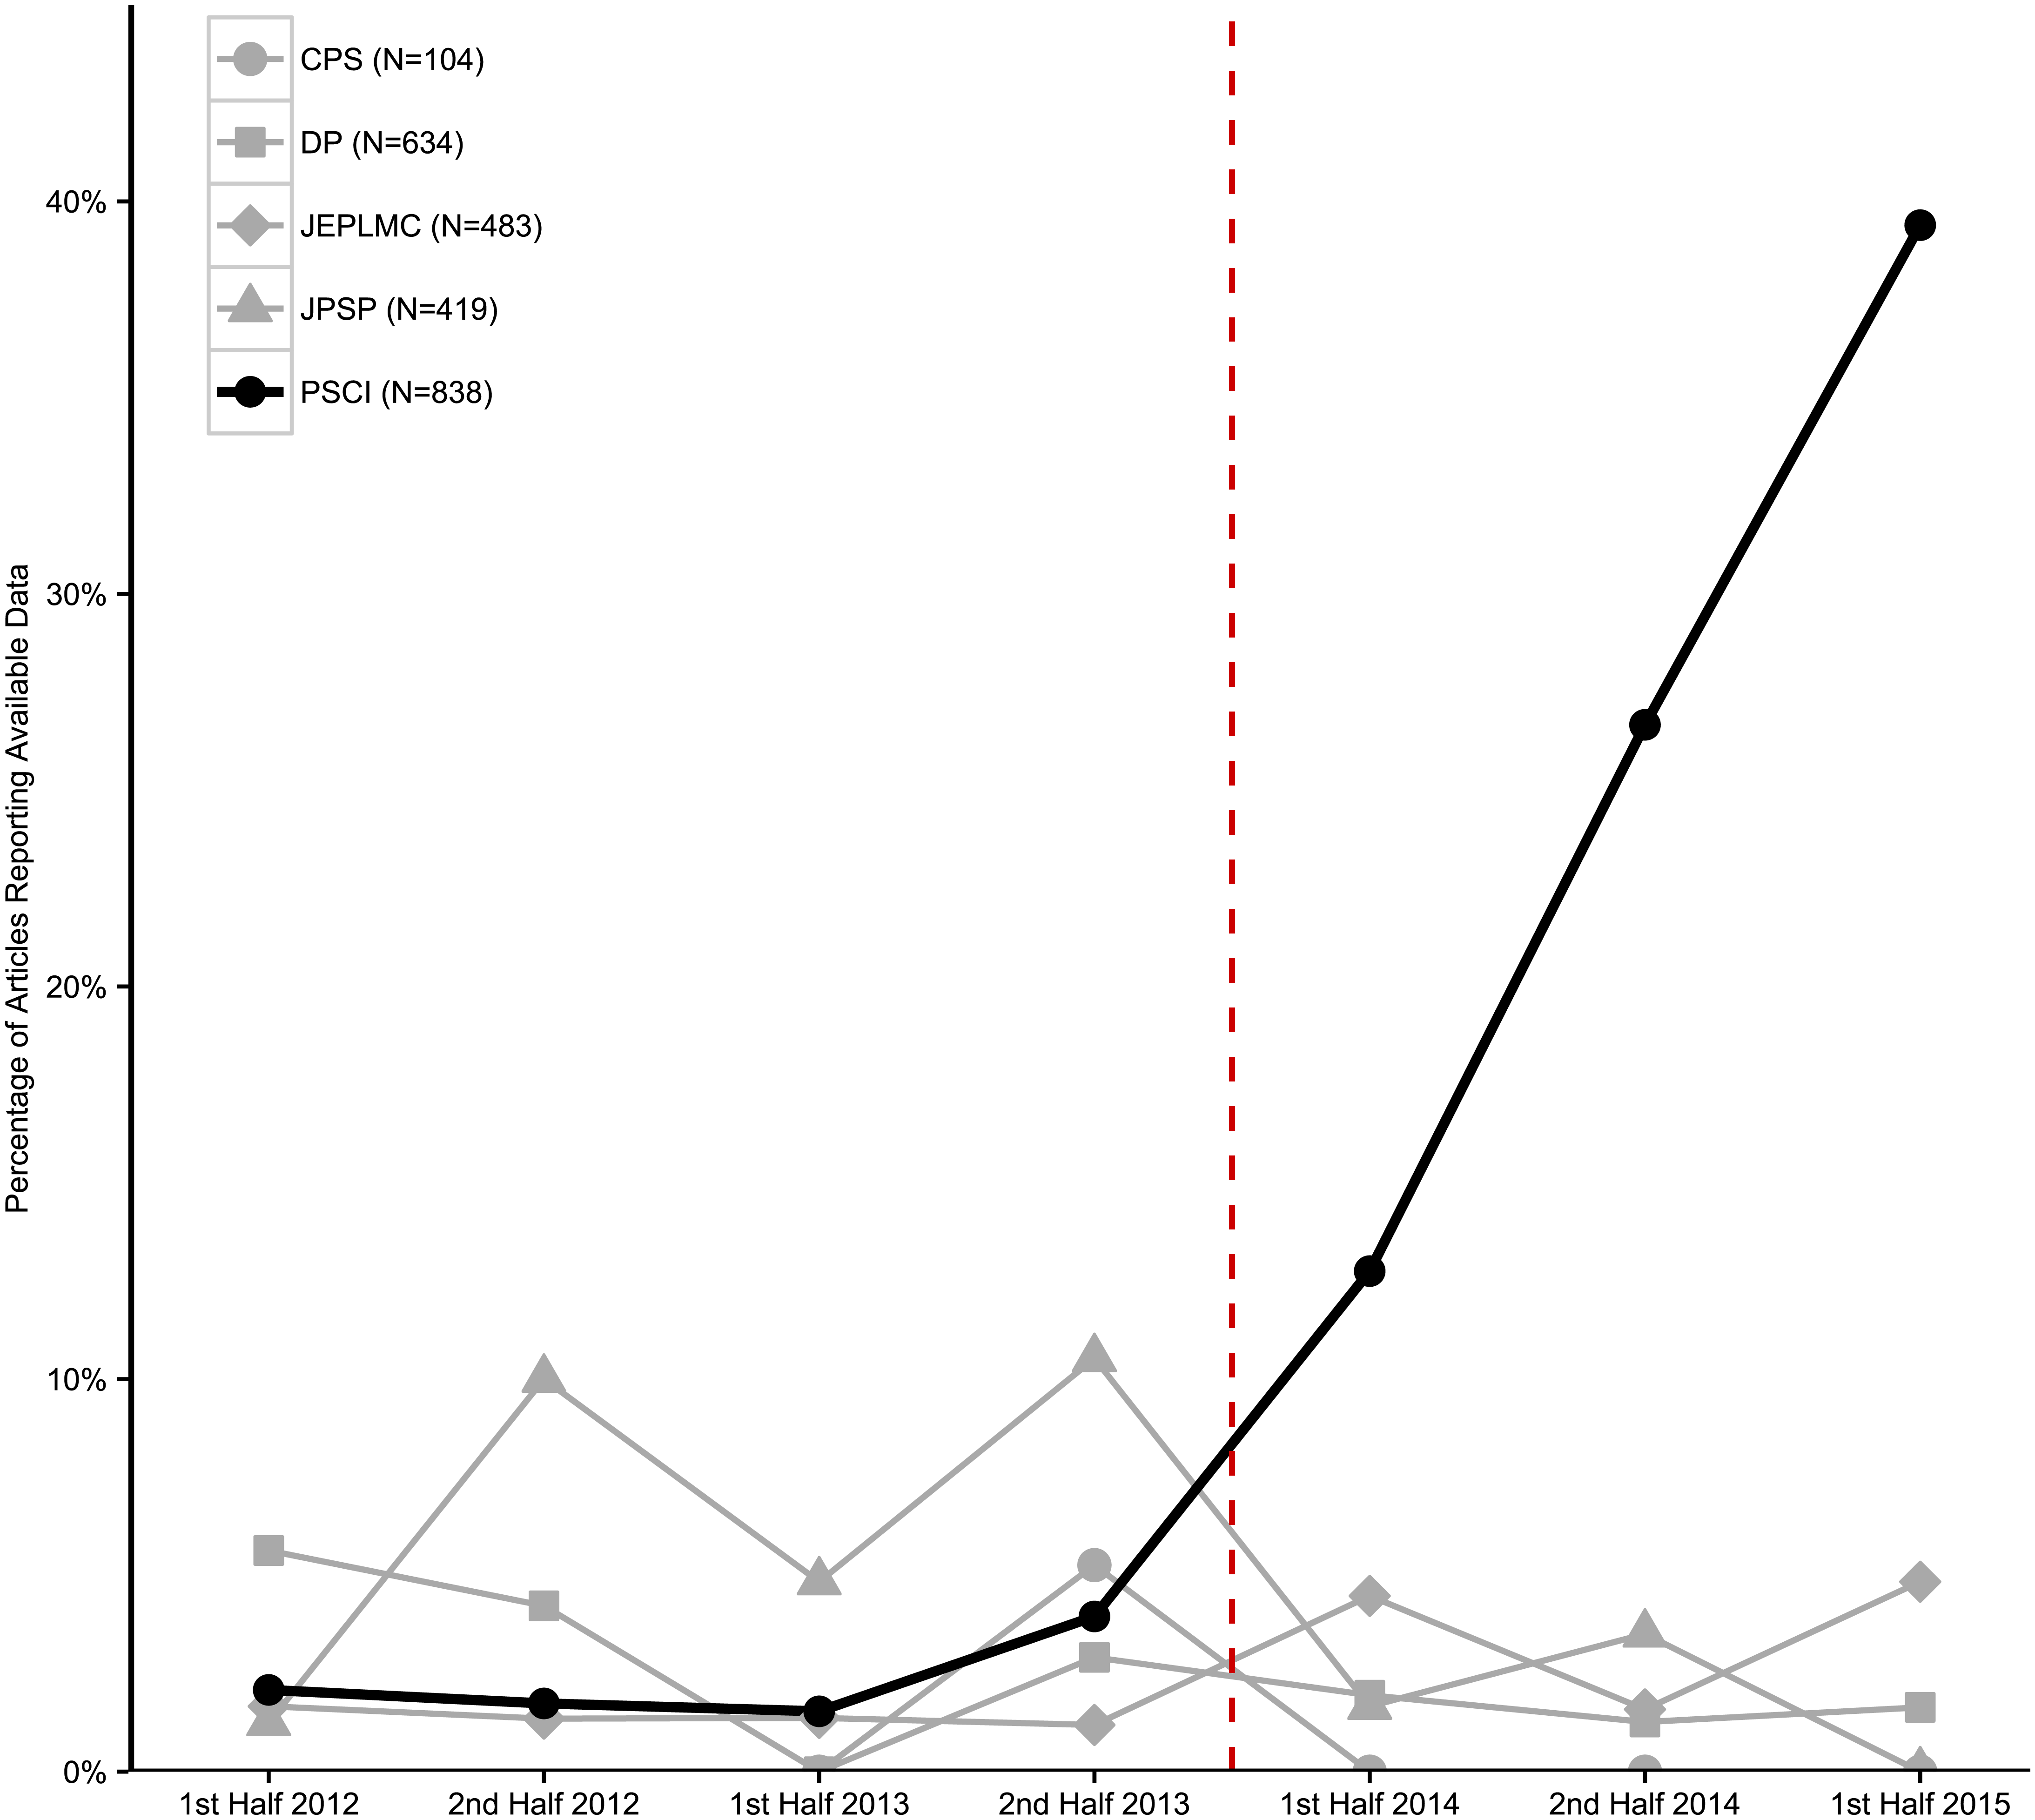
doi.org/10.1371/journal.pbio.1002456

