Slide 1
DSC 530 Final Project
Exploratory Data Analysis of Auto Accidents and Severity
By: Charles Thurston
Bellevue University Summer 2021 – DSC 530-T302

Slide 2
Statistical Question
What contributes to the severity of auto accidents and what changes can prevent or minimize these factors?
Variables selected are Injuries, Fatalities, coll_type, Surf_cond, traf_cntrl and Num_veh.

Slide 3

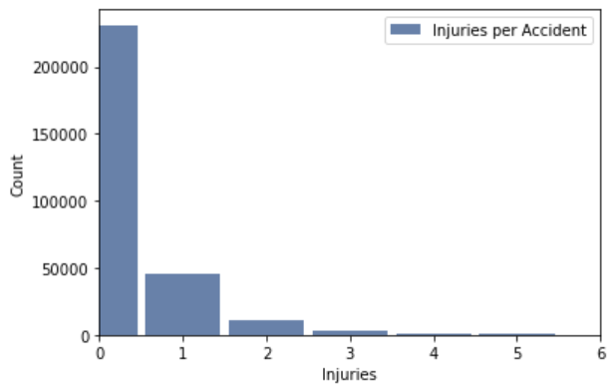
Histogram of the ‘Injuries’ Variable
This variable shows the total number of injuries reported in each accident from the given dataset.
Mean = 0.2873922587228913
Less than 29% of accidents result in an injury
Std Dev = 0.6777496605046021
Variance = 0.4593446023141033
There are very few accidents that result in 4 or more injured people but I don’t consider them outliers since major accidents can occur and just show that a majority of accidents are very minor overall.

Slide 4
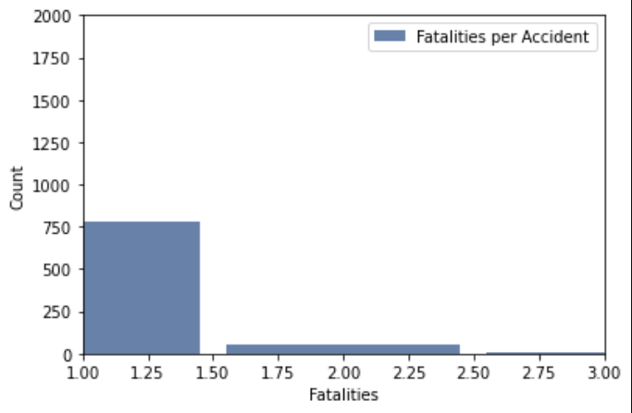
Histogram of the ‘Fatalities’ Variable
This variable shows the total number of fatalities reported in each accident from the given dataset.
Mean = 0.0031367821956790483
Only 0.3% of accidents from 2014 resulted in a fatality
Std Dev = 0.06162909218114471
Variance = 0.003798145003072032
The same with number of injuries in an accident, there are no outliers and does show that very few accidents in 2014 resulted in more than one fatality.

Slide 5
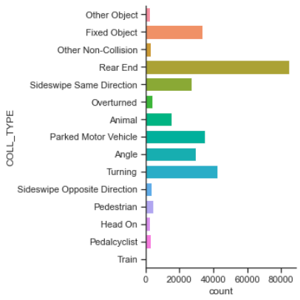
Histogram of the ‘Coll_type’ Variable
This variable shows the frequency of each collision type
The chart shows that a majority of accidents that occurred in 2014 were rear-end and it was by far the most. Many other accident types were similar frequencies like fixed object, sideswipe same direction, parked vehicles, angle and turning accidents. Going along the lines of the injuries and fatalities, this shows that the inherently more severe collisions like head on and overturned vehicles are far fewer.

Slide 6
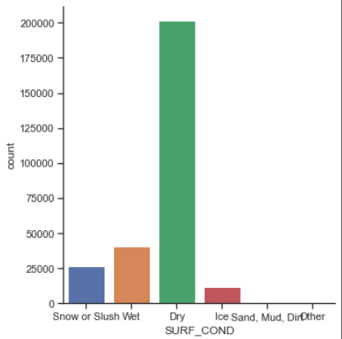
Histogram of the ‘surf_cond’ Variable
This variable shows the surface conditions when accident occurred.
This variable shows that there is a clear majority of accidents that were not affected by road surface conditions and the least amount are icy conditions. This indicates there are other factors that may follow this like safer driving, people driving less when road conditions are less safe, and other factors.

Slide 7
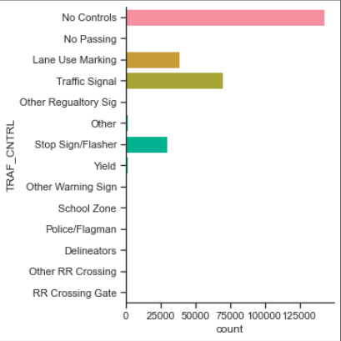
Histogram of the ‘Traf_Cntrl’ Variable
This variable counts the number of accidents related to each traffic control or the lack of a traffic control.
The results of this variable regarding the frequency of accidents without a traffic control does suggest that there could be more controls put in place when looking to lessen the frequency and severity of accidents.
This is a bit of a surprise given that most of the claims I investigate have some form of traffic controls in place, which compared to no controls, all incidents with controls present are near equivalent with no controls.

Slide 8
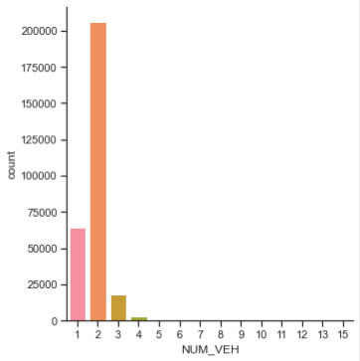
Histogram of the ‘Num_veh’ Variable
This variable shows the number of vehicles involved per accident for 2014.
Mean = 1.86999133618018
A majority of accidents have 2 or less vehicles involved in a given accident and the mean shows that.
Std Dev = 0.580815289181151
Var = 0.33734640014658407
This data shows that there are no outliers and that there are very few accidents that have 4 vehicles involved.

Slide 9
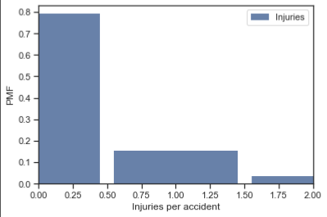
Probability Mass Function for Injuries in Accident
This compares the probability that an injury will occur in an accident. This shows that nearly 80% of accidents will not result in an injury while only 15% of accidents will have 1 injury.

Slide 10
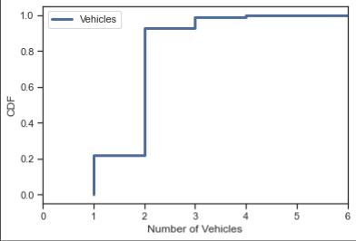
Cumulative Distribution Function for the number of Vehicles involved in an accident
The assumption of auto accidents is that the more vehicles involved inherently increases the severity of accidents. This CDF shows that a clear majority of accidents involve at least 2 vehicles and that only 20% of accidents recorded in 2014 data involved only one vehicle. So with the question asked about factors that contribute to more severe accidents, one is certainly the number of vehicles involved.

Slide 11
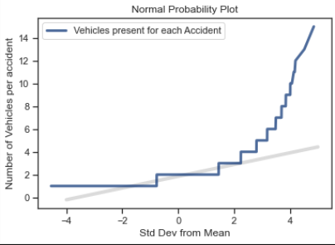
Normal Probability Plot for Injuries from accidents
This shows that the number of vehicles in an accident follows the normal distribution until there are more than 2 vehicles involved in an auto accident.
This shows that accidents with more than two vehicles are involved, the distribution skews since there is a lower likelihood for accidents to include more than 2 vehicles in 2014.

Slide 12
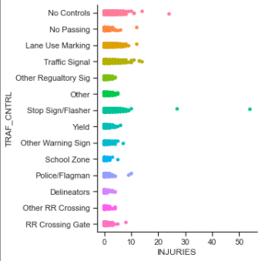
Scatterplot showing Injuries per traffic control
The scatterplot here shows the number of injuries for each instance of traffic controls whether present or not. This does show correlation between stop sign/flasher and total injuries being higher in these accident scenes along with no traffic controls being present also showing injuries. The other variables of traffic controls like school zone show that injuries rarely occur.

Slide 13
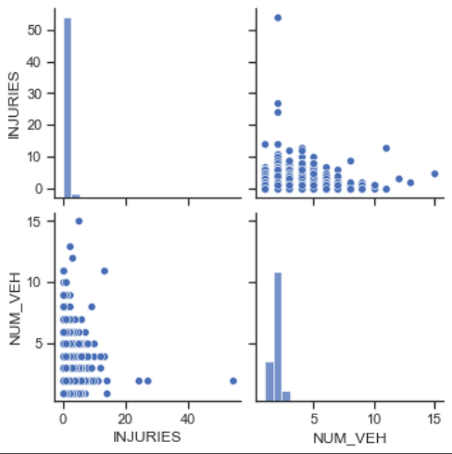
Correlation test between injuries and the number of vehicles in an accident

Slide 14
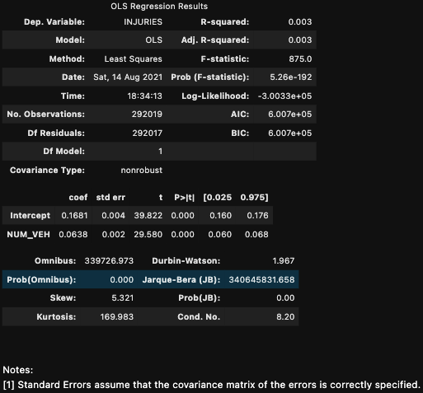
Correlation test between injuries and the number of vehicles in an accident

