Slide 1
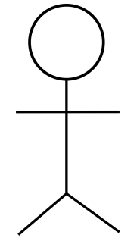
Tea Coffee Vending Machine
Choose Item
Choose Quantity
Make Payment
Refill Container
User
Generate Report
Exit
Reset Container
Operator

Slide 2
<<interface>>
Report
ReportImpl
+Id
-productType
-quantity
-totalSaleAmount
+generateReport()
+drinkWiseReport()
+containerStatusReport()
+refillingCounterReport()
Controller
+Id
<<interface>>
ProductDispenser
+displayMenuOption()
+callSelectedOption()
+Id
+placeOrder()
+calculateProductCost()
+dispense ()
<<interface>>
Container
ProductDispenserImpl
+Id
+checkAvailability()
+updateContainerCapacity()
+resetContainer()
+containersStatus()
+updateRefillingCounter()
-type
-Price
-quantity
ContainerImpl
-type
-totalQuantity
-availableQuantity
-updateSaleCount()
-updateCapacity()

Slide 3
User
Main Menu
Product dispenser
Product
Container service
Container
1.select product()
2. product Details()
3. checkAvailability()
4.productAvailable()
5.calculate Amount()
6.displayAmount()
7.insertMoney()
8.checkAmount()
9.dispense product()

Slide 4
Operator
Menu
Controller
Container
Service
Container
Report
Service
Report
1.checkContainer
Capacity()
2.check
ContainerStatus()
3.check
AvailableCapacity()
4.available
Capacity()
5.refillContainer()
6.refillStatus()
7.generateReport()
8.Report
Menu()
9.getReport
Menu()
10.sendReport
Option()
11.getReport()
12.generate
Report()
13.retreived
Report()

Slide 5
Tea Coffee Vending Machine Vendor Application
Users
Business Layer
Application Facade
Menu Controller
Product Dispensing Service
Container Service
Reports Service
Data Layer
Product Dispenser DAO
Container DAO
Reports DAO

