Slide 1
NYC
AIRBNB ANALYSIS
CHARU JOSHI

Slide 2

AIRBNB
Airbnb is an online platform that enables individuals to rent out their homes, apartments, or rooms to travellers seeking short-term accommodations
The New York City Airbnb dataset contains information on almost 49,000 Airbnb listings in New York City, making it a comprehensive snapshot of the city's Airbnb market

Slide 3
Table of Contents
01
02
03
04
Problem Statement
Data Description
Visualisations
Insights

Slide 4
Problem Statement
NYC Airbnb dataset available containing information properties including their location, property type, room type, price, availability, and various other features.
Clean up the data for missing values, required computed fields and incorrect values.
Create innovative and interactive visualisations which are intuitive to the users.
Look for insights on how do various factors such as location, availability, property type, etc. influence the prices of Airbnb listings in NYC?

Slide 5
Understanding the Problem
Source of Data
Number of Rows
Key Features
Kaggle – NYC Airbnb Dataset
The dataset contains 16 columns and 49,000 rows indicating Airbnb listings.
Some of the key features in the dataset include: location, property type, price, availability, and number of reviews.

Slide 6
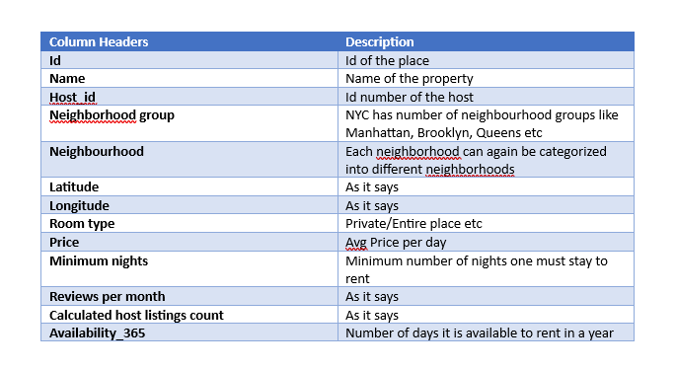
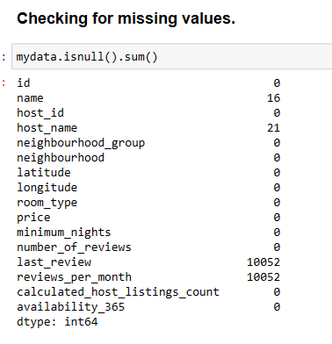
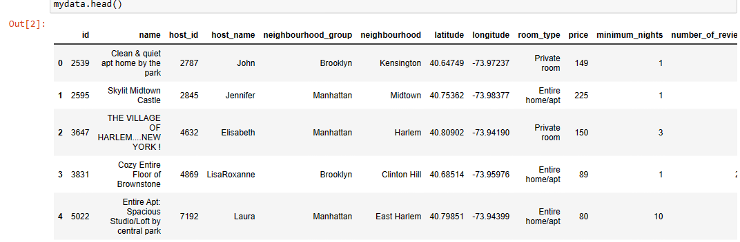
Data Description

Slide 7
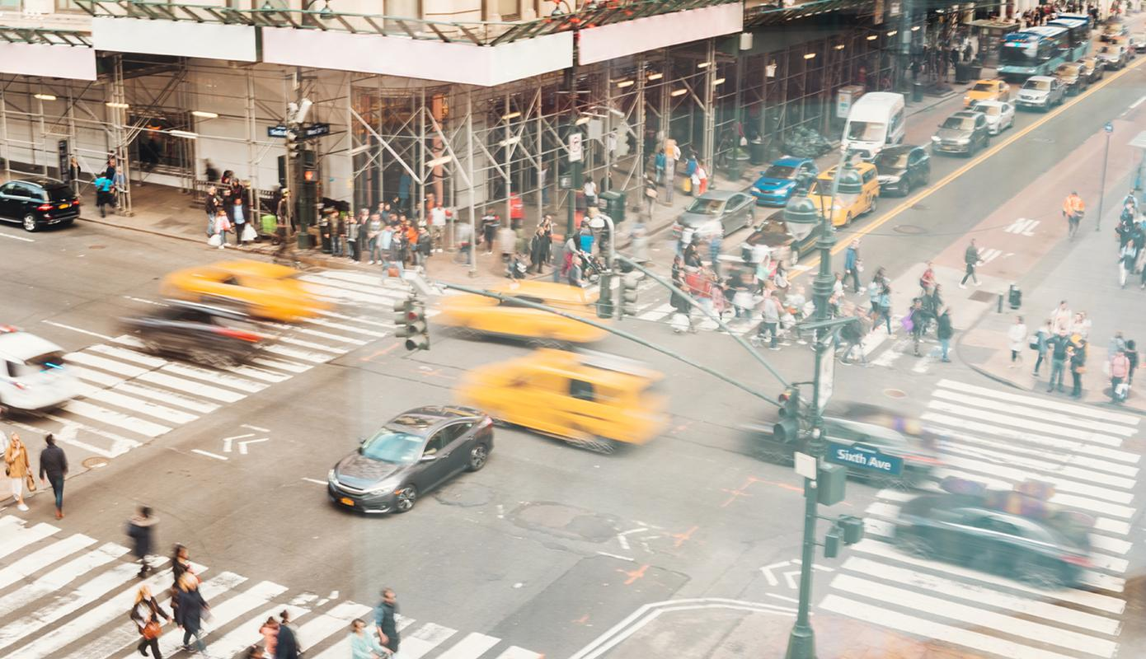
VISUALISATIONS

Slide 8
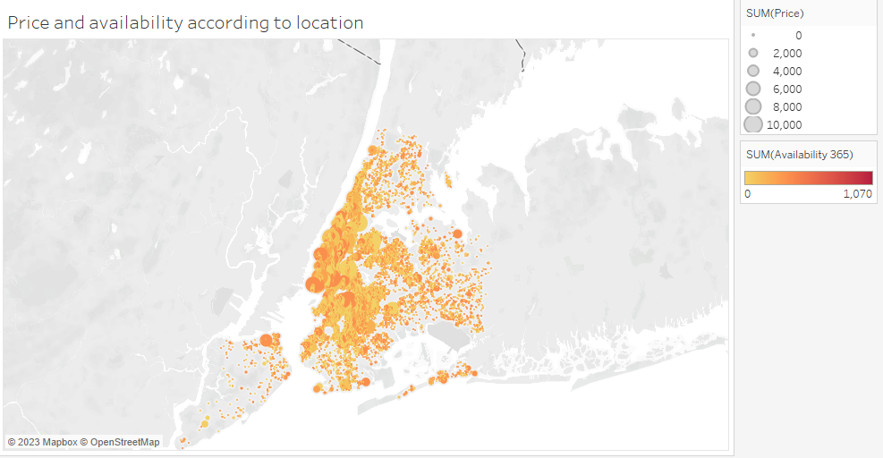
Location of properties
How are properties spread in the city?
Manhattan and Brooklyn have highest density of properties in NYC
Other neighbourhoods slightly sparsely populated

Slide 9
PRICE of properties
Prices are shown by sizes of circles spread across city.
Where are most expensive (or cheap) properties?
Pockets of highly expensive properties are in Manhattan downtown, upper west, upper east
Properties in Brooklyn, Queens and Staten Island are relative cheaper

Slide 10
AVAILABILITY of properties
How does the availability of properties vary across the city?
Pockets which are darker shades in every part of the city indicating a higher availability
Shall analyse this more meaningfully in out next visualization

Slide 11
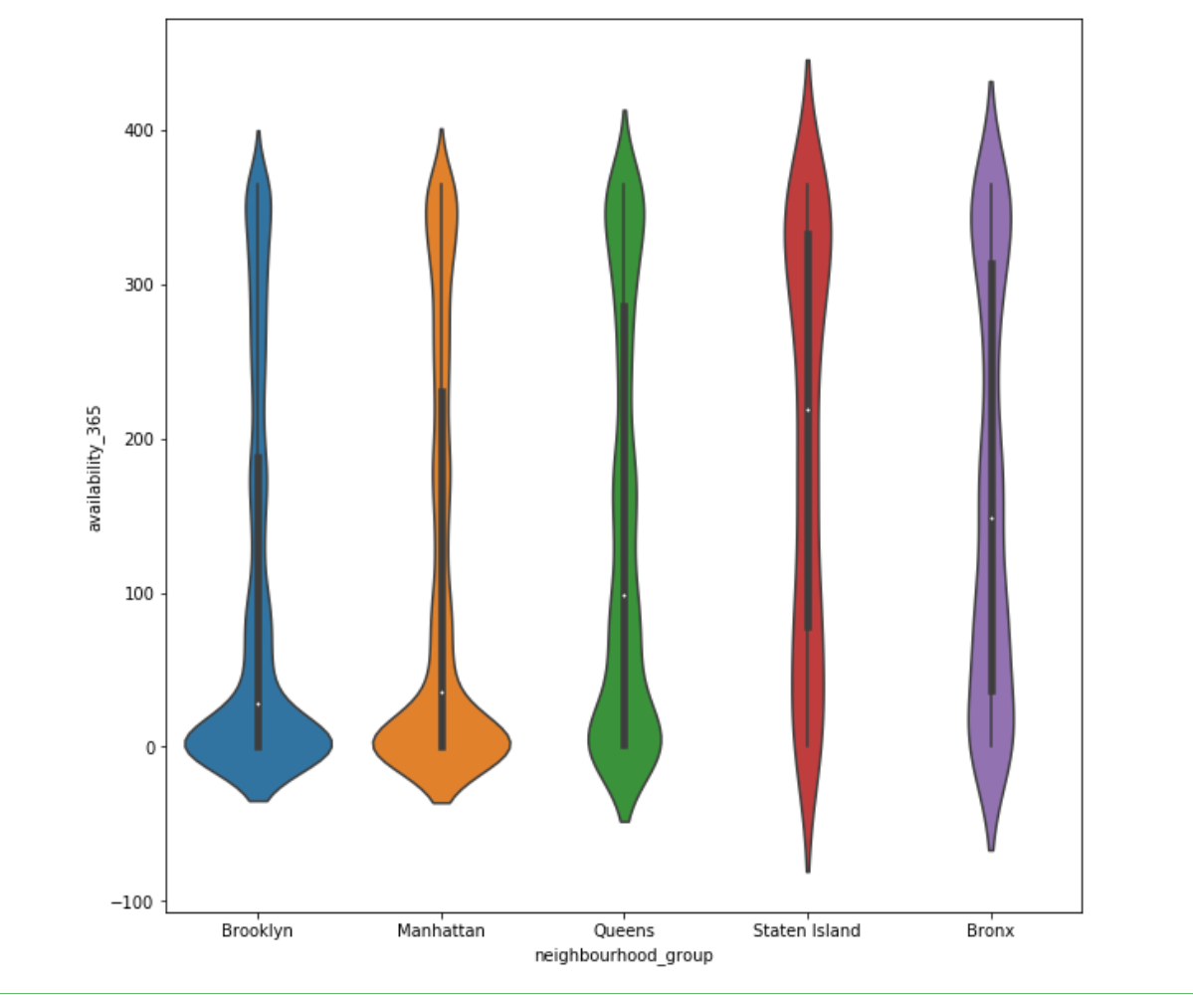
AVAILABILITY of properties
Violin plot used to represent availability of properties in different neighbourhoods
Staten Island has the highest median followed by Bronx
Brooklyn and Manhattan which we observed to have the highest density of properties usually have the lowest median of availability available across the year.

Slide 12
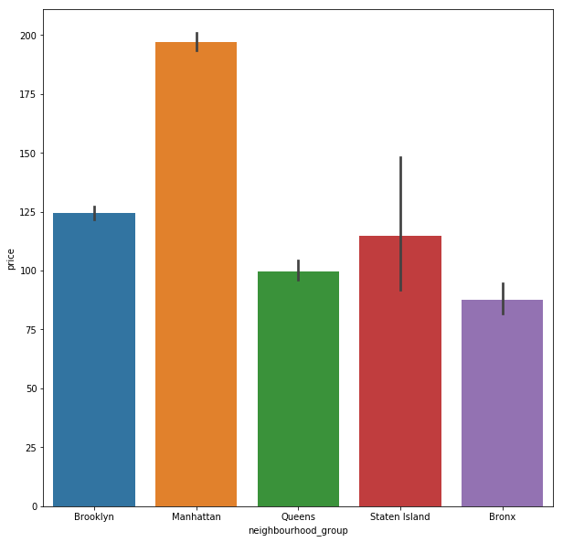
Neighbourhood group average price
Manhattan has the highest average price among all neighbourhood groups, followed by Brooklyn, Staten Island, Queens and The Bronx.
The difference in average price between neighbourhood groups is significant, ranging from around $120 per night in Staten to almost $200 per night in Manhattan.

Slide 13
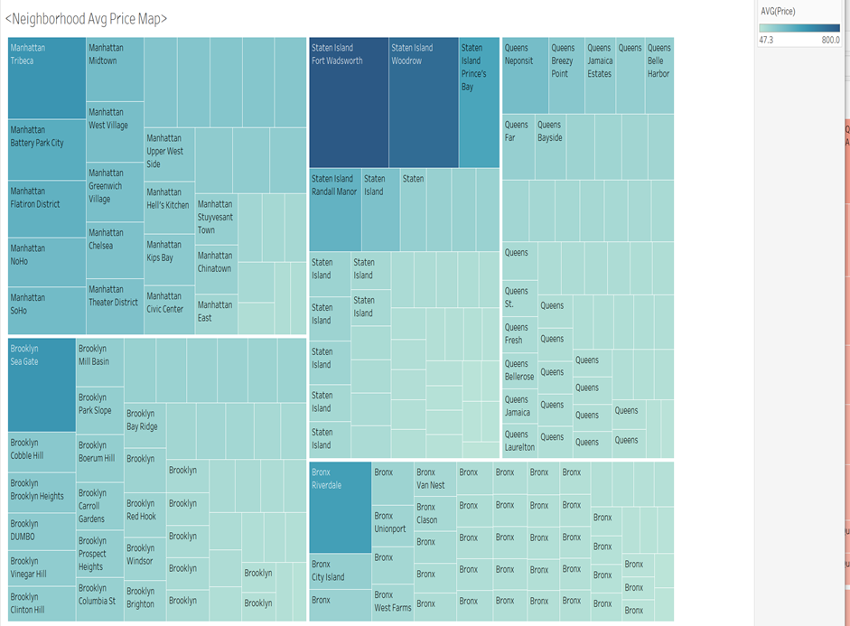
Neighbourhood average price map
Shows spread of avg prices by explicitly naming the neighbourhood to give more quantitative info
Most expensive neighbourhood is not actually in Manhattan but rather in Staten Island’s Fort Wadsworth and Woodrow.
Manhattan's Tribeca and Battery Park City are the most expensive in Manhattan and Brooklyn is led by Sea Gate as the most expensive

Slide 14
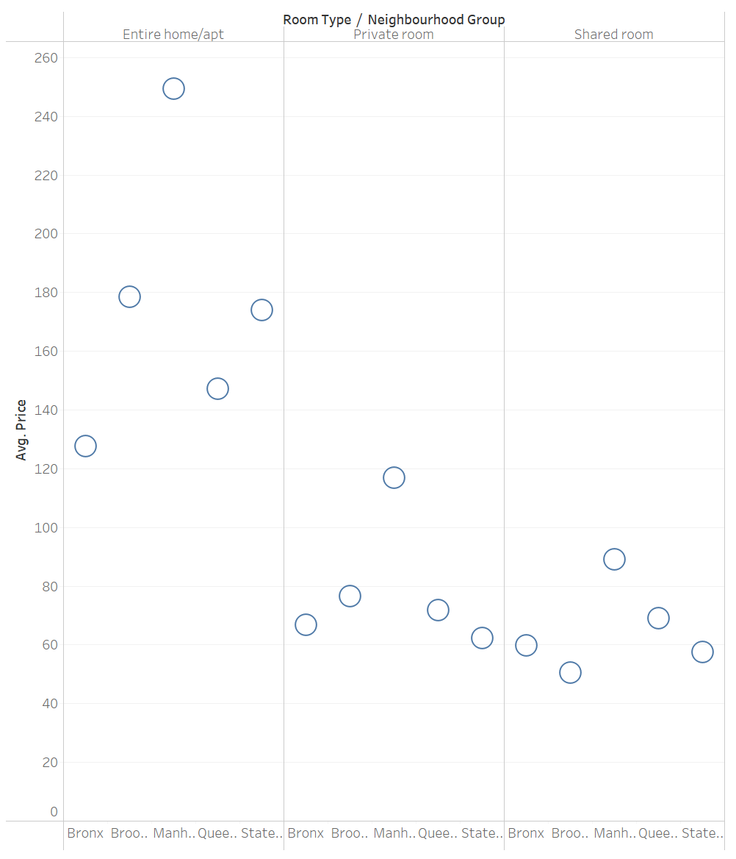
AVERAGE PRICE BY ROOM TYPE
Entire home is the most expensive across all the neighbourhoods
Private room has the next highest average price followed by shared room.

Slide 15
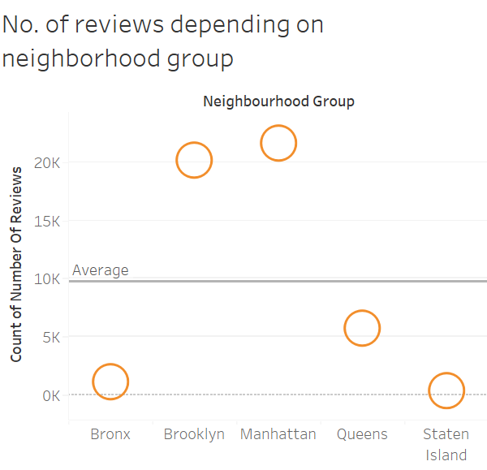
No. of reviews by neighbourhood
Manhattan has the highest number of reviews followed by Brooklyn.
The average number of reviews is around 10,000.
Queens, Bronx and Staten Island have comparatively lower reviews.

Slide 16
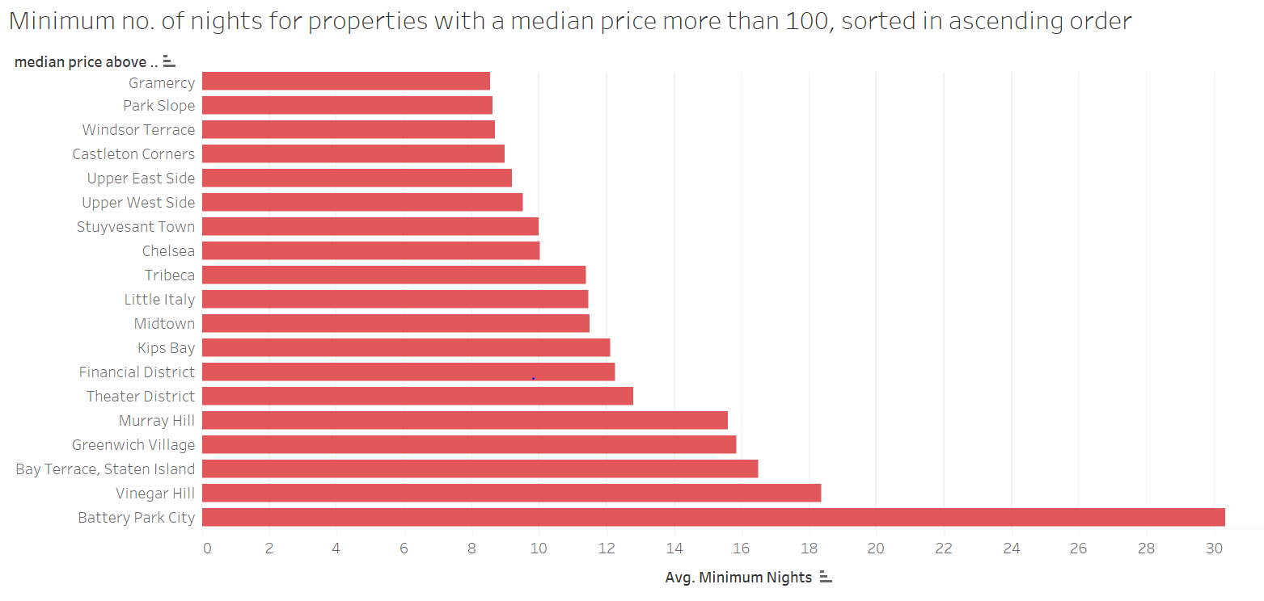
Minimum no. of nights
Battery Park City has the max. stay requirement of at least 30 days.
Vinegar Hill and Bay Terrace follow next with around 20 min. nights
Gramercy and Park Slope have comparatively lower min nights requirement.

Slide 17
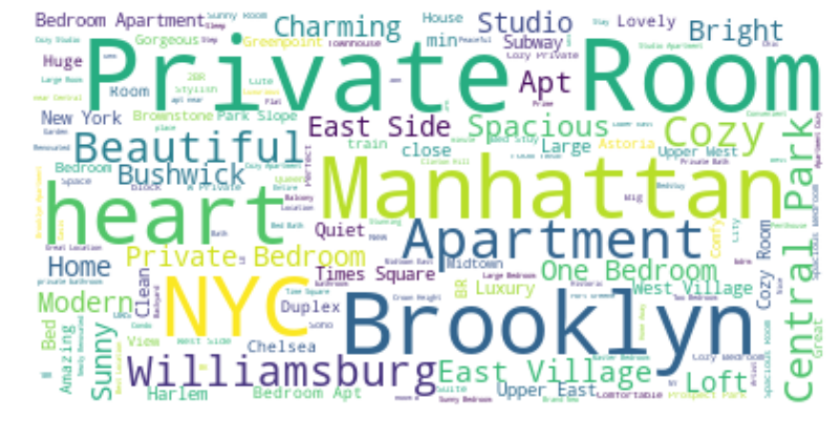
WORD CLOUD
Word cloud provides a visual representation of the words that are more frequently used in the Name of the listings.
The frequent use of these words in the listing names suggests that highly valued. For instance, words related to the description of the room such as "cozy," "modern," "spacious," "bright," and "luxury" indicate that the hosts are keen on highlighting the specific features and amenities of their rooms to attract potential guests.

Slide 18
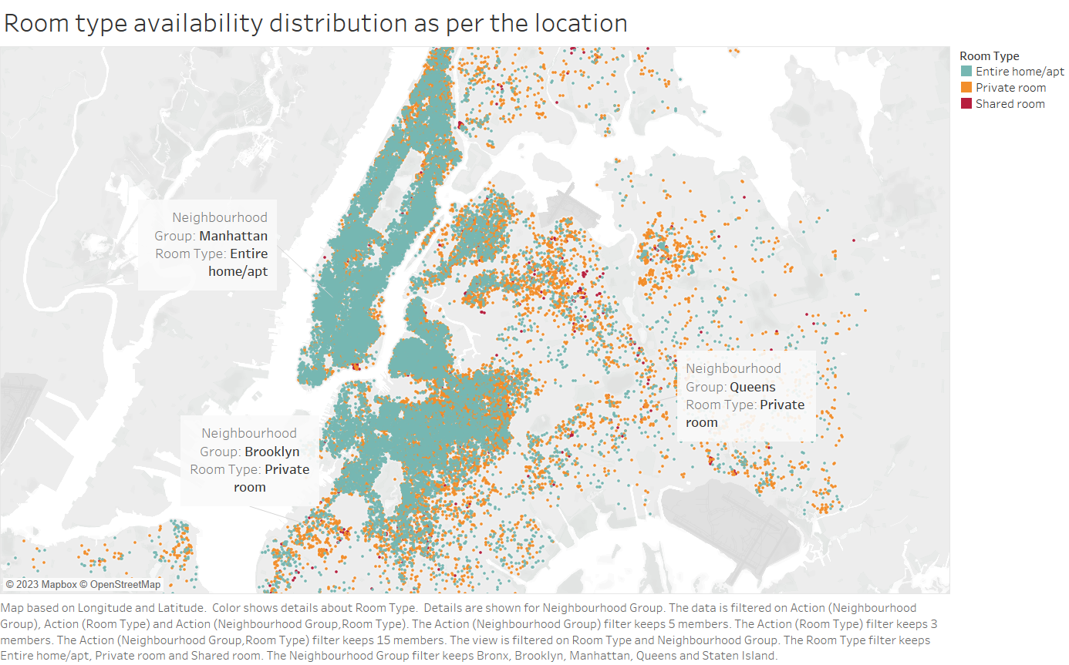
Room type availability distribution
How does the availability distribution of room types vary across different neighbourhoods in New York City?
Manhattan has a higher concentration of entire homes/apartments available compared to Brooklyn and Queens
Private rooms are more commonly available in Brooklyn and Queens compared to Manhattan
Shared rooms have relatively low availability across all boroughs compared to other room types
Airbnb hosts looking to rent out an entire home or apartment may want to consider listing in Manhattan, where there is higher demand for such listings whereas hosts looking to rent out a private room or shared room may want to consider listing in Brooklyn or Queens, where these types of listings are more commonly available.

Slide 19
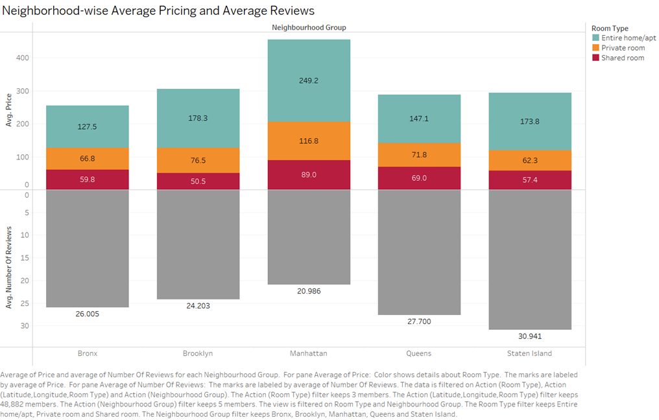
Neighbourhood-wise Average Pricing and Average Reviews
Shows that entire homes/apartments are generally priced higher than private and shared rooms across most neighborhoods, except for a few affordable neighborhoods in the outer boroughs where private rooms are priced higher.
The most expensive neighborhoods for Airbnb listings are primarily located in Manhattan, such as Tribeca, Soho, and Greenwich Village, while the most affordable neighborhoods are mainly located in the outer boroughs, such as Queens and the Bronx.
The chart shows that some of the neighborhoods with the highest pricing also receive the highest number of reviews, indicating that they are popular among tourists and travellers.
This analysis can be used by both Airbnb hosts and guests to make informed decisions about pricing, location, and preferences when it comes to renting an Airbnb in New York City.

Slide 20
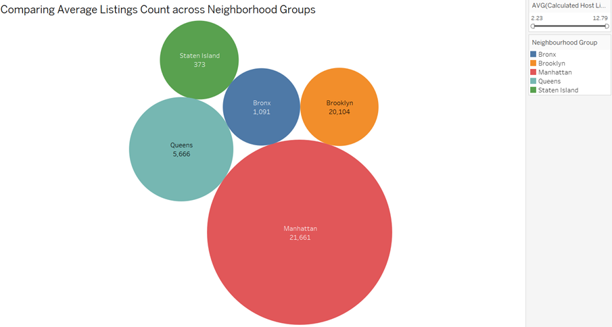
Comparing Average Listings Count across Neighborhood Groups
The highest average calculated host listings count is in the Manhattan neighbourhood group, followed by Brooklyn and Queens, while Staten Island has the lowest average calculated host listings count.
There is a wide variation in the number of listings within each neighbourhood, with some neighbourhoods having significantly more listings than others.
Hosts with larger properties or multiple properties may have a higher number of listings, while those with a unique selling proposition or competitive pricing may attract more guests and generate higher revenue, resulting in a higher number of listings.
There is a positive correlation between the number of listings and the average price per night, suggesting that hosts with a higher number of listings tend to charge a higher price per night.

Slide 21
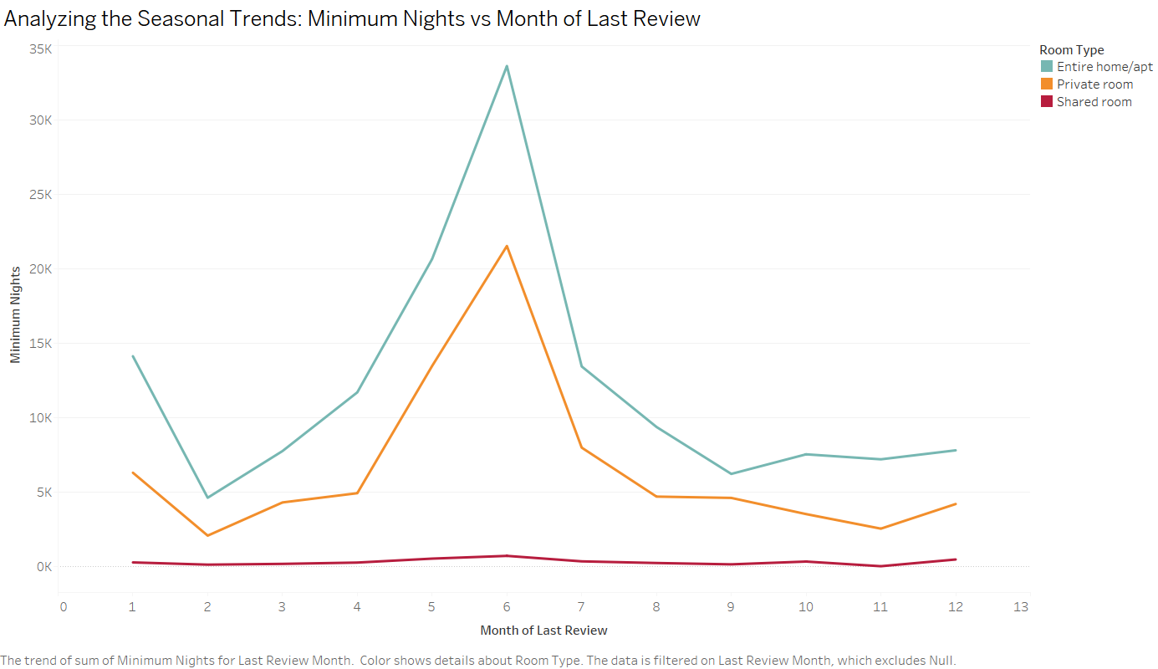
Analyzing the Seasonal Trends: Minimum Nights vs. Month of Last Review
It also highlights the impact of seasonality on the review frequency and booking patterns of Airbnb listings in different neighbourhoods.
It reveals that the minimum number of nights booked for Airbnb listings tends to increase during the summer months and decrease during the winter months.
This suggests that travellers are more likely to stay for longer periods during the summer season. The chart also shows that some neighbourhoods have a higher demand for longer stays compared to others.
During the summer months, New York City experiences a high influx of tourists, and the demand for accommodation increases.
As a result, the prices of Airbnb listings tend to be higher, and hosts prefer to book guests for longer durations to maximize their profits. Moreover, many tourists prefer to stay for longer periods during the summer months to enjoy the city's various outdoor activities and events.
On the other hand, during the winter months, the demand for Airbnb listings decreases, and the prices tend to be lower.

Slide 22
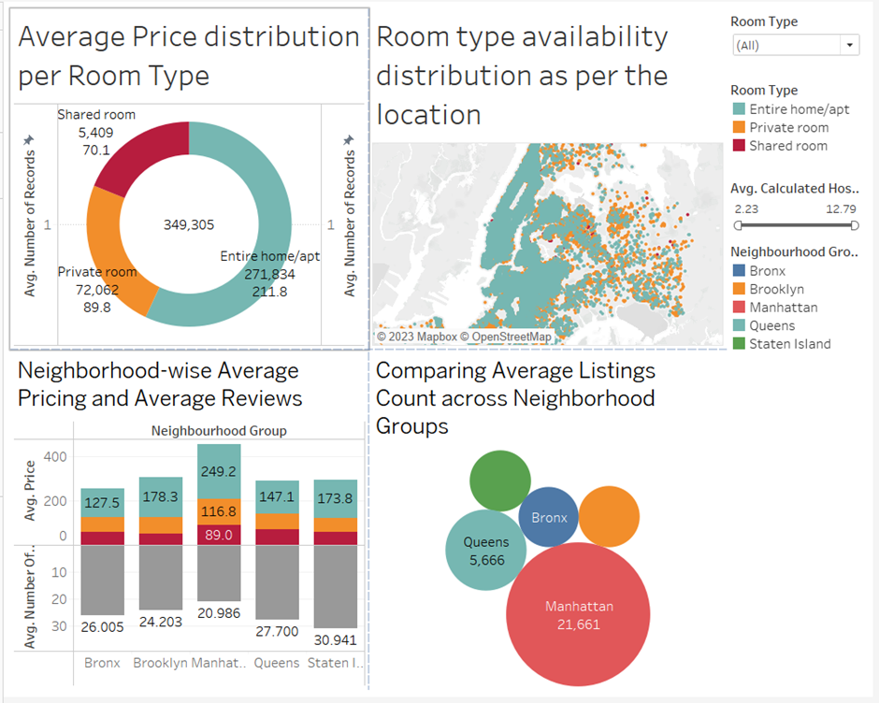
Insights into Distribution, Pricing, and Availability of Room Types across Neighbourhoods
The dashboard provides insights into the concentration of different room types in different neighbourhoods and how it may impact pricing and availability.
The dashboard helps to understand the pricing trends of different room types in different neighbourhoods and how it may impact availability.
The availability of different room types in different neighbourhoods also varies and can impact pricing.

Slide 23
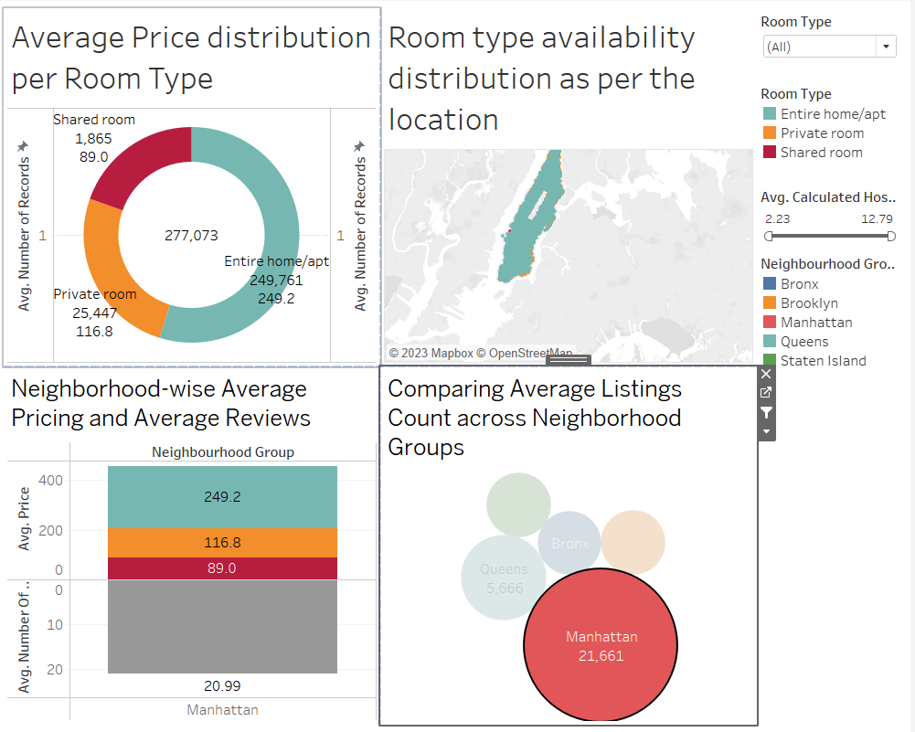
Contd……
The most common type of Airbnb listing in New York City is entire apartments, and they are most commonly located in Manhattan.
Prices vary by location, with Manhattan being the most expensive.
The highest average calculated host listings count is in the Manhattan neighbourhood group, followed by Brooklyn and Queens, while Staten Island has the lowest average calculated host listings count.
There is a positive correlation between the number of listings and the average price per night, suggesting that hosts with a higher number of listings tend to charge a higher price per night.

Slide 24
Key insights summary
Pockets of highly expensive properties are in Manhattan downtown, upper west, upper east while properties in Brooklyn, Queens and Staten Island are relative cheaper
Staten Island has the highest median of available nights followed by Bronx; Brooklyn and Manhattan which we observed to have the highest density of properties usually have the lowest median of availability available across the year.
Most expensive neighbourhood is not actually in Manhattan but rather in Staten Island’s Fort Wadsworth and Woodrow. Manhattan's Tribeca and Battery Park City are the most expensive in Manhattan and Brooklyn is led by Sea Gate as the most expensive
Manhattan has the highest number of reviews followed by Brooklyn while Queens, Bronx and Staten Island have comparatively lower reviews.

