Slide 1



AIR QUALITY PREDICTION AND ANALYSIS
STUDENT NAME:
CHARUL

Slide 2

Learning Objectives:
Learn how to load and manage large, real-world datasets.
Handle missing data using interpolation and other techniques.
Parse and format time-series data for temporal analysis.
Gain insights into air quality trends using statistical summaries.
Enhance problem-solving and critical thinking by tackling data challenges.
Explore stationarity, autocorrelation, and seasonality analysis.
GOAL
Source :
www.freepik.com/

Slide 3
Tools and Technology used:
Kaggle API: To download datasets directly from Kaggle.
Pandas: For data wrangling, cleaning, and manipulation.
Numpy: For numerical computations.
Matplotlib: For creating static, animated, and interactive plots.
Seaborn: For creating more aesthetically pleasing and informative statistical graphics.

Slide 4
Methodology:
Data Preprocessing
Load dataset (station_day.csv).
Check missing values & duplicates.
Drop rows with missing values.
Feature Selection
Inputs: PM2.5, PM10, NO, NO2, NOx, NH3, CO, SO2, O3, Benzene.
Target: AQI.
Model Training
Split data (80% train, 20% test).
Train *Linear Regression model.
Predict AQI values.
Performance Evaluation
Calculate 80-20 accuracy using absolute percentage error.
Plot actual vs predicted AQI with a 45° reference line.

Slide 5
Problem Statement:
Problem: Given historical air quality data from multiple locations in India, there is a need to analyze pollution trends and develop predictive models for the Air Quality Index (AQI). The objective is to forecast future AQI levels and identify pollution hotspots and seasonal variations to support environmental management strategies.
Key Objectives:
Trend Analysis: Analyze historical air pollution data to uncover trends and seasonal patterns.
Hotspot Identification: Identify regions and times where pollution levels are consistently high.
Time-Series Forecasting: Build predictive models to forecast AQI levels for the next 7 days.
Pollution Source Identification: Analyze correlations between different pollutants to understand their sources and impacts.
Insights and Recommendations: Provide actionable insights for policymakers to mitigate air pollution.
Challenges:
Handling missing and noisy data in environmental datasets.
Managing seasonal and regional variations in pollution levels.
Building accurate time-series models for AQI prediction.
Visualizing and interpreting insights effectively for stakeholders.
Success Criteria:
Achieve high accuracy in AQI predictions using appropriate forecasting models.
Identify and visualize pollution hotspots and trends over time.
Provide meaningful recommendations for pollution mitigation strategies.

Slide 6
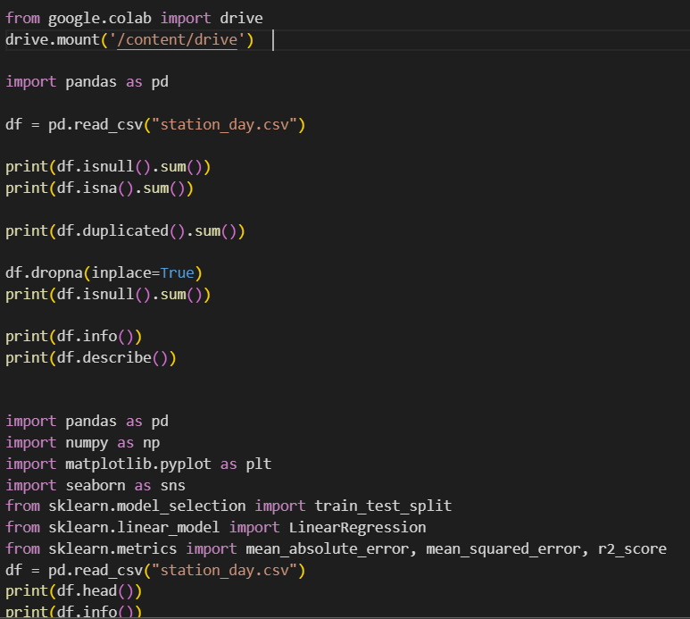
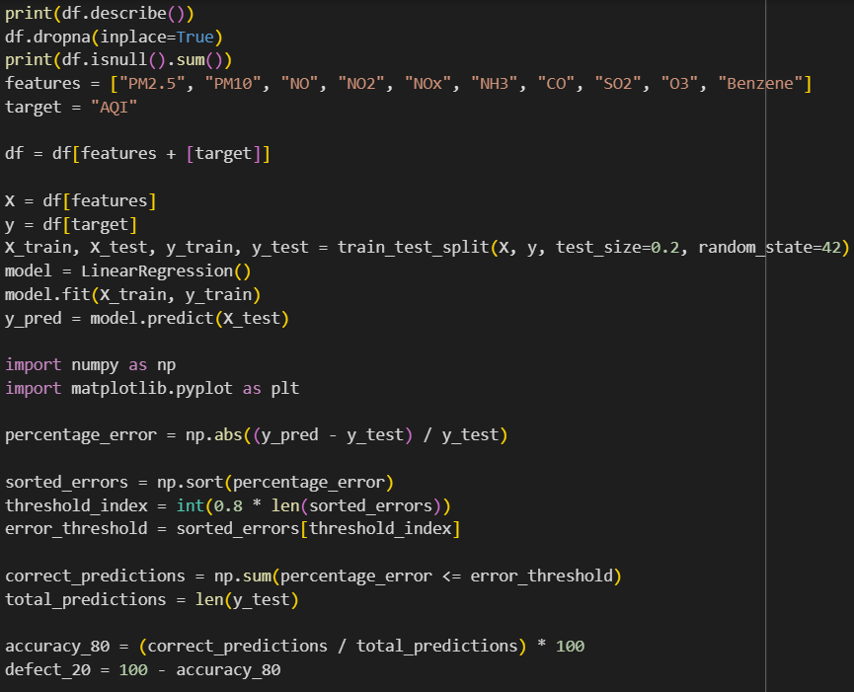
Solution:

Slide 7
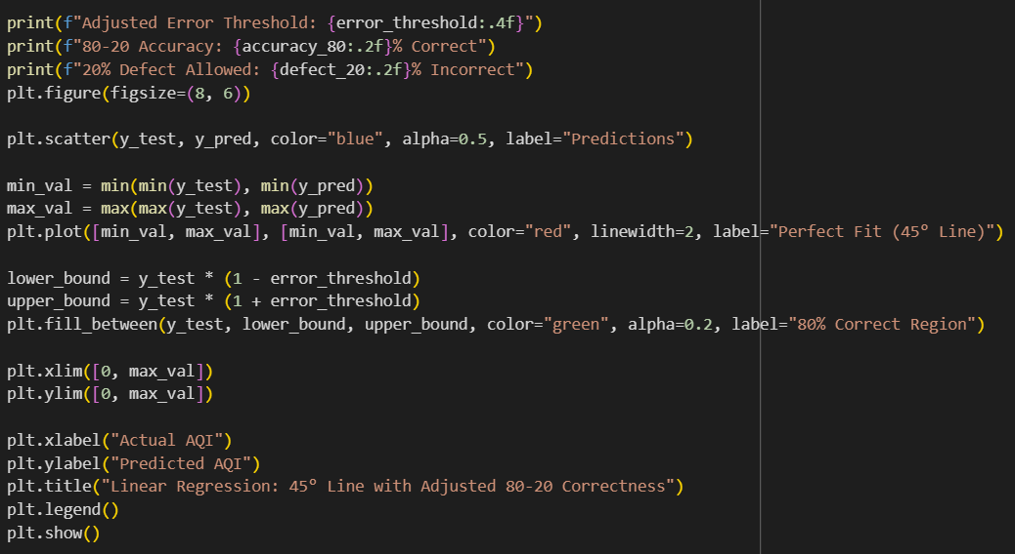
Solution:

Slide 8
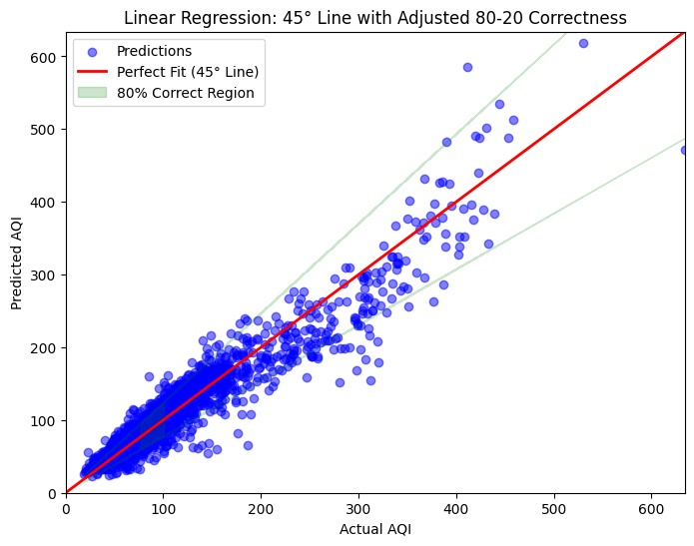
Screenshot of Output:

Slide 9
Conclusion:
This project aimed to analyze and predict air quality trends in India using the historical air quality data provided by the Air Quality Data in India dataset. Through this analysis, we gained valuable insights into the state of air pollution across various Indian cities, identified key pollution hotspots, and developed predictive models to forecast future Air Quality Index (AQI) levels.
Key Findings:
Pollution Trends
Seasonal Variations
Prediction Accuracy
Pollution Hotspots
This project has successfully demonstrated the potential of data analytics and machine learning in understanding and addressing air pollution challenges in India. Through accurate predictions, identifying hotspots, and providing actionable insights, we can contribute to reducing the impact of air pollution and improving the quality of life for millions of people in the country.
Github link:
https://github.com/charul-333/Air-quality-index-predictor-using-linear-regression.git

