Slide 1
Round 2- Phase 3 Solution Design and Architecture
Team UIET_BigOh_3 :

Slide 2

Detailed Business Case:
There are multiple sources of trending topics and articles each stating a different scenario or perspective on social media, blogs, online newspapers etc. The readers are not sure of the closest situation due to these multiple view points, reviews and portrayal and are often mislead from the actual information or scenario.

Slide 3
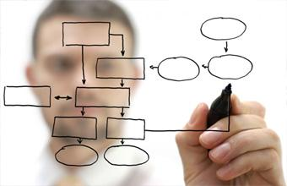
Solution Design and Architecture

Slide 4
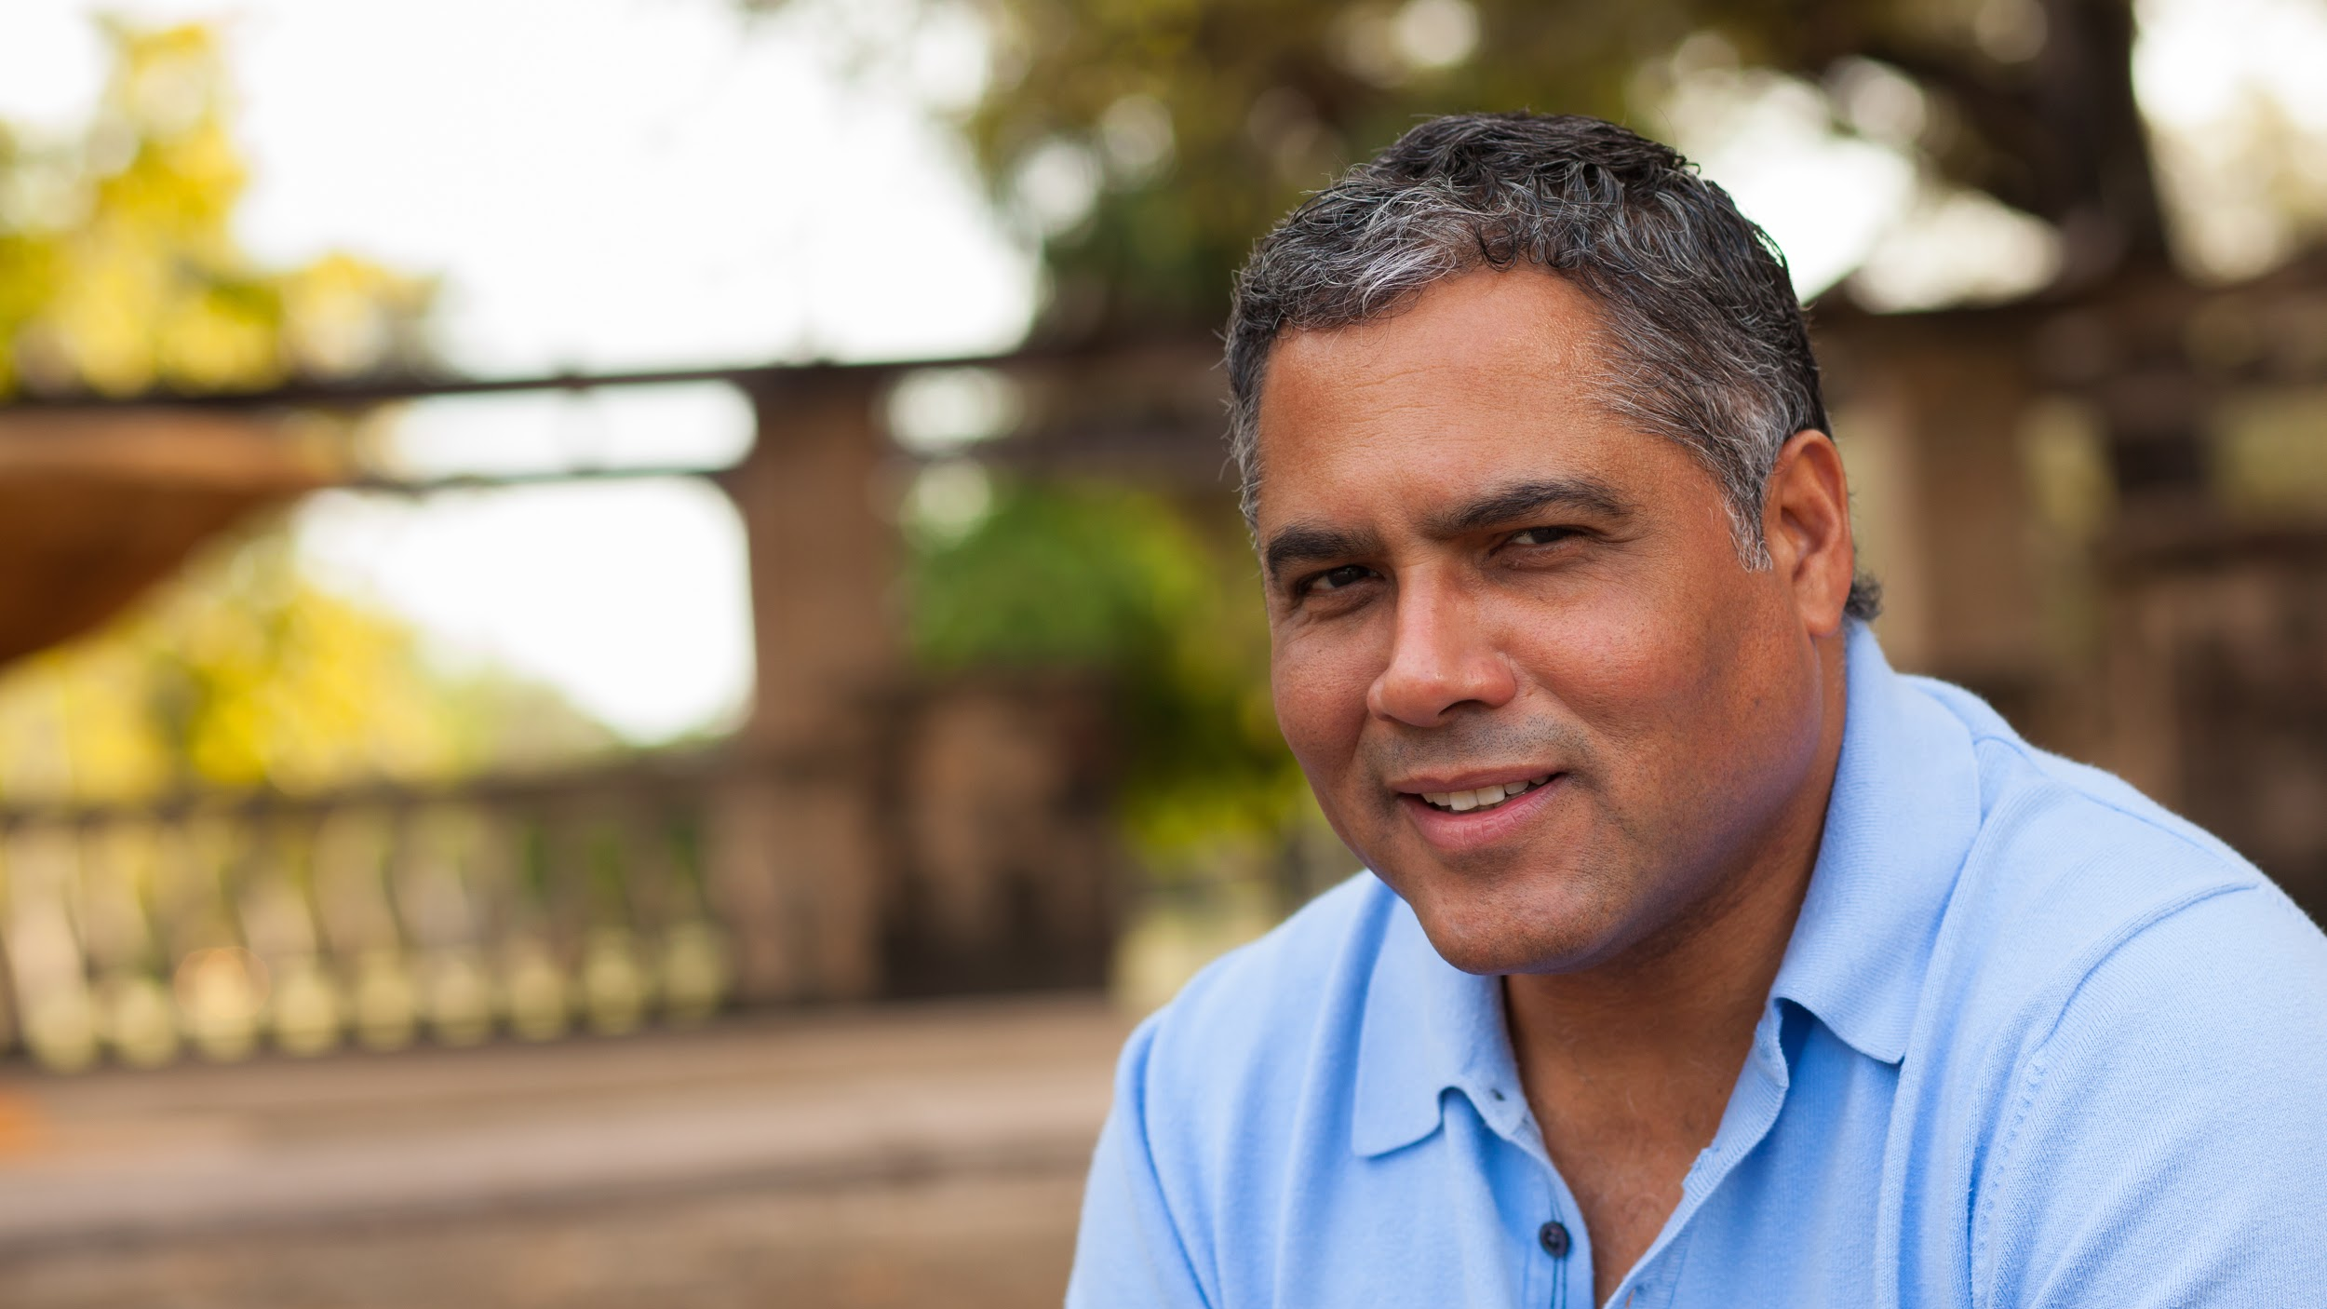
User Interaction
The user interacts with the product through a GUI (Android/Web application). This can be either through Speech Recognition or through text.

Slide 5


2. Extract Data
The data is extracted from 2 sources:
Social Medias The live streaming data is extracted using Apache Flume in the form of small chunks of data.
Online Newspaper sites Data from these sites are extracted through web scraping using python libraries like BeautifulSoup, urllib, etc.
The final extracted data from both the sources is stored in Hadoop Distributed File System.

Slide 6
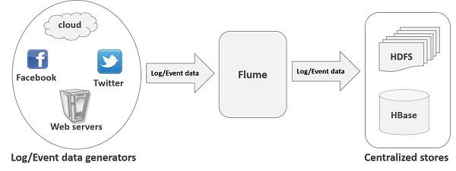
Storage of Live Streaming Data

Slide 7
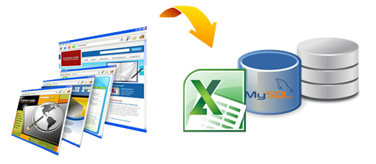
Web Scraping

Slide 8
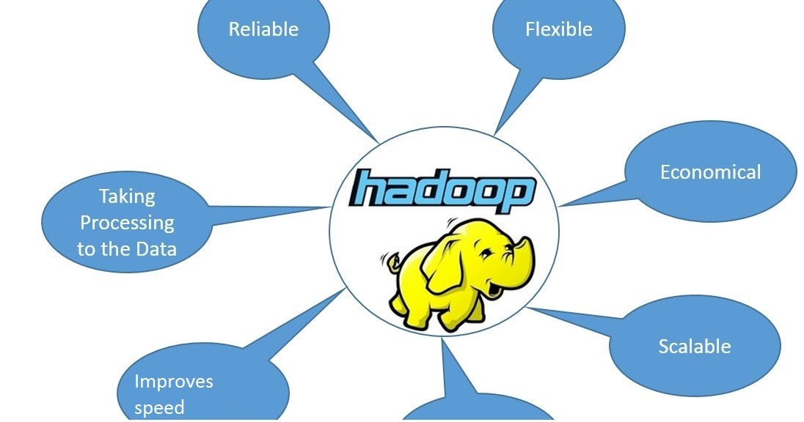
3. DATA STORAGE
Data is stored in Hadoop DFS which is an open-source file system that runs on commodity hardware.
It is suitable for applications that have large datasets.

Slide 9
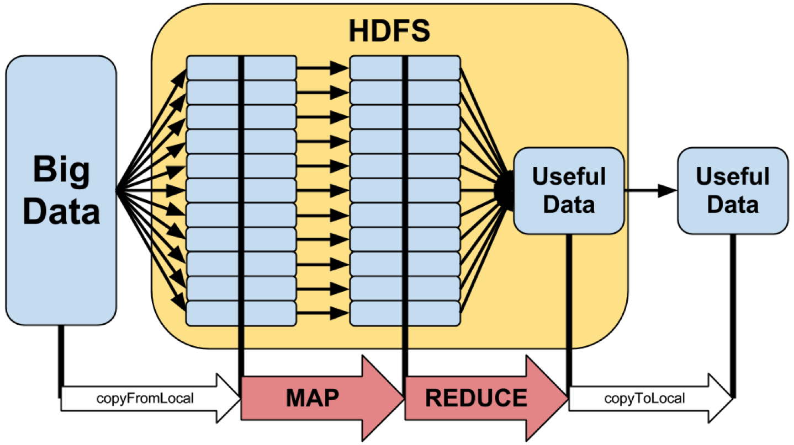
4. Processing
The data is then processed using mapper and reducer code in python. The code involves extracting text data from json files stored through live streaming and the performing summarization on the entire collected data.

Slide 10
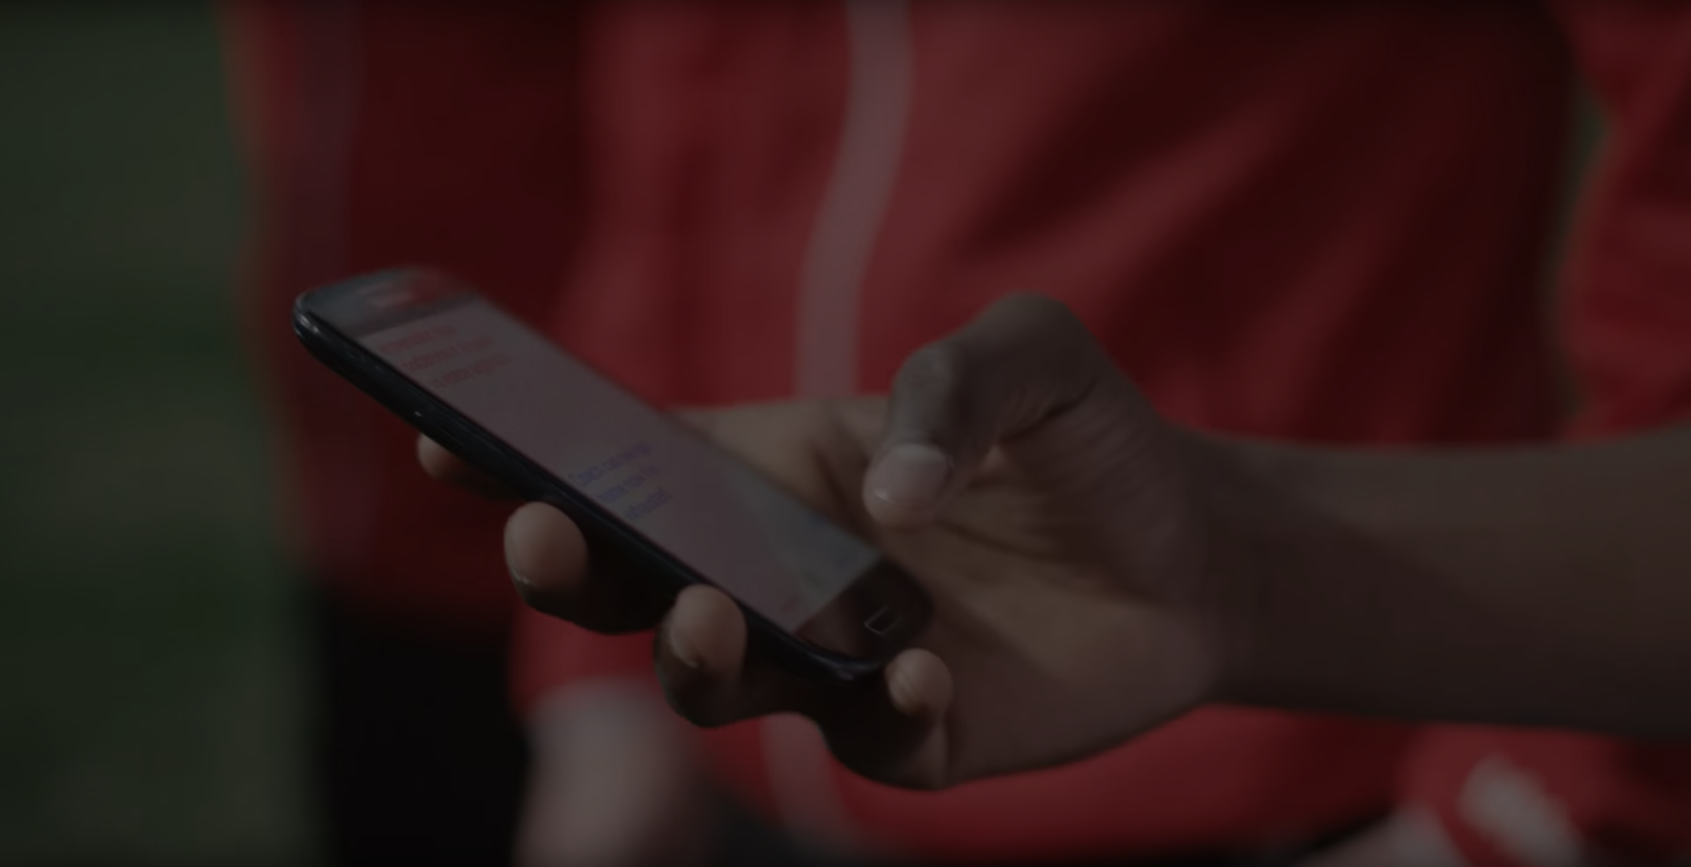
5. Final Result The final result is stored in the form of a text file and the displayed at the user GUI (Android App/ Web App) as an output.

Slide 11
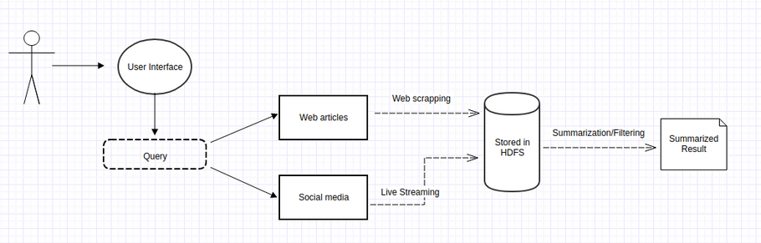
USE CASE DIAGRAM

Slide 12
THANK YOU!

