Slide 1
By: Charulata Lodha Neha Agrawal Prajakta Yerpude Raj Patni
Socio-Economic Analysis Dashboard

Slide 2
AGENDA
Introduction
Project Overview
Pre-Project Training
Project Phases
Planning & Analysis Phase
Design Phase
Development Phase
Testing
Deliverables
Challenges
Lessons
References

Slide 3
INTRODUCTION
Conducting a social and economic impact assessment is important for several reasons. In general, it is used to alert the community of the impact and magnitude of the proposed development on the community’s social and economic well-being.
The factors taken in consideration are :
Crime
Education
Sectorial Analysis
These are compared over a span of 5 years for all states in India

Slide 4
CRIME ANALYSIS
Systematic analysis for identifying and analyzing patterns and trends in crime.
Information on patterns can help law enforcement agencies deploy resources in a more effective manner.
It also plays a role in devising solutions to crime problems, and formulating crime prevention strategies.
The Major Crimes taken in account are –
Murder
Kidnapping
Rape
Theft

Slide 5
Education
Just as a face is the mirror to the heart of a person, level of education reflects the status of a nation.
Education provides required knowledge, technique, skill and information and enables people to know their rights and duties towards their family, society and motherland at large.
Analysis about educational sector in India will help to discover the trends in No. of Institutes, No. of Enrollment and Expenditure over the span of years .

Slide 6
SECTORIAL ANALYSIS
Sectorial analysis helps to measure of the size of an economy
Make In India is a new national program designed to transform India into a global manufacturing hub.
Local and foreign industries to invest in India and make the country a economic powerhouse.
A young nation with 800 million people under age 35, is brimming with optimism and confidence.
The Dashboard will help to analyze the best scenario to set up industries from various sectors which include :
Agriculture
Manufacturing
Mining
Industrial
Notes:
The young people's energy, enthusiasm and enterprise are India's greatest strength. Unleashing those attributes is government's biggest mission

Slide 7



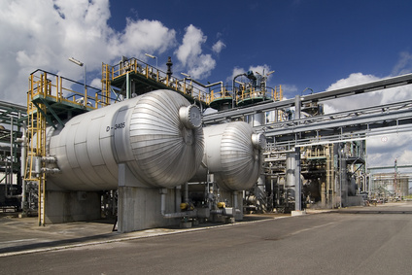
WHY SOCIO-ECONOMIC ANALYSIS?

Slide 8
PROJECT OVERVIEW
End-to-End Business Intelligence Project on Social and Economic data.
Data Identification
3 Areas of Importance – Crime, Education & GSDP (Industries)
Extract Transformation and Loading
Reporting
It leads to proper analysis of Socio-Economic on different aspects like:
Analysis of Crime data
Analysis of Education data
Analysis of Economic data
Dashboard.

Slide 9
BUSINESS REQUIREMENT
Aim: Business Intelligence Dashboard.
Raw Data from Excel sheets ,CSV and PDF files.
Metrics required are:
Different types of crimes and cases.
Count of educational institutes, Enrollment at various levels and Expenditure on education.
Power, Land, Telecom and Labour.
Add-ons for different sectors.
Dimensions used are :
Location
Time

Slide 10
PRE PROJECT TRAINING
SQL
Data warehouse concepts
Microstrategy

Slide 11
PROJECT PHASES
PLANNING & ANALYSIS
DEVELOPMENT
DEPLOYMENT
DESIGN
TEST

Slide 12
PLANNING & ANALYSIS PHASE
PLANNING
&
ANALYSIS
DESIGN
DEVELOP
TEST
DEPLOY

Slide 13
PLANNING AND ANALYSIS
Three Major Areas of Socio-Economic Analysis are :
Crime
Education
Different sectors which contribute to the economy
(Agriculture, Mining, Manufacturing)

Slide 14
CRIME ASSESSMENT
Analysis on total number of criminals based on-
Gender (Male and Female)
Age Group (18-30, 30-50, 50 and above)
Crime Type (Kidnapping, Theft, Rape, Murder)

Slide 15
EDUCATION ASSESSMENT
Analysis on number of Institutes based on levels.
(Primary, Secondary, Undergraduate, Postgraduate)
Analysis on total number of enrolments of students.
(Primary, Secondary, Undergraduate, Postgraduate)
Analysis on expenditure on education for each state.

Slide 16
GROSS DOMESTIC PRODUCT
Analysis on Sectorial Indices - Power, Land, Telecom
Analysis on Labour Rates for each sector
Analysis on add-ons for
Agriculture (Value production output for different crops)
Mining (Total number of mines for different minerals)
Manufacturing(Total number for pharmaceutical and petrochemical)
,

Slide 17
DESIGN PHASE
DESIGN
PLANNING & ANALYSIS
DEVELOP
TEST
DEPLOY

Slide 18
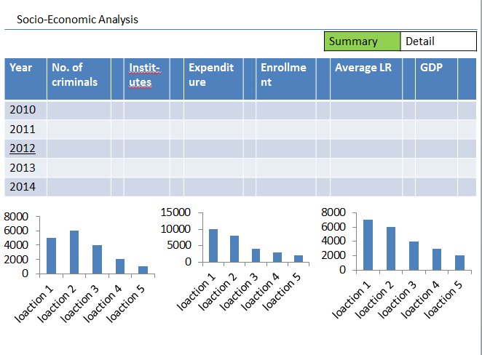
MOCKUPS

Slide 19
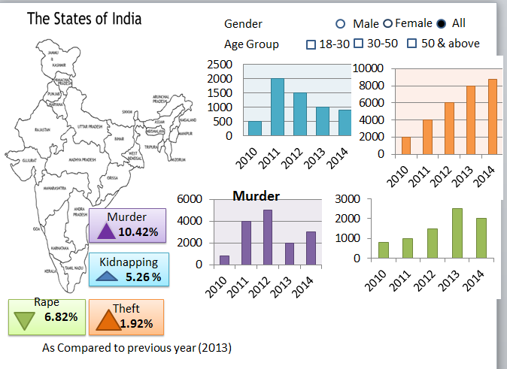
MOCKUPS

Slide 20
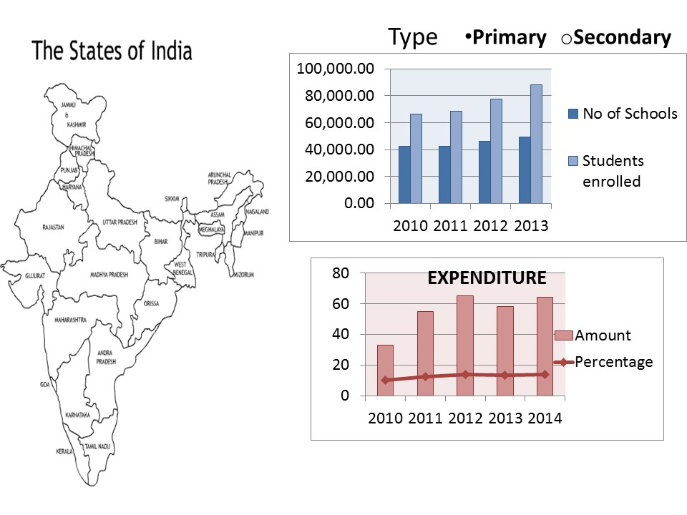
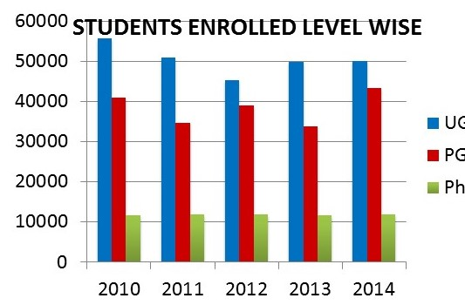
MOCKUPS

Slide 21
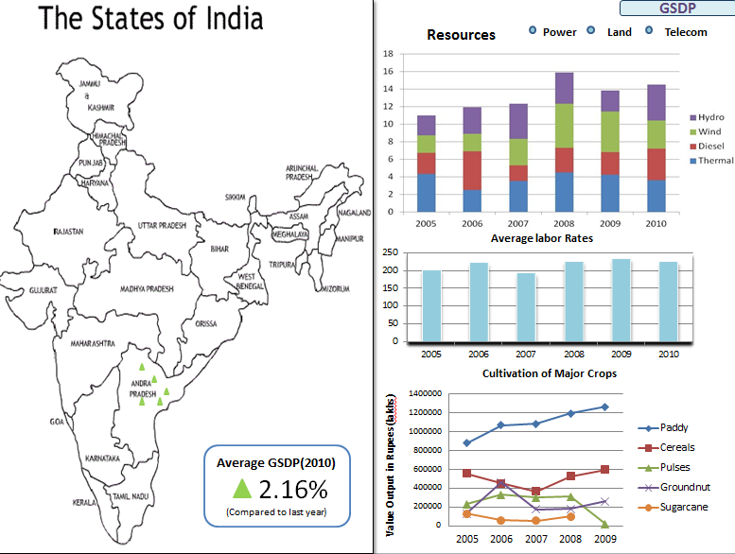
MOCKUPS

Slide 22
DESIGN PHASE
Logical and Physical Data Model
Sheet 1 contains PDM
Sheet 2 contains LDM

Slide 23
DEVELOPMENT PHASE
DEVELOPMENT
PLANNING & ANALYSIS
DESIGN
TEST
DEPLOY

Slide 24
ETL
Extraction
Data from Excel Sheets and CSV files
Transformation
Date
Data type conversions
Substring
Project loading in data warehouse by using SQL scripts.

Slide 25
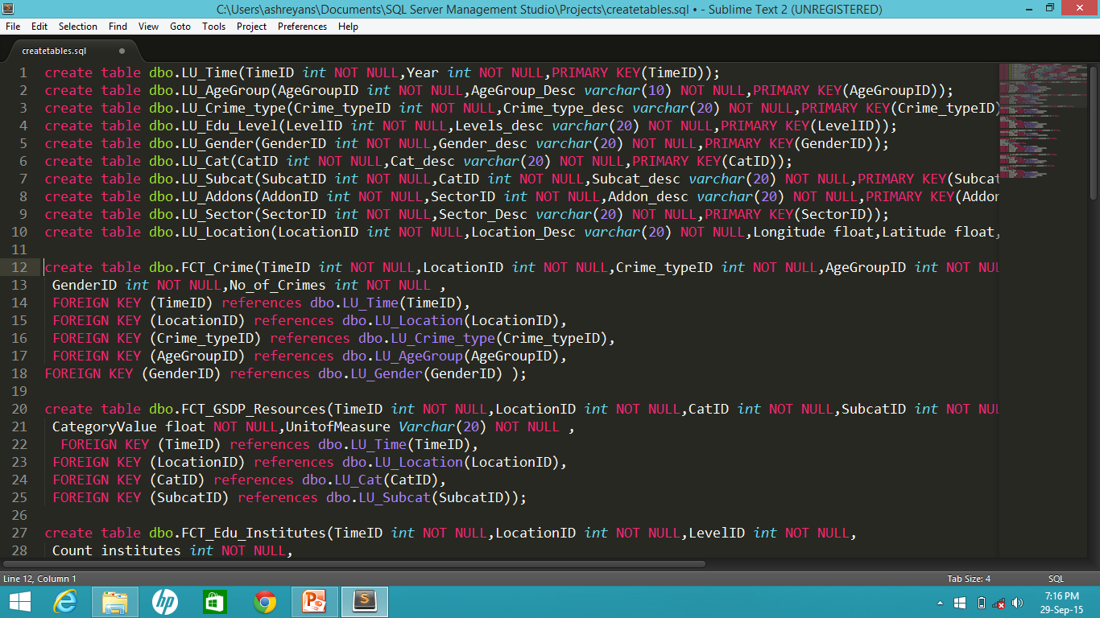
ETL SCRIPTS
Script files attached

Slide 26
TESTING PHASE
TEST
PLANNING & ANALYSIS
DESIGN
DEVELOP
DEPLOY

Slide 27
TESTING
Duplicate value check in lookup table
Count check
Verification of data

Slide 28
DEPLOYMENT PHASE
DEPLOYMENT
PLANNING & ANALYSIS
DESIGN
DEVELOP
TEST

Slide 29
DELIVERABLES
FIRST DELIVERABLE:
Logical Data Model and Physical Data Model
SECOND DELIVERABLE:
ETL scripts in SQL
THIRD DELIVERABLE:
Reports for dashboard
FOURTH DELIVERABLE:
Dashboard

Slide 30
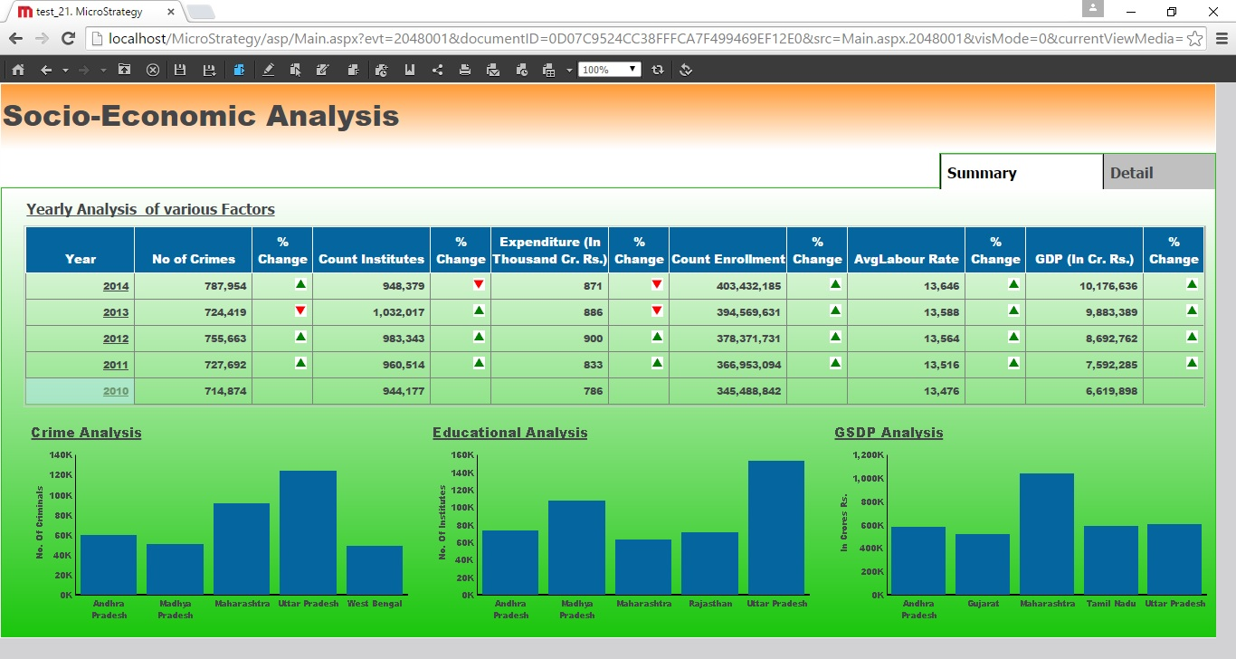
SCREENSHOTS

Slide 31
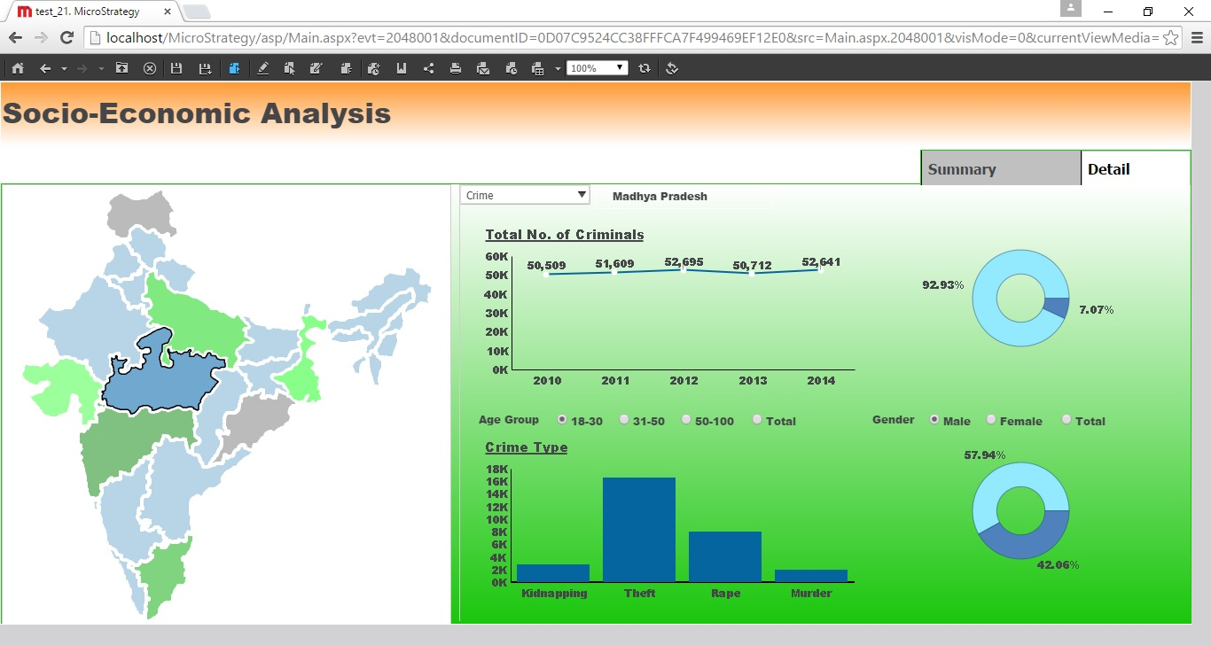
SCREENSHOTS

Slide 32
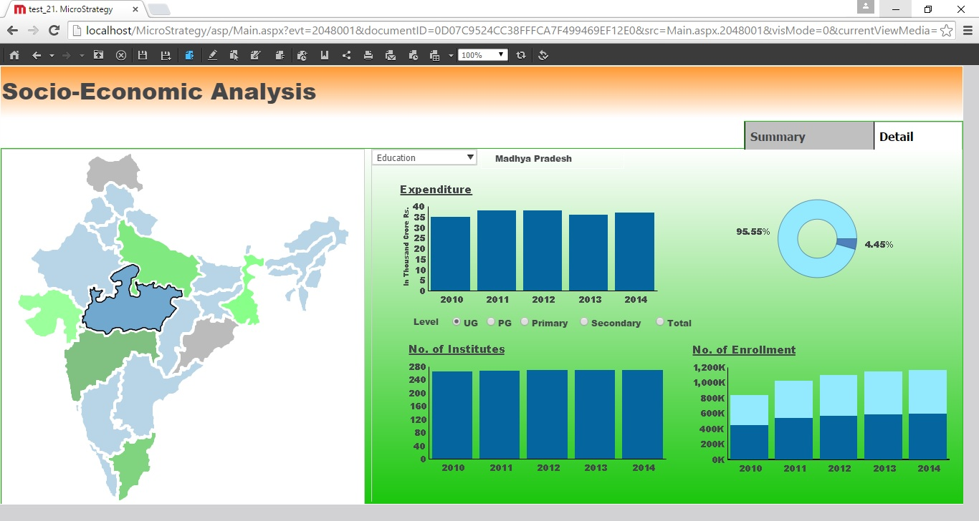
SCREENSHOTS

Slide 33
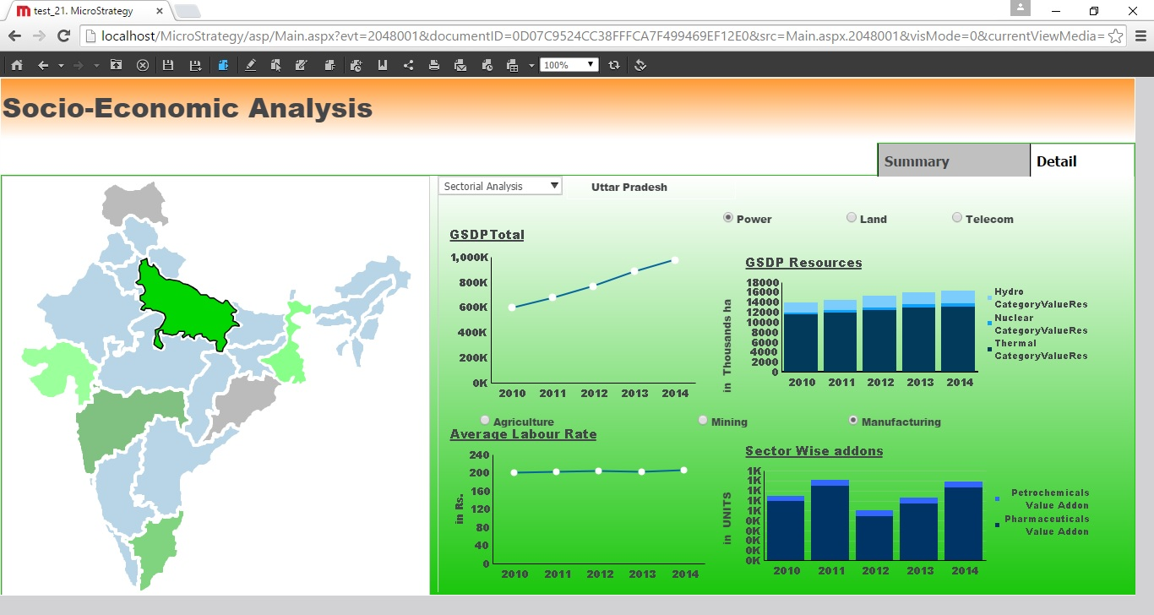
SCREENSHOTS

Slide 34
CHALLENGES
Installation problem
Data volume problem
Data Extraction from Pdf files
File type conversion problem

Slide 35
LESSONS
Technical lessons
Practical lessons
Management lessons

Slide 36
OUR MENTORS
Mr. Vaibhav Fating(Chief Mentor)
Mr. Naveedur Rehman(DB)
Mr. Syed Husain(DB)
Mr. Gaurav Dholwani (MSTR)
Miss. Arpita Agrawal(MSTR)
Mr. Yash Gharpure(MSTR)

Slide 37
REFERENCES
https://data.gov.in/
http://planningcommission.gov.in/
http://www.ibef.org/
www.microstrategy.com
https://www.google.co.in/

Slide 38
Thank you…

