Slide 1



PLAGIARISM DETECTION USING NLP
Presented By,
Abinaya Shree J(811722104004)
Charulatha K(811722104023)
Harshitha K(811722104052)
Guided By,
Mrs. R.Sathya, M.E.,(PhD.,)
DD/MM/YYYY

Slide 2
ABSTRACT
Plagiarism detection is a critical task in educational and professional environments, where originality and integrity are essential. This project introduces an AI-powered plagiarism detection system that utilizes Natural Language Processing (NLP) techniques to identify content similarities at the document level. The system processes user-submitted documents and compares them against a database of reference files to determine the extent of copied or paraphrased content.
DD/MM/YYYY

Slide 3
OBJECTIVE
Develop an AI-driven plagiarism detection system using Natural Language Processing (NLP) techniques.
Analyze textual similarities, paraphrasing patterns, and semantic meanings to enhance accuracy and efficiency.
Move beyond traditional keyword matching to provide a more comprehensive plagiarism detection solution.
DD/MM/YYYY

Slide 4
LITERATURE SURVEY
S.No. | Paper Title | Year | Remark
1 | FTLM: A Fuzzy TOPSIS Language Modeling Approach for Plagiarism Severity Assessment | 2024 | Introduces a hybrid fuzzy logic and language modeling technique for quantifying the severity of plagiarism.
2 | Academic Source Code Plagiarism Detection by Measuring Program Behavioral Similarity | 2021 | Innovatively detects plagiarism in source code by analyzing behavioral semantics rather than surface-level similarity.
3 | Exploring the Landscape of Intrinsic Plagiarism Detection: Benchmarks, Techniques, Evolution, and Challenges | 2022 | A comprehensive survey outlining benchmarks, techniques, and challenges in detecting plagiarism without reference documents.
DD/MM/YYYY

Slide 5
LITERATURE SURVEY
S.No. | Paper Title | Year | Remark
4 | Plagiarism Detection of Multi-Threaded Programs via Siamese Neural Networks | 2020 | Utilizes deep learning to detect plagiarism in complex multi-threaded code by comparing semantic representations.
5 | Plagiarism Detection in Computer Programming Using Feature Extraction From Ultra-Fine Grained Repositories | 2020 | Leverages fine-grained code features to enhance accuracy in detecting subtle forms of plagiarism in programming tasks.
6 | Understanding plagiarism linguistic patterns, textual features, and detection methods | 2012 | Examines linguistic cues and textual features to identify writing-style-based plagiarism techniques.
DD/MM/YYYY

Slide 6
LITERATURE SURVEY
S.No. | Paper Title | Year | Remark
7 | On automatic plagiarism detection based on n-grams comparison | 2009 | Applies n-gram analysis for fast and scalable comparison of texts for potential plagiarism instances.
8 | Plagiarism Detection without Reference Collections | 2017 | Explores intrinsic plagiarism detection methods that rely solely on internal stylistic inconsistencies.
9 | Academic Plagiarism Detection: A Systematic Literature Review | 2020 | Offers a structured overview of the evolution, methods, and evaluation practices in academic plagiarism research.
DD/MM/YYYY

Slide 7
EXISTING SYSTEM
Existing plagiarism detection systems, such as Turnitin, Grammarly, and Copyscape, are commonly used in academic and professional settings to ensure content originality. These tools compare documents against large databases using techniques like keyword matching, string comparison, and fingerprinting.
While effective for detecting exact or slightly altered content, they struggle to identify paraphrased or semantically similar text due to limited NLP integration.
Existing systems tend to be costly, inflexible, and insufficient for advanced semantic detection, highlighting the need for a more intelligent, customizable, and accessible solution
DD/MM/YYYY

Slide 8
PROPOSED SYSTEM
The proposed system is an AI-powered plagiarism detection application designed to efficiently analyze and compare textual content using advanced NLP techniques.
The system allows users to upload documents through a web-based interface developed using the Flask framework.
Once a document is submitted, it undergoes several stages of processing, including text cleaning, tokenization, and normalization to prepare the data for analysis.
By integrating machine learning techniques web interface, the proposed system provides an effective solution for maintaining content integrity in academic and professional domains.
DD/MM/YYYY

Slide 9
SYSTEM ARCHITECTURE
USER INTERFACE
DOCUMENT UPLOAD
PREPROCESSING
FEATURE EXTRACTION
TESTING WITH NEW INPUT TEXT
REFERENCE DOCUMENT
PLAGIARISM % DISPLAY
HIGHLIGHTED MATCHES
DD/MM/YYYY

Slide 10
MODULE 1 : User Interface
The User Interface serves as the entry point for users to interact with the plagiarism detection system. Designed using the Flask web framework, it provides a clean and user-friendly environment where users can navigate through the platform with ease.
Through this interface, users can upload documents for analysis, view the results of the plagiarism check, and interpret highlighted text and percentage scores.
DD/MM/YYYY

Slide 11
MODULE 2 : Document Upload Module
This module allows users to upload their documents in supported formats such as .txt, pdf, or .docx. Once a document is uploaded, it is temporarily stored for processing. This module is responsible for validating the file type and size, and for securely passing the document to the preprocessing stage. It acts as a bridge between user input and backend analysis.
DD/MM/YYYY

Slide 12
MODULE 3 : Preprocessing
Preprocessing involves preparing the uploaded document and reference texts for analysis. This includes text extraction, converting all characters to lowercase, removing special characters, eliminating stop words, and applying techniques like tokenization and lemmatization. These steps standardize the data and reduce noise, ensuring more accurate similarity detection during testing.
DD/MM/YYYY

Slide 13
MODULE 4 : Reference Document Module
.This module contains a curated database of documents that serve as the baseline for comparison. These reference documents could include academic papers, web-scraped articles, or previously submitted assignments. The module ensures these texts are also preprocessed and stored in vectorized form to enable efficient comparison with user-submitted content during testing.
DD/MM/YYYY

Slide 14
MODULE 5 : Output for Plagiarism Detect Module
The final module generates and displays the result of the plagiarism check. It provides a plagiarism percentage indicating how much of the submitted document matches the reference documents. Additionally, it highlights the plagiarized sections within the text, offering transparency and detailed feedback. The output helps users and evaluators understand the nature and extent of plagiarism, facilitating informed decisions.
DD/MM/YYYY

Slide 15
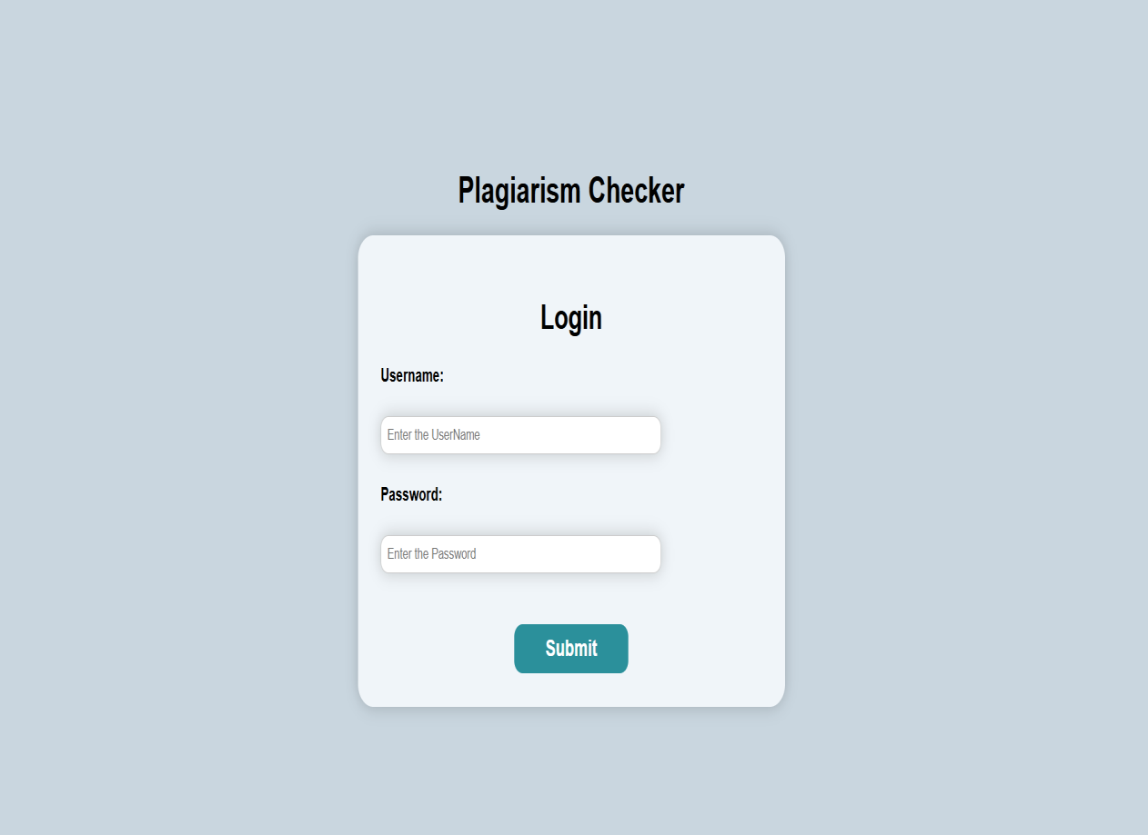
OUTPUT
Fig 2.1: Login Page
DD/MM/YYYY

Slide 16
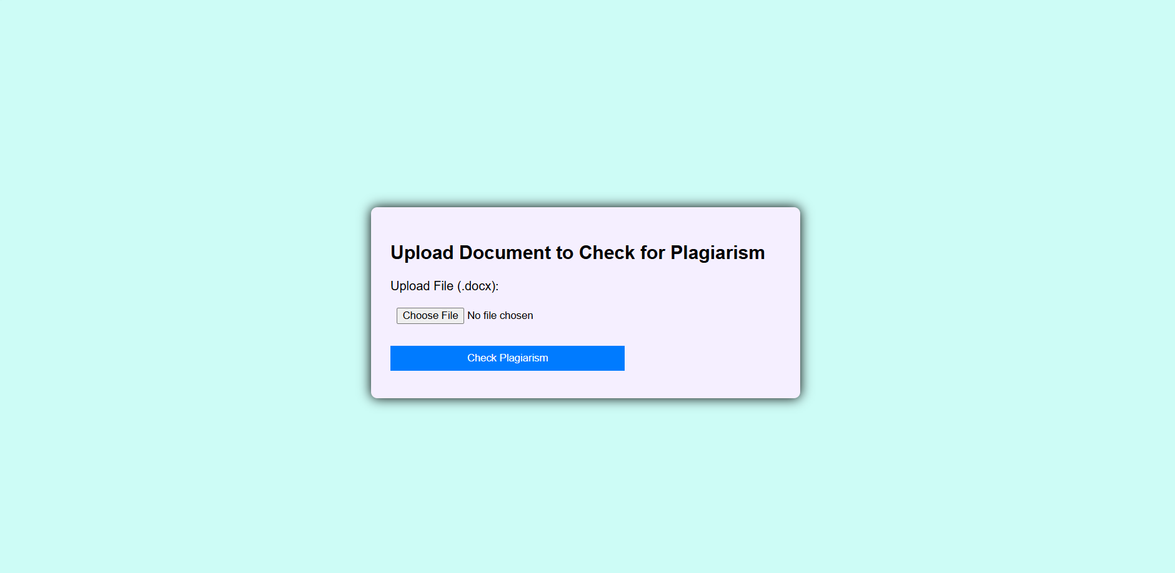
OUTPUT
Fig 2.2: Document Upload Page
DD/MM/YYYY

Slide 17

OUTPUT
Fig 2.3: Detected Percentage
DD/MM/YYYY

Slide 18
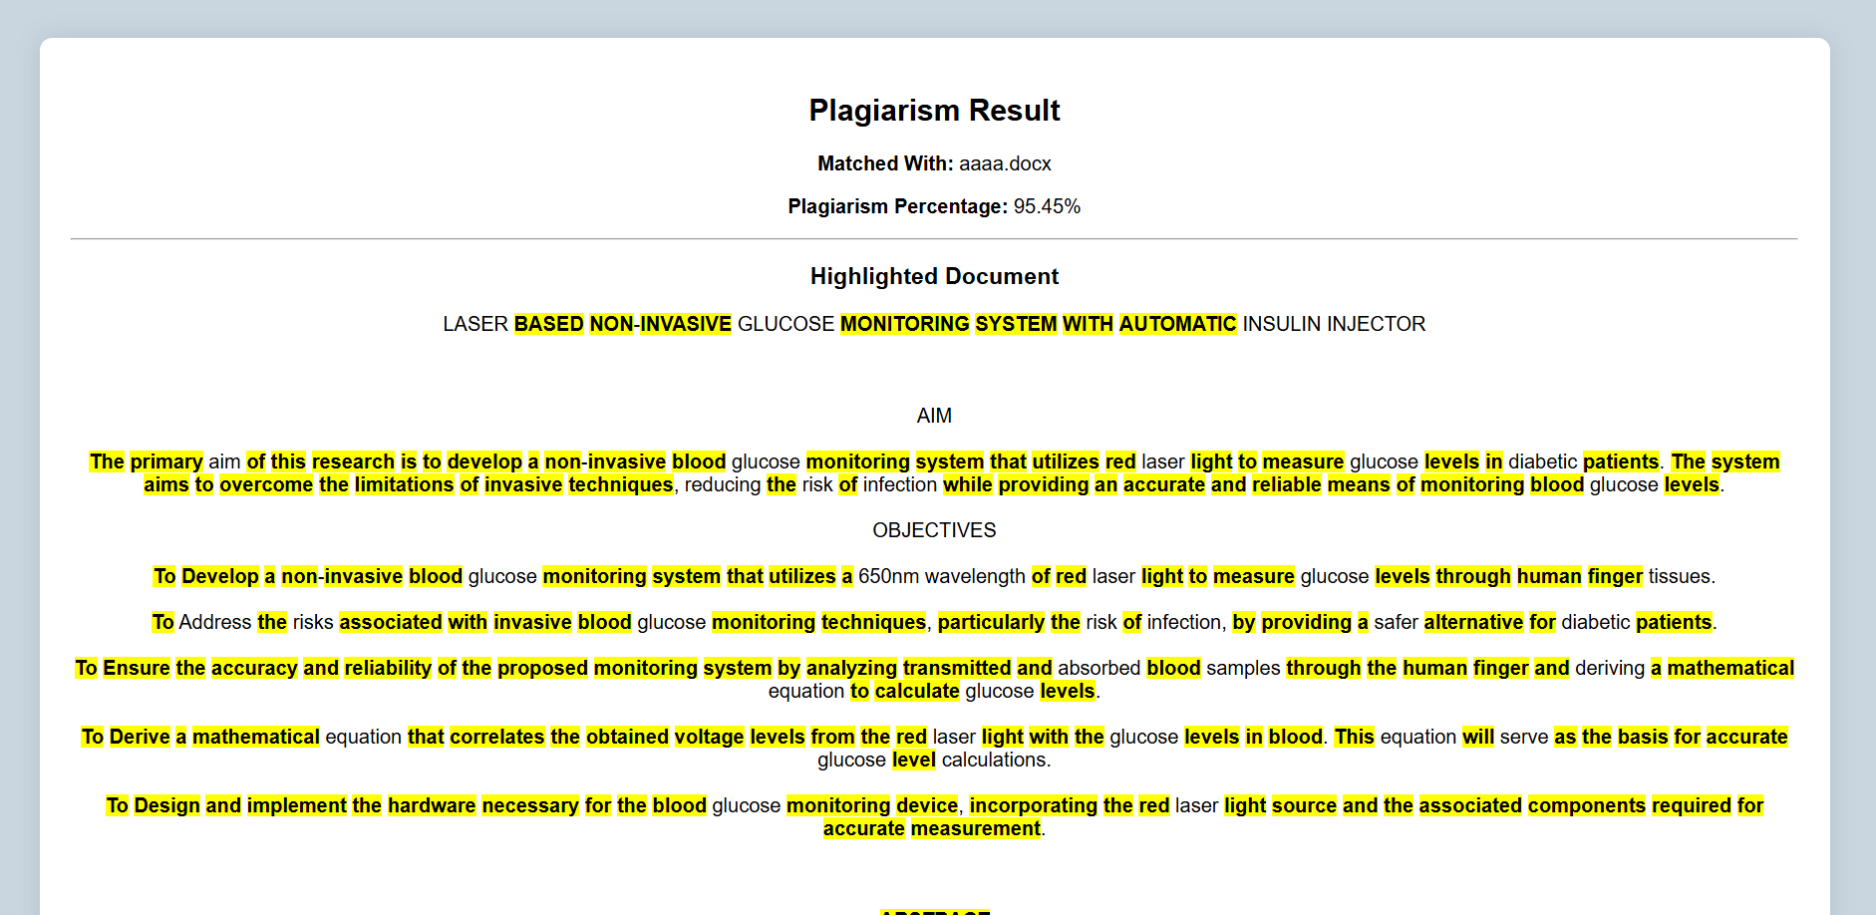
OUTPUT
Fig 2.4 Plagiarism highlighted text

Slide 19
CONCLUSION & FUTURE ENHANCEMENT
The current AI-powered plagiarism detection system can be further enhanced to improve its accuracy, scalability, and user experience. One potential enhancement is the integration of advanced deep learning models like BERT or RoBERTa, which would offer a deeper contextual understanding of text and significantly improve the detection of paraphrased content.
Additionally, expanding the system to support multiple languages would broaden its applicability across diverse academic and professional settings, making it useful on a global scale.
Another area of improvement could be the implementation of real-time web crawling, enabling the system to compare documents against dynamic online content and continually update its reference database.
DD/MM/YYYY

Slide 20
REFERENCES
[1] D. S. Morris, ‘‘Automatic grading of student’s programming assignments: An interactive process and suite of programs,’’ in Proc. 33rd Annu. Frontiers Educ. (FIE), vol. 3, 2003, pp. 1–6.
[2] S. Rajesh, V. V. Rao, and M. Thushara, ‘‘Comprehensive investigation of code assessment tools in programming courses,’’ in Proc. IEEE 9th Int. Conf. Converg. Technol. (I2CT), Apr. 2024, pp. 1–6
[3] M. Messer, N. C. C. Brown, M. Kölling, and M. Shi, ‘‘Automated grading and feedback tools for programming education: A systematic review,’’ ACM Trans. Comput. Educ., vol. 24, no. 1, pp. 1–43, Mar. 2024.
DD/MM/YYYY

Slide 21

DD/MM/YYYY

