Slide 1


DEPARTMENT OF COMPUTER SCIENCE AND ENGINEERING
20CS7503 & DESIGN PROJECT – III
END SEMESTER PRACTICAL EXAMINATION- DEC 2025
REVIEW PRESENTATION
Batch No.:19
Date: 01-12-2025
Session: AN

Slide 2
SMART PREP:AI POWERED SUMMARIZER AND TESTS
Guide Name:
Mr. A. MALARMANNAN M.E.,
Team Members:
ABINAYA SHREE J(811722104004)
CHARULATHA K(811722104023)
HARSHITHA K(811722104052)

Slide 3
OBJECTIVE OF THE PROJECT
1. Automate document text extraction from PDF files to eliminate manual reading effort and reduce time spent parsing lengthy materials.
2. Generate intelligent, AI-powered summaries, insights, and structured study questions tailored for academic preparation.
3. Personalize analysis based on page range, question type, and output format, offering flexibility in how content is consumed.

Slide 4
INTRODUCTION
The volume of academic content continues to grow, making it difficult for students to manually process large PDFs and study materials.
Traditional learning tools focus primarily on viewing documents, offering little support for summarization or conceptual understanding.
With advancements in Large Language Models (LLMs), AI can now generate high-quality summaries, questions, and insights with remarkable accuracy.
Smart Prep integrates PDF extraction and AI reasoning into a single streamlined workflow, reducing the cognitive load on students.
The system acts as a personal study assistant, transforming raw documents into digestible, exam-oriented learning resources instantly.

Slide 5
LITERATURE SURVEY
TITLE OF THE PAPER | AUTHOR(S) | PAPER GIST | TECHNOLOGY USED
Automatic Text Summarization using NLP | Jane Doe | Proposed algorithms to summarize large documents efficiently using extractive methods. | NLP, Python (NLTK, spaCy)
Generating Questions from Text | John Smith | Discussed methods to generate short and long-answer questions from educational content. | NLP, Machine Learning, Python
PDF Text Extraction Techniques | Alice Brown | Compared techniques to extract text accurately from PDFs and DOCX. | PDF-Parse, Mammoth, JavaScript
AI-Assisted Learning Tools | Robert Lee | Developed a system for students to get summaries and practice questions automatically. | OpenAI API, NLP, Node.js

Slide 6
LITERATURE SURVEY
TITLE OF THE PAPER | AUTHOR(S) | PAPER GIST | TECHNOLOGY USED
Text Summarization Using Transformer-Based Deep Learning Models | A. Nallapati, J. Cheng, A. FitzGerald | The paper demonstrates how transformer architectures perform traditional summarization | BERT, PEGASUS, Seq2Seq Transformers, NLP preprocessing.
Automatic Question Generation Using T5 Transformer Model | P. Lewis, M. Ott | Introduces a method for generating questions from textual content using the T5 model. | T5, Encoder-Decoder architecture, Beam Search, NLP pipelines.
A Study on PDF Text Extraction Techniques for NLP Applications | S. Patankar, R. Kanade | Compares PDF extraction frameworks multi-column text when preparing input for NLP tasks. | pdfminer.six, PyPDF2, OCR methods, Text normalization tools.
AI-Assisted Learning Systems for Automated Study Material Generation | J. Kim, L. Wang | Discusses integrated systems that combine summarization, question generation, to support efficient academic learning | Deep Learning-based NLP models, Cloud AI APIs, LLMs such as GPT/LLaMA.

Slide 7




EXISTING SYSTEM ARCHITECTURE
Read
Document
Manually
Identify
Key Points
manually
Prepare
Summaries
manually
Create
Questions
manually

Slide 8
PROBLEM IDENTIFICAITON
Students often struggle to efficiently extract key information from long PDF documents, leading to decreased study productivity.
Manual summarization and question creation require significant time and effort, especially when preparing for exams under tight deadlines.
Existing tools do not offer AI-based academic content generation, forcing students to rely on generic, non-customized outputs.
There is a lack of systems that support custom page ranges, output formats, or question types, reducing the flexibility required for targeted preparation.
A user-friendly tool that integrates automated extraction, intelligent analysis, and customizable outputs is missing in the current learning ecosystem.

Slide 9

PROPOSED SYSTEM ARCHITECTURE
Backend
LLaMA Model
Generate Summary, Q&A
Web Interface
HTML file Input
Text area
Analysis option
AI Analysis
Document
AI Analysis
LLaLa Model
Generate Summary, Q&A
Text Extract
(pdf-parse)

Slide 10
SOFTWARE AND HARDWARE REQUIREMENTS
HARDWARE
Processor: Intel i3 or higher / AMD equivalent
RAM: Minimum 8 GB (recommended 16 GB for faster NLP processing)
Storage: At least 5 GB free disk space for project and temporary uploads
Internet Connection: Required for API calls to NLP/AI services
SOFTWARE
Operating System: Windows 10/11, macOS, or Linux
Backend: Node.js, Express.js
Frontend: HTML5, CSS3, JavaScript
Libraries/Frameworks:
Multer (File upload handling)
PDF-Parse (PDF text extraction)
Mammoth.js (DOC/DOCX)
NLP Libraries
5. Browser: Latest versions of Chrome, Firefox, or Edge

Slide 11
MODULES
PDF Upload Module
Text Extraction Module
Analysis Selection Module
AI Processing Module
Output Formatting & Export Module

Slide 12
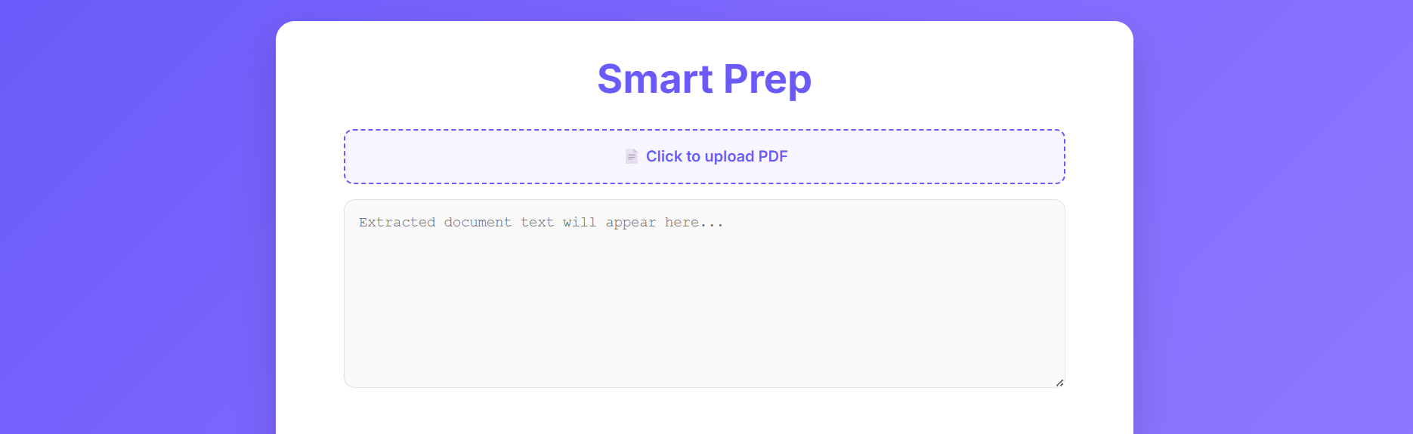
FILE UPLOAD MODULE
Users upload PDF files through an HTML <input type="file"> element integrated into the UI.
The selected file is packaged using Form Data and sent to the backend.
Multer middleware efficiently handles the upload process, converting the PDF into a buffer for further processing.

Slide 13
PAGE RANGE SELECTION MODULE
The backend processes the uploaded PDF buffer using the pdf-parse library.
Text content is extracted, cleaned, and formatted to remove unnecessary noise.
The extracted text is returned to the frontend and displayed in a textarea for review.

Slide 14
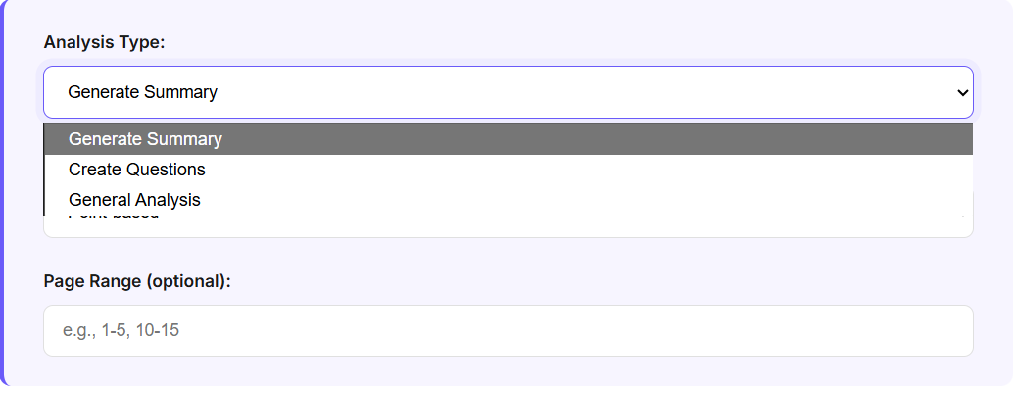
ACTION SELECTION MODULE
The interface allows users to choose the type of analysis: Summary, Question Generation, or General Analysis.
Users can additionally specify output format (points or paragraph) and an optional page range.
These choices are included in the analysis request to customize the AI’s behavior.

Slide 15
TEXT EXTRACTION & NLP PROCESSING MODULE
The backend dynamically builds an AI prompt based on selected options and extracted text.
This prompt is processed using the Groq LLaMA-3.3 70B model, ensuring high-quality academic outputs.
The model generates structured summaries, insights, or categorized questions (short/long answer).

Slide 16
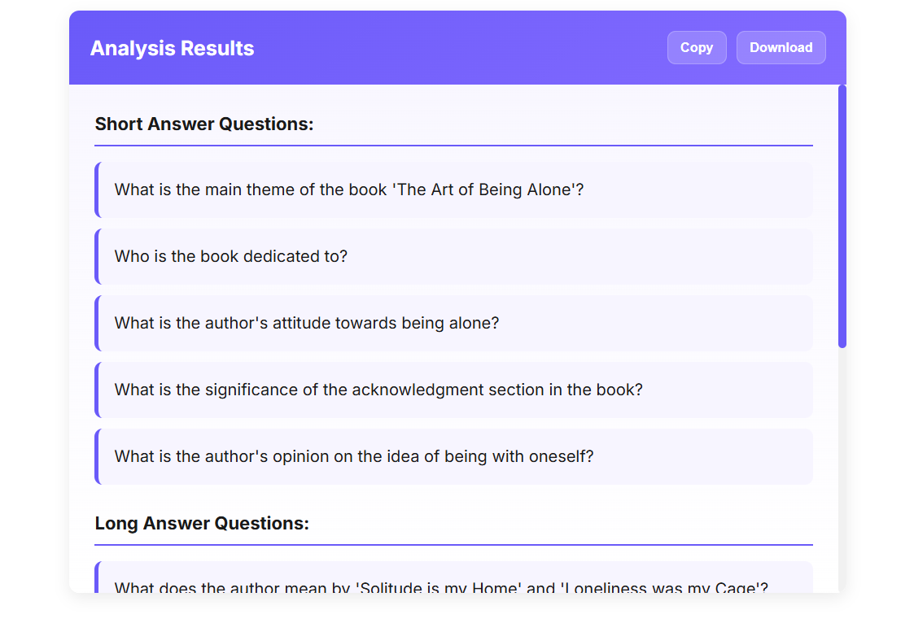
OUTPUT & EXPORT MODULE
AI-generated results are formatted and displayed in the results section of the UI.
The interface supports user-friendly actions such as copy to clipboard for quick reuse.
Users can also download the output as a text file, enabling offline access and saving study material.

Slide 17
CONCLUSION
Smart Prep successfully integrates PDF extraction and AI-driven analysis into a single, streamlined platform. The system transforms lengthy academic documents into meaningful summaries, insights, and structured study questions. By automating manual tasks like reading, summarizing, and note-making, the project significantly enhances study efficiency.
The combination of Node.js, pdf-parse, and the Groq LLaMA model demonstrates a reliable, scalable solution for educational content processing. Overall, Smart Prep proves effective as a lightweight, user-friendly tool that supports faster and smarter exam preparation.

Slide 18
FUTURE ENHANCEMENTS
In the future, Smart Prep can be expanded to support more advanced document processing and intelligent learning features. Multilingual analysis and topic-based segmentation can help students generate summaries and questions in their preferred language while automatically organizing content into chapters or themes.
Further enhancements can focus on user experience and accessibility. A mobile app version and real-time collaboration features would enable students to access Smart Prep on the go and work together more effectively, transforming the platform into a complete AI-powered learning companion.

