Slide 1



INTRODUCTION TO MACHINE LEARNING: Python and Machine Learning
Jainam Mehta,
DSC – CHARUSAT Lead
Rakshil Kevadiya,
Machine Learning Team

Slide 2
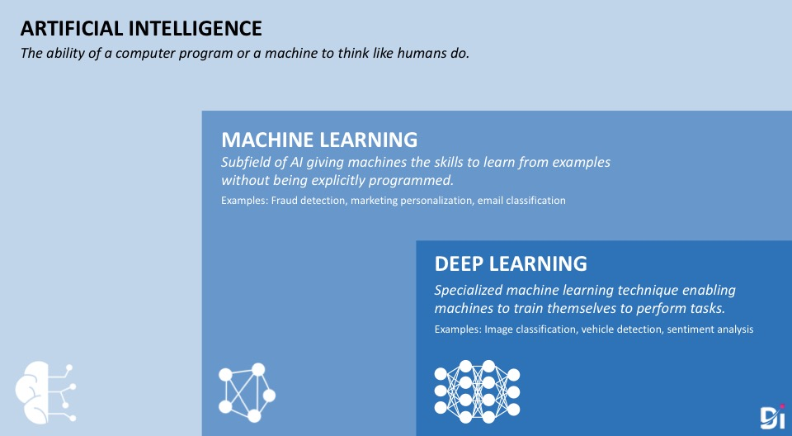

Slide 3
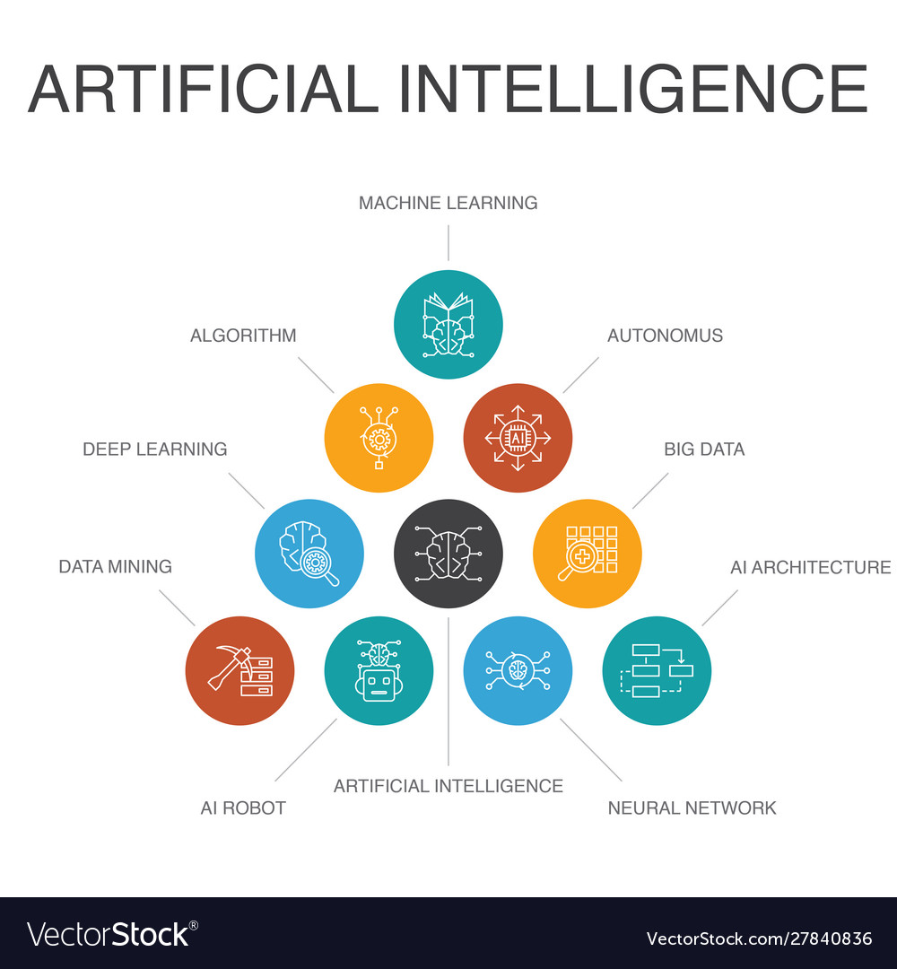
Artificial Intelligence:

Slide 4
Machine Learning:
Machine Learning is all about making sense out of data. Data comes in many form, images, audio files, tabular data(#examples with n properties).
Machine learning includes algorithms which finds common patterns in the set of data with help of human intelligence.
Meaning of the term “help of human intelligence” is that the algorithms needs processed data, i.e. certain high dimensional properties(features) need to be extracted before feeding the input to the algorithm.

Slide 5
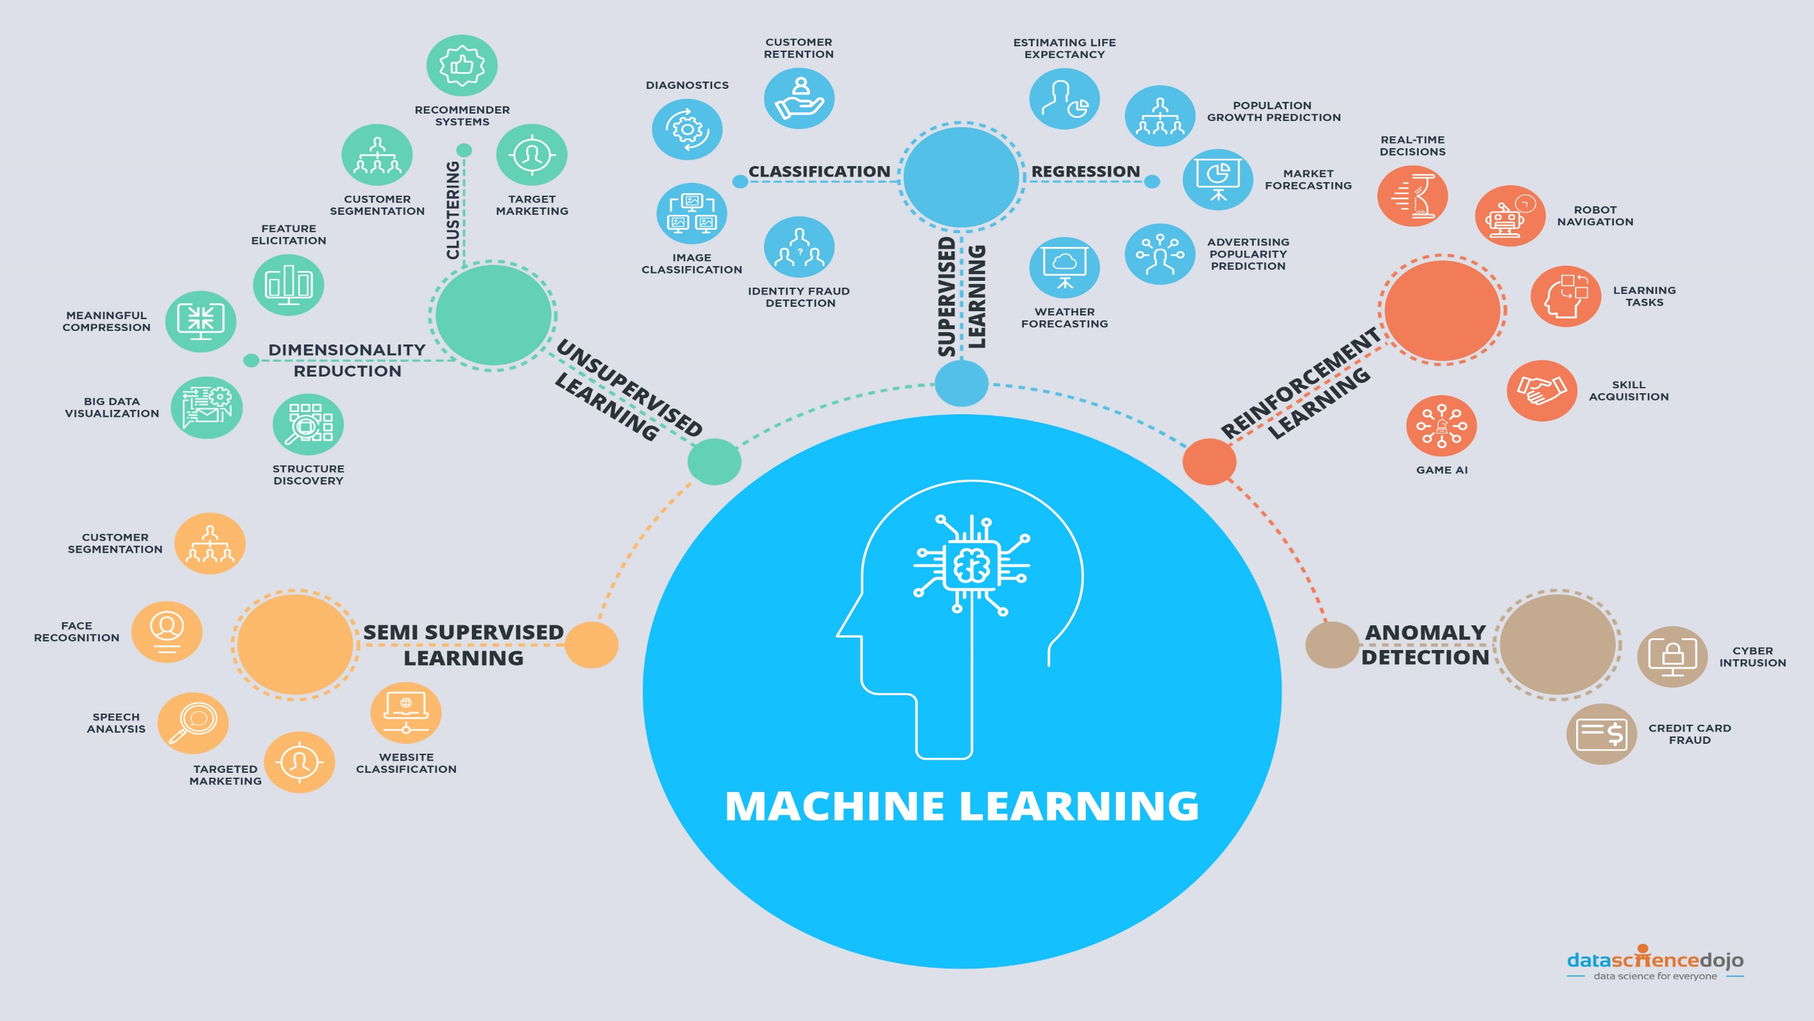

Slide 6
Machine Learning: Use Cases
Fraud Detection
Dynamic Pricing
Email Filtering
Smart Recommendations (Spotify)
Gaming AI
Protein Structure Prediction
Many more

Slide 7
Machine Learning: Feature Extraction
Trigger word detection:
feature extraction: Phonemes
Image classification
feature extraction: Shapes, edges, colors, contours etc.

Slide 8
Deep Learning:
Deep Learning is subset of Machine Learning which does not require feature engineering/extraction and can learn patterns from data with spare pre-processing.
But unlike Classical machine learning algorithms, Deep learning algorithms requires a lot of data(usually at least 10 times more) of the pattern it is trying to find. It also requires a lot of computing power compared to classical machine learning algorithms.
The current development in data collection and hardware acceleration has given us access to huge amounts of different types of data and high speed computation which allows us to practically implement deep learning algorithms.

Slide 9
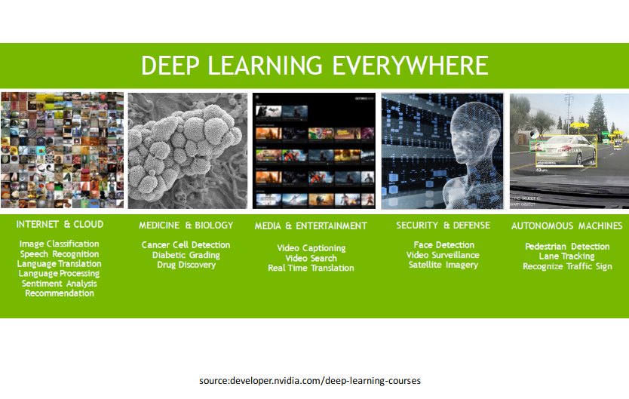
Deep Learning: Use cases

Slide 10
Deep Learning: Algorithms
There are different types of algorithms in Deep Learning according to the domain in which they are used.
Artificial Neural Networks: Almost used with all other deep learning algorithms.
Convolutional Neural Networks: Mostly used in Vision related tasks
Sequence Models: Mostly used for Language and time-series related tasks
Generative Models: Used for generating new data

Slide 11

Thank You!

