Slide 1
Intelligent Triage of Customer Support Ticket
Shreyas Katale
Charvi Rathod
Nikhil Patil

Slide 2
Introduction and Problem Statement
This project focuses on automatically classifying customer support tickets into correct product categories. We compare a traditional machine learning model with a fine-tuned Large Language Model to improve accuracy and efficiency.
The Context: Modern service companies receive thousands of unstructured support tickets daily.
The Impact:
  High TTR: Increased Time-to-Resolution.
  Low CSAT: Frustrated customers waiting for the right department.
The Problem: "Triage" (sorting) is currently a manual bottleneck.
  Human agents must read, understand, and route every email.
  Process is slow, expensive and prone to human error.
The Goal: Automate this process by building an AI that can classify complaints into 20 specific financial product categories (e.g., Mortgage, Fraud, Student Loans) with human-level accuracy.

Slide 3
Dataset Overview
We used the Consumer Financial Protection Bureau (CFPB) dataset for this project.
Link : https://www.consumerfinance.gov/data-research/consumer-complaints/
The dataset contains real-world customer complaint narratives written in natural language.
Each complaint describes an issue faced by a customer in detail.
Every complaint is labeled with a specific financial product category.
These labeled complaints help train and test our classification models.

Slide 4
Dataset Details
Input (X): Consumer complaint narrative
  Characteristics: Unstructured, variable length, contains typos, emotional language, and redacted PII (e.g., "XXXX").
Target (Y): Product
  Taxonomy: 20 distinct financial categories (e.g., Mortgage, Debt Collection, Credit Card).
Scale & Sampling:
  Raw Data: More than 2 Million rows (Too large for rapid prototyping).
  Our Subset: Stratified sample of 100,000 records to ensure representation of rare classes.
The Challenge: Extreme Class Imbalance.
  Top Class: "Credit Reporting" (~50% of data).
  Minority Classes: "Student Loan" (<5% of data).
  Solution: We used Stratified Splitting to ensure our validation set was statistically valid.

Slide 5
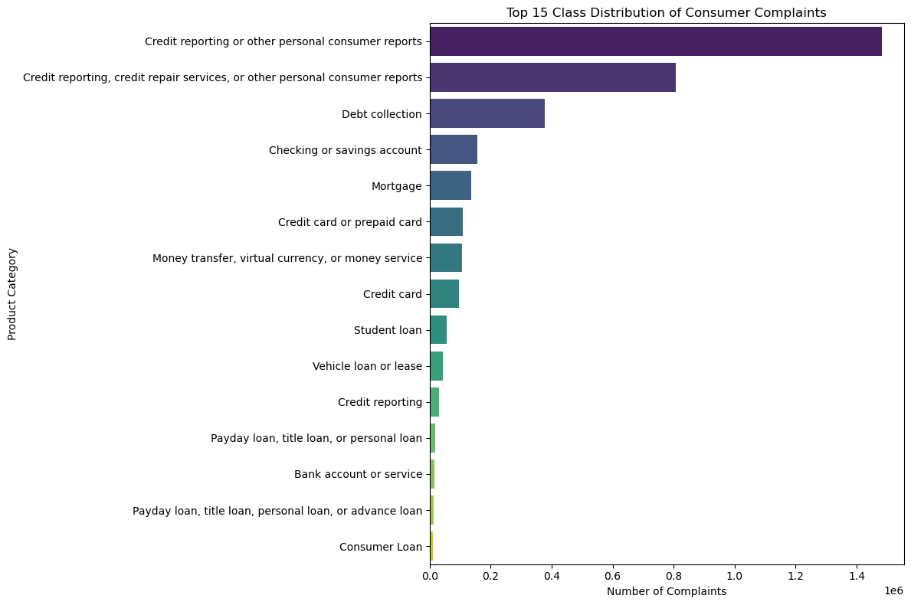
Data Analysis
The dataset has class imbalance, meaning some product categories have many more samples than others.
Popular products like credit reporting and mortgages appear more frequently in the data.
Less common products have fewer complaint records available.
Because of this imbalance, accuracy alone is not a reliable metric.
We use Weighted F1-score to fairly evaluate model performance across all classes.

Slide 6
Baseline Model
Raw Text
TF-IDF Vectorizer
Sparse Matrix
Logistic Regression
Probability
Why a Baseline?
To quantify the true value of the LLM. If a simple model gets 90% accuracy, complex AI is unnecessary.
Feature Extraction: TF-IDF (Term Frequency-Inverse Document Frequency)
Converts text into numerical vectors.
Logic: Penalizes common words ("the", "is") and rewards rare, meaningful words ("foreclosure", "overdraft").
Configuration: Removed English stop-words; capped at 5,000 features to prevent overfitting.
The Classifier: Logistic Regression
Type: Multinomial (One-vs-Rest) for 18 classes.
Strengths: Fast training (<2 mins), highly interpretable, and computationally cheap.

Slide 7
Baseline Results & Limitations
Key Results:
Overall Score: Weighted F1-Score of 0.7300.
Training Time: < 5 Minutes (on CPU).
Where it Excelled:
  Simple, keyword-heavy categories (e.g., "Mortgage" -> detected word "escrow").
Where it Failed (The "Context Gap"):
  Negation: Cannot distinguish "I am happy" from "I am not happy" (Bag-of-Words limitation).
  Semantic Overlap: Confused "Credit Card" vs. "Prepaid Card" because they share similar keywords.
  Unseen Vocabulary: Fails completely on slang or typos it hasn't seen during training.

Slide 8
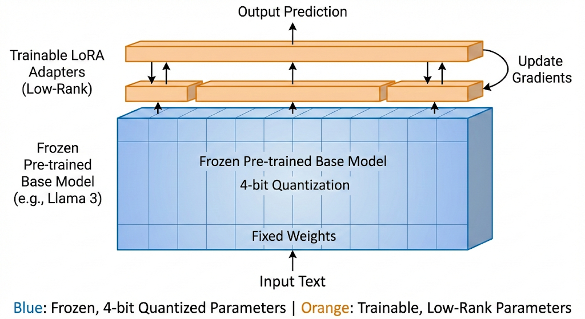
The AI Solution – Llama 3 & QLoRA
The Model: Meta-Llama-3-8B
Selected for its state-of-the-art reasoning capabilities in the 7B-10B parameter class.
Problem: Loading the full model requires ~16GB+ VRAM; training it requires >60GB (impossible on our L4/T4 GPU).
The Solution: QLoRA (Quantized Low-Rank Adaptation)
Quantization: We compressed the base model weights from 16-bit to 4-bit precision (nf4 data type), reducing memory usage by ~70%.
Frozen Weights: The core "brain" of Llama 3 is locked (frozen). We do not retrain it.
Adapter Layers: We injected small, trainable matrices (adapters) into the attention layers. Only these tiny layers are updated during training.
The Result: We successfully fine-tuned an 8B model using less than 6GB of VRAM for trainable parameters, effectively democratizing enterprise-grade AI.

Slide 9
LLM Fine-Tuning Training Configuration & Strategy
Key Specifications:
Adapter Configuration (LoRA):
  Rank (r): 16 – Controls the complexity of the new features.
  Alpha (ɑ): 32 – Scaling factor (how strongly the model 'listens' to new training).
  Target Modules: q_proj, v_proj (Attention mechanisms).
Training Hyperparameters:
  Steps: 1,200 (approx. 1 epoch).
  Batch Size: 2 (with Gradient Accumulation = 8 →Effective Batch Size of 16).
  Learning Rate: 2e-4 (standard for QLoRA).
Prompt Engineering (Instruction Tuning):
  Formatted inputs to guide the model's reasoning:
  Template: "Classify the following consumer complaint into one of these 18 categories: [List]..."
  This converts the task from simple "prediction" to "instruction following."

Slide 10
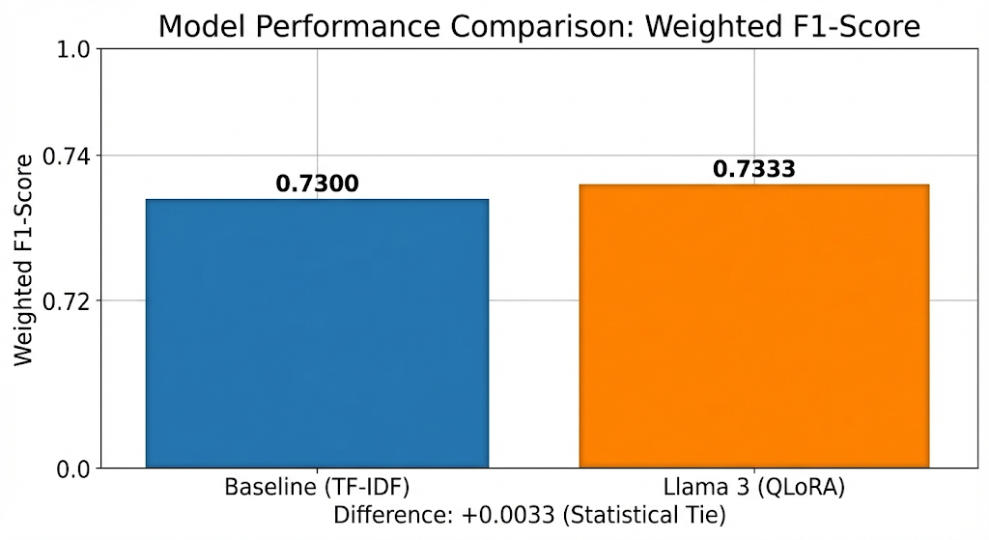
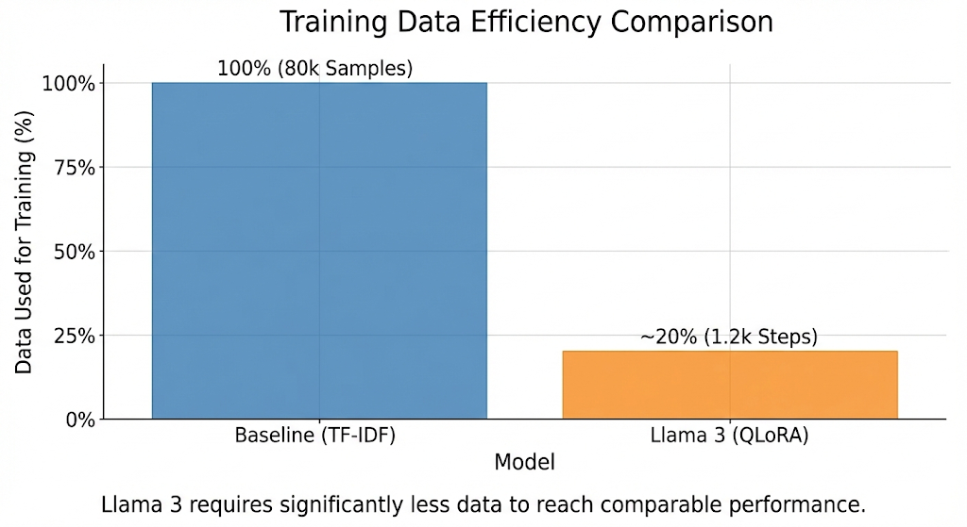
Results
Head-to-Head Performance:
Baseline (TF-IDF): 0.7300 Weighted F1-Score.
Llama 3 (QLoRA): 0.7333 Weighted F1-Score.
Result: The LLM successfully matched and slightly exceeded the strong statistical baseline.
Data Efficiency:
Baseline required the entire dataset (80,000 samples) to build its probability map.
Llama 3 achieved this performance after just 1,200 training steps (approx. 20% of the data), leveraging its pre-trained knowledge.
Category-Level Analysis:
Strong Performance: "Mortgage" (F1: 0.90) and "Money Transfers" (F1: 0.89).
Challenges: "Credit Card" vs. "Prepaid Card" (F1: 0.52). The model struggled with legacy categories that share near-identical vocabulary.

Slide 11
DEMO

Slide 12
Conclusion & Future Work
Key Takeaways:
Feasibility Proven: We successfully fine-tuned an 8-billion parameter LLM on a single Cloud GPU using QLoRA, overcoming significant hardware constraints.
Efficiency Win: The Llama 3 model matched the statistical baseline's accuracy (F1: 0.7333) while requiring only ~20% of the training data exposure.
Business Impact: The solution offers deep semantic understanding (context-awareness) that simple baselines lack, providing a robust foundation for automated customer support.
Future Roadmap:
Extended Training: Increase training duration from 1,200 steps to 3 full epochs to potentially surpass 80% F1-score.
RAG Integration: Implement Retrieval-Augmented Generation to allow the model to cite specific company policies when routing tickets.
Cloud Deployment: Containerize the application (Docker) and deploy to a serverless endpoint (e.g., AWS SageMaker) for real-time, low-latency inference.

Slide 13
THANK YOU

