Slide 1
Microsoft Engage 2022
Project Walk Through

Slide 2
Flow of slides
Facial Recognition
About the dataset
FER2013
Important Links
Understanding the problem
About the model
Mini-Xception
Demonstration

Slide 3
Facial Recognition
Smarter Advertising

Slide 4
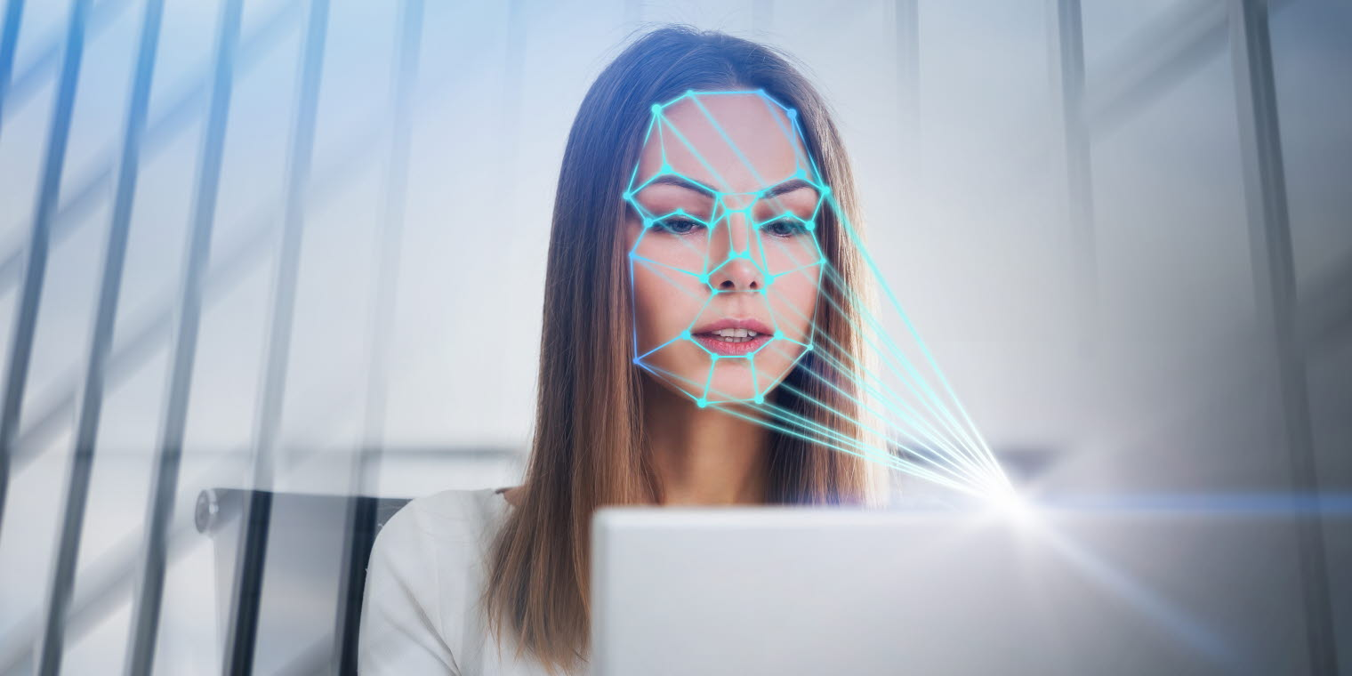
Understanding the problem
-Amplify Advertising
We will be using, Facial Recognition - Face Emotion Detection
Through detecting the emotions, companies can better understand and connect with their customers.
We will be detecting Seven main emotions - Happy, Sad, Disgust, Surprise, Fear, Angry, and Neutral.
Building Face Emotion Detection model from scratch to achieve this.

Slide 5
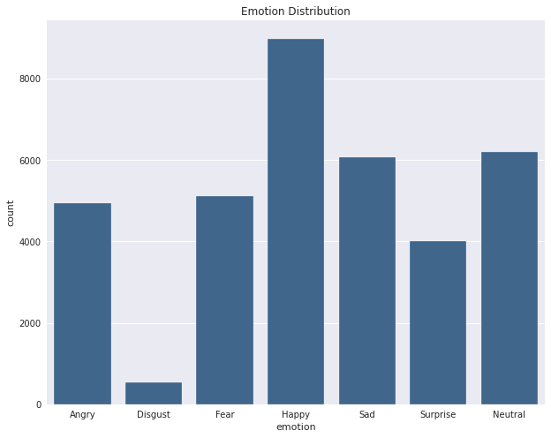
About the Dataset
-Fer2013 Emotion Dataset
Emotion Distribution
Training 28709 Images
PublicTest 3589 Images
PrivateTest 3589 Images
Training dataset formed by Training Images + PrivateTest Images
Validation dataset formed by PublicTest

Slide 6
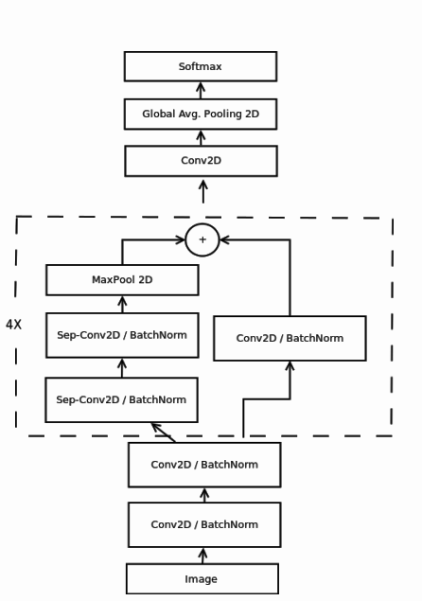
About the model
Mini-Xception
It is a Fully-connected deep convolutional Neural Network Model.
Inspired by Xception architecture
Used both residual modules and depth-wise separable convolutions.
Achieved an accuracy of 70% by training the model on FER2013 dataset

Slide 7
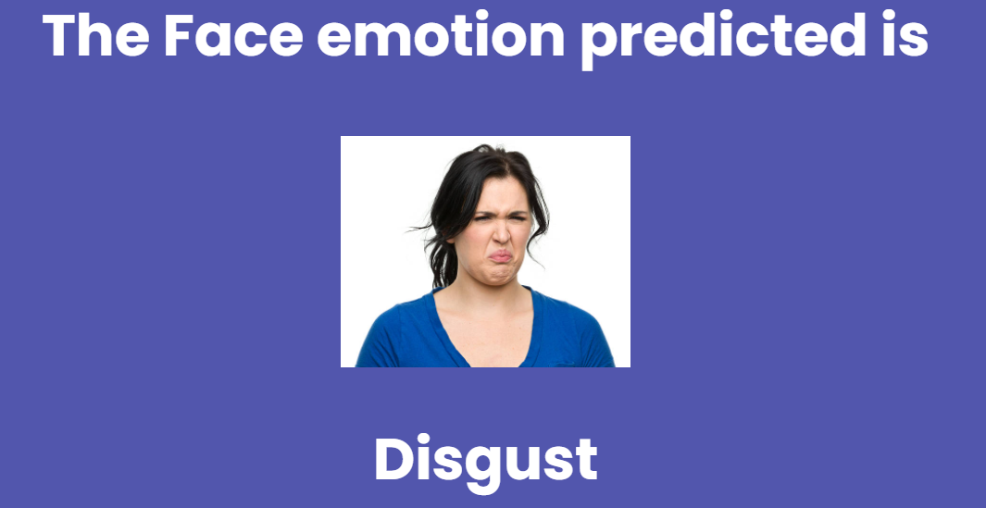
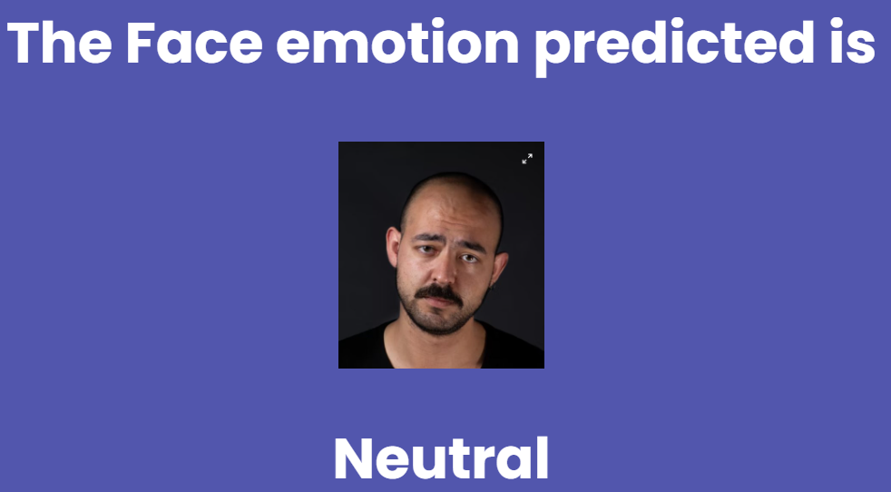
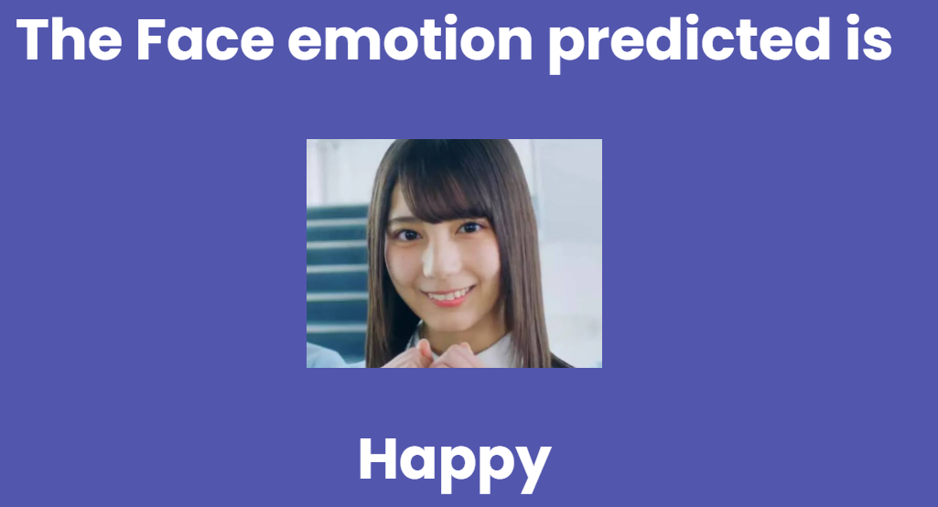
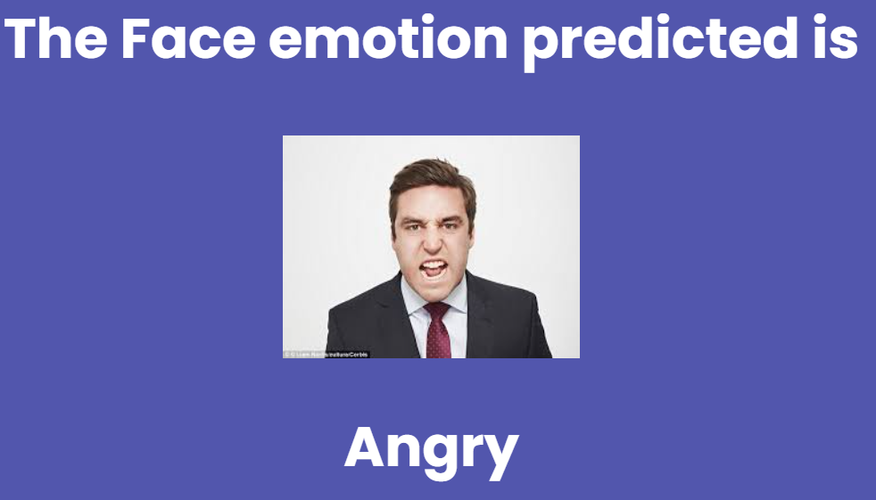
Demonstration of Emotion Prediction from the application

Slide 8
Important Links
Link to the github repository: https://github.com/charvi212002/face_emotion_detection
Link to the App working demo-video:
Link to the hosted website:

Slide 9
Thank You

