Slide 1

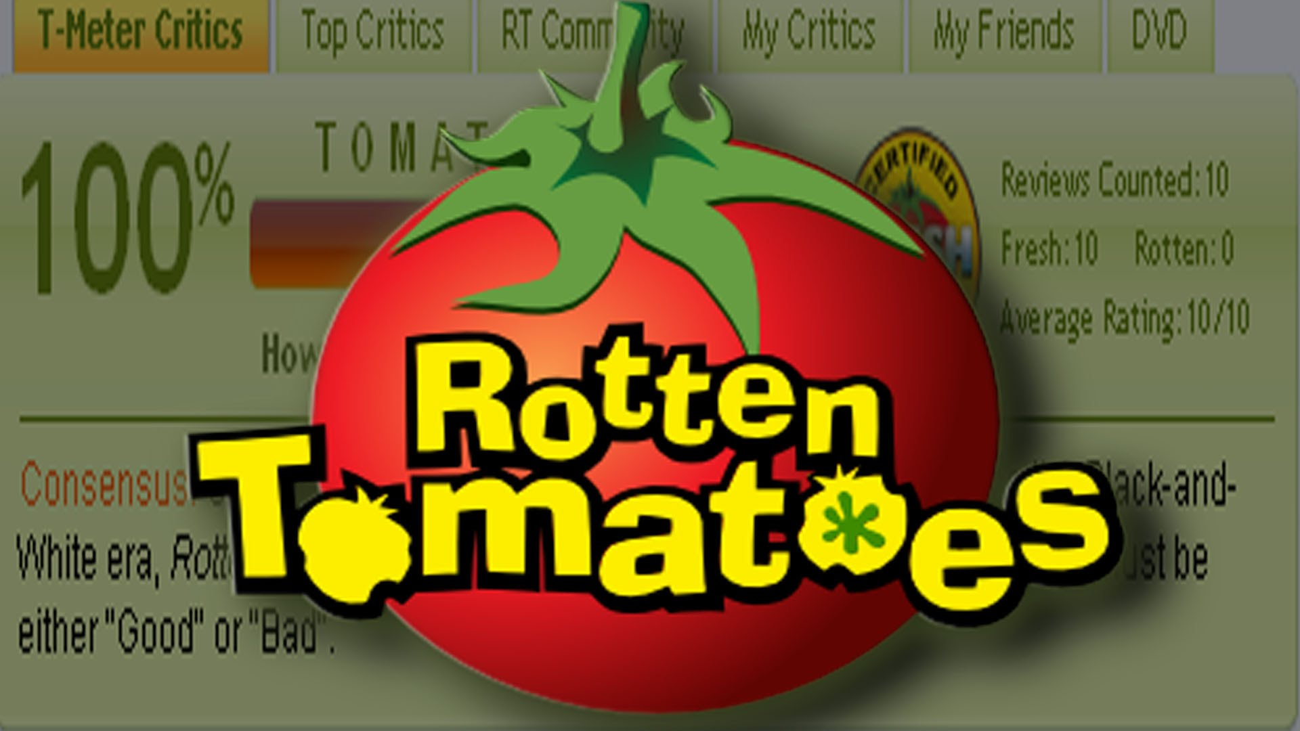
Movie Review Analysis

Slide 2
Objectives of the project
As an Analytics Consultant, help the production companies decide where to invest money. Do the reviews relate to a movie’s box office collection? If yes, is it the audience or the critic reviews that matter more?
What was the most talked about aspect of the movie and how did it impact the producers monetarily?
Notes:
What is most liked in a movie to create a movie’s brand name? Does the audience or critic have a liking for a certain kind of movie?
Slide 2:
Define the objective of the project, we are focusing on a few set of movies randomly handpicked by a bunch of people. This included movies of various genres and movies that had varied combination of success rates with reviews and the box office collections. So we intend to find the impact of each of those reviews on the box office collection if any. Mention rotten tomatoes, 42 movies,
We are analytics team of some production company and we want to see which movies have highest box office collections.
-Rajat

Slide 3
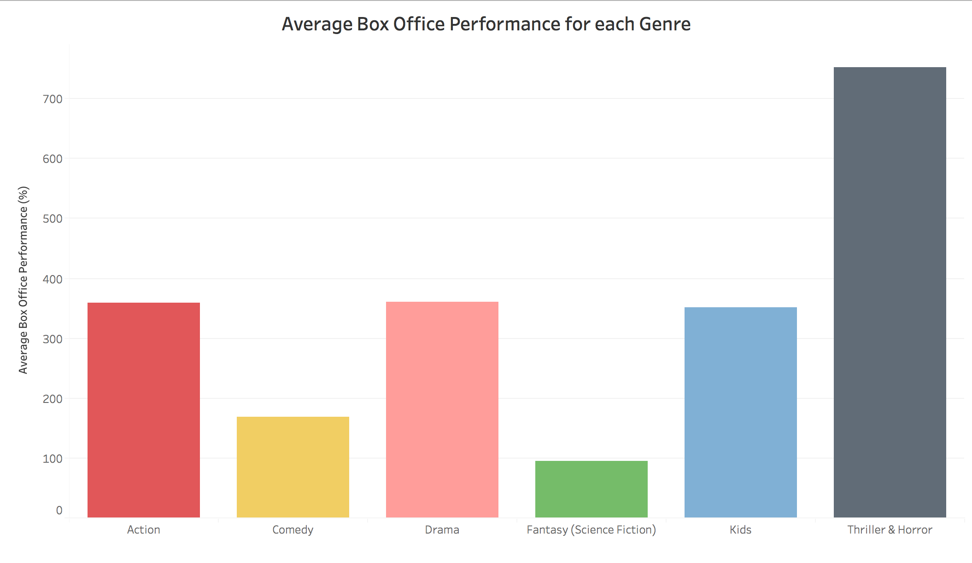
Exploratory Analysis
Notes:
Slide 3:
Reiterate disclaimer
Limitations: genre (reclassify); few comedy/kids; few G/PG
Box office performance (difference between collections & budget) - percentage (scaling for comparison)
Thriller/Horror (good), fantasy (poor)
-Arjun

Slide 4
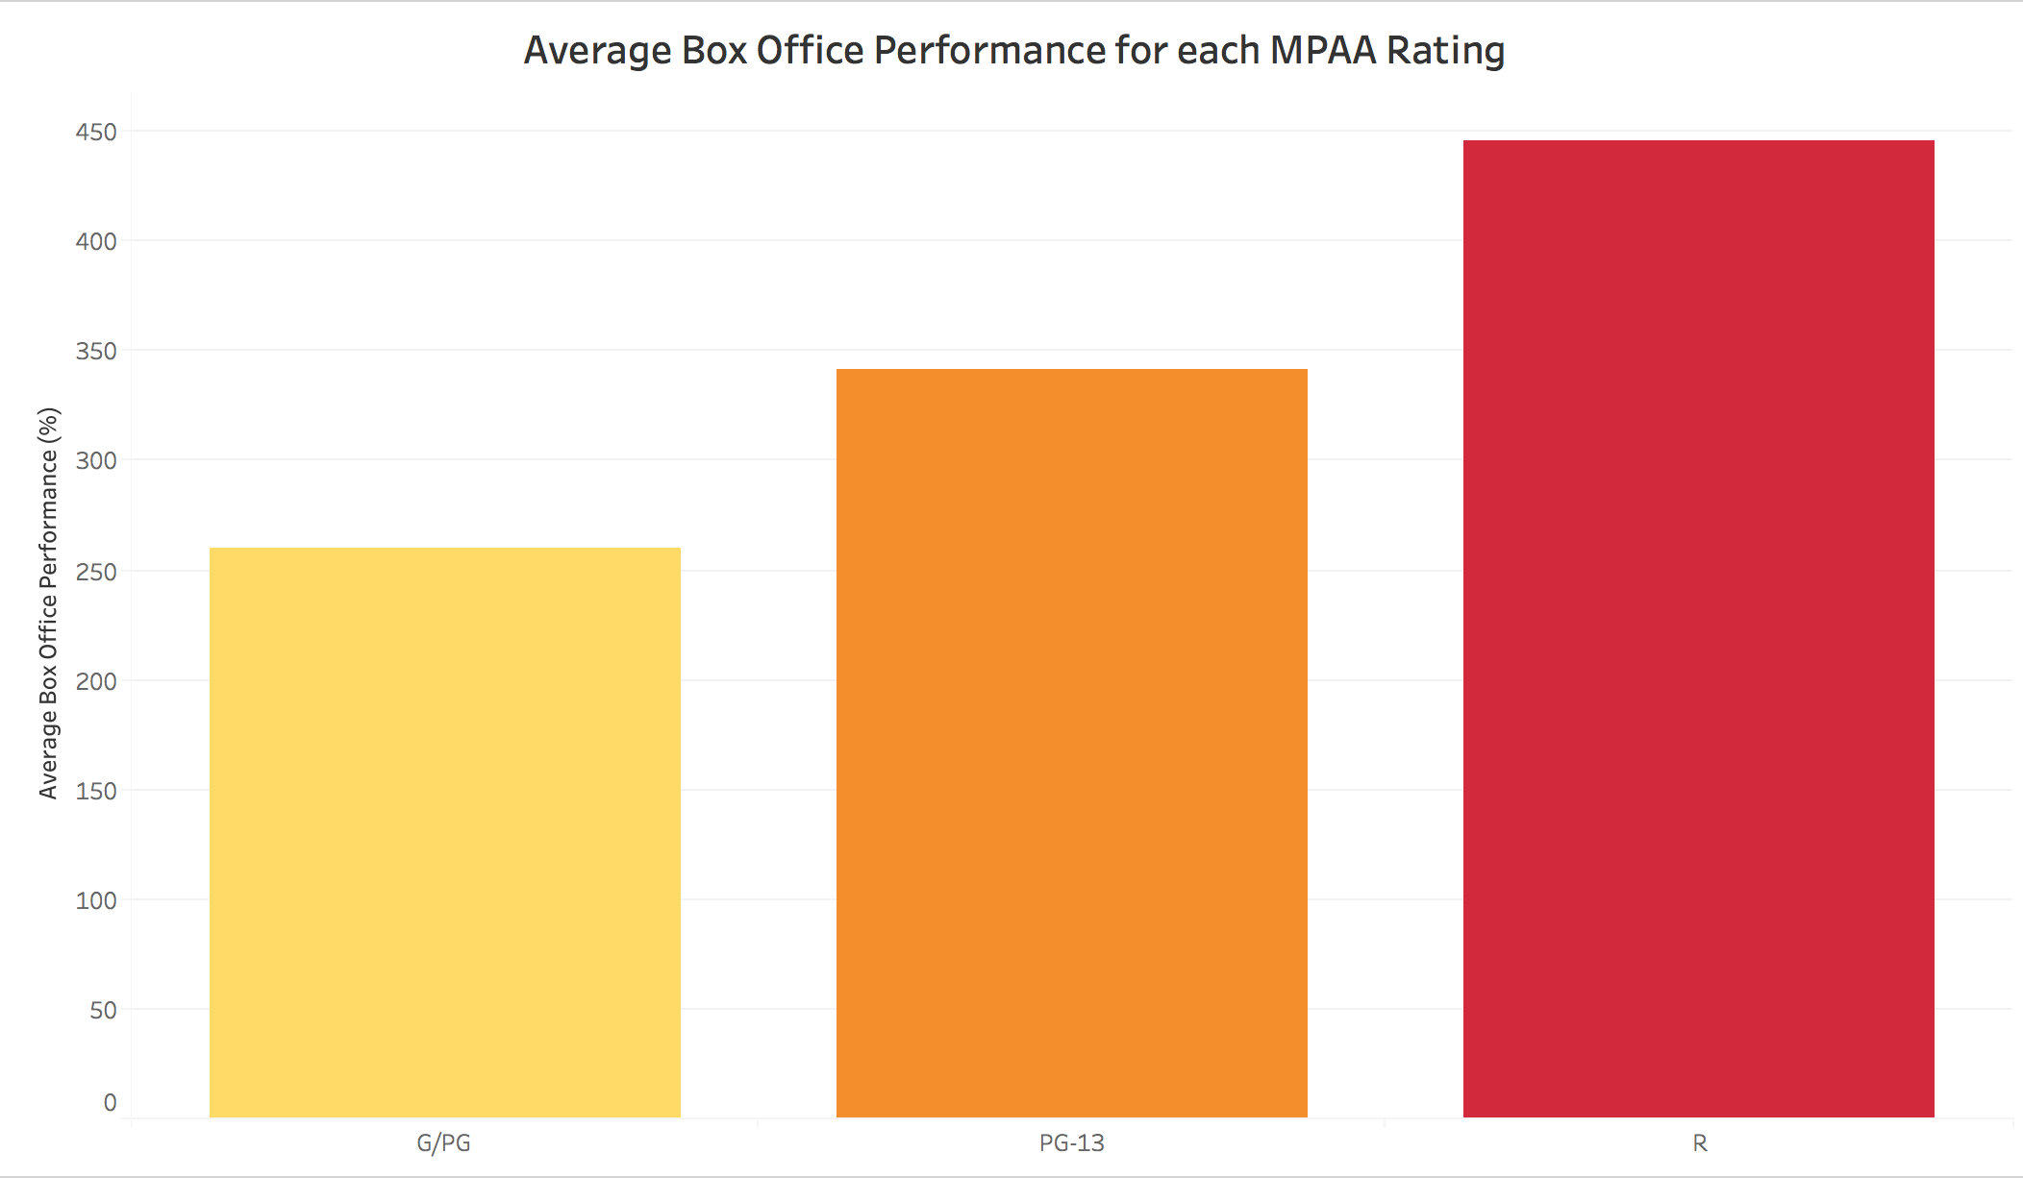
Exploratory Analysis
Notes:
Slide 4:
How do audience and critics score vary across R and PG rated movies?
Then we used the scraped data on the MPAA rating of the movie to understand the box office collection of these movies. Quite unexpectedly, The R rated and PG 13 movies seemed to have done better of for the production companies than the movies that were focused on a wider stream of audience.

Slide 5
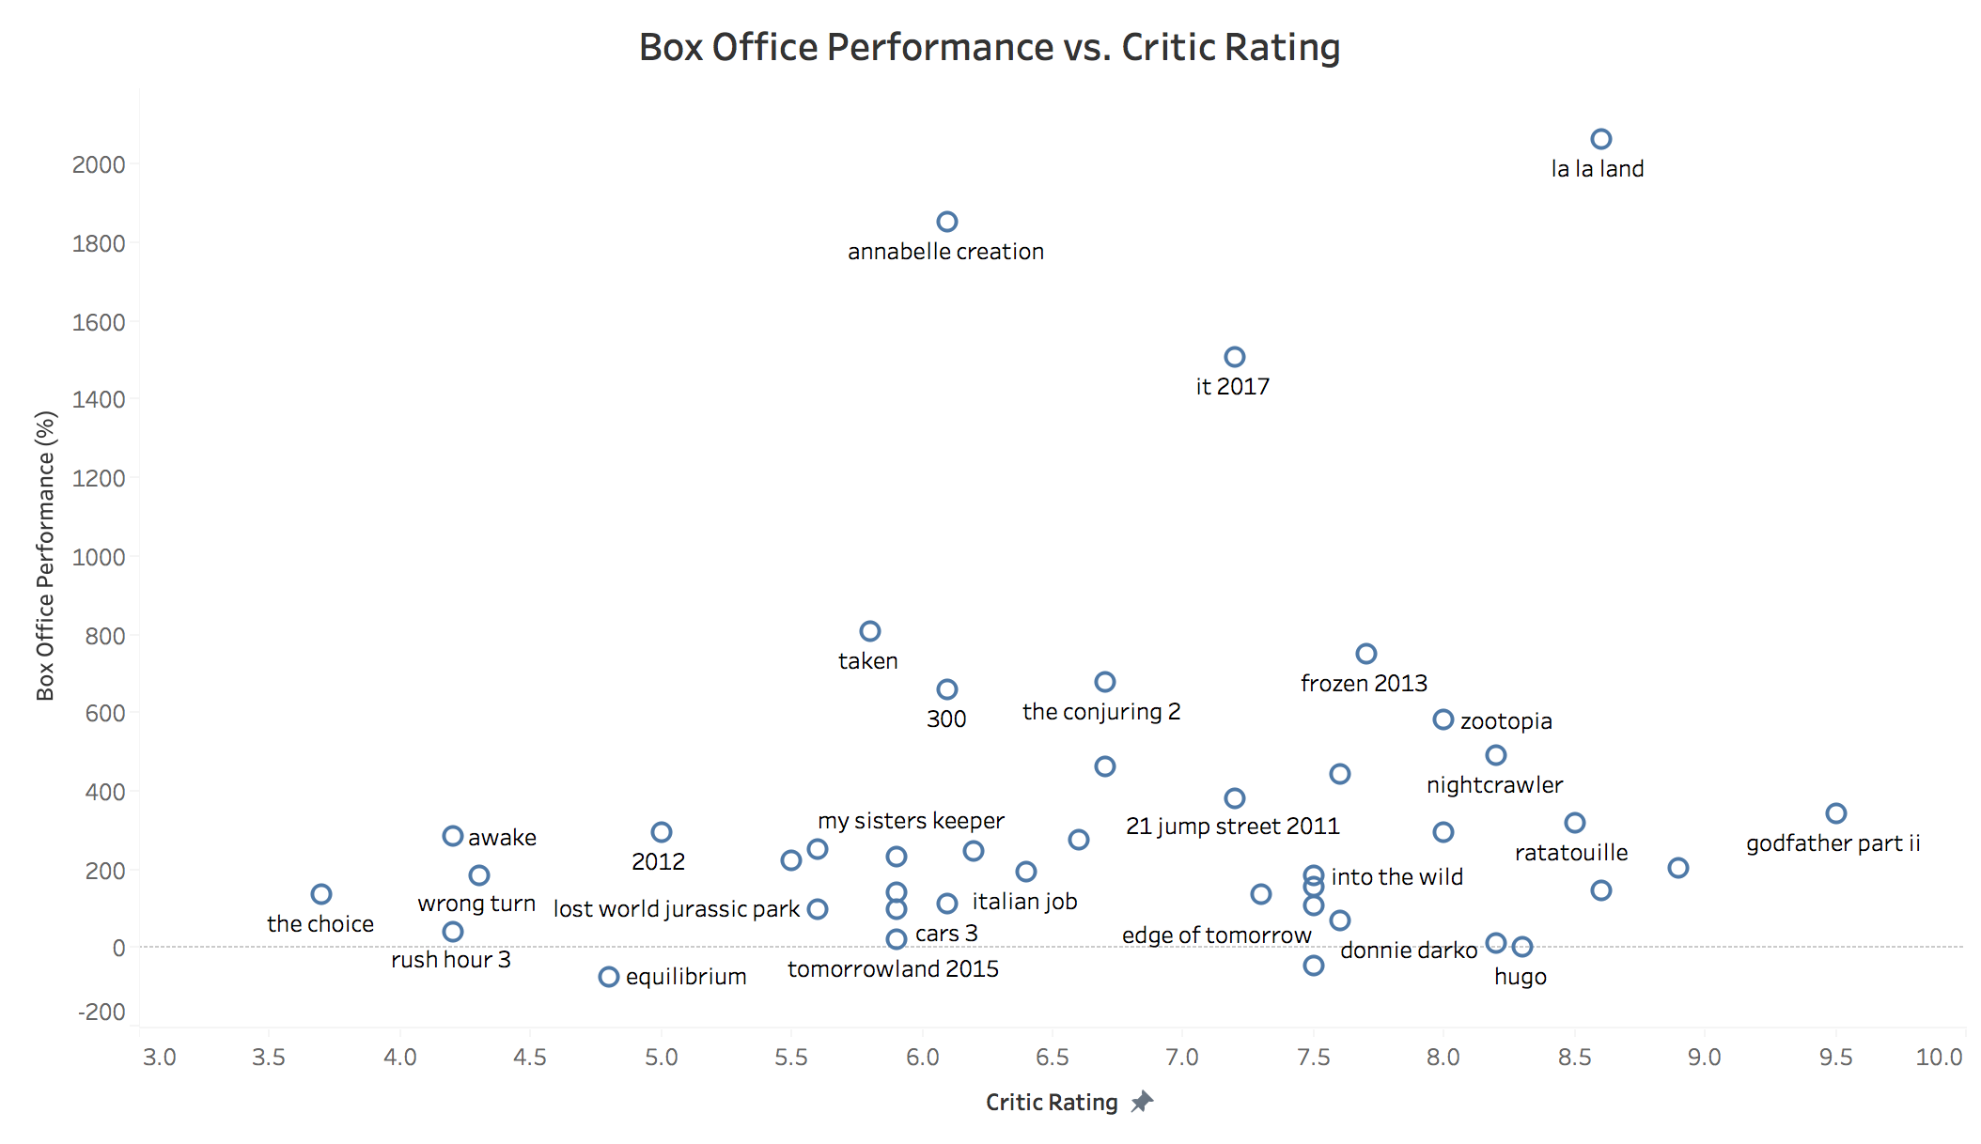
Exploratory Analysis
Notes:
Slide 4:

Slide 6
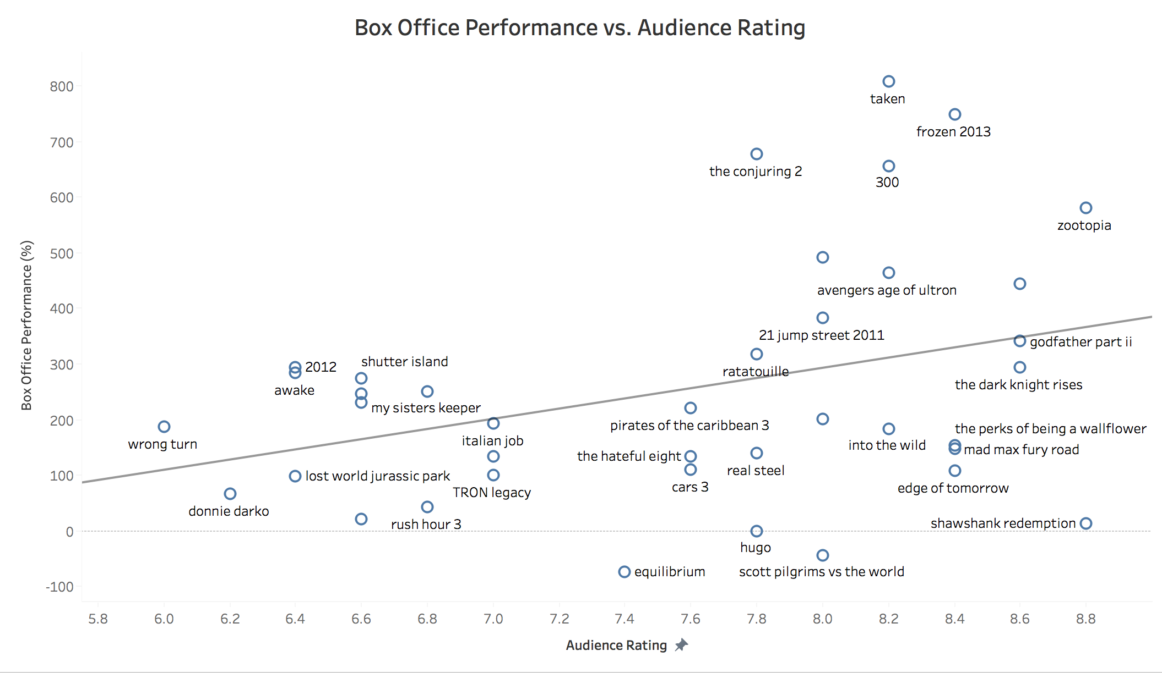
Exploratory Analysis
Notes:
Slide 4:
How do audience and critics score vary across R and PG rated movies?
Then we used the scraped data on the MPAA rating of the movie to understand the box office collection of these movies. Quite unexpectedly, The R rated and PG 13 movies seemed to have done better of for the production companies than the movies that were focused on a wider stream of audience.

Slide 7
Data Cleaning:
After scraping data from Rotten Tomatoes for audience and critic reviews:
Removed stopwords and lemmatized the word corpus
Movie names like “Mad Max” and “It’s a Wonderful Life” were skewing sentiment analysis
- movie names were replaced by word ‘movie’
- For word cloud, movie names were most frequently occurring words
- movie names were removed from analysis

Slide 8
Do the Critics and Audience hold similar sentiments towards a movie?
Notes:
Slide 8&9:
Talks briefly about the sentiment analysis we did and then bring out the most important finding. That the critic having a positive sentiment can mean, critic having a positive sentiment but the vice versa is not possible.

Slide 9
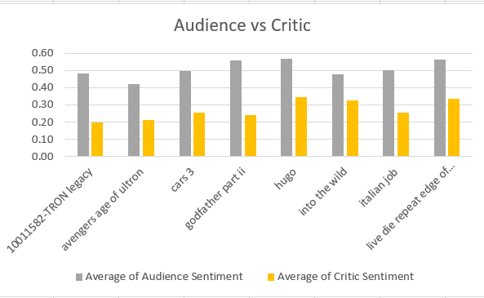
Audience tend to be more accepting than the critics

Slide 10
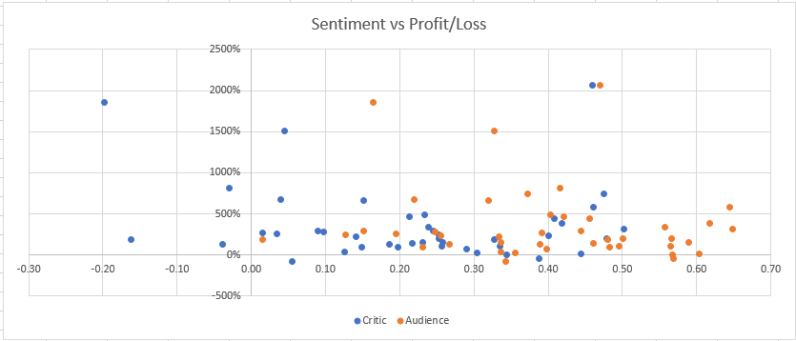
Audience sentiments tend to have a better relation with percentage profit/loss

Slide 11
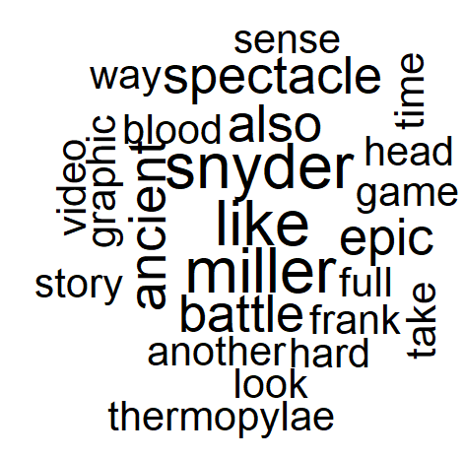
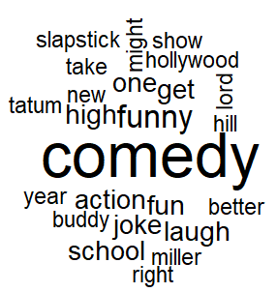
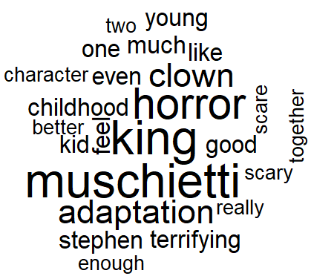
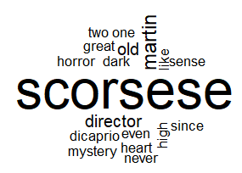
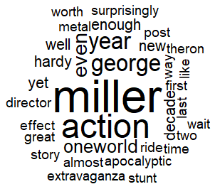
What should the producers market?
300
21 Jump Street
IT
Shutter Island
Mad Max: Fury Road
Notes:
Slide 13&14:
Word clouds made on the successful movies in the box office, five from each of the PG 13 and R rating movies. And what aspect of it got the actual attention of the audience towards the movies and got them to be successful. **Talk a bit about each of the movie**
What are the words that are most associated with a movie.
Using the critic reviews to help producers decide

Slide 12
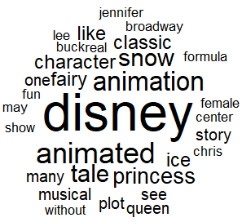
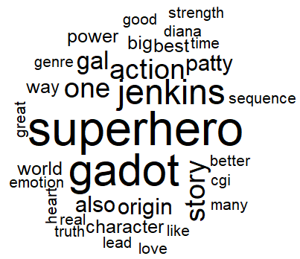
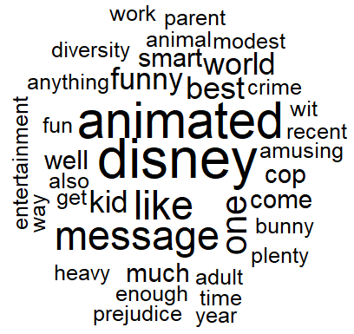
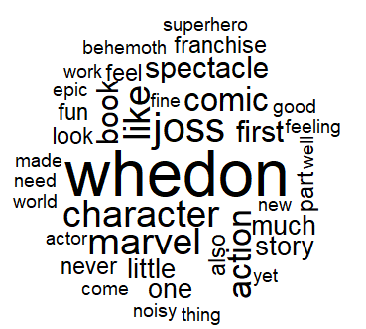
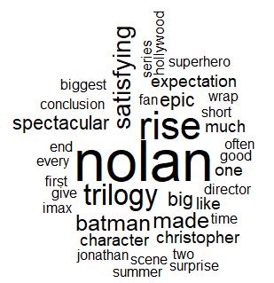
Frozen
Wonder Woman
Zootopia
Avengers: Age of Ultron
The Dark Knight Rises

Slide 13
Learnings from the analysis
- Audience rating are a major driver of box office collections
- R rated movies have higher profits
- Audience sentiments about a movie directly influence box office collection
- Audience reviews usually are much higher than critic reviews
- For R rated movies, director, writers could be a major driver for movie’s success
- For G/PG rated movies, production company, the message movie holds are the most often talked about topics
Notes:
The most talked about topics for each MPAA rating of movie which could be used for marketing the company

