Slide 1
Open University Learning Analysis

Slide 2
Open University wants to understand student performance and module engagement to provide better learning experience
Current State
Gap
Future State
Open University Learning contains data about student demographics their courses, interactions and final result
They want to identify key business and student performance metrics
There is no insight into student and business performance
Open University has identified metrics to understand student performance and minimize the associated risk
It has also identified key factors which can help assess business performance
This will be decided after exploratory data analysis
Key Question

Slide 3
Student course data is used to perform a holistic analysis to understand business better
Problem Statement
Open University wants to analyze its data to understand metrics important to measure student and business performance
Data
Student demographic information, assessment details, student scores, engagement, course details about 30k students across 43 attributes
Analysis
Univariate and bivariate analysis to understand relation between variables
Feature selection and model building to predict student’s final result based on attributes obtained from data exploration
Findings
Features like scores, sum of clicks, student demographics are important variables for student classification
To understand module health, increasing withdrawal rate and falling scores and engagement is a good indicator
Modules perform better during J session as compared to B session
Recommendations
Module BBB, GGG could be scraped due to low engagement and material of subpar quality
Student who are being classified as failing or withdrawing the course should be paid extra attention from instructors
Improvements
Classification models like AdaBoost, XGBoost, SVM can be employed to see if recall for Withdrawal, Failure further improves
A more comprehensive analysis on student engagement on the basis of activity can be done to understand more clearly

Slide 4
A methodical data analysis can help glean insights to help Open University understand its business performance
Data Cleaning
Data exploration
Problem formulation
Check for data discrepancies, missing values, data types
Analyze relations through bivariate and univariate analysis
Select business problem with potential for biggest impact
Model building
Feature Selection
Data imputation
Train appropriate models on the dataset and select best model according to evaluation criteria
Select most relevant features to solve business problem
Impute missing values according to insights obtained from data exploration
Business recommendations
Combine insights generated through data exploration, feature selection, model building and provide recommendations to business

Slide 5
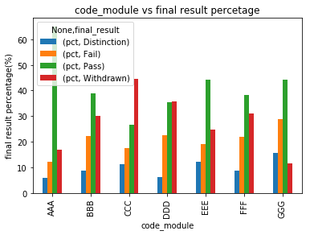
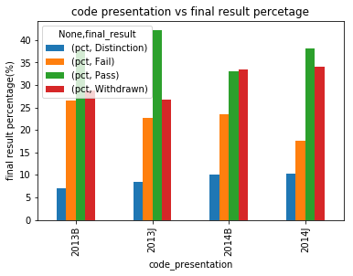
Student’s performance varies across courses and presentations due to module quality and student engagement
Student result percent for different course modules
Student result percent for different course presentations
Module CCC -> high withdrawal rate of 45%; pass percentage being about 28%
Module AAA -> high pass percentage of over 60%
Failure percentage remains to be almost same across modules lying between 20-30%
Pass percentage shows fluctuating trend
Maximum being 40% during session J
Falling to 30-35% during session B
Low quality of modules offered, inefficient instructors during session B

Slide 6
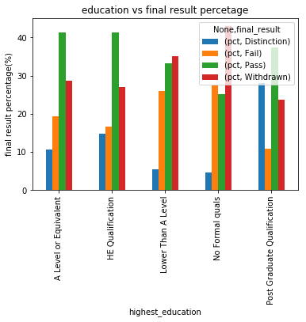
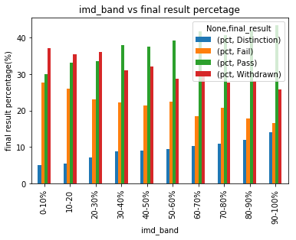
Student’s module and presentation performance is different for different demographic segments
Student result percent for different education background
Student result percent for different IMD bands
Student with no formal qualification or qualification lower than A level -> highest withdrawal rate of 45%
Higher education level -> Higher pass percent
Post graduate students lowest failure rates
Lower imd_band -> high withdrawal rate of 38%
Higher imd_band -> withdrawal rate of 28%
Pass percent increases gradually with increasing imd_band
** IMD: Index of Multiple Deprivation
Notes:
For student information, final percentage did not vary much across gender
Also, region did not have a discriminatory effect except student from Ireland having highest pass percentage
For age band, older students had higher pass percentage and lower failure and withdrawal rates
Students with disability have higher withdrawal rates and lower pass percent

Slide 7
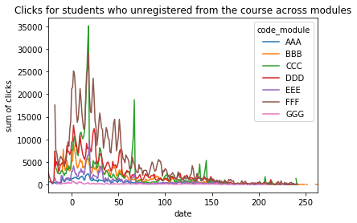
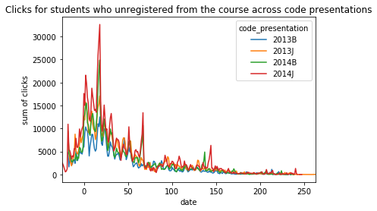
Student engagement varies over time for students who withdrew from course and students who completed the course across modules and presentations
Student engagement for students who withdrew from course across modules
Student engagement for students who withdrew from course across presentations
Modules CCC, EEE -> highest click activity initially but big dips afterwards
CCC -> highest withdrawal rate
Clicks fall after 50 days from start of module
For students who completed -> no gradual dip, fluctuating trend, interaction till end of module
Presentation 2013J and 2014J -> maximum clicks
Session J -> lower withdrawal
Difference in module offerings, quality or demographics

Slide 8
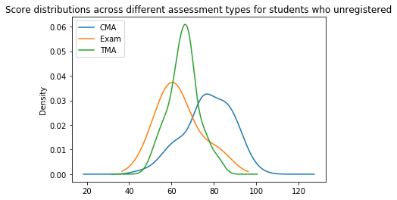
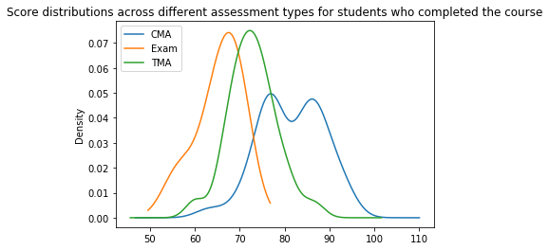
Score distributions across assessment types helps understand student performance for different customer segments
Score distribution of students who withdrew from the course
Score distribution of students who completed the course
Students scored maximum in CMA followed by TMA and Exams
For CMA, distribution function was spread over a wide range of values from 40-100
TMA most values were centered around 60
Marks centered around 65 and 70 for Exams and TMA respectively
CMA has a widespread distribution with values from 60 to 100
CMA has 2 distinct peaks for students who scored around 75 and students who scored 90

Slide 9
Student demographic information analysis, module engagement and scores can help assess student performance and has potential to create huge impact for business
Current State
Gap
Future State
Open University Learning contains data about student demographics their courses, interactions and final result
They want to identify key business and student performance metrics
There is no insight into student and business performance
Open University has identified metrics to understand student performance and minimize the associated risk
It has also identified key factors which can help assess business performance
What are the key student demographics and performance that increases probability of student failure or withdrawal?
What are module related metrics that might affect student performance?
Key Question

Slide 10
Data exploration insights can be used to impute variables and select relevant features for further processing
Data imputation
Values for score imputed by mean score of each student
Imdb_band missing values has higher pass percentage, imputed by average of higher imd_band, 60-70%
Values like sum_clicks, date imputed by mode of column
Data preparation
StudentInfo, assessment, courses and click activity datasets combined to create master dataset
Master dataset has final results according to scores of student for different demographics and assessment types
Value counts for final result for students revealed class imbalance with 61% of dataset having students with pass result

Slide 11
Open University can incorporate variables learnt from data exploration to build solution to minimize student failure or withdrawal
Why classification?
Classification model can help instructors understand variables which affect student performance and probability of student failing or withdrawing from the course
This can lead to them paying extra attention to students at risk through more interaction, exercises
Feature selection → Model fitting → Model evaluation → Model selection
Feature Selection
iterative process
Tree based methods employed for selecting relevant features
Work well with class imbalance
Combined with features obtained from EDA
Selected features like score, sum of clicks, date submitted, module length and relevant demographics

Slide 12
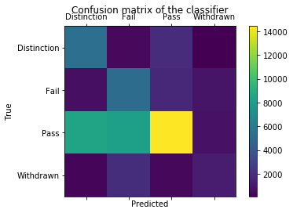
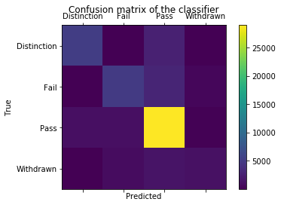


Classification methods with high recall are good classifiers for predicting failure and withdrawal rate
Confusion matrix for Logistic Regression on downsampled data
Confusion Matrix for Random Forest run on original data
Data downsampling was done due to huge class imbalance in dataset
Logistic Regression was fit on training data size = 0.7
Class Fail getting accurately recognized in most cases
Class Withdrawn is getting predicted as withdrawn or fail in most cases
Random Forest takes care of class imbalance
Classifier was fit on original training data using gini as split criteria
Class Fail getting accurately recognized in most cases but had a lower recall than Logistic Regression
Class Withdrawn getting predicted as Pass in most cases which is a huge concern although recall is higher
Logistic Regression on downsampled data is a better classifier
Precision = tp/(tp+fp) Recall = tp/(tp+fn)

Slide 13
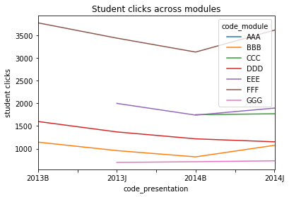
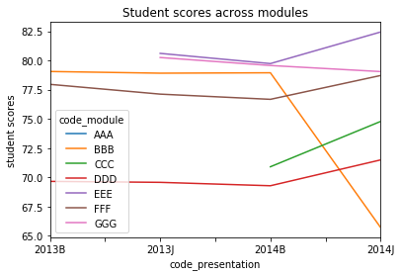
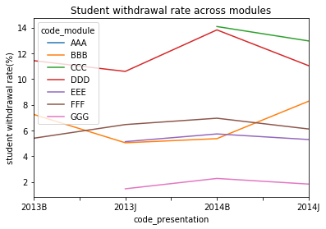
Student failures and withdrawals can also be a result of low quality modules
Student engagement over time across modules
Student scores over time across modules
Student withdrawal rate over time across modules
Student engagement is higher during 'J' code presentation
CCC module which was offered in 2014 has higher student engagement
Modules like DDD have consistently falling student clicks
Mean student score has taken a huge hit for BBB module in 2014J whereas scores for all other modules have increased.
Although DDD has lower student engagement, mean scores are not affected.
As student scores have dipped significantly for module BBB, withdrawal rate has increased for the same
DDD is exhibiting a fluctuating trend in terms of withdrawal rate
Notes:
Module BBB is performing worst among all modules with among the lowest engagement, decreasing scores and increasing withdrawal rate.
Module CCC although having among highest withdrawal rate is improving steadily in terms of engagement, scores and withdrawals
Module GGG performs quite differently as it has lowest withdrawal rate and highest scores with lowest student engagement. This could be attributed to the fact that GGG has less engaging material of subpar quality

Slide 14
Student failures and withdrawals have a multifarious perspective and minimizing these is value adding for both instructors and stakeholders
Student scores
Student demographics
Student engagement
Withdrawal rate
Student scores
Student engagement
Module length
Number of previous attempts
Module performance across presentations
Instructor
Stakeholder
Know probability of a student failing or withdrawing based on the demographics and scores in a particular assignment
The classification model is proactive in nature and can help pull down the withdrawal and failure rate
With the student identified, instructors can provide extra help
Know module performance over time
Can help eliminate low performing, low quality modules
Can help redesign better modules and launch them during specific sessions when they have higher engagement

Slide 15
The impact of this analysis can be measured by implementing recommendations generated from the insights through appropriate testing
Classification model to measure student performance:
Impact of employing classification model can be measured by falling failure and withdrawal rates
A random subset of students can be classified on the basis of results obtained from classification model
Their end of module performance when compared with students who were not classified can be compared to measure success of this analysis
Analysis to measure health of a module:
Analyzing student scores, engagement and withdrawal rate for a module over time can help identify less-engaging/low quality modules
The business impact of scraping certain courses could be measured by overall rising ROI (Return on Investment)
Also, the overall student withdrawal and failure rates could be measured

