Slide 1
Hack-o-Hire Barclays
Theme: Email Classification
Team Name: Sentinels
Team Members: Charvi Jain Shaurya Singh Srinet Harsh Wadhwa Akshat Singh

Slide 2
Proposed Solution
Our proposed solution leverages TF-IDF (Term Frequency-Inverse Document Frequency), a statistic that quantifies the importance of a word in the context of a document, alongside Multinomial Naive Bayes, a classifier particularly suited for discrete data and widely applied in Natural Language Processing (NLP) tasks.
In addition to TF-IDF and Multinomial Naive Bayes, we will also consider the inclusion of additional features such as email metadata (e.g., sender information, subject length, time sent) and sentiment analysis scores. By incorporating these features into our classification model, we can capture more nuanced information from the emails, leading to improved accuracy in classification and more effective routing of emails to the appropriate teams for further processing. This holistic approach ensures comprehensive analysis of email content and context, enhancing the overall performance of our email classification system.

Slide 3
Tech Stack
Product scalability and interpretability
Deployed as a web extension, our solution ensures cross-platform compatibility, enabling seamless interpretation across different devices and operating systems.
Users can access the email classification and routing system from various platforms, including desktops, laptops and tablets, ensuring consistent functionality and accessibility regardless of the device used.
This approach maximizes usability and convenience, allowing users to efficiently manage customer inquiries and support processes across diverse platforms with ease.
Our tech stack includes
Python for NLP,
Machine learning for Classification,
Node.js for server-side development,
AWS infrastructure for reliability and scalability.
This cohesive approach ensures a robust email classification and routing system, enhancing operational efficiency.

Slide 4
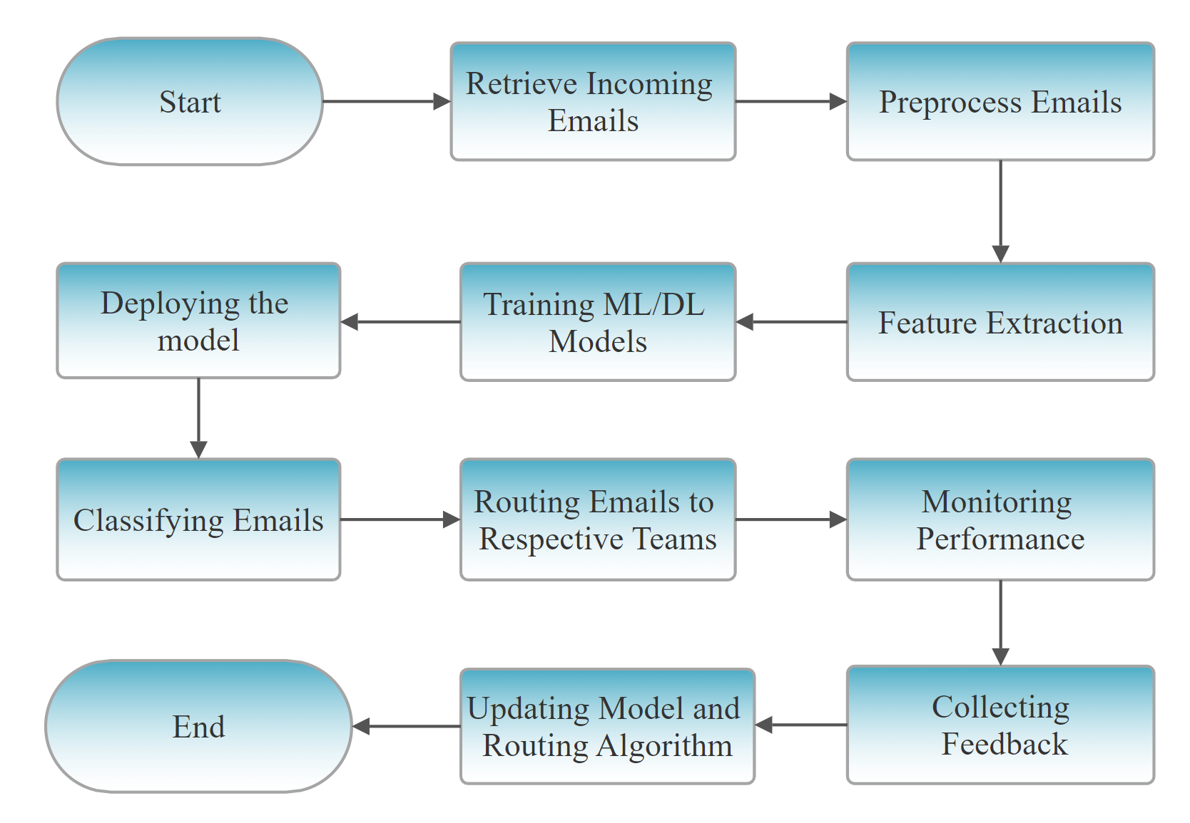
Our end-to-end solution approach

