Slide 1
Final Project Expo
Multi-Objective PPO-Based NOMA Scheduling
Results & Evaluation

Slide 2
RL Formulation & Training
Algorithm: Stable-Baselines3 PPO
State: Channel Gains + Battery Levels
Reward = (1.0)T - (2.5)E - (1.0)SIC + (0.5)Fairness

Slide 3
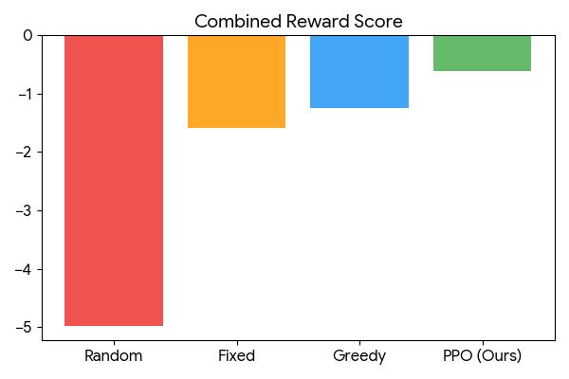
Final Results: PPO vs Baselines

