Slide 1
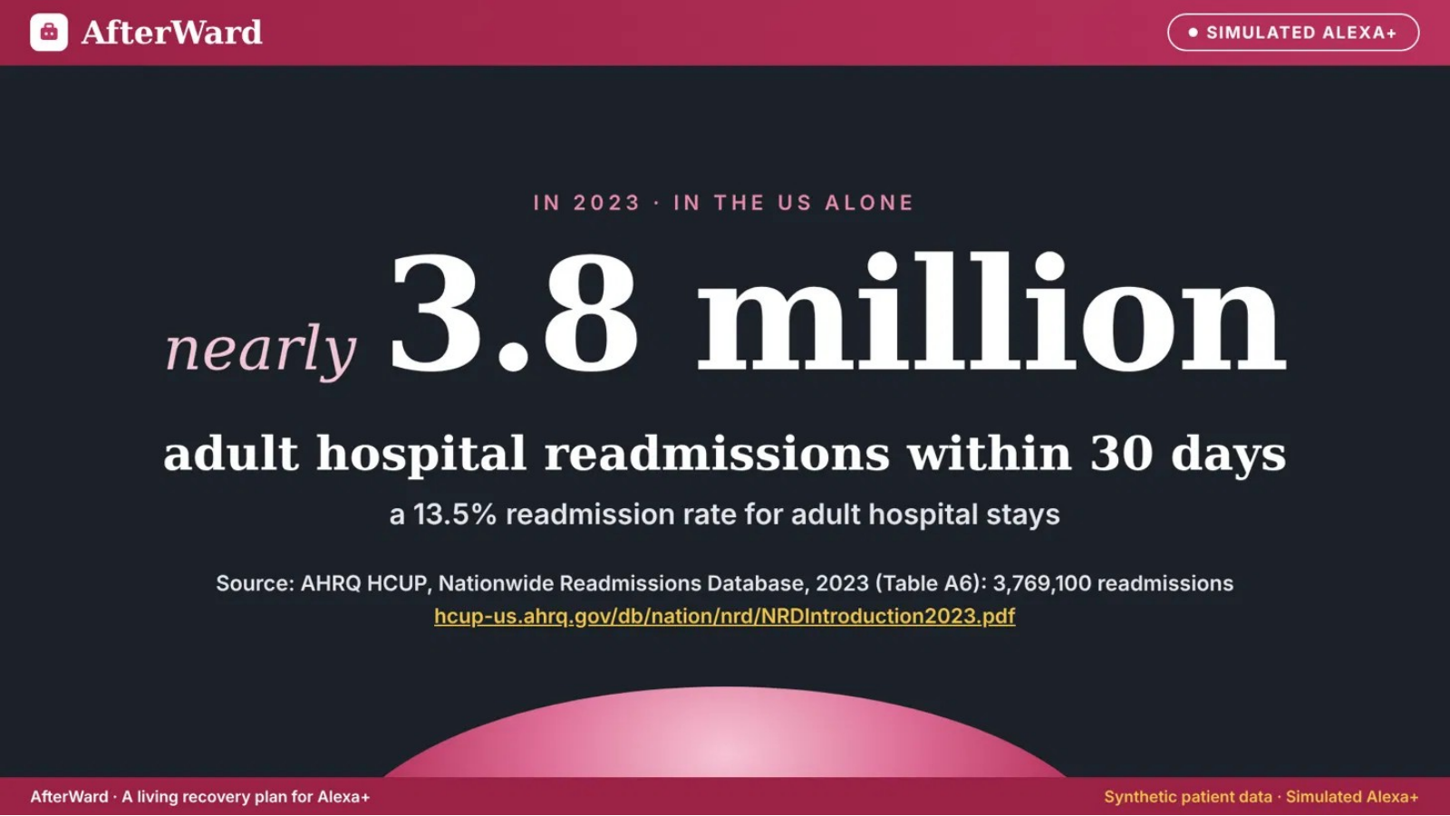
Notes:
AfterWard demo slide 1. Consistent AfterWard brand header and footer. Original content retained.

Slide 2
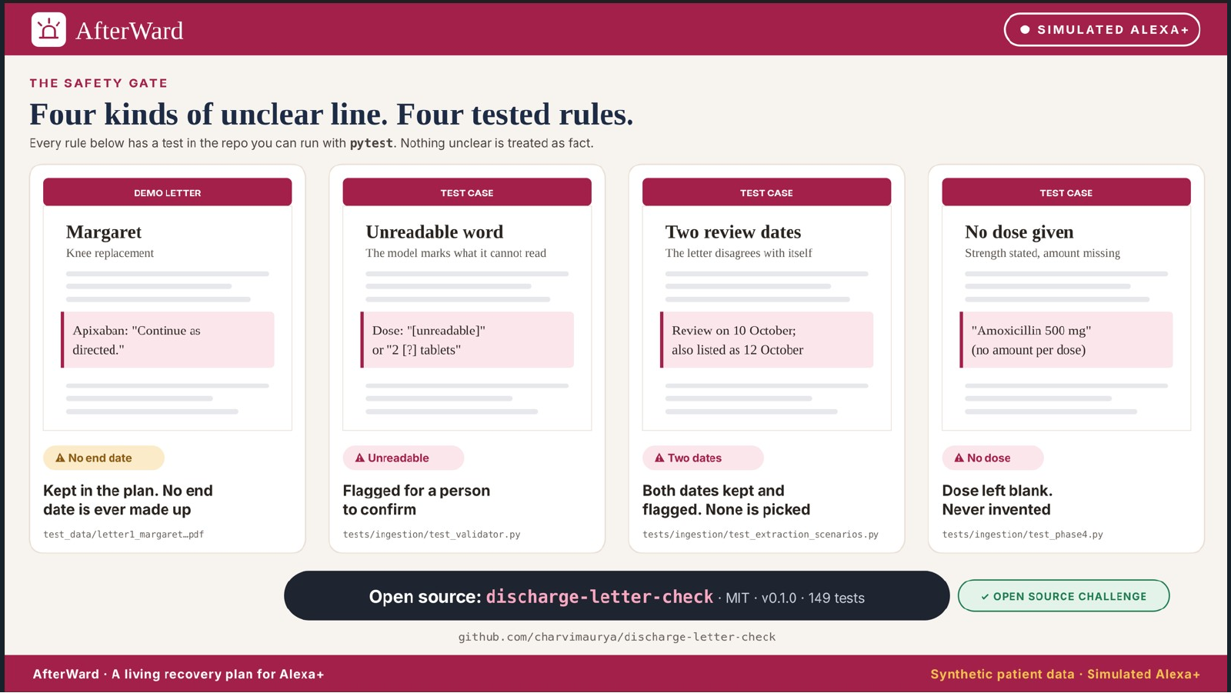
Notes:
AfterWard demo slide 2. Consistent AfterWard brand header and footer. Original content retained.

Slide 3
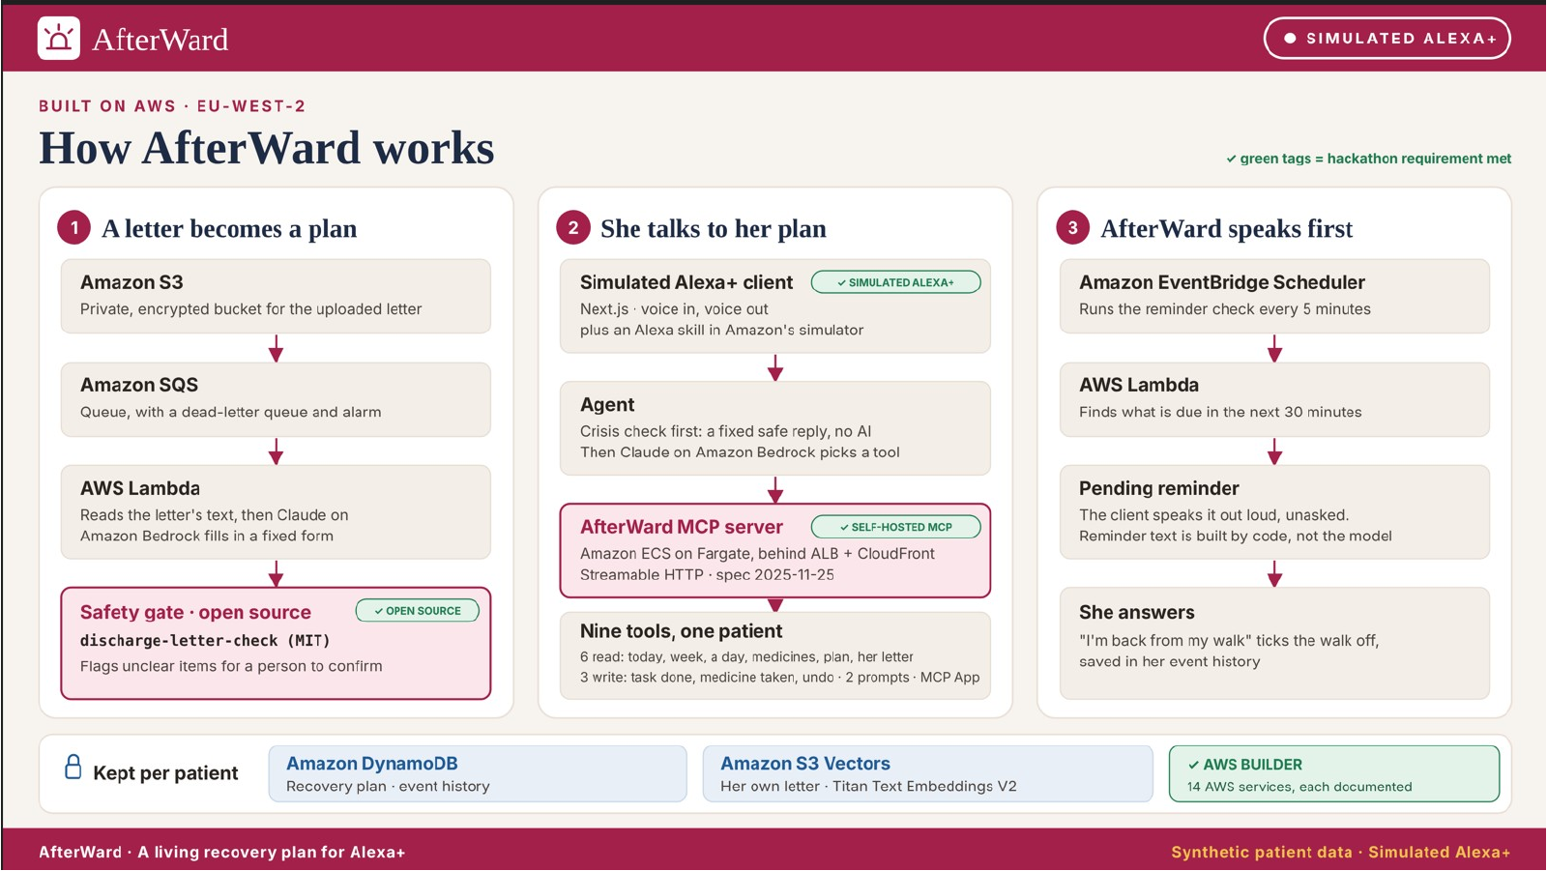
Notes:
AfterWard demo slide 3. Consistent AfterWard brand header and footer. Original content retained.

Slide 4
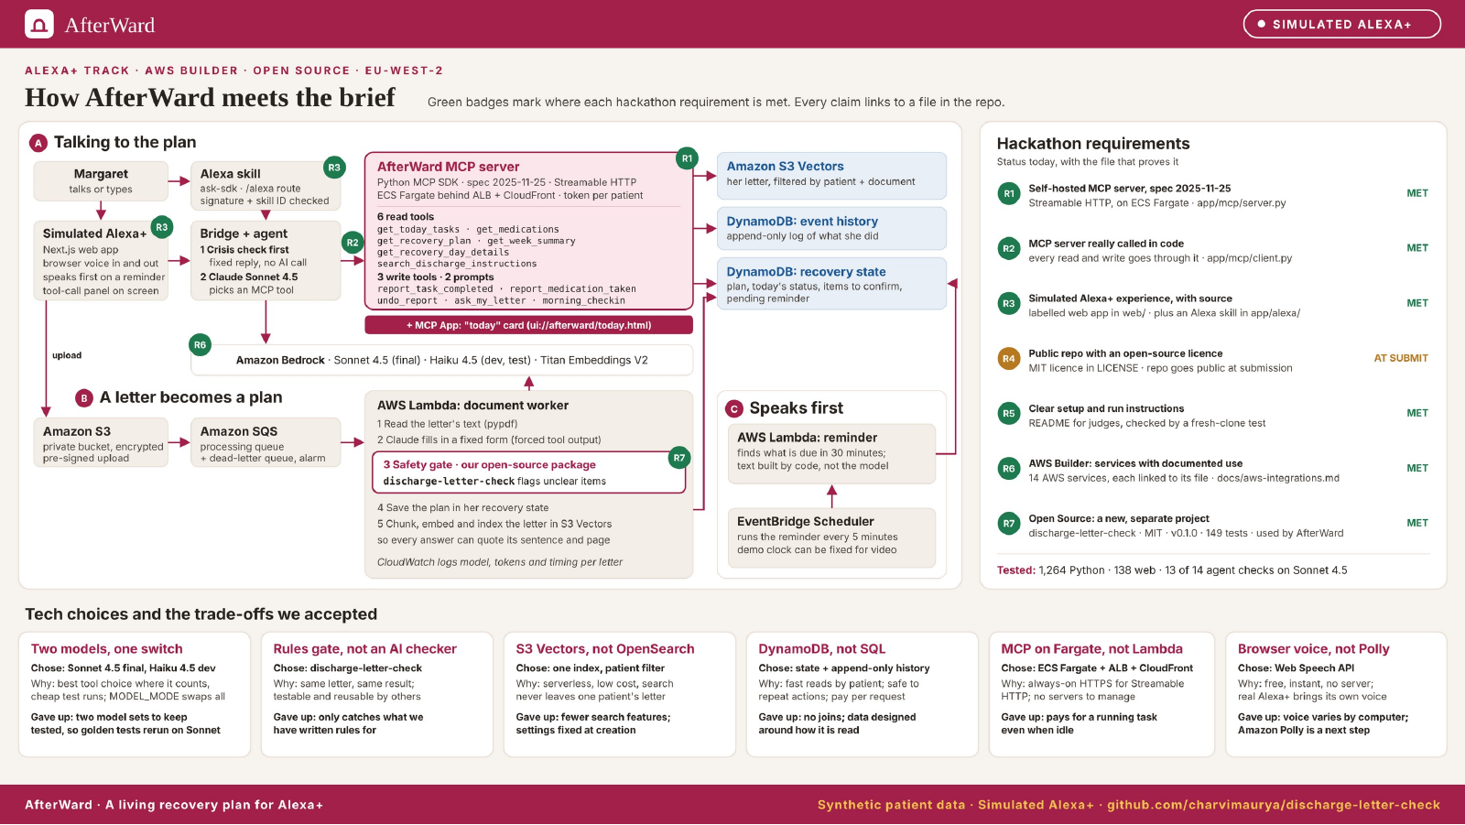
Notes:
AfterWard demo slide 4. Consistent AfterWard brand header and footer. Original content retained.

Slide 5
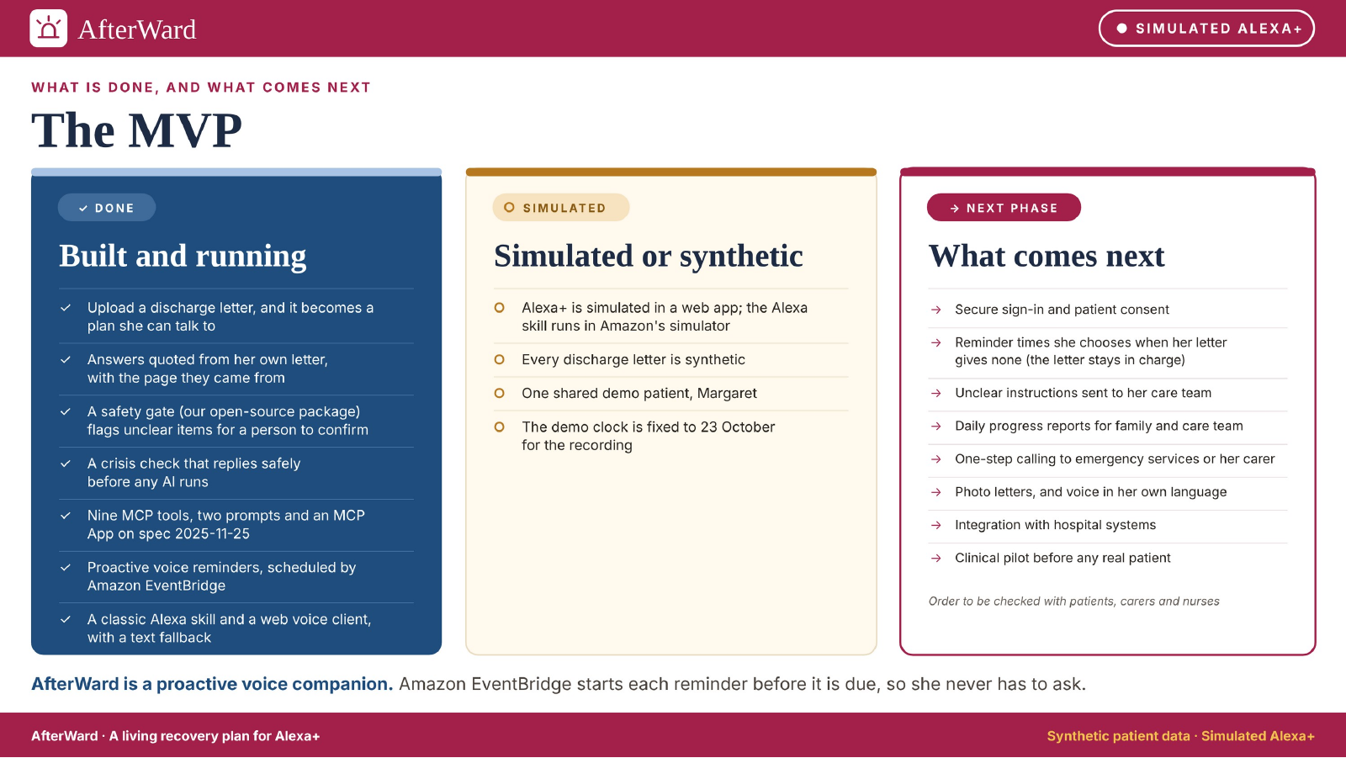
Notes:
AfterWard demo slide 5. Consistent AfterWard brand header and footer. Original content retained.

Slide 6
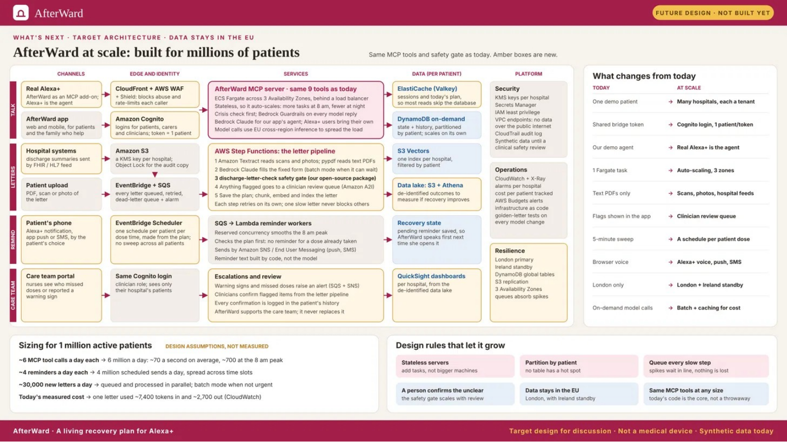
Not a chatbot wrapper. Nine MCP tools, two prompts and an MCP App connect the letter, recovery plan and voice experience.
Notes:
AfterWard demo slide 6. Consistent AfterWard brand header and footer. Original content retained.

Slide 7
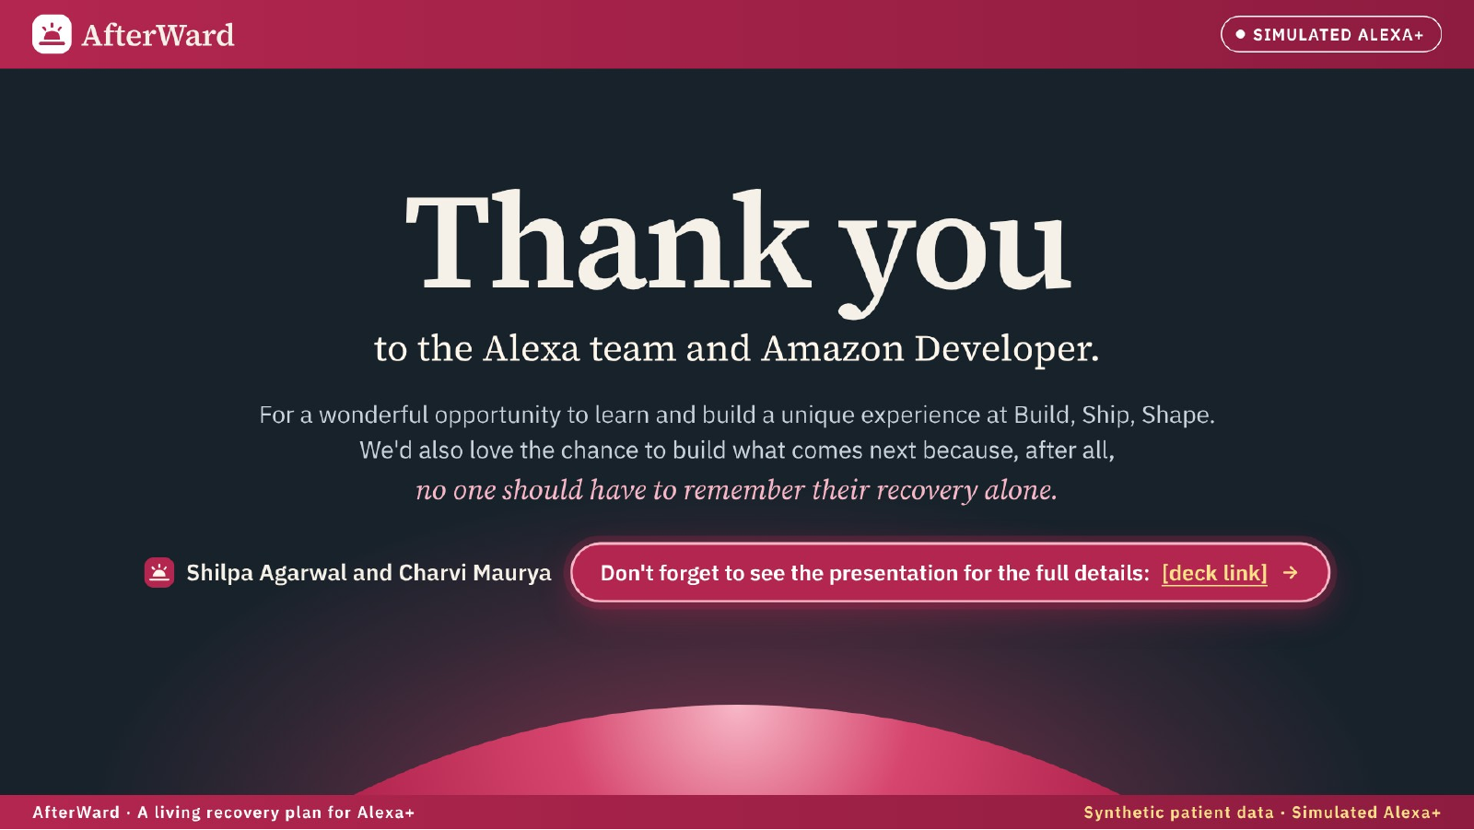
Notes:
AfterWard demo slide 7. Consistent AfterWard brand header and footer. Original content retained.

Slide 8
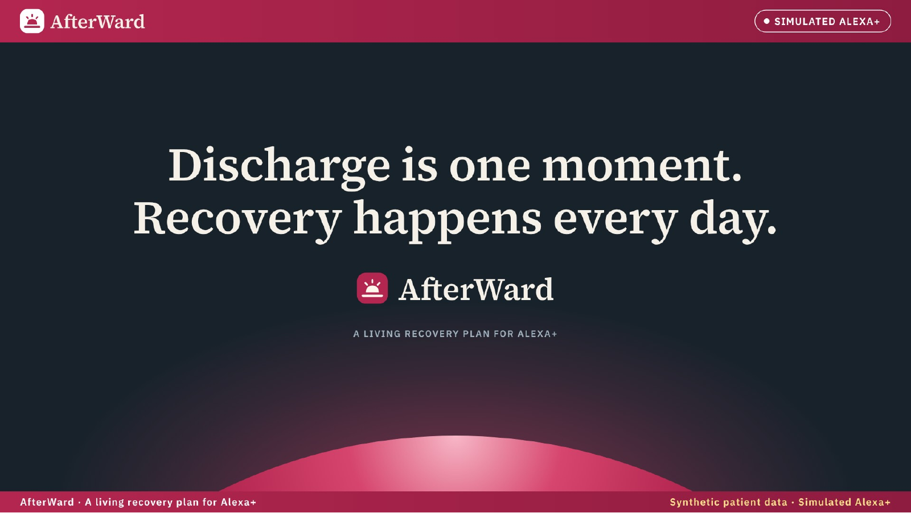
Notes:
AfterWard demo slide 8. Consistent AfterWard brand header and footer. Original content retained.

