Slide 1

AfterWard
AfterWard
AfterWard
● SIMULATED ALEXA+
● SIMULATED ALEXA+
BUILD, SHIP, SHAPE: AMAZON DEVELOPER HACKATHON
A Living Recovery Plan for Alexa+
Discharge is one moment. Recovery happens every day. AfterWard turns a discharge letter into a daily plan that updates as you recover.
Alexa+ track
AWS Builder
Open Source
Team: Shilpa Agarwal and Charvi Maurya
Synthetic data only. Simulated Alexa+ client.
AfterWard · A living recovery plan for Alexa+
Synthetic patient data · Simulated Alexa+
AfterWard · A living recovery plan for Alexa+
Synthetic patient data · Simulated Alexa+

Slide 2
Paper goes home. The care team stays behind.
AfterWard
AfterWard
● SIMULATED ALEXA+
● SIMULATED ALEXA+
THE NEED
A discharge letter holds every instruction, but it cannot support each moment of recovery at home.
Paper cannot remind her
Paper cannot remember
Paper cannot clarify
An unclear end date or two different dates need a person, not a confident guess.
The morning walk, the tablets after breakfast and the follow-up dates still depend on memory.
It never changes when Margaret finishes a walk or takes a dose.
AfterWard · A living recovery plan for Alexa+
Synthetic patient data · Simulated Alexa+
AfterWard · A living recovery plan for Alexa+
Synthetic patient data · Simulated Alexa+
Notes:
Margaret, 68, is one week home after a knee replacement. Everything she needs is written down, but paper cannot remind, remember or clarify. The next slide shows the size of the problem.

Slide 3
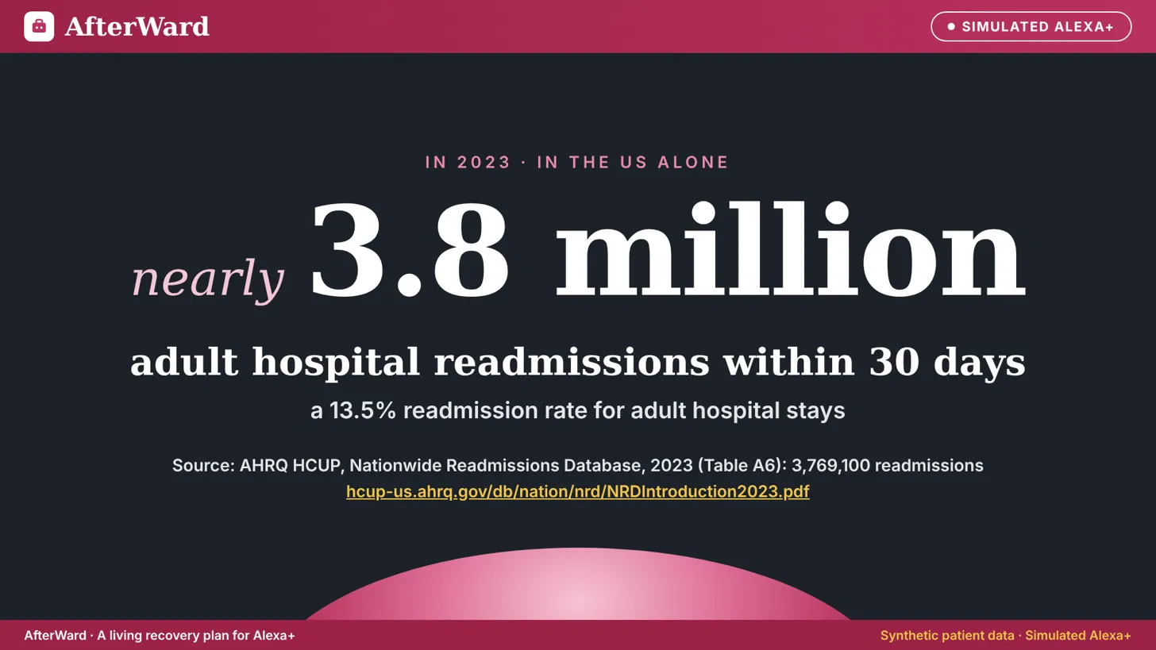
AfterWard
● SIMULATED ALEXA+
AfterWard · A living recovery plan for Alexa+
Synthetic patient data · Simulated Alexa+
Notes:
In the US alone, adults had nearly 3.8 million hospital readmissions within 30 days in 2023 (3,769,100, a 13.5% rate). We built AfterWard for what happens after the ward, at home. We do not claim AfterWard reduces readmissions; that needs a clinical pilot.

Slide 4
Value proposition
AfterWard
AfterWard
● SIMULATED ALEXA+
● SIMULATED ALEXA+
THE PRODUCT
Alexa+ can already set a reminder and answer questions about a document. AfterWard adds what recovery needs: a plan built from your letter, that knows what you have done.
Builds the plan for you
Knows what you did
Never guesses
Speaks and shows
Says when the letter is unclear, and points you to your care team.
Each day's medicines, exercises, walks and appointments, from your own letter.
“I'm back from my walk” ticks it off. One more to go today.
A reminder before each item. The rest is on screen, with its source.
AfterWard is not a doctor. It helps you follow the plan your care team already gave you.
AfterWard · A living recovery plan for Alexa+
Synthetic patient data · Simulated Alexa+
AfterWard · A living recovery plan for Alexa+
Synthetic patient data · Simulated Alexa+

Slide 5
What AfterWard adds to Alexa+
AfterWard
AfterWard
● SIMULATED ALEXA+
● SIMULATED ALEXA+
THE PRODUCT: WHY THIS IS A NEW EXPERIENCE
ALEXA+ TODAY
AFTERWARD ADDS
Sets a reminder when you ask for one.
A plan built for you. The letter becomes each day's medicines, exercises, walks and appointments. Nobody types anything in.
Answers questions about a document you share, and adds its dates to your calendar.
It knows what is done. “I'm back from my walk” ticks walk 1 of 2, and the plan changes.
General features, made for any document or task.
It never guesses. Fixed rules flag an unclear line, and AfterWard says “your letter does not say”.
It shows its source. The sentence from her own letter is on screen beside the answer.
Why now: every hospital writes its letter differently. A language model can read them all, and fixed rules make that safe to act on.
Alexa+ today: About Amazon, “What can Alexa+ do? Top features to try out”. AfterWard runs in a simulated Alexa+ client.
AfterWard · A living recovery plan for Alexa+
Synthetic patient data · Simulated Alexa+
AfterWard · A living recovery plan for Alexa+
Synthetic patient data · Simulated Alexa+

Slide 6
The solution
AfterWard
AfterWard
● SIMULATED ALEXA+
● SIMULATED ALEXA+
THE PRODUCT
STEP 1
STEP 2
STEP 3
A letter becomes a plan
You talk, the plan updates
AfterWard speaks first
Upload the discharge letter once. Claude on Amazon Bedrock reads it, and fixed rules check every line.
A schedule checks every 5 minutes and starts a reminder 30 minutes before an open item.
Say what you did or ask what is left. An MCP tool reads or updates the plan and saves it.
Nine tools on a self-hosted MCP server, spec 2025-11-25, over Streamable HTTP. Sand: read. Pink: write.
get_today_tasks
get_medications
get_recovery_plan
get_week_summary
get_recovery_day_details
search_discharge_instructions
report_task_completed
report_medication_taken
undo_report
AfterWard · A living recovery plan for Alexa+
Synthetic patient data · Simulated Alexa+
AfterWard · A living recovery plan for Alexa+
Synthetic patient data · Simulated Alexa+

Slide 7
One morning with Margaret
AfterWard
AfterWard
● SIMULATED ALEXA+
● SIMULATED ALEXA+
THE DEMO: WHAT MARGARET SAYS, WHAT RUNS, WHAT AFTERWARD SAYS
7:00 am. Nobody asked.
“Good morning, Margaret. I hope you slept well. You have about thirty minutes until your morning walk, at half past seven.”
EventBridge schedule
“Alexa, I'm back from my walk.”
“Well done, Margaret, that's your morning walk done. Next is 2 tablets of your paracetamol and 1 tablet of your blood thinner, after breakfast.”
report_task_completed
“I've had my breakfast, and I've taken my medicine.”
“Your paracetamol, your blood thinner, or both?”
Nothing saved yet: it asks first
“I've taken both. How long do I take them for?”
[CHARVI: INSERT EXACT TESTED MEDICATION RESPONSE]
report_medication_taken, search
“Alexa, can I plan to go for a drive?”
“Your consultant review is on 23 November. Please follow the driving instructions in your letter and confirm with your care team.”
search_discharge_instructions
“My calf is swollen and I'm a bit short of breath.”
[CHARVI: INSERT EXACT TESTED EMERGENCY REPLY BEFORE SUBMISSION]
Fixed rules. No AI decides.
CHARVI TO DO · Replace bracketed medication/emergency words with exact successful demo outputs.
AfterWard · A living recovery plan for Alexa+
Synthetic patient data · Simulated Alexa+
AfterWard · A living recovery plan for Alexa+
Synthetic patient data · Simulated Alexa+
Notes:
Lines follow the final demo video script. Before recording, copy the app's real words into the medicine and driving replies; they must be what the system really says.

Slide 8
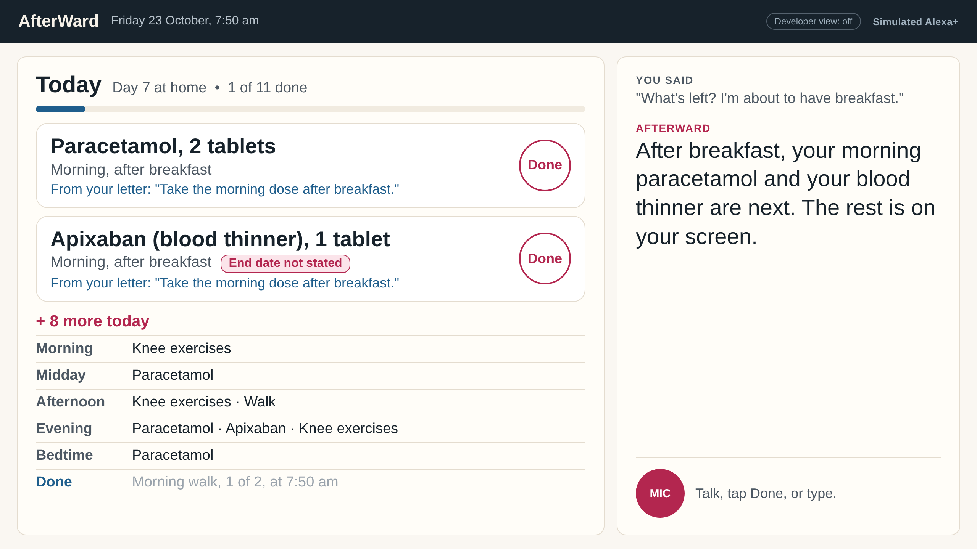
Designed for a device with a screen
AfterWard
AfterWard
● SIMULATED ALEXA+
● SIMULATED ALEXA+
THE PRODUCT: VOICE FIRST, NOT VOICE ONLY
Voice
Her hands are on a walking frame, so she talks and AfterWard answers aloud. It names two items and stops.
Screen
Two large cards she can read from across the room. The rest of the day is grouped below.
Touch and text
Tap a button for a short answer, or type. One set of MCP tools sits behind all three.
CHARVI TO DO · Replace left mock-up with screenshots of the actual Today / week dashboard.
CURRENT DESIGN MOCK-UP · CHARVI TO REPLACE WITH REAL RUNNING-APP SCREENSHOT. Simulated Alexa+ client.
AfterWard · A living recovery plan for Alexa+
Synthetic patient data · Simulated Alexa+
AfterWard · A living recovery plan for Alexa+
Synthetic patient data · Simulated Alexa+

Slide 9
AfterWard speaks first
AfterWard
AfterWard
● SIMULATED ALEXA+
● SIMULATED ALEXA+
PROACTIVE MEANS MORE THAN “SET A REMINDER”
A reminder only knows the time. AfterWard knows her plan: what is done, what is next, and what is still open.
1
2
3
Schedule
Guard
Deliver
Amazon EventBridge Scheduler checks every 5 minutes for anything due in the next 30.
Already done, only if needed, stopped or unclear? No reminder is sent.
The client speaks a short reminder. The words are built by code from her saved plan, not by the model.
Verified: EventBridge → Lambda → web companion speaks proactively (SIMULATED). Classic Alexa skill does not speak first.
AfterWard · A living recovery plan for Alexa+
Synthetic patient data · Simulated Alexa+
AfterWard · A living recovery plan for Alexa+
Synthetic patient data · Simulated Alexa+

Slide 10
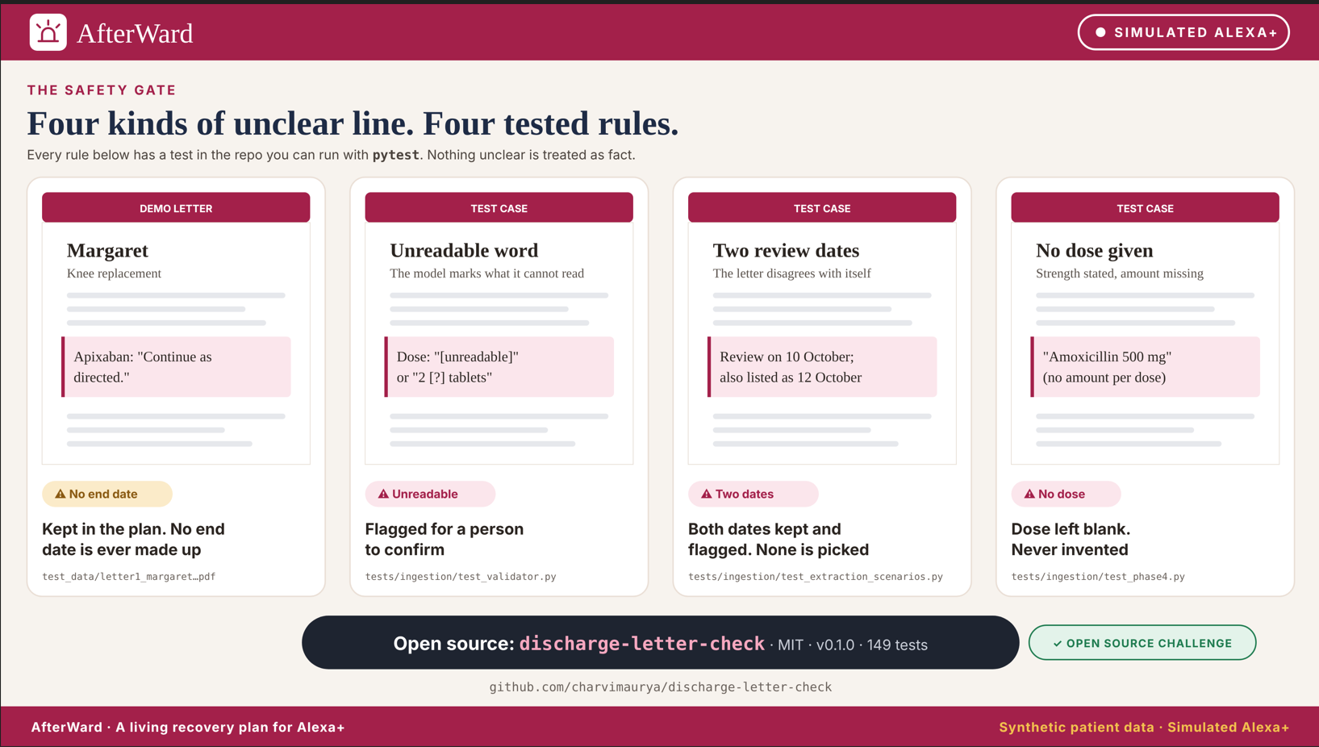
AfterWard
● SIMULATED ALEXA+
CHARVI TO DO · Insert GitHub Actions / 149 passing open-source tests screenshot in appendix.
AfterWard · A living recovery plan for Alexa+
Synthetic patient data · Simulated Alexa+
Notes:
AI understands messy letters; code decides what is safe to show. Each rule has a test in the repo you can run with pytest. Crisis words also get a fixed reply before any AI runs (999 and Samaritans 116 123).

Slide 11
More than tools: prompts and an MCP App
AfterWard
AfterWard
● SIMULATED ALEXA+
● SIMULATED ALEXA+
THE PRODUCT: ONE MCP SERVER, MANY FRONT ENDS
9
2
1
Tools
Prompts
MCP App: the Today card
Six read the plan, the week and her letter. Three write: a task done, a dose taken, and undo for a report made by mistake.
ask_my_letter
Search her letter first, answer with the page, never guess.
A host that supports MCP Apps shows Margaret's day as a card, not plain text: progress, what is done, what is next, and a “needs confirmation” tag.
morning_checkin
Read today's plan, then one short spoken step.
ui://afterward/today.html
The prompts put our safety rules where any agent can use them, including Alexa+, which is the agent in a real add-on.
CHARVI TO DO · Add real MCPJam tool-call and Today-card screenshots (see appendix placeholders).
9 tools and 2 prompts implemented and tested. CHARVI: add MCPJam tool-call + MCP App screenshots (appendix placeholder).
AfterWard · A living recovery plan for Alexa+
Synthetic patient data · Simulated Alexa+
AfterWard · A living recovery plan for Alexa+
Synthetic patient data · Simulated Alexa+
Notes:
Task 2 (the two prompts) and Task 3 (the MCP App Today card) are complete. The Today card is linked to get_today_tasks and get_week_summary. It is not in the demo video.

Slide 12
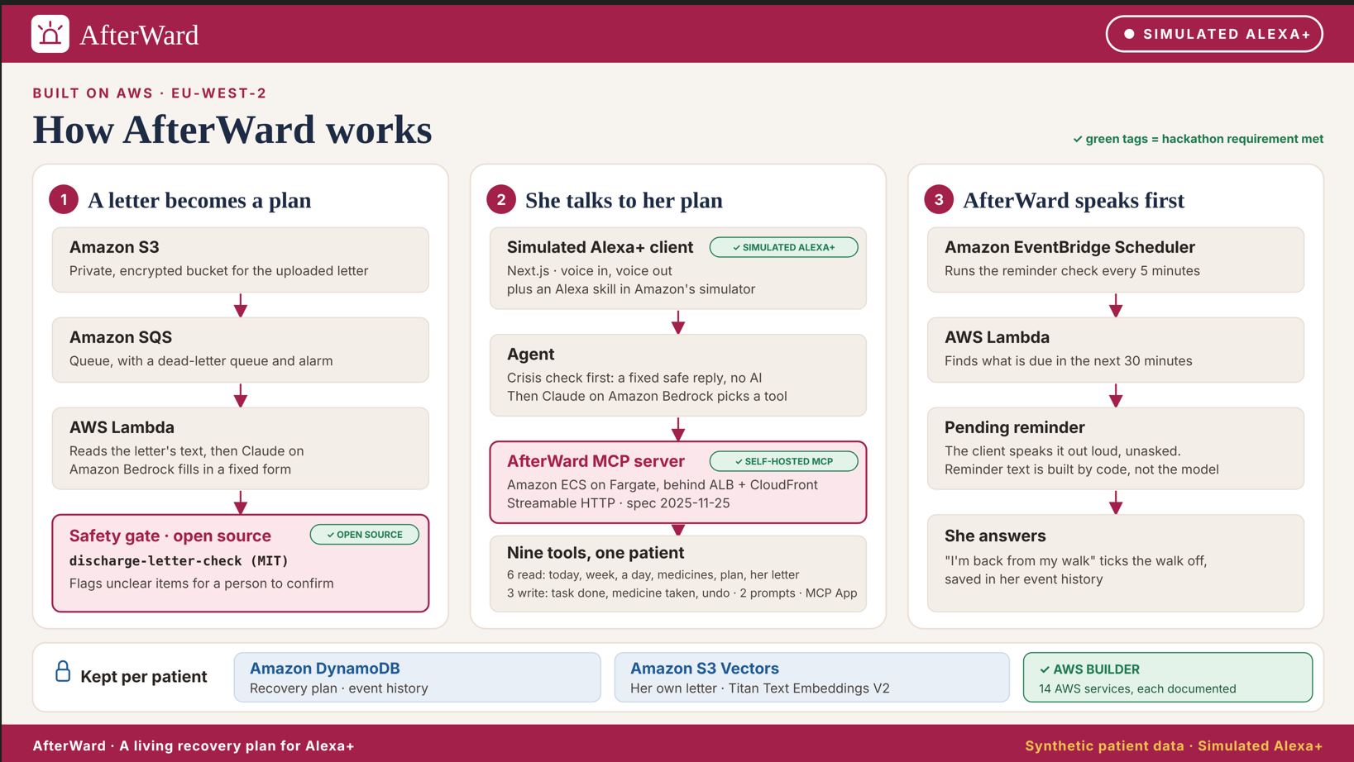
AfterWard
● SIMULATED ALEXA+
AfterWard · A living recovery plan for Alexa+
Synthetic patient data · Simulated Alexa+
Notes:
Three flows meet in one plan. The letter lands in S3, is queued to Lambda, and Bedrock turns it into her plan in DynamoDB. S3 Vectors searches only her letters. EventBridge Scheduler checks every five minutes. The MCP server runs on ECS Fargate behind a load balancer and CloudFront.

Slide 13
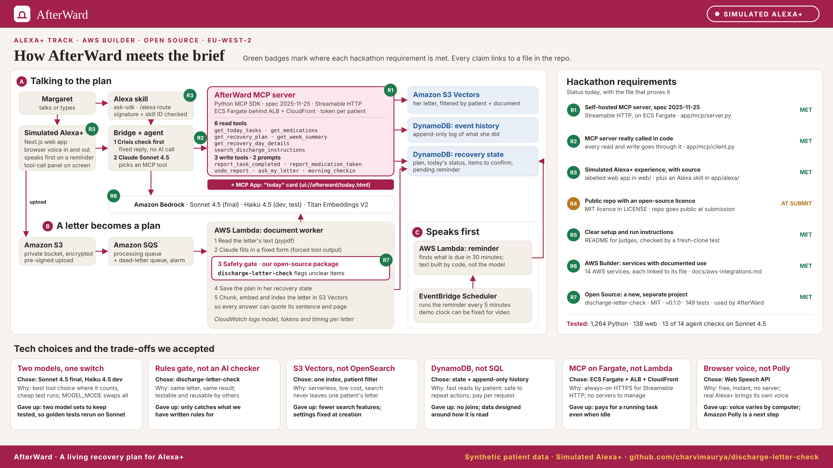
AfterWard
● SIMULATED ALEXA+
AfterWard · A living recovery plan for Alexa+
Synthetic patient data · Simulated Alexa+
Notes:
Every hackathon requirement is marked on the architecture with a green badge and linked to a file in the repo. The repo goes public at submission. Tested: 1,264 Python and 138 web tests; 13 of 14 agent checks on Claude Sonnet 4.5.

Slide 14
Impact
AfterWard
AfterWard
● SIMULATED ALEXA+
● SIMULATED ALEXA+
IMPACT AND GROWTH
IN THE BUILD
OUR OWN TESTS
EVIDENCE AND NEXT STEP
For the patient
For safety
For the health system
Knows what is due today without re-reading her paperwork.
1,269 Python and 143 web tests pass (user-reported final results).
In a 2024 study, 50 discharge summaries scored 13% for understandability. AI rewrites scored 81%.
Agent evaluation: confirm final run numbers before submission; crisis responses are deterministic.
Hears a reminder before each item, hands free.
3.77 million 30-day readmissions of US adults in 2023 show how large that gap is.
Where the letter is unclear, hears “your letter does not say”, not a guess.
Open limitation: when only one medicine is due, the system may infer it; explicit confirmation is the next fix.
A pilot would measure recovery days on track.
We do not claim that AfterWard reduces readmissions. That needs a pilot with real patients.
CURRENT RECORDS ≠ CLINICAL OUTCOME · 1,269 Python + 143 web tests (confirm CI).
Sources: AHRQ HCUP Nationwide Readmissions Database 2023; JAMA Network Open, 2024. Test numbers: our own runs, October 2026.
AfterWard · A living recovery plan for Alexa+
Synthetic patient data · Simulated Alexa+
AfterWard · A living recovery plan for Alexa+
Synthetic patient data · Simulated Alexa+

Slide 15
Go-to-market
AfterWard
AfterWard
● SIMULATED ALEXA+
● SIMULATED ALEXA+
IMPACT AND GROWTH: A PLAN, NOT YET TESTED
NOW
NEXT
LATER
Prove
At home
With hospitals
PLANNED, NOT COMPLETED: 3–5 interviews (nurse, carer, recently discharged patient), letter evaluation, clinician safety review.
The patient or a family member shares the letter. Secure sign-in and consent. An Alexa+ add-on, when the toolkit opens to developers.
A pilot with one orthopaedic unit measures recovery days on track. Then more procedures: the open-source checks are not tied to one operation.
First users
Who pays
Channels
Why AfterWard
People at home after planned surgery, and the family who help them
An untested hypothesis: free for the patient, paid by a hospital or insurer
Alexa+ at home, discharge teams, and developers through the open-source checks
A plan built from the letter itself, that knows what is done and never guesses
Interviews, clinician review and clinical pilot are FUTURE PLANS; none claimed completed.
AfterWard · A living recovery plan for Alexa+
Synthetic patient data · Simulated Alexa+
AfterWard · A living recovery plan for Alexa+
Synthetic patient data · Simulated Alexa+

Slide 16
Mini challenges
AfterWard
AfterWard
● SIMULATED ALEXA+
● SIMULATED ALEXA+
THE JOURNEY: HOW AFTERWARD MEETS EACH ONE
AWS Builder
Open Source
A project that incorporates AWS services with documented integrations.
A new, additional open-source project, created during the hackathon window.
14 AWS services in eu-west-2 (London), including IAM and KMS
A new public repo with an MIT licence, version 0.1.0
One page lists each service, its code and its live status
A fixed form for each letter, and rules that flag missing, unclear or unreadable lines
Bedrock
S3
S3 Vectors
SQS
Lambda
149 tests on Python 3.11 to 3.13, run by GitHub Actions
DynamoDB
EventBridge Scheduler
ECS Fargate and ECR
AfterWard uses it, so the open-source code is the real safety check
Load Balancing
CloudFront
Secrets Manager
github.com/charvimaurya/discharge-letter-check
CloudWatch
AfterWard · A living recovery plan for Alexa+
Synthetic patient data · Simulated Alexa+
AfterWard · A living recovery plan for Alexa+
Synthetic patient data · Simulated Alexa+

Slide 17
Friction log and product feedback
AfterWard
AfterWard
● SIMULATED ALEXA+
● SIMULATED ALEXA+
THE JOURNEY: ONE EXAMPLE OF EACH
FRICTION LOG ENTRY
PRODUCT FEEDBACK ENTRY
No way to test on Alexa+
Amazon S3 Vectors
Task
Try our MCP server on real Alexa+
Used for
Search over the patient's own letter
Expected
A simulator or a test device for entrants
Worked
Serverless, low cost, every search filtered to one patient
Actual
The add-on toolkit and web simulator are in preview with select partners
Needs work
An index with no matching vectors returns empty results, with no warning
Severity
Medium: the rules allow a simulated client
Workaround
A web client labelled as simulated, plus a classic Alexa skill
Onboarding
Simple setup; the silent empty result was the main blocker
Suggestion
Open the web simulator to hackathon entrants
Build again
Yes, for per-patient search at low cost
14 friction log entries, from Alexa+ access to AgentCore and S3 Vectors, each with time lost, a workaround and a suggestion. Product feedback covers 9 product areas.
AfterWard · A living recovery plan for Alexa+
Synthetic patient data · Simulated Alexa+
AfterWard · A living recovery plan for Alexa+
Synthetic patient data · Simulated Alexa+

Slide 18
AfterWard
● SIMULATED ALEXA+
CHALLENGE → DECISION → REUSABLE SAFETY RULE
When being too cautious becomes unsafe
THE PROBLEM
WHY IT MATTERED
WHAT WE CHANGED
An unclear blood-thinner end date initially caused the whole medicine to disappear from the plan.
Missing an end date is not the same as missing a valid daily instruction. Hiding everything can be risky.
Field-level validation: keep supported instructions; flag the unknown end date for human confirmation.
THE LESSON · Safe AI must distinguish what is known, unknown and awaiting a person’s confirmation.
AfterWard · A living recovery plan for Alexa+
Synthetic patient data · Simulated Alexa+

Slide 19
Thank you
AfterWard
AfterWard
● SIMULATED ALEXA+
● SIMULATED ALEXA+
AFTERWARD: A LIVING RECOVERY PLAN FOR ALEXA+
Discharge is one moment. Recovery happens every day.
We started with Margaret. We are building for everyone recovering at home.
Demo video: [CHARVI: ADD PUBLIC VIDEO URL]
AfterWard: github.com/charvimaurya/post-discharge-mcp
Shilpa Agarwal (shilpajagarwal@gmail.com)
Charvi Maurya, final-year Computer Science student (charvim2006@gmail.com)
A living plan: reminds, records progress, and flags uncertainty for a person.
Discharge is one moment. Recovery happens every day.
Open source: github.com/charvimaurya/discharge-letter-check
AfterWard · A living recovery plan for Alexa+
Synthetic patient data · Simulated Alexa+
AfterWard · A living recovery plan for Alexa+
Synthetic patient data · Simulated Alexa+
Notes:
Thank you to the Alexa team and Amazon Developer, for a wonderful opportunity to learn and build a unique experience at Build, Ship, Shape. We'd also love the chance to build what comes next because, after all, no one should have to remember their recovery alone.

Slide 20
The detail behind the build
AfterWard
AfterWard
● SIMULATED ALEXA+
● SIMULATED ALEXA+
APPENDIX
What inspired us, the architecture, every technology choice with its trade-off, how it scales, and what we learned.
AfterWard · A living recovery plan for Alexa+
Synthetic patient data · Simulated Alexa+
AfterWard · A living recovery plan for Alexa+
Synthetic patient data · Simulated Alexa+

Slide 21
No one should have to remember their recovery alone.
AfterWard
AfterWard
● SIMULATED ALEXA+
● SIMULATED ALEXA+
OUR VISION
Every discharge letter becomes a plan that speaks at the right time, remembers what you did, and is honest about what it does not know.
AfterWard · A living recovery plan for Alexa+
Synthetic patient data · Simulated Alexa+
AfterWard · A living recovery plan for Alexa+
Synthetic patient data · Simulated Alexa+

Slide 22
Current state and target state
AfterWard
AfterWard
● SIMULATED ALEXA+
● SIMULATED ALEXA+
THE PRODUCT
PERSONA
TODAY
WITH AFTERWARD
Patient at home
A few sheets of paper. She works out what is due today, remembers what she has done and tracks her follow-ups, hands on a walking frame.
A daily plan from her own letter. A spoken reminder 30 minutes before each item. She says what she did and asks what the letter said.
In the hackathon build
Family carer
Phones to ask “did you take your tablets?” and depends on the patient's memory. May never have seen the letter.
With the patient's permission, sees what was done today and what is still open, without having to ask.
Roadmap, not built
Care team
Writes the letter, then has no view of what happens at home. An unclear line surfaces only if the patient calls.
Unclear lines are flagged on day one for the team to confirm. The letter arrives digitally through a hospital link (FHIR).
Roadmap, not built
Only the patient row is built. For the carer and the care team, “Today” is an assumption we are testing in interviews with a nurse, a carer and a recently discharged patient.
AfterWard · A living recovery plan for Alexa+
Synthetic patient data · Simulated Alexa+
AfterWard · A living recovery plan for Alexa+
Synthetic patient data · Simulated Alexa+

Slide 23
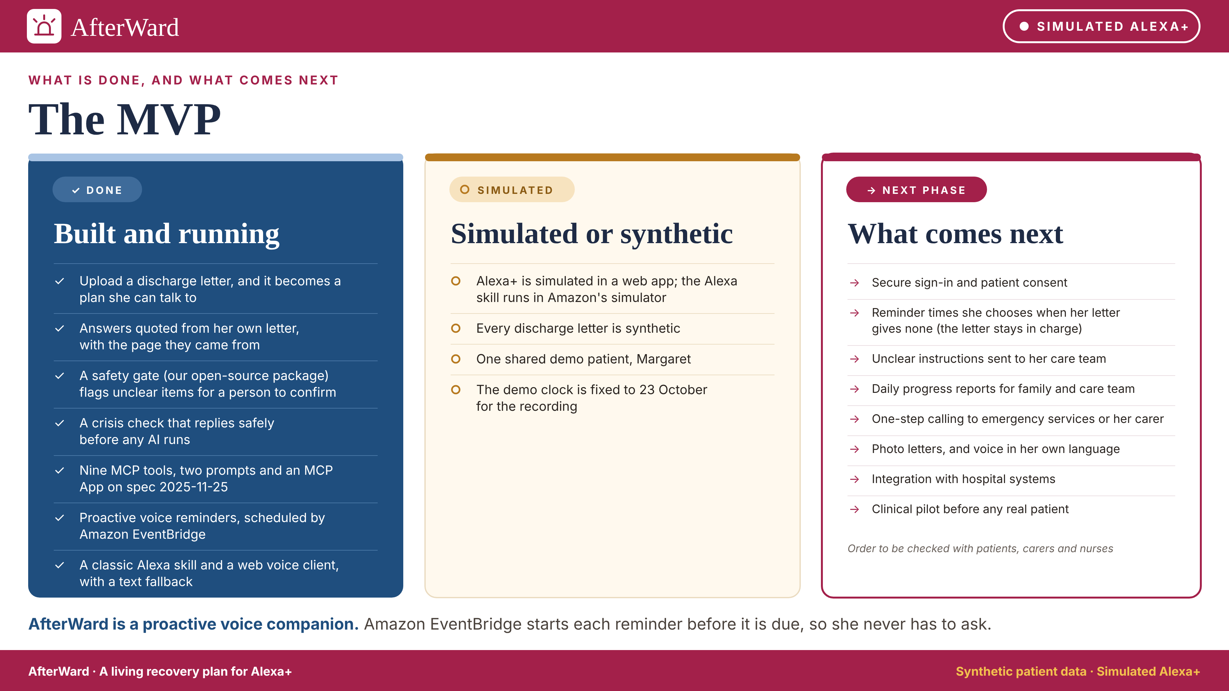
AfterWard
● SIMULATED ALEXA+
AfterWard · A living recovery plan for Alexa+
Synthetic patient data · Simulated Alexa+
Notes:
Blue is built and running. Amber is simulated or synthetic. Rose is what comes next. AfterWard is a proactive voice companion: Amazon EventBridge starts each reminder before it is due.

Slide 24
North Star metric
AfterWard
AfterWard
● SIMULATED ALEXA+
● SIMULATED ALEXA+
IMPACT AND GROWTH: HOW WE WILL MEASURE SUCCESS
Kind | Metric | How we measure it | Today
Input | Letter to ready plan | Time from upload to plan | About 15 seconds
Input | Reminders acted on | Item done within 2 hours of its reminder | In the pilot
Input | Answers from her letter | Replies backed by a letter search | Enforced in code
Guardrail | Crisis replies | Fixed reply before any AI | 3 of 3 tests pass
Guardrail | Tool errors | Alarm above 3 in 5 minutes | Alarm live
Outcome | 30-day readmissions | Against usual care | Pilot only
OUR NORTH STAR
Recovery days on track
The share of a patient's days where every item her letter set for that day is recorded as done.
It is the value she feels: today's plan, done. Our weekly recovery view already shows days completed.
A missing record counts as unknown, not missed. It is not a clinical score.
Inputs move the North Star; guardrails must never get worse. “Today”: our own runs on synthetic letters, October 2026.
AfterWard · A living recovery plan for Alexa+
Synthetic patient data · Simulated Alexa+
AfterWard · A living recovery plan for Alexa+
Synthetic patient data · Simulated Alexa+
Notes:
Upload-to-ready time is logged as the CloudWatch metric upload_to_ready_ms. Tool errors and crisis handling are logged per request. Readmissions are an outcome for a clinical pilot; we make no claim about them today.

Slide 25
Roadmap and global expansion
AfterWard
AfterWard
● SIMULATED ALEXA+
● SIMULATED ALEXA+
IMPACT AND GROWTH
Now
Next
Later
Global
Hackathon MVP
Ready for a pilot
Connected
Country by country
Letter to daily plan
Secure sign-in and consent
Hospital link (FHIR), so the letter arrives digitally
One AWS region per country, so data stays local
Open-source safety checks
Reminder times the patient can change
9 MCP tools, 2 prompts, an MCP App
A care team view, with permission
Local languages and medicine names
A family view, with permission
Scheduled reminders
Rules reviewed by a clinician
A pilot that measures recovery days on track
Local privacy rules: UK GDPR, HIPAA, GDPR
Simulated Alexa+ and a classic Alexa skill
An Alexa+ add-on, when the toolkit opens
A medical device check in each market
Everything after “Now” is a plan. The safety checks and the MCP tools carry over to each country. The region, the language and the rules are what change.
AfterWard · A living recovery plan for Alexa+
Synthetic patient data · Simulated Alexa+
AfterWard · A living recovery plan for Alexa+
Synthetic patient data · Simulated Alexa+

Slide 26
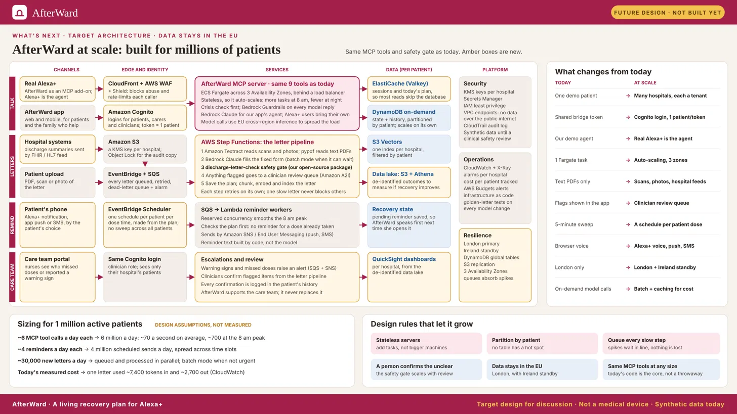
AfterWard
● SIMULATED ALEXA+
AfterWard · A living recovery plan for Alexa+
Synthetic patient data · Simulated Alexa+
Notes:
A target design for discussion, not built yet. The same MCP tools and safety gate carry over; amber boxes are new. Sizing figures are design assumptions, not measurements. Today's measured cost: one letter used about 7,400 tokens in and 2,700 out.

Slide 27
Amazon Leadership Principles in practice
AfterWard
AfterWard
● SIMULATED ALEXA+
● SIMULATED ALEXA+
THE JOURNEY: HOW WE WORKED
Principle | What we did
Customer Obsession | Built for Margaret: voice first, because her hands are on a walking frame.
Earn Trust | Every answer shows its source sentence. Alexa+ is always labelled simulated.
Insist on the Highest Standards | 1,264 Python and 138 web tests. Safety replies have exact-wording tests.
Dive Deep | Traced a silent empty search and a dropped emergency number to the cause.
Invent and Simplify | AI where understanding is needed; fixed rules where safety matters.
Bias for Action | AgentCore would not deploy, so we moved the MCP server to ECS Fargate.
Frugality | Haiku for daily tests, Sonnet for final runs, swapped by one setting.
Hire and Develop the Best | A mentor and a student developer: first AWS build, first voice agent.
Ownership | Open-sourced our safety checks; 14 friction log entries with suggestions.
Success and Scale Bring Broad Responsibility | Synthetic data only, one patient per request, crisis replies before any AI.
Still earning Deliver Results: one agent test still fails, and the web client is not hosted yet.
AfterWard · A living recovery plan for Alexa+
Synthetic patient data · Simulated Alexa+
AfterWard · A living recovery plan for Alexa+
Synthetic patient data · Simulated Alexa+
Notes:
Principle names are from Amazon's published Leadership Principles. Every example on this slide is in our friction log, test results or AWS integrations page.

Slide 28
Judging criteria
AfterWard
AfterWard
● SIMULATED ALEXA+
● SIMULATED ALEXA+
THE JOURNEY: HOW AFTERWARD MEETS EACH ONE
Tech implementation
Design
Potential impact
Quality of the idea
How well is the project built, and how effectively does it use the required tech?
Does the project deliver a complete, coherent product experience?
Does the project make a credible, specific case for solving customer needs?
Is this a creative, imaginative use of the required tools?
More than a reminder or document Q&A
Self-hosted MCP server on ECS Fargate, spec 2025-11-25
Voice first, because her hands are on a walking frame
One named user and one specific need
A plan that knows what is done and never guesses
9 tools, 2 prompts and an MCP App, checked in MCP Inspector and MCPJam
A screen drawn to Amazon's add-on design guide: large text, simple cards
Every number has a source or is our own test
The gate is a reusable open-source package
A North Star metric, measured from day one
1,264 Python and 138 web tests pass
The whole flow also works by text
Bonus, up to 10%: a friction log with 14 entries, each with a suggestion for Amazon. Required: product feedback on every tool we used.
AfterWard · A living recovery plan for Alexa+
Synthetic patient data · Simulated Alexa+
AfterWard · A living recovery plan for Alexa+
Synthetic patient data · Simulated Alexa+

Slide 29
We began with one use case. We chose a wider mission.
AfterWard
AfterWard
● SIMULATED ALEXA+
● SIMULATED ALEXA+
THE JOURNEY: WHY WE TOOK ON THE WIDER PROBLEM
Recovery at home can happen at every age, in every country. Our aim: Alexa carries the plan, so patients and the people who care for them are free to focus on getting better.
Built so far: synthetic letters for patients of different ages and conditions. Alexa+ is simulated. Everything beyond the hackathon build is a plan.
AfterWard · A living recovery plan for Alexa+
Synthetic patient data · Simulated Alexa+
AfterWard · A living recovery plan for Alexa+
Synthetic patient data · Simulated Alexa+

Slide 30
What inspired us
AfterWard
AfterWard
● SIMULATED ALEXA+
● SIMULATED ALEXA+
THE NEED
The care team stays at the hospital. The paper goes home.
WHO WE BUILT FOR
From that moment, the patient has to remember which medicine is due, what they are allowed to do, when the follow-up is and which warning signs matter. They do this while tired, sore or in pain.
Margaret, 68
A new knee, a walking frame and a few sheets of paper. Her hands are on the frame, so talking is easier than tapping.
The information is all on the page. But paper cannot notice that you already did your morning walk. We wanted to help with the part of recovery that happens at home, the everyday moments that matter, and make that support available to people of any age, anywhere in the world.
A synthetic patient. No real patient data is used anywhere.
AfterWard · A living recovery plan for Alexa+
Synthetic patient data · Simulated Alexa+
AfterWard · A living recovery plan for Alexa+
Synthetic patient data · Simulated Alexa+

Slide 31


Architecture: hackathon build
AfterWard
AfterWard
● SIMULATED ALEXA+
● SIMULATED ALEXA+
HOW IT IS BUILT: THREE PATHS THAT MEET IN THE DATA
A
Talking to the plan
Simulated Alexa+ client
AfterWard MCP server
Data, kept per patient
Margaret
Agent (demo only)
talks or types
Next.js, voice in and out
Claude Sonnet 4.5 on Bedrock
9 tools, on ECS Fargate
Event History
DynamoDB: what she did
Paths: A
B
A letter becomes a plan
Letter upload
Amazon S3
Amazon SQS
Lambda worker
Amazon S3 Vectors
PDF through a pre-signed URL
private bucket
queue with a dead-letter queue
Claude reads, the safety gate checks
search over her own letter
Paths: A and B
C
AfterWard speaks first
The client picks up the pending reminder and speaks first. The words are built by code, not by the model.
Amazon EventBridge
Recovery State
Lambda reminder
DynamoDB: the current plan
a check every 5 minutes
finds what is due in 30 minutes
Paths: A, B and C
Pink: the MCP server the track judges, behind a load balancer and CloudFront. Blue: data. Region eu-west-2 (London). The web client and agent run locally.
AfterWard · A living recovery plan for Alexa+
Synthetic patient data · Simulated Alexa+
AfterWard · A living recovery plan for Alexa+
Synthetic patient data · Simulated Alexa+

Slide 32
Technology choices: models
AfterWard
AfterWard
● SIMULATED ALEXA+
● SIMULATED ALEXA+
HOW IT IS BUILT: EACH CHOICE, ITS TRADE-OFF AND ITS OPEN-SOURCE OPTION (1 OF 4)
Decision | We chose | Why | Trade-off we accept | Open-source option
Reading the letter | Claude Sonnet 4.5 on Bedrock, forced tool output | Reads messy letters well; predictable JSON; nothing to host | Cost per letter; output can vary, so the safety gate is required | Qwen2.5-VL or Llama 3.3 70B on vLLM; needs a GPU
Agent (demo only) | Claude Sonnet 4.5 on Bedrock | Best at choosing tools and asking “which tablet?” | Slower and pricier than Haiku | Qwen2.5 or Llama 3.3 on vLLM or Ollama
Dev and test model | Claude Haiku 4.5, EU inference profile | Cheap and fast for many test runs; stays in EU regions | Lower quality, so final tests rerun on Sonnet | A small local model in Ollama: free, but weaker
Model switching | One MODEL_MODE setting | Swaps every model with no code change | Two sets of models to keep tested | LiteLLM
Embeddings | Titan Text Embeddings V2, 512 dimensions | AWS-native, cheap, fits S3 Vectors | Less precise than 1,024; the size is fixed for life | BGE or nomic-embed-text
AfterWard · A living recovery plan for Alexa+
Synthetic patient data · Simulated Alexa+
AfterWard · A living recovery plan for Alexa+
Synthetic patient data · Simulated Alexa+

Slide 33
Technology choices: data and processing
AfterWard
AfterWard
● SIMULATED ALEXA+
● SIMULATED ALEXA+
HOW IT IS BUILT: EACH CHOICE, ITS TRADE-OFF AND ITS OPEN-SOURCE OPTION (2 OF 4)
Decision | We chose | Why | Trade-off we accept | Open-source option
Vector store | Amazon S3 Vectors, one index, patient filter | Serverless, low cost; search stays in one patient's letter | Fewer search features; settings fixed at creation | pgvector, Qdrant or Chroma
Database | DynamoDB: Recovery State and Event History | Fast reads by patient; conditional writes; pay per request | No joins or flexible queries | PostgreSQL, which can also hold pgvector
Document storage | A private Amazon S3 bucket | Durable, cheap, encrypted; an event on every upload | Key names must stay consistent | MinIO
Processing | S3 event to SQS to Lambda, with a dead-letter queue | Upload returns at once; retries; failed jobs are kept | Messages can arrive twice, so each step must be safe to repeat | RabbitMQ, or Redis with Celery
Reminders | EventBridge Scheduler and a reminder Lambda | A managed clock, with no always-on server | Spoken by our simulated client, not by Alexa+ | Celery Beat or APScheduler
AfterWard · A living recovery plan for Alexa+
Synthetic patient data · Simulated Alexa+
AfterWard · A living recovery plan for Alexa+
Synthetic patient data · Simulated Alexa+

Slide 34
Technology choices: server and platform
AfterWard
AfterWard
● SIMULATED ALEXA+
● SIMULATED ALEXA+
HOW IT IS BUILT: EACH CHOICE, ITS TRADE-OFF AND ITS OPEN-SOURCE OPTION (3 OF 4)
Decision | We chose | Why | Trade-off we accept | Open-source option
AWS region | eu-west-2 (London) | Close to UK users; patient data stays in the UK | Newer services and models reach London later | Any UK or EU server you control
MCP server | Python MCP SDK, Streamable HTTP, spec 2025-11-25 | Required by the track; testable with MCP Inspector | A public endpoint we must secure: token and Origin check | Already open source
MCP hosting | A container on ECS Fargate, behind a load balancer and CloudFront | The AgentCore starter would not deploy; a container runs the same anywhere | An always-on task to pay for and keep patched | Docker behind Caddy or Nginx, with Let's Encrypt
Infrastructure | Task definition, Lambda build script and an alarm template in the repo | Every integration visible in code, and listed in one AWS page | Not one-click yet; some steps run by hand | Docker Compose, Terraform or OpenTofu
Monitoring | CloudWatch: JSON logs, 5 metrics, 3 alarms with email | Built in; a failed letter or tool error reaches us at once | AWS-only; no dashboard yet | Prometheus and Grafana
AfterWard · A living recovery plan for Alexa+
Synthetic patient data · Simulated Alexa+
AfterWard · A living recovery plan for Alexa+
Synthetic patient data · Simulated Alexa+

Slide 35
Technology choices: experience and safety
AfterWard
AfterWard
● SIMULATED ALEXA+
● SIMULATED ALEXA+
HOW IT IS BUILT: EACH CHOICE, ITS TRADE-OFF AND ITS OPEN-SOURCE OPTION (4 OF 4)
Decision | We chose | Why | Trade-off we accept | Open-source option
Patient interface | Next.js web app: simulated Alexa+, voice and screen | Shows the whole experience; the Alexa+ toolkit is in preview | Must always be labelled as simulated; more code | Already open source; Whisper for speech-to-text
Voice in and out | The browser's speech (Web Speech API) | Her hands are busy, so she talks and replies are spoken | Sounds different on each computer; Amazon Polly is on the roadmap | Whisper and Piper
Real Alexa today | A classic Alexa custom skill: “open after ward” | Margaret asks on a real Alexa voice, through the same MCP tools | Cannot speak first; tested in the console, not published | None needed
Sign-in | A demo session for one patient (Cognito later) | Keeps focus on the core loop; patient scope still enforced | Not a production login yet | Keycloak
Safety checks | discharge-letter-check, our own library | Fixed rules, 149 tests, never guesses; reusable | Only catches problems we have written rules for | Already open source (MIT)
AWS calls live only in service modules, so any one choice can be swapped for its open-source option by replacing one module.
AfterWard · A living recovery plan for Alexa+
Synthetic patient data · Simulated Alexa+
AfterWard · A living recovery plan for Alexa+
Synthetic patient data · Simulated Alexa+

Slide 36
Architecture at scale
AfterWard
AfterWard
● SIMULATED ALEXA+
● SIMULATED ALEXA+
HOW IT IS BUILT: A DESIGN SKETCH, NOT BUILT
A
Talking to the plan
Data, kept per patient
Patients
Alexa+ or any MCP client
Load balancer
MCP server copies
many at once
spreads the calls
identical, no shared state
the agent
Recovery State
DynamoDB: one small item per medicine, task and daily occurrence
B
A letter becomes a plan
Letter uploads
Amazon S3
Amazon SQS
Lambda workers
Event History
about 10 a second at peak
private bucket
absorbs the bursts
about 200 at once
DynamoDB: what each patient did
Amazon S3 Vectors
C
AfterWard speaks first
search, filtered to one patient
The same reminder logic, spread over many workers.
Amazon EventBridge
Queue
Reminder workers
a schedule per time zone
batches of patients
many at once
Pink boxes are what changes at scale. The shape of the system stays the same. None of this slide is built.
AfterWard · A living recovery plan for Alexa+
Synthetic patient data · Simulated Alexa+
AfterWard · A living recovery plan for Alexa+
Synthetic patient data · Simulated Alexa+

Slide 37
How it scales
AfterWard
AfterWard
● SIMULATED ALEXA+
● SIMULATED ALEXA+
HOW IT IS BUILT: IF EVERY US HOSPITAL ADMISSION USED AFTERWARD
10
5,000
Assumptions, not measured
35.7 million admissions a year. 30 days of use. 15 tool calls a day. Peak is 10 times the average. 20 seconds to read a letter.
uploads a second at peak
tool calls a second at peak
Part | Hackathon build | At the target
Letter workers | 2 at once | About 200 at once, capped to the Bedrock limit
Amazon Bedrock | Default request cap | Cap raised to about 600 letters a minute
MCP server | One deployment | Several identical copies behind a load balancer
Plan storage | One item per patient | One small item per medicine, task and daily occurrence
Reminders | One schedule, one Lambda | A schedule per time zone and a queue of patient batches
A design sketch, not built. Admissions: AHA Fast Facts on U.S. Hospitals 2026 (2024 survey).
AfterWard · A living recovery plan for Alexa+
Synthetic patient data · Simulated Alexa+
AfterWard · A living recovery plan for Alexa+
Synthetic patient data · Simulated Alexa+

Slide 38
Challenges we faced
AfterWard
AfterWard
● SIMULATED ALEXA+
● SIMULATED ALEXA+
THE JOURNEY: A FIRST-TIME TEAM ON AN AGGRESSIVE SCHEDULE
First time on AWS
A student developer
Mentoring at full speed
An aggressive schedule
Our first build on the AWS stack. We learned each service, from Bedrock to Lambda and DynamoDB, while building with it.
Only developer is a final-year Computer Science student. AWS and voice agents were both new ground, learned while building.
Guiding a student through a first cloud build means teaching and delivering at the same time.
We learned the stack and shipped on it in the same weeks. A fixed cut order means safety is never what gives way.
A safety rule too blunt
Messy letters
Queues deliver twice
No Alexa+ to test on
It would have hidden a blood thinner over an unclear end date. We now flag the field, not the whole item.
A photo once read 111 as 171 with no warning. Medicines read from photos are now held back.
A repeated message must change nothing. Every write carries a key, so a repeat is saved once.
The Alexa+ toolkit is in preview with select partners. We built a web client, always labelled as simulated.
AfterWard · A living recovery plan for Alexa+
Synthetic patient data · Simulated Alexa+
AfterWard · A living recovery plan for Alexa+
Synthetic patient data · Simulated Alexa+

Slide 39
What we learned
AfterWard
AfterWard
● SIMULATED ALEXA+
● SIMULATED ALEXA+
THE JOURNEY: OUR FIRST BUILD ON AWS, AND OUR FIRST VOICE AGENT
On AWS
On voice
Check the region on day one
Ears are not eyes
Newer services and models reach London later. One read-only call per service proves the setup.
A long spoken list is hard to follow. AfterWard names the next two items and shows the rest on screen.
Some choices cannot be undone
Ask before you write
A vector index keeps its size for life, so we fixed 512 dimensions before indexing anything.
“I took my tablets” could mean any of them. AfterWard asks which one and saves nothing until it knows.
Assume every message arrives twice
A reminder is not a question
A queue can redeliver, so each write has to be safe to repeat.
“I hope you slept well” is a statement on purpose. AfterWard must not judge symptoms.
Test cheap, finish strong
A small model for daily tests and the final models for the last run, swapped by one setting.
The rules live in the tools
With real Alexa+, Alexa+ is the agent. So every rule sits in the MCP tools, not in our demo agent.
AfterWard · A living recovery plan for Alexa+
Synthetic patient data · Simulated Alexa+
AfterWard · A living recovery plan for Alexa+
Synthetic patient data · Simulated Alexa+

Slide 40
AfterWard
● SIMULATED ALEXA+
SUBMISSION CHECKLIST · CHARVI
Evidence screenshots to insert
INSERT SCREENSHOT HERE
INSERT SCREENSHOT HERE
INSERT SCREENSHOT HERE
MCPJam / Inspector tool call
MCP App Today card
Open-source CI
Successful invocation + tool result; redact credentials.
Real host screenshot with today / week information.
149 tests; Python 3.11–3.13; show passing run.
AfterWard · A living recovery plan for Alexa+
Synthetic patient data · Simulated Alexa+

