Slide 1
Google Drive link for the python code file and video: https://drive.google.com/drive/folders/135RD4jUauEMCgBj6YDBiehZjQr3863HL?usp=sharing
Project: Home screen utility program using Tkinter GUI
Learning from the project:
I was able to gain better understanding of python and its functions.
Learned on how to implement tkinter for GUI
Learned how to use pywhatkit to send WhatsApp messages, perform a google search, play videos via YouTube and to convert text to handwritten text.
Learned how to download videos on YouTube using pytube.
Learned on how to set a simple alarm with the help of datetime and windsound modules.
Learned how to display first few URL’s from google search results by using search function of googlesearch module.
Gained confidence for making future projects.

Slide 2
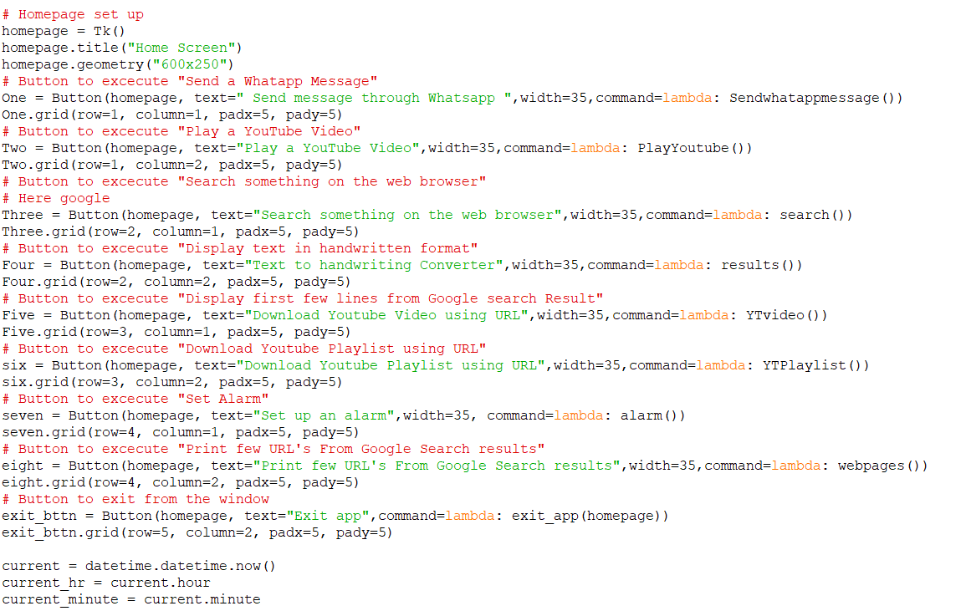
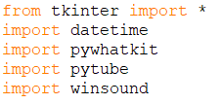
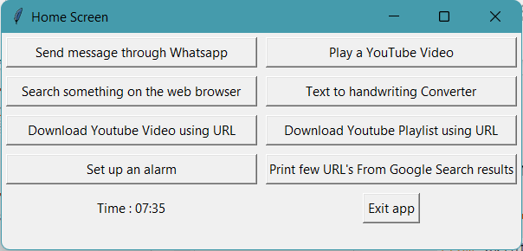
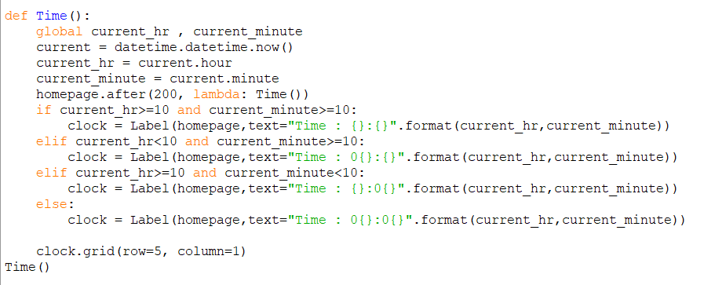

Project
Coding for the main window

Slide 3
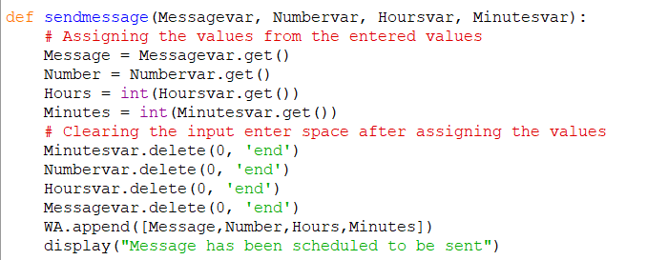
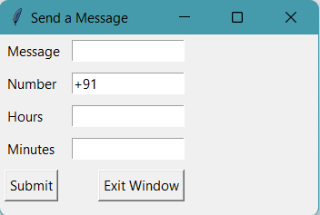
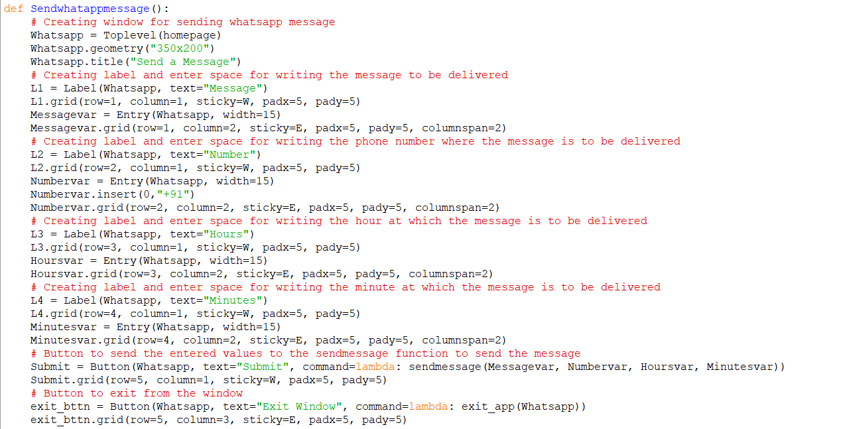
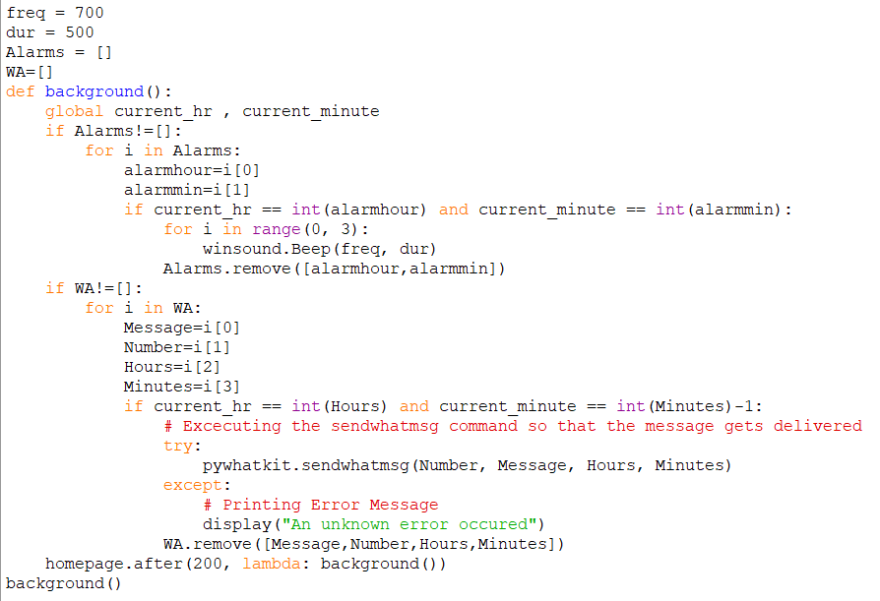
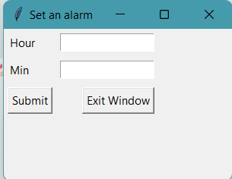
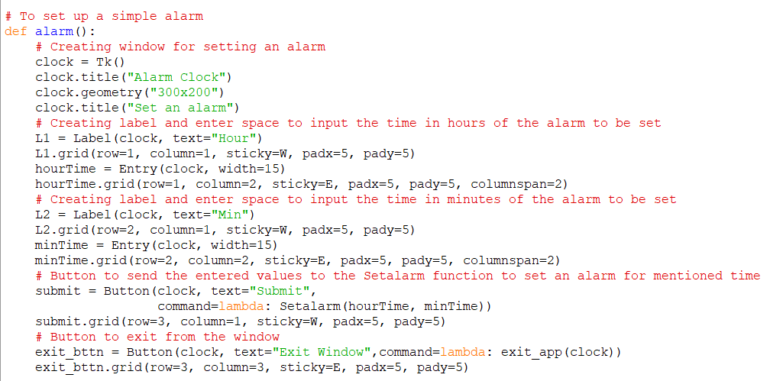
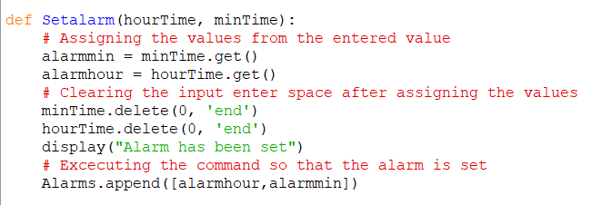
Coding for sending message window
Coding for setting up an alarm

Slide 4
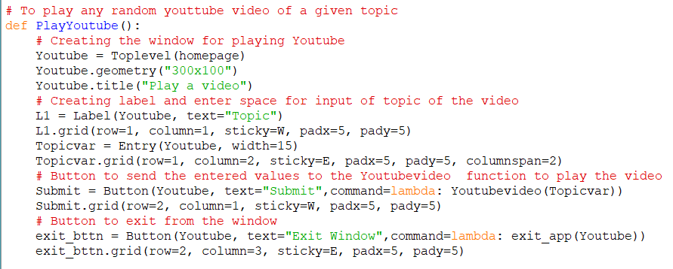
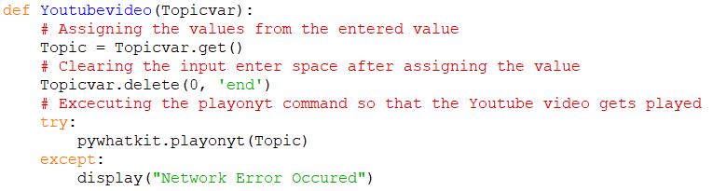
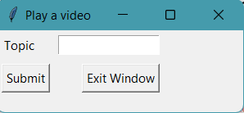
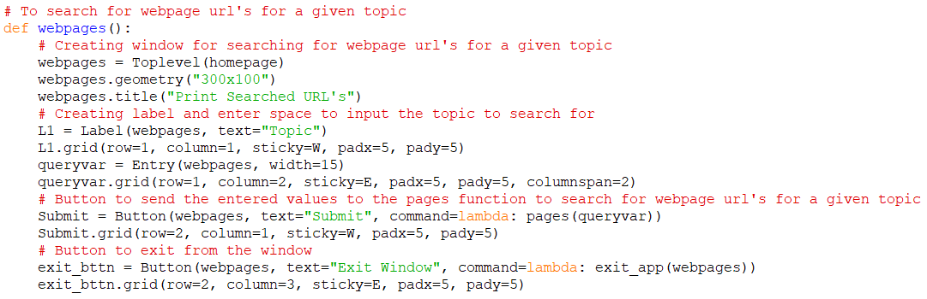
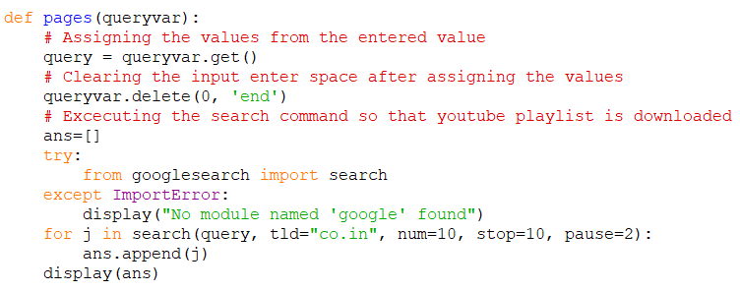
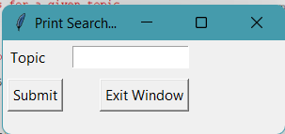
Coding for playing a random YouTube video window
Coding for printing webpage URL from google search results window

Slide 5
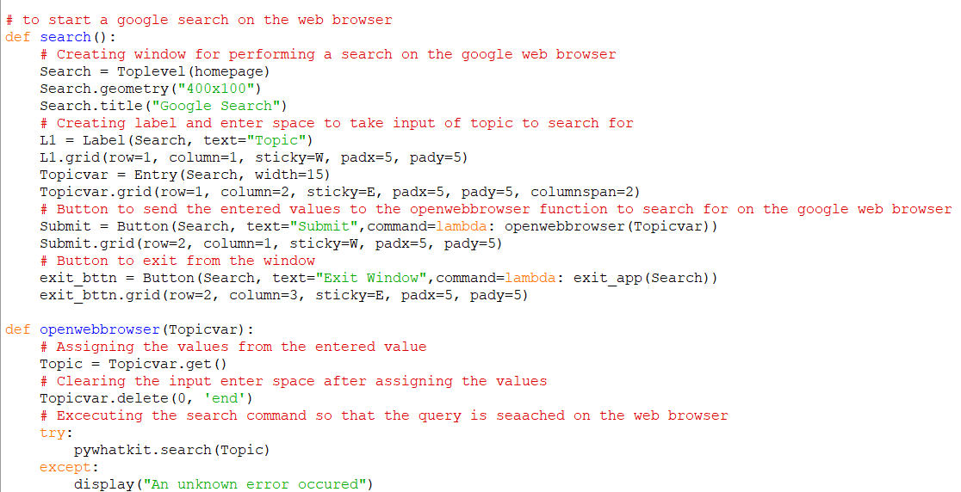
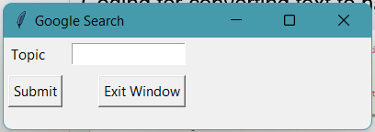
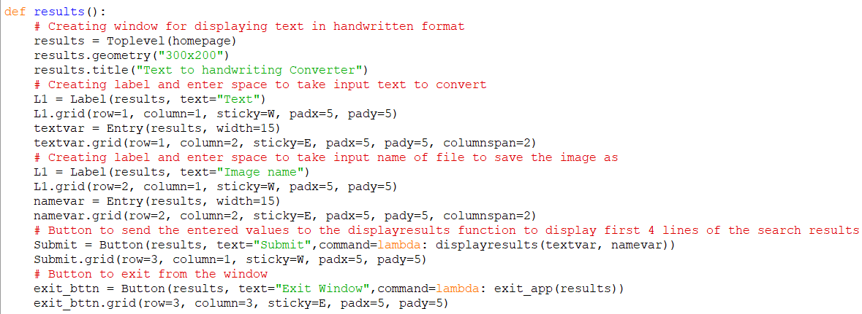
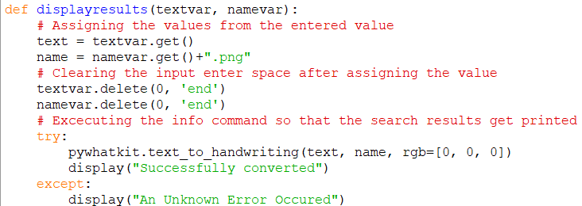
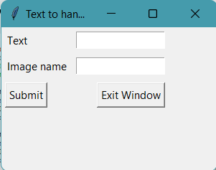
Project
Coding for the performing a google search window
Coding for converting text to handwritten text window

Slide 6
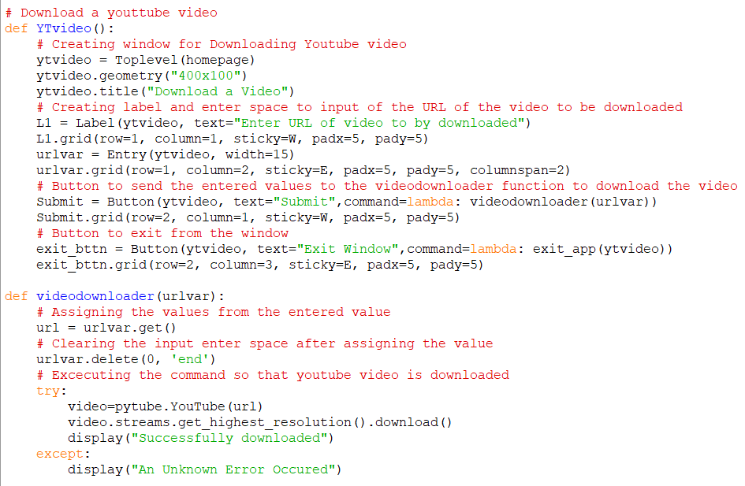
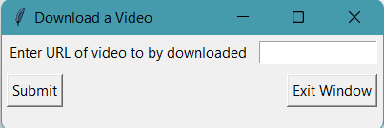
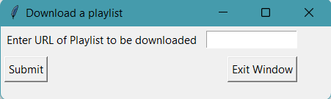
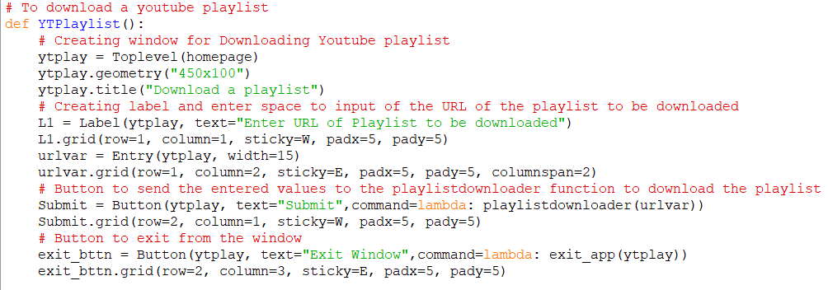
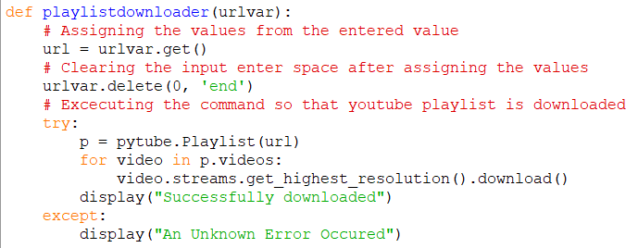
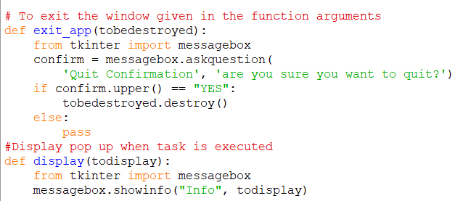
Coding for downloading a video window
Coding for downloading a playlist window
Coding for Quit confirmation message box Pop-up when task is executed

Slide 7
Thank You !

