Slide 1
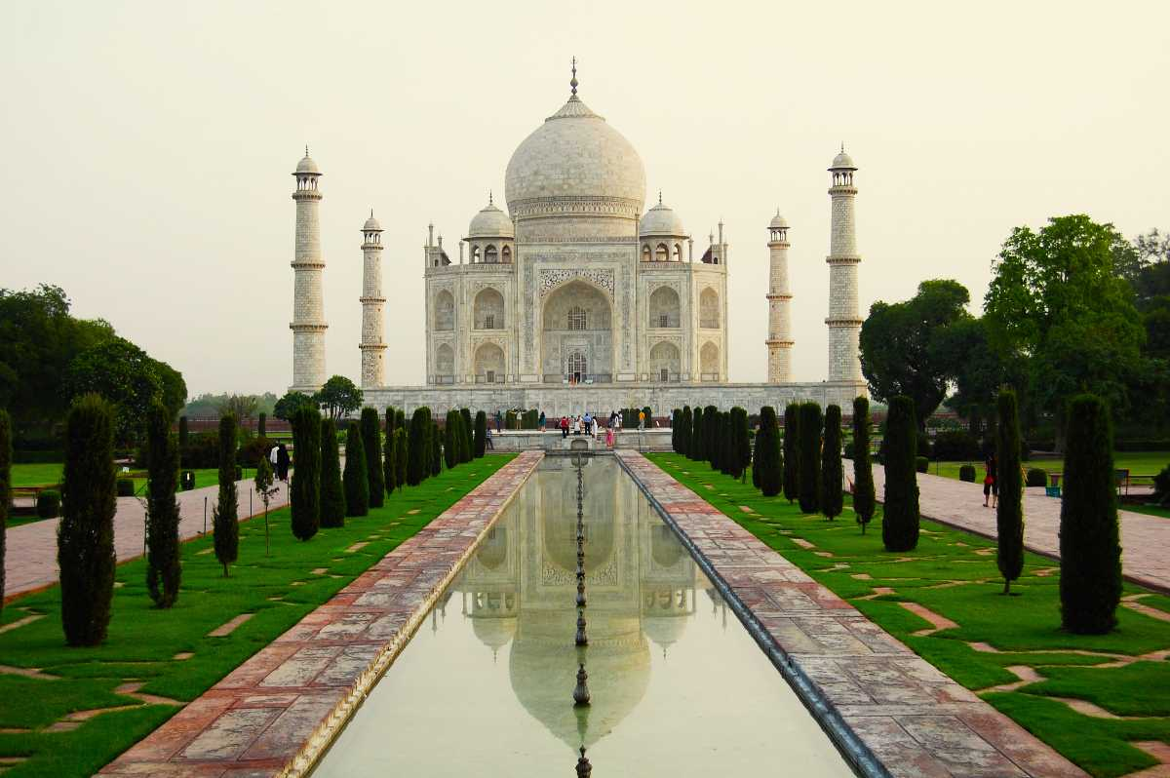
Unveiling India's Heritage Through AI Using CNN
Guide - Dr. Reena Roy R
Team Members:
21BCE1431 Adithya S Nair
21BCE1440 Charvi Upreti
21BCE1329 Teja Pasonri

Slide 2
Abstract
This project aims to develop an intelligent system capable of recognizing various monuments from image inputs.
The system utilizes a custom-built Convolutional Neural Network (CNN) image classifier for monument recognition.
Upon successful identification, the system displays the name of the recognized monument along with a few lines of information about it to the user.
Additionally, efforts will be made to integrate multiple languages to enhance accessibility for diverse users.

Slide 3
Introduction
Problem: Many individuals may not actively seek out information about cultural landmarks and historical monuments, leading to a lack of awareness and knowledge about India's rich cultural heritage.
Solution: A monument recognition system addresses this issue by providing automated identification and information for various monuments through image inputs. Users can easily access detailed information about recognized monuments without actively seeking it out.
Benefits:
Facilitates cultural education: The monument recognition system offers individuals the opportunity to learn about Indian culture and heritage effortlessly by providing information about recognized monuments.
Encourages exploration: Users can explore and discover information about different monuments by simply uploading images, encouraging curiosity and engagement with cultural landmarks.
Cultivates appreciation: By providing insights into the historical significance and architectural beauty of monuments, the system fosters appreciation for India's diverse cultural heritage.
Significance: The monument recognition system represents a significant advancement in leveraging technology to promote cultural awareness and education.

Slide 4
Objective
Objective of this project is to serve as an education tool to provide name and information about the monument whenever an image is uploaded.
This tool will help people learn more about monuments. This can help preserve and spread knowledge about our cultural heritage.

Slide 5
Problem Statement
The problem at hand is the lack of widespread awareness and knowledge about India's cultural landmarks and historical monuments among the general populace. Many individuals may not actively seek out information about these monuments, leading to a gap in understanding and appreciation of India's rich cultural heritage. This lack of awareness can hinder efforts to preserve and promote cultural landmarks, potentially resulting in neglect or underappreciation of these significant sites. Thus, there is a need for a solution that can effectively bridge this gap by providing accessible and engaging ways for individuals to learn about and engage with India's cultural heritage.

Slide 6
S.No. | Title | Year | Author Name | Conclusion | Reference Link
1 | Survey Study: Monument Recognition using Artificial Intelligence | 2023 | Mennat Allah Hassan, Alaa Hamdy, Mona Nasr | Integrated AI and cultural heritage documentation through computer vision and natural language processing, highlighted the practicality of AI in cultural preservation, and suggested the need for scalability and adaptability exploration. | https://fcihib.journals.ekb.eg/article_306352_b38eb7151c318636a0c69b3099cab9e8.pdf?lang=en
2 | Artificial intelligence-based visual inspection system for structural health monitoring of cultural heritage | 2022 | M. Mishra, T. Barman, G.V. Ramana | Advanced AI for accurate identification of architectural elements, emphasized the potential of AI to enhance conservation and foster a meticulous understanding of historical structures, acknowledged the need to address ethical considerations and biases. | https://doi.org/10.1007/s13349-022-00643-8
3 | Sustainable Tourism Development Using Leading-edge Artificial Intelligence (AI), Blockchain, Internet of Things (IoT), Augmented Reality (AR) and Virtual Reality (VR) Technologies | 2023 | Nitin Rane, Saurabh Choudhary, Jayesh Rane | Explored AI-driven virtual tours through VR and AR for heritage exploration, suggested the need for a deeper exploration of user perceptions and the effectiveness of immersive experiences in conveying historical narratives. | http://dx.doi.org/10.2139/ssrn.4642605
4 | HierarchyNet: Hierarchical CNN-Based Urban Building Classification | 2020 | Salma Taoufiq, Balázs Nagy, Csaba Benedek | The Branch Convolutional Neural Network performs better than it's counterpart. The proposed model explicitly incorporates knowledge obtained from a coarser level as input to the finer level via a multiplicative layer. This improves the accuracy of the overall model while using significantly less parameters. | https://www.mdpi.com/2072-4292/12/22/3794

Slide 7
S.No. | Title | Year | Author Name | Conclusion | Reference Link
5 | Heritage Identification of Monuments using Deep Learning Techniques | 2023 | Sowjanya Jindam, Jaimini Keerthan Mannem, Meena Nenavath, Vineela Munigala | Initially, satellite images were sourced from platforms such as Google Earth. Following this, features were extracted using techniques like LBP (Local Binary Patterns) and MSD (Mean-Shift Detection). The architectural framework adopted for analysis was a CNN (Convolutional Neural Network) model. Data division involved allocating 30% for testing purposes and 70% for training. Finally, the user interface (UI) was developed using the Streamlit framework. | https://www.ijipr.latticescipub.com/wp-content/uploads/papers/v3i4/D1022063423.pdf
6 | EXABSUM: a new text summarization approach for generating extractive and abstractive summaries | 2023 | Zakariae Alami Merrouni, Bouchra Frikh and Brahim Ouhbi | This paper presents a novel text summarization tool capable of producing two distinct types of summaries: one employing extractive techniques and the other abstractive methods. In the extractive approach, the initial step involves tokenizing the first sentence, converting it to lowercase, performing part-of-speech tagging, lemmatization, and removing stop words. Subsequently, redundancy detection is conducted to retain only non-repetitive sentences. Relevance scores are then assigned to each sentence, and the summary is generated accordingly. On the other hand, the abstractive method involves compressing and merging sentences, followed by a re-ranking process based on the quantity and relevance of key phrases present. which are then used for summary generation. | https://link.springer.com/article/10.1186/s40537-023-00836-y
7 | Multidimensional comparison of Chinese-English interpreting outputs from human and machine: Implications for interpreting education in the machine-translation age | 2024 | Yiguang Liu, Junying Liang | The limitations of MT systems were revealed in narrowing down interpreting into a word-to-word information transfer. The AI-supported human interpreting is promising. | https://www.sciencedirect.com/science/article/pii/S0898589824000068

Slide 8
S.No. | Title | Year | Author Name | Conclusion | Reference Link
8 | Moments of relational work in English fan translations of Korean TV drama | 2020 | Miriam A. Locher | The analysis of scenes in Korean TV drama shows that even when the complex nuances of the Korean original is lost, the viewers can still understand the importance and gain cultural insight. | https://www.sciencedirect.com/science/article/pii/S0378216620301843
9 | Semantic-Summarizer: Semantics-based text summarizer for English language text Semantic-Summarizer: Semantics-based text summarizer for English language text | 2023 | Mudasir Mohd, Nowsheena, Mohsin Altaf Wani, Hilal Ahmad Khanday, Umar Bashir Mir, Sheikh Nasrullah, Zahid Maqbool, Abid Hussain Wani | The paper introduces SemanticSum, a Python-based text summarizer that utilizes libraries such as scikit-learn, PyTorch, and gensim. In the final version, users have the capability to upload a PDF document, which is then processed and analyzed by the system to generate summaries. These summaries are subsequently presented to the user via the system's web interface. The summarizer employs Natural Language Processing (NLP) techniques for its operation. Initially, inconsistencies are addressed by removing stopwords, punctuation marks, converting text to lowercase, lemmatizing, and eliminating URLs. Following this, Word2Vec is employed to capture the semantics of the text, followed by clustering, and finally, a novel ranking algorithm is applied. | https://www.sciencedirect.com/science/article/pii/S2665963823001197
10 | Landmark Recognition Model for Smart Tourism using Lightweight Deep Learning and Linear Discriminant Analysis | 2023 | Mohd Norhisham Razali, Enurt Owens Nixon Tony, Ag Asri Ag Ibrahim, Rozita Hanapi and Zamhar Iswandono | UMS landmark dataset was captured and made public. Feature extraction was done using transfer learning approach by reusing the model weights on pre-trained CNN models (Efficient Net (EFFNET), RESNET152, NASNetMobile and MobileNetV2. The extracted features were fed to Linear Support Vector Machine (LSVM), CNN (1D), Gradient-Boosting Decision Tree (GBDT), Stochastic Gradient Descent (SGD) and Multilayer Perceptron (MLP). In this work, Principal Component Analysis (PCA), LinearDiscriminant Analysis (LDA), Boruta and Recursive Feature Elimination (RFE)were evaluated. EFFNET-CNN achieved 100% and 94.26% accuracies on UMS landmark and Scene-15 dataset, respectively. | https://thesai.org/Publications/ViewPaper?Volume=14&Issue=2&Code=IJACSA&SerialNo=25

Slide 9
Some conference papers
S. No. | Title | Year | Author Name | Conclusion | Reference Link
1 | Cathedral and Indian Mughal Monument Recognition Using Tensorflow | 2021 | Aniket N., A.K. Mallick, V. Yadav, H. Ahmad, D.K. Sah, C. Barna | Explored automated monument recognition in India using CNNs, emphasized potential challenges in model interpretability and data diversity for a more comprehensive understanding of India's diverse heritage. | https://doi.org/10.1007/978-3-030-51992-6_16
2 | An AI Lens on Historic Cairo | 2020 | Ahmed El Antably, Ahmed S. Madani | Applied semantic segmentation for monument conservation, highlighted AI's role in identifying areas of deterioration on historical structures, acknowledged the scalability challenges and the need for practical implementation in real-world conservation scenarios. | https://papers.cumincad.org/data/works/att/acadia20_426.pdf
3 | A Study on Efficient Image Classification of Historical Monuments Using CNN | 2023 | Sarika Khandelwal, Arunesh Prasad, Anshuman Kumar, Jaanhavi Gautam, Aishwarya Patle | CNN models like ResNet50, InceptionResNetV2, EfficientNetB1, EfficientNetB3, and MobileNetV2 were used to classify Indian monuments. They trained these models on a dataset which has over 4,000 images of 24 different types of monuments. The model’s accuracy was improved by tuning various parameters and using data augmentation techniques. The maximum accuracy attained was with MobileNetV2 model with accuracy of 99.7% on train set and a validation accuracy of 95.58%. | https://ieeexplore.ieee.org/document/10220670
4 | A Hybrid Deep Learning Approach for Multi-Classification of Heritage Monuments Using a Real-Phase Image Dataset | 2023 | Vinay Kukreja, Rishabh Sharma, Satvik Vats | Employed a hybrid approach with convolutional neural networks (CNNs) and long short-term memory (LSTM) models. The maximum accuracy of 92.37% was achieved in binary classification (heritage vs. non-heritage) for recognizing monuments and further a 95.89% accuracy was attained in multi-classification across four categories. | https://ieeexplore.ieee.org/document/10220787

Slide 10
Some conference papers
S. No. | Title | Year | Author Name | Conclusion | Reference Link
5 | Identification of monuments from Aerial images using deep learning Techniques | 2023 | Gautam Kumar Jaiswal, Renu Chaudhary, Mohit, Srishty | Collected approximately 2000 images for the study. Subsequently, data annotation was carried out, incorporating bounding boxes for labeling. To enhance the dataset, data augmentation techniques such as resizing, re-scaling, rotating, adjusting brightness, and mosaic application were applied. The evaluation of model performance revealed an accuracy of 63% using the VGG-16 architecture and an impressive 90% accuracy using the YOLOv5 PyTorch model. | https://www.ijeast.com/papers/123-129,%20Tesma0802,IJEAST.pdf
6 | Intelligent English Translation Model Based on Improved GLR Algorithm | 2023 | Shengbo Yang | The accuracy of English translation is 75.1% before modification and 99.1% after using smart text. The English translation knowledge model is highly accurate and can meet the needs of English translation. | https://www.sciencedirect.com/science/article/pii/S1877050923018859
7 | A French-to-English Machine Translation Model Using Transformer Network | 2022 | Taoling Tian, Chai Song, Jin Ting, Hongyang Huang | The model can be applied to translation of languages with large lexical databases. It achieves a translation accuracy of 80% for French to English translation. | https://www.sciencedirect.com/science/article/pii/S1877050922001831
8 | Role of Artificial Intelligence in Preservation of Culture and Heritage | 2020 | Bishwa Ranjan Das, Hima Bindu Maringanti, Niladri Sekhar Dash | Explored AI applications in archaeological studies in India, showcased AI's potential in uncovering lesser-known archaeological sites, emphasized the collaborative approach with traditional methodologies, and called for a deeper investigation into the dynamics of this interdisciplinary interaction. | https://books.google.co.in/books?hl=en&lr=&id=YLOGEAAAQBAJ&oi=fnd&pg=PA92&dq=applications+of+artificial+intelligence+(AI)+in+archaeological+studies,+particularly+in+the+context+of+India&ots=wS8lvCZVX1&sig=of-NXYLyQPIbmQ2ZX3gpZWBOigM&redir_esc=y#v=onepage&q&f=false

Slide 11
Summary Of Existing Paper
Previously, various CNN architectures such as Efficient Net (EFFNET), RESNET152, NASNetMobile, and MobileNetV2 were utilized for classifying Indian monuments.
Additionally, VGG16 and YOLOv5 were employed for this purpose. Furthermore, CNN models combined with Long Short-Term Memory (LSTM) were also utilized for the classification of Indian monuments.

Slide 12
Proposed Idea
Dataset: https://www.kaggle.com/datasets/danushkumarv/indian-monuments-image-dataset
Web page to upload image and display information after detection.
CNN for image classification.

Slide 13
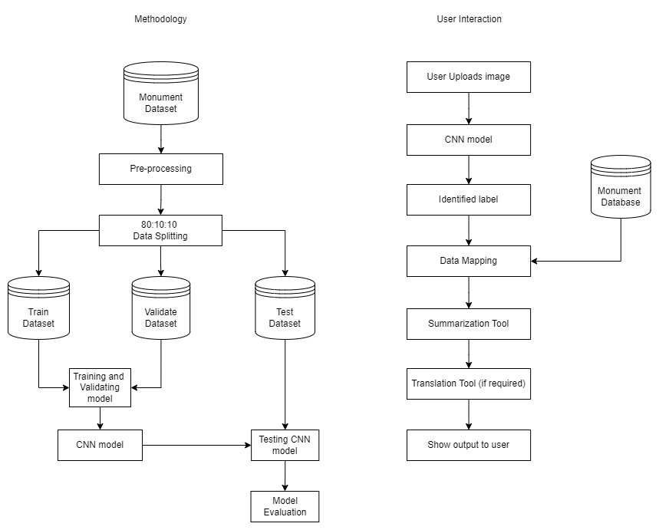
Architecture Diagram

Slide 14
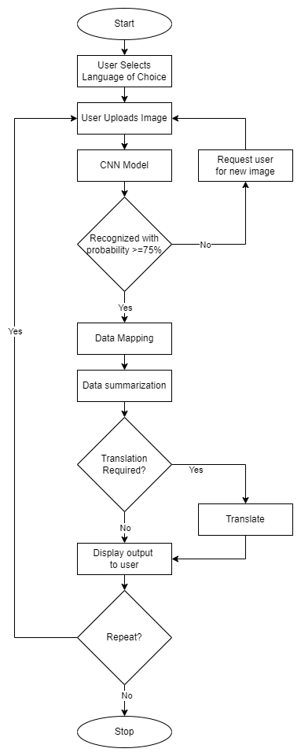
Block Diagram

Slide 15
Thank You

