Slide 1
IT Project Team 1 Arjen Schuurman Dennie Grondelaers Jesse Vranken Niek Vandael Academiejaar 2015-2016

Slide 2
I-Talent Platform
Web Application
Kickstarter
Pitch Idea with Media
Like/Subscribe
Status Updates

Slide 3
I-Talent Platform
Tasks:
Planning
Communication
Analysis
Documentation
Development
Quality Management

Slide 4
I-Talent Platform
Goals:
Web Based
Future Proof
Secure
Single Page
Open Source

Slide 5
I-Talent Platform
Action:
Brainstorming
Meetings
Analysis
And finally…coding!!

Slide 6
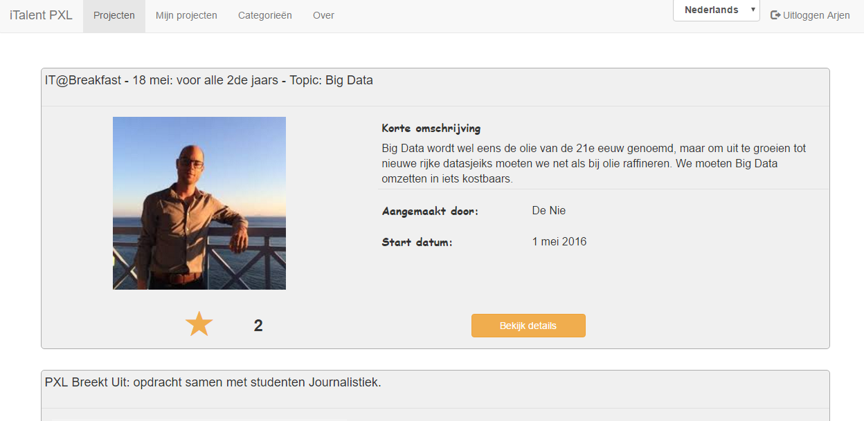
I-Talent Platform
First result:

Slide 7
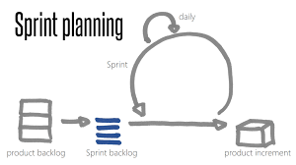
Reflection
Planning : Agile
Requirements is a starting point

Slide 8
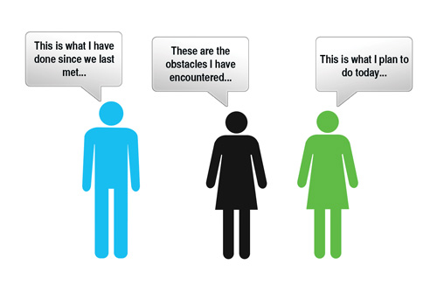
Reflection
Meetings: keep it short !

Slide 9
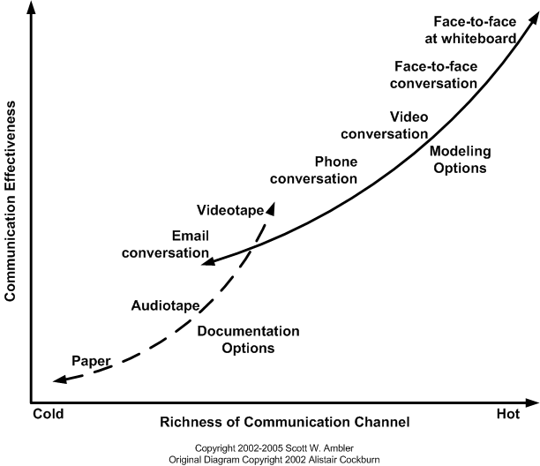
Communication

Slide 10
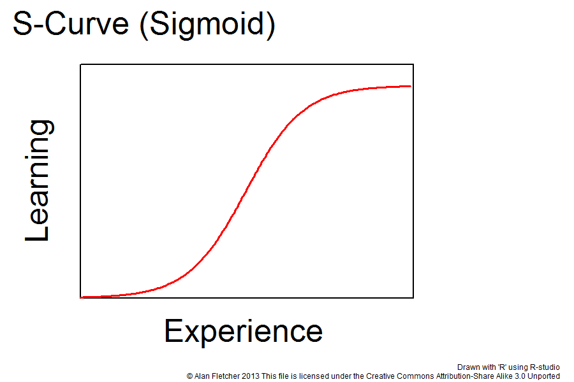

Tooling

Slide 11
We would keep
Daily communication
Open Source Technologies
Build- and Deploy Processes
Planning Tools

Slide 12
We would change
Getting the requirements clear
Plan ahead too much

Slide 13
We could change
More face-to-face meetings
Create less analysis

Slide 14
Questions?

