Slide 1
IT-Project Team 1 Arjen Schuurman Dennie Grondelaers Jesse Vranken Niek Vandael
Bart Hunerbein Academiejaar 2015-2016

Slide 2
I-Talent-Platform
Webapplicatie
Ideeën pitchen
Kickstarter
‘Liken’/leuk vinden
Inschrijven/steunen
Commentaar
Opvolging

Slide 3
I-Talent-Platform
Tasks:
Planning
Communicatie
Analyse
Documentatie
Ontwikkeling
Kwaliteitsbeheer

Slide 4
I-Talent-Platform
Doel:
Webapplicatie
Veilig
Single page
Toekomstgericht
Open bron

Slide 5
I-Talent-Platform
Ontwikkelomgeving:
Skype
Openshift
Jenkins
Eclipse/IntelliJ
Git
RTC

Slide 6

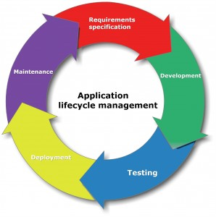



Application Lifecycle Management

Slide 7
Requirement specification
Story board
Task/defect
Continuous integration

Slide 8
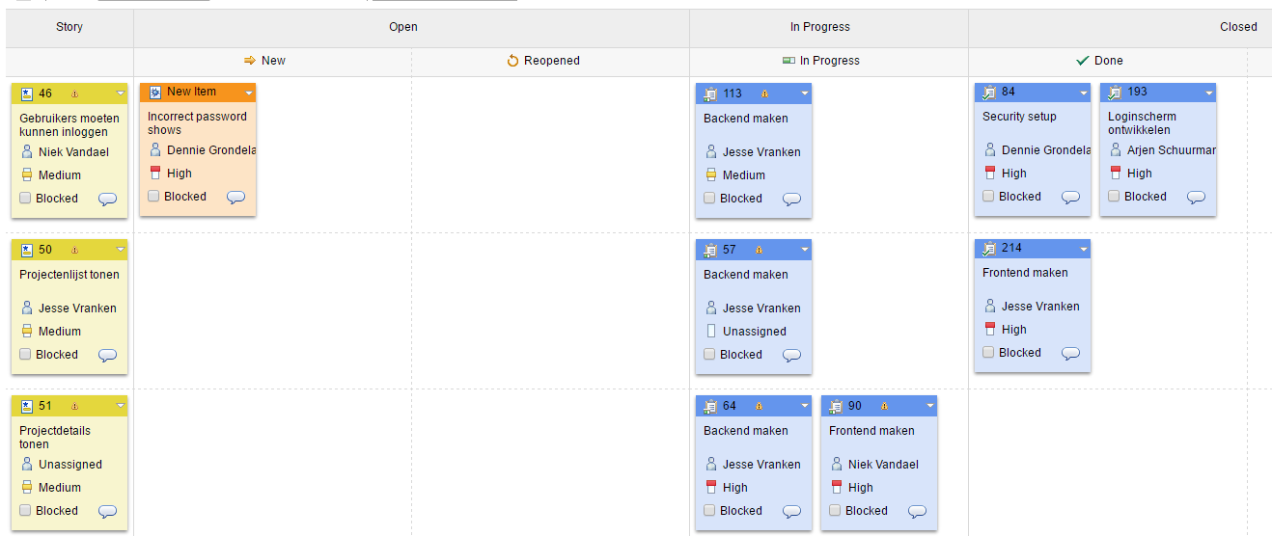
Requirement specification

Slide 9
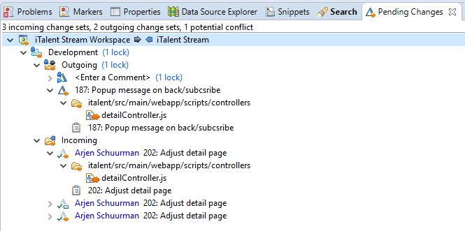
Development
Eclipse + RTC plugin

Slide 10
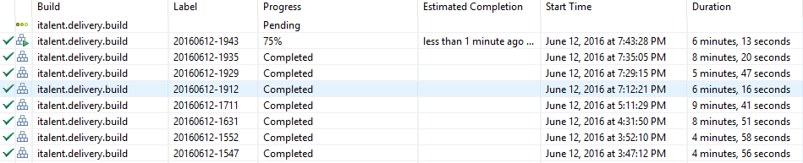
Testing, deployment & maintenance
Testing: Jenkins
Deployment: OpenShift
All OK? Snaphot!

Slide 11
Project metrics

Slide 12
Front-end tools
Bower
AngularJs
Twitter Bootstrap

Slide 13

Bower
Korte bower uitleg.. todo

Slide 14

AngularJs
Korte uitleg AngularJS.. todo

Slide 15

Twitter Bootstrap
Korte uitleg Bootstrap.. todo

Slide 16
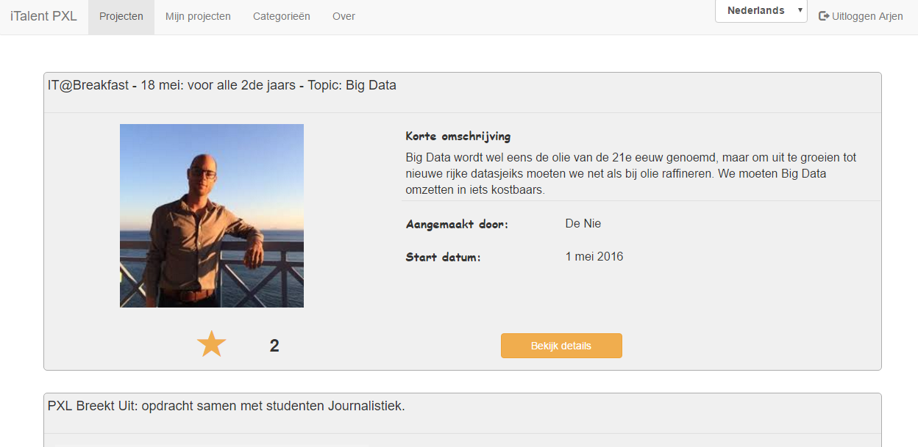
I-Talent-Platform
First results:

Slide 17
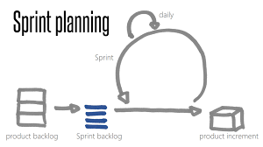
Reflection
Requirements are a starting point
Planning : Agile

Slide 18
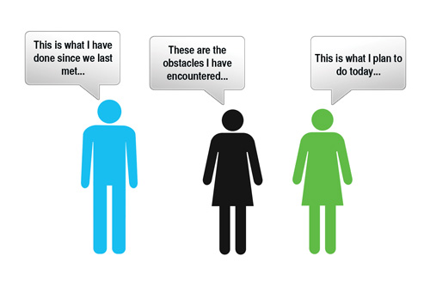
Reflection
Meetings: keep it short !

Slide 19
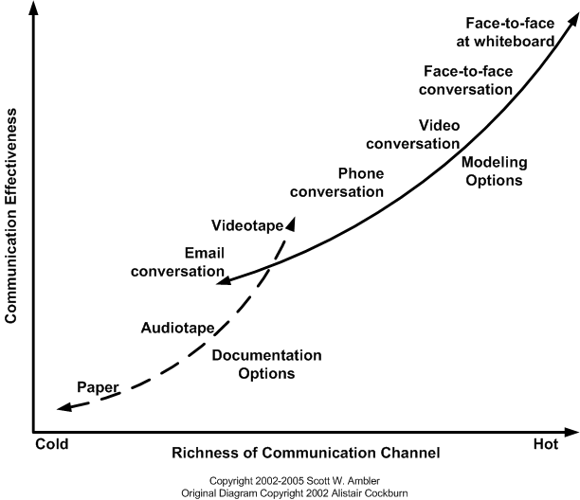
Communication

Slide 20
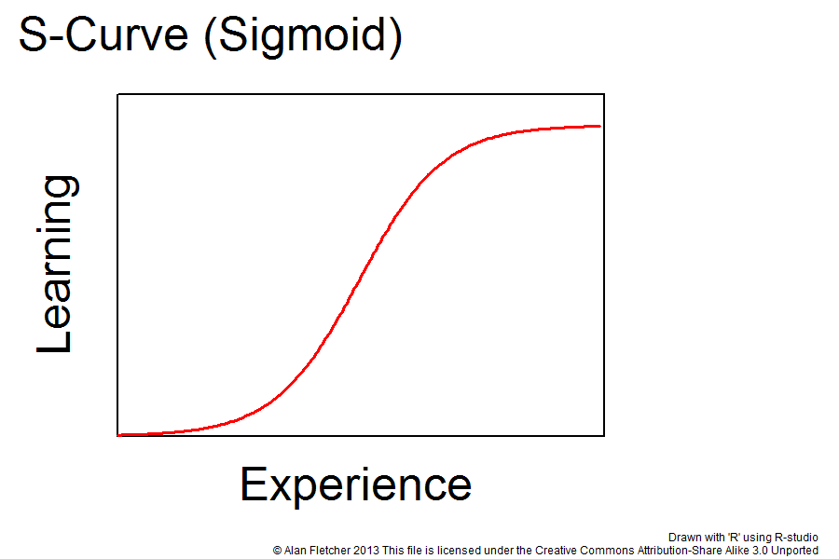

Tooling

Slide 21
We would keep
Daily communication
Open Source/Cross Platform technologies
Build- and deploy processes
SCRUM / Planning tools

Slide 22
We would change
Getting requirements clear
Don’t plan ahead too much
Establish early on what technology to use

Slide 23
We could change
More face-to-face meetings
Create less analysis / when needed

Slide 24
Questions?

