Slide 1
IT-Project Team 1 Arjen Schuurman Dennie Grondelaers Jesse Vranken Niek Vandael
Bart Hunerbein Academiejaar 2015-2016

Slide 2
I-Talent-Platform
Webapplicatie
Ideeën pitchen
Kickstarter
‘Liken’/leuk vinden
Inschrijven/steunen
Commentaar
Opvolging

Slide 3
I-Talent-Platform
Tasks:
Planning
Communicatie
Analyse
Documentatie
Ontwikkeling
Kwaliteitsbeheer

Slide 4
I-Talent-Platform
Doel:
Webapplicatie
Veilig
Single page
Toekomstgericht
Open bron

Slide 5
I-Talent-Platform
Ontwikkelomgeving:
Skype
Openshift
Jenkins
Eclipse/IntelliJ
Git
RTC

Slide 6
I-Talent-Platform
Action:
Brainstorming
Meetings
Analysis
And finally… coding!!

Slide 7
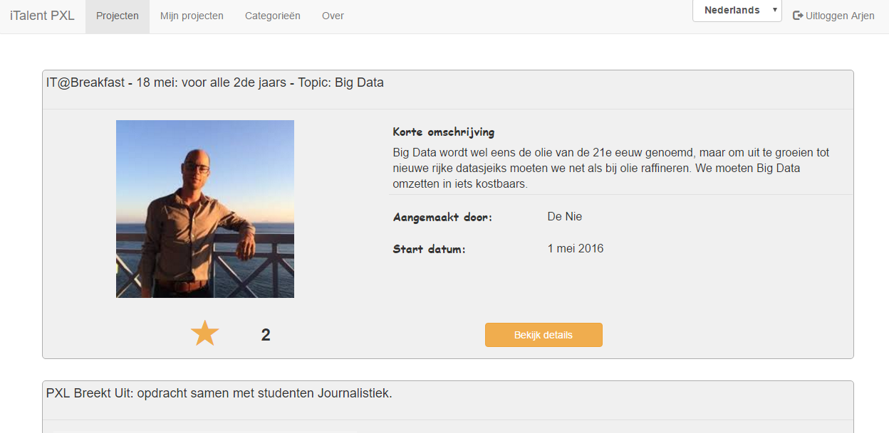
I-Talent-Platform
First results:

Slide 8
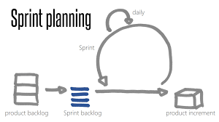
Reflection
Requirements are a starting point
Planning : Agile

Slide 9
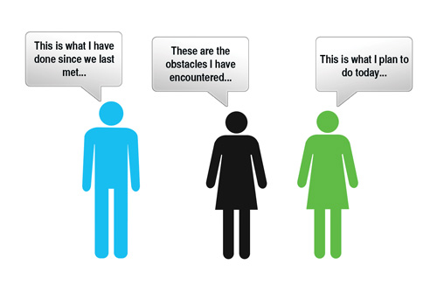
Reflection
Meetings: keep it short !

Slide 10
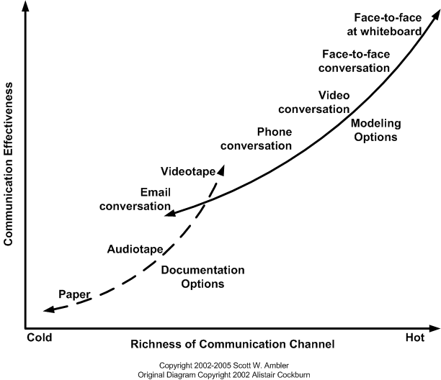
Communication

Slide 11
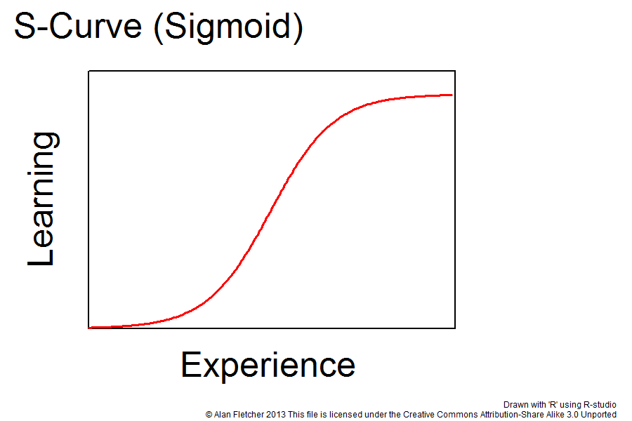

Tooling

Slide 12
We would keep
Daily communication
Open Source/Cross Platform technologies
Build- and deploy processes
SCRUM / Planning tools

Slide 13
We would change
Getting requirements clear
Don’t plan ahead too much
Establish early on what technology to use

Slide 14
We could change
More face-to-face meetings
Create less analysis / when needed

Slide 15
Questions?

