Slide 1
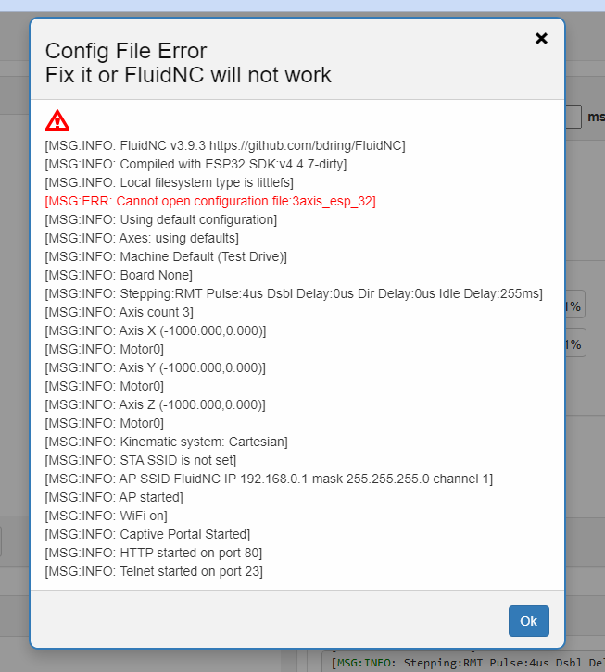
I keep getting the error that it can not open
Configuration file: 3axis_esp_32

Slide 2
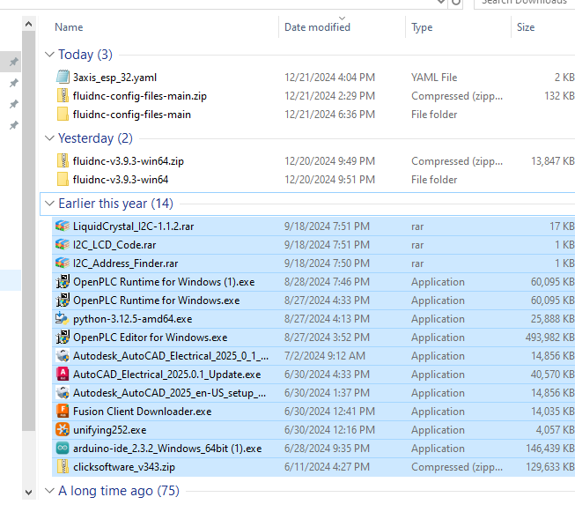
This is a screen shot of the file system on my computer.
The file is selected under my download folder and then uploaded to the ESP32.

Slide 3
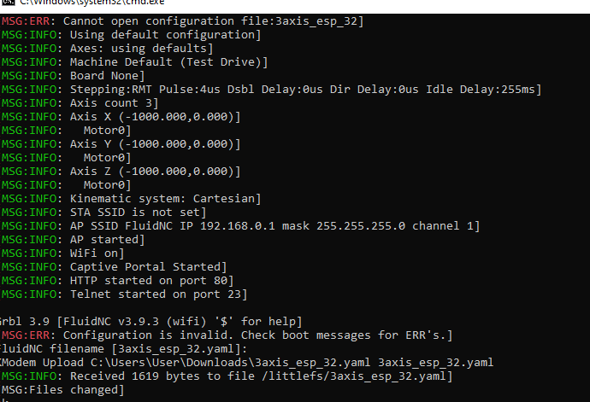
The file is selected under my download folder and then uploaded to the ESP32 using the command CTRL_U with the terminal. As you can see it was received.

