Slide 1
ERC Meeting
October 1 2024
Present: Jon, Kim, Shane, Minghua, Wubing, Martina

Slide 2
From Discussion:
https://esajournals.onlinelibrary.wiley.com/doi/10.1002/ecm.1628
https://global-surface-water.appspot.com/

Slide 3






Local
Driver
Biodiversity
Measures
Regional
Driver

Slide 4


WP3: Resurveys of zooplankton metacommunities in ponds and wetlands
Time 1
Time 2

Slide 5
WP3: Resurveys of zooplankton metacommunities in ponds and wetlands
Salinity
Hydroperiod
Pond size
...
Time 1
Time 2

Slide 6
WP3: Resurveys of zooplankton metacommunities in ponds and wetlands
Salinity
Hydroperiod
Pond size
...
Time 1
Time 2
Habitat loss
Land use change
...

Slide 7
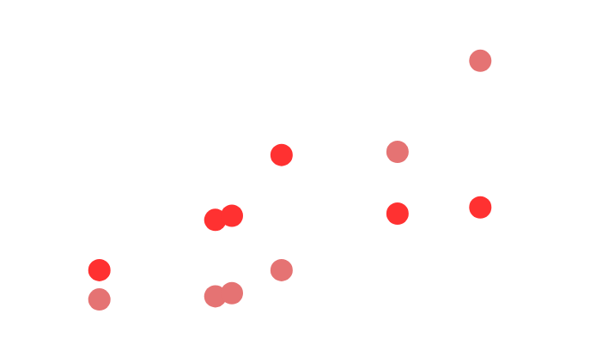

Biodiversity
Measure(s)
Local Driver(s)
Regional Driver(s)

Slide 8
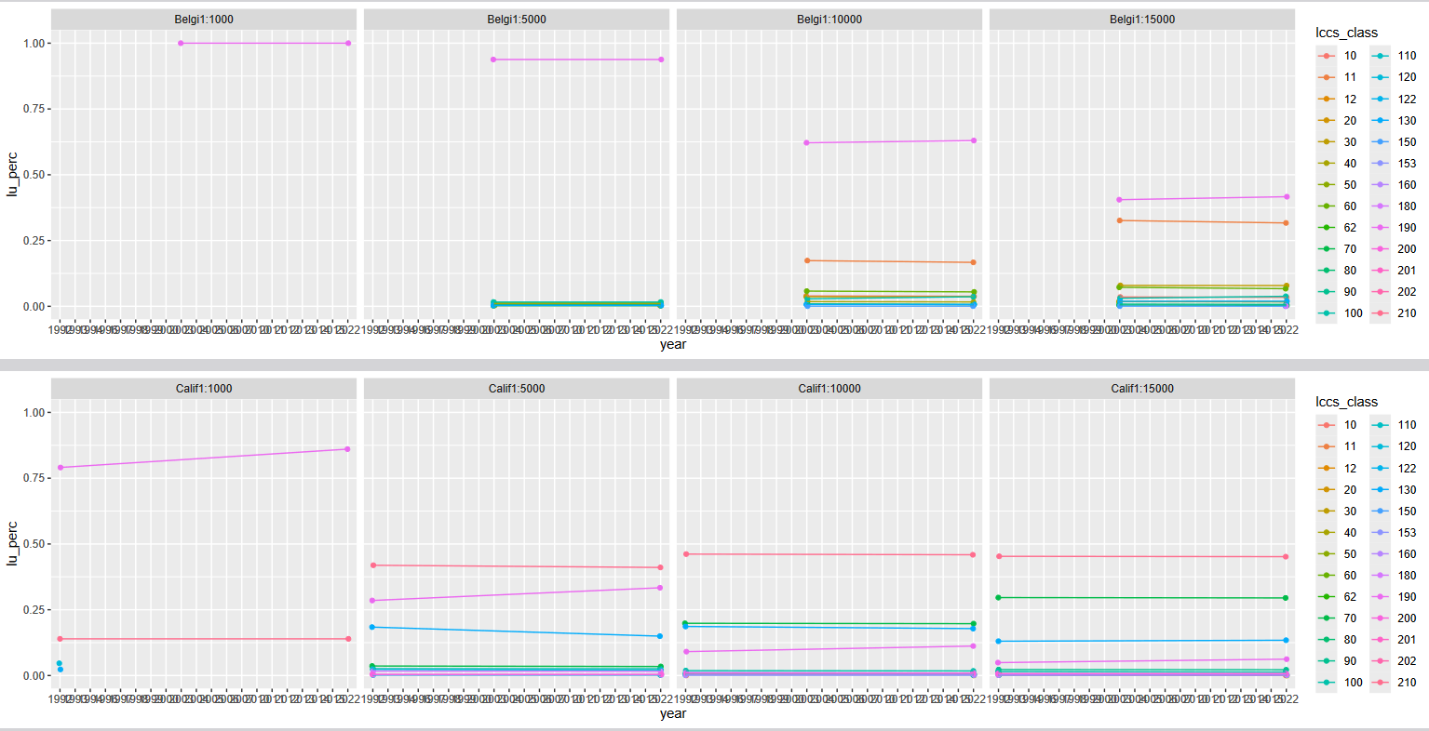
Regional Driver--Land use change (Alban)

Slide 9
WP3: Resurveys of zooplankton metacommunities in ponds and wetlands
Time 1
Time 2
What local driver data is available?

Slide 10
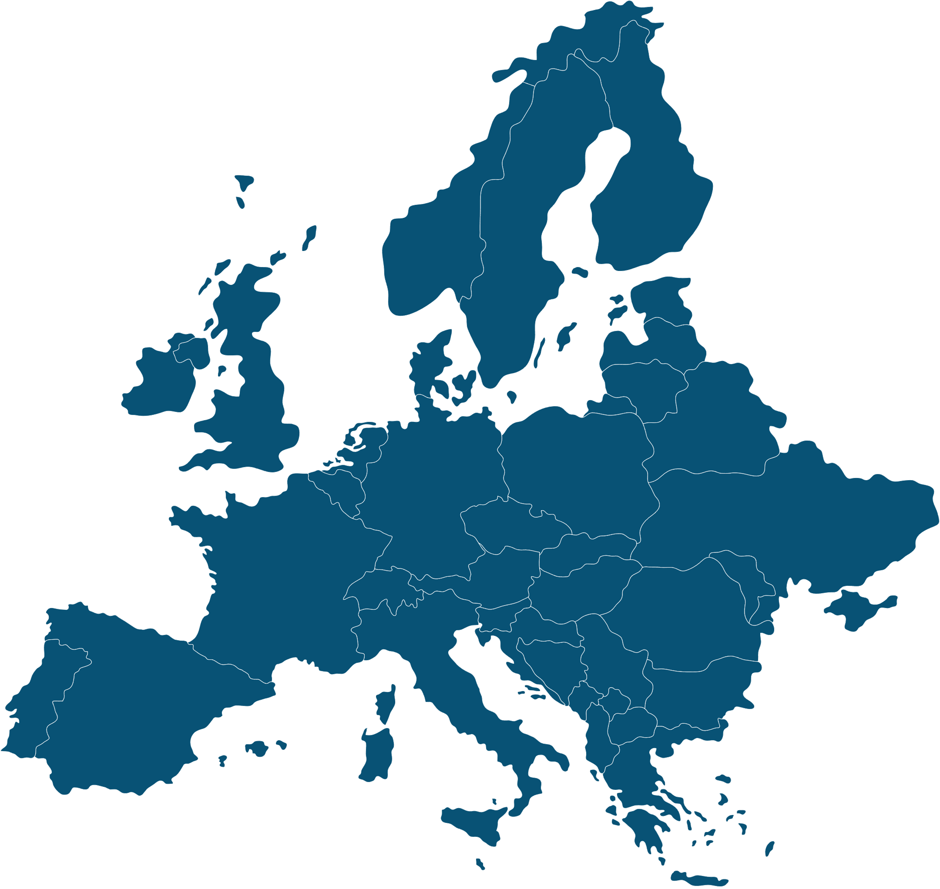

Geographical distribution

Slide 11
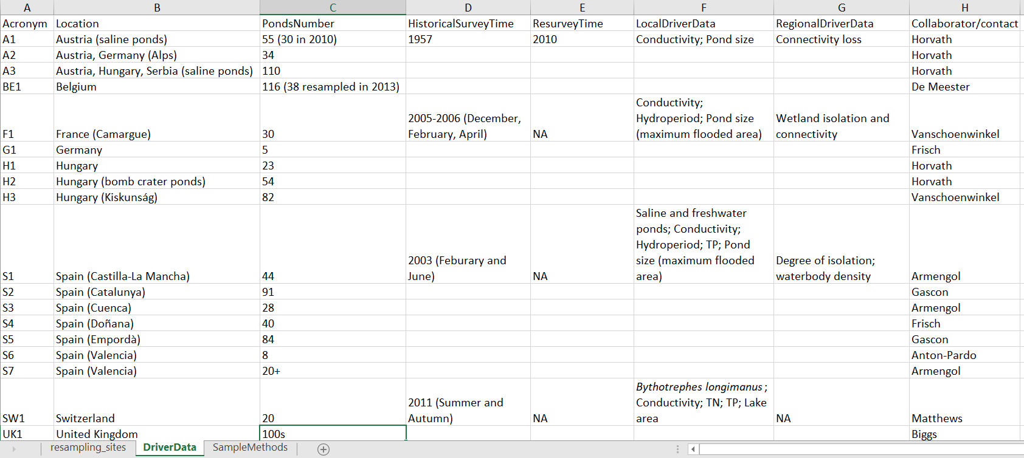
Local Driver

Slide 12
Next steps
Decide local and regional drivers
Decide the sites according to total sample and lab time length (lab time = 10*field work time)
Get the historical data
Extract sampling methods of each study
Decide sampling months and methods for each meta community (The historical sample happened at different seasons)
Feedback

