Slide 1
Spatial scale and macroecology
Petr Keil
petr.keil@idiv.de
github.com/petrkeil

Slide 2


Slide 3
1. Geographic range and its size

Slide 4
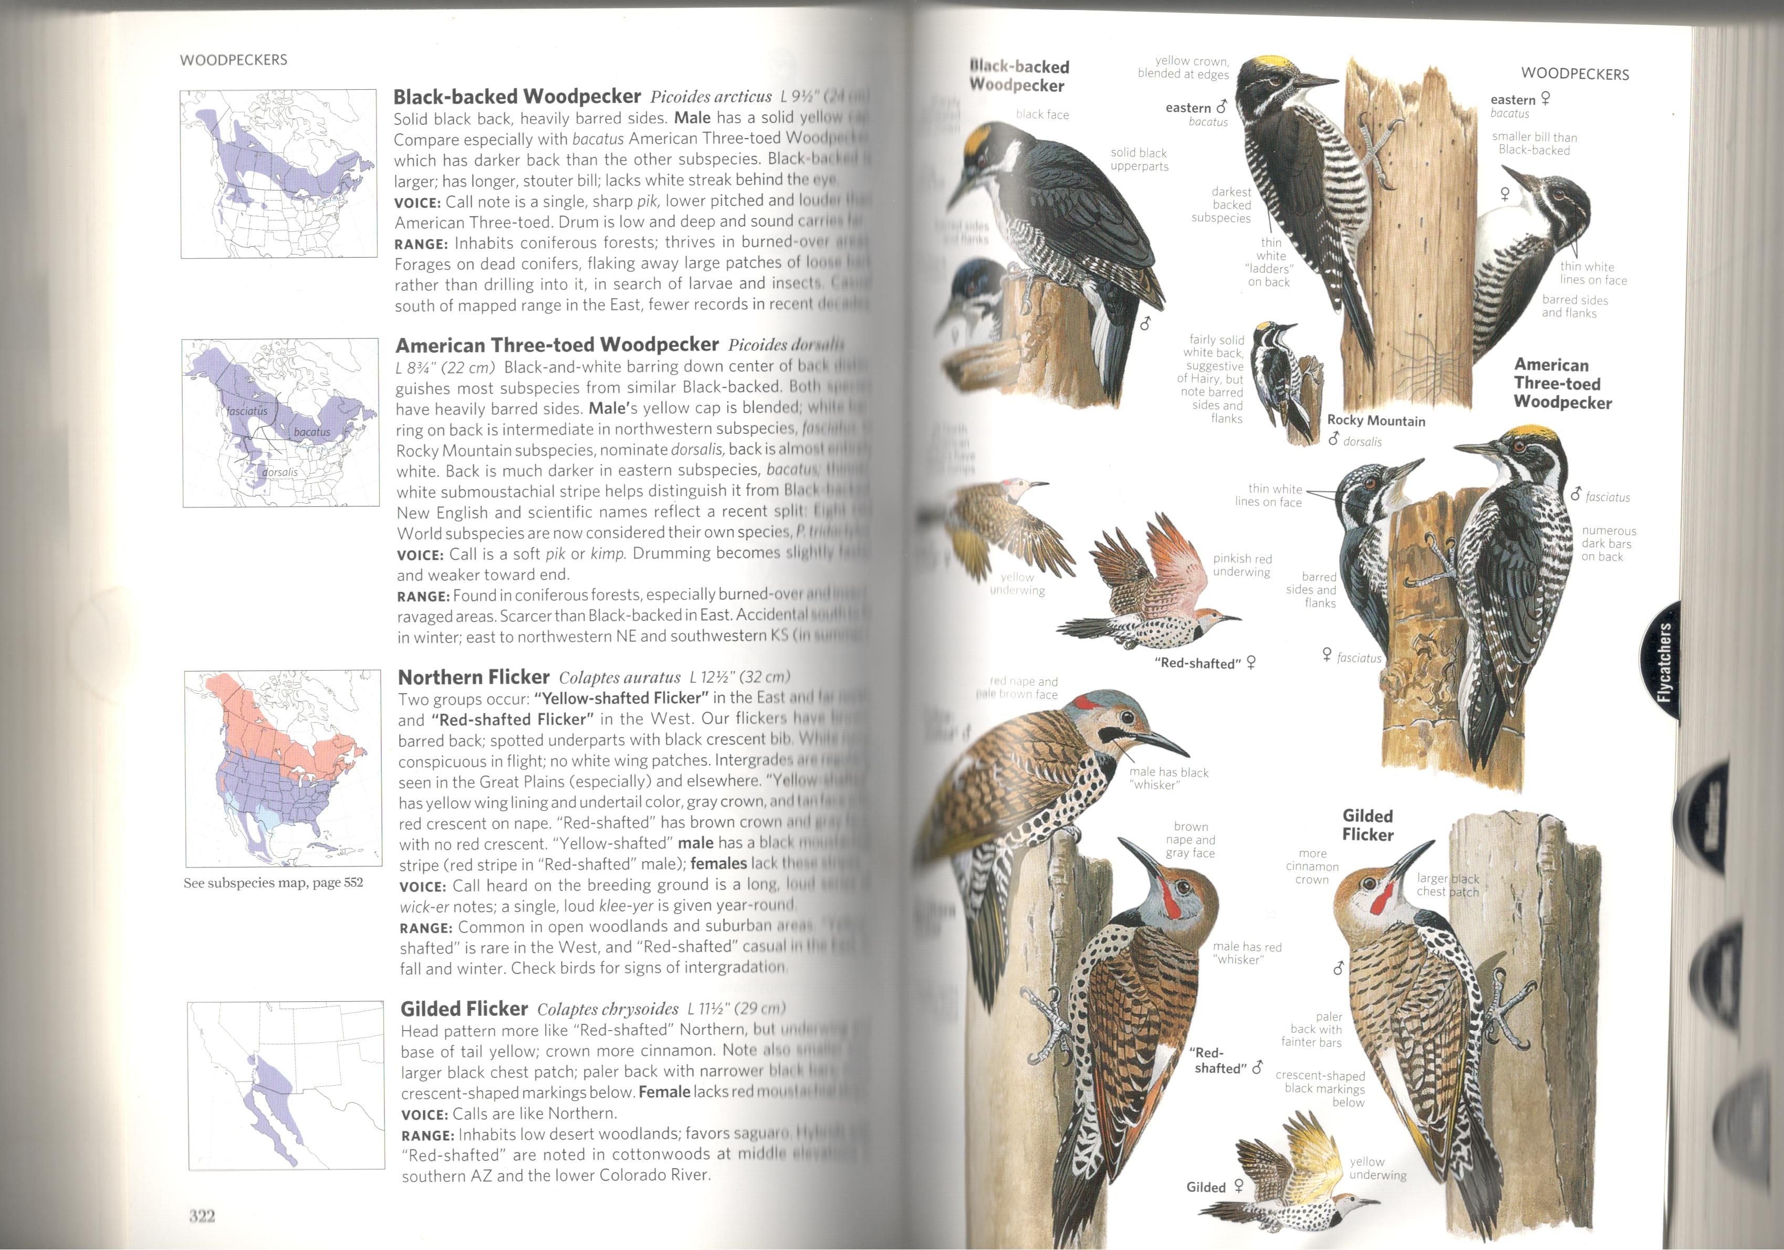
Geographic range – widespread and rare species

Slide 5
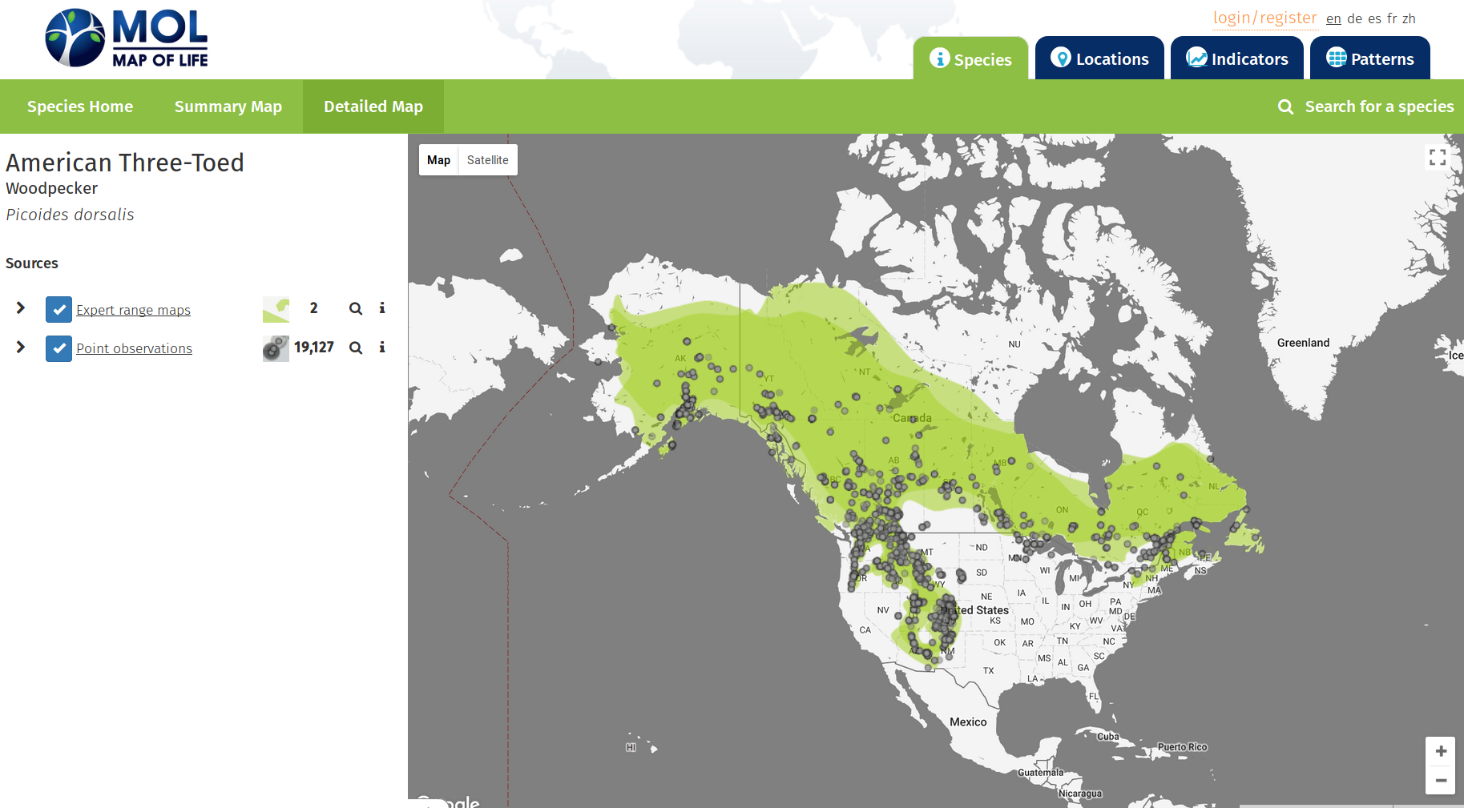
Geographic range – expert range maps vs. point observations

Slide 6
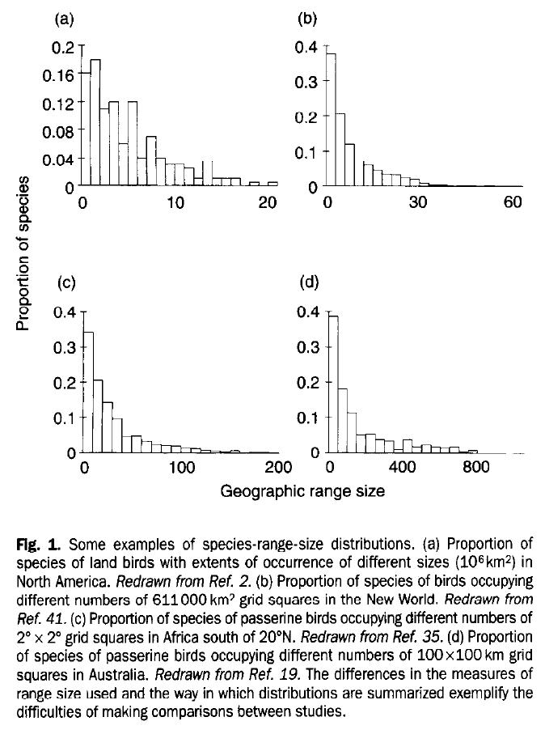
Geographic range – most species are rare

Slide 7
Geographic range size is a fundamental quantity in basic macroecology, macroevolution, and biogeography.
Is species rare or widespread?
Is it endemic or pandemic?
Is it an invasive alien?
Where are the areas with many rare species?
Are geographic ranges shrinking or expanding?
Why are there so many species in the tropics?

Slide 8
Geographic range size is a key predictor of extinction risk (Purvis et al. 2000 Proc R Soc B, Thomas et al. 2004 Nature).

