Slide 1
Introduction to the R package
mobsim
February 12th 2020
Alban Sagouis
Original creator: Felix May

Slide 2
Biodiversity science
Real world
Sampling
???
???
Species A: 10
Species B: 5
Species C: 1
Species D: 1
???
???
Sampling
Scaling
Heterogeneity
Interpretations & Conclusions
???

Slide 3
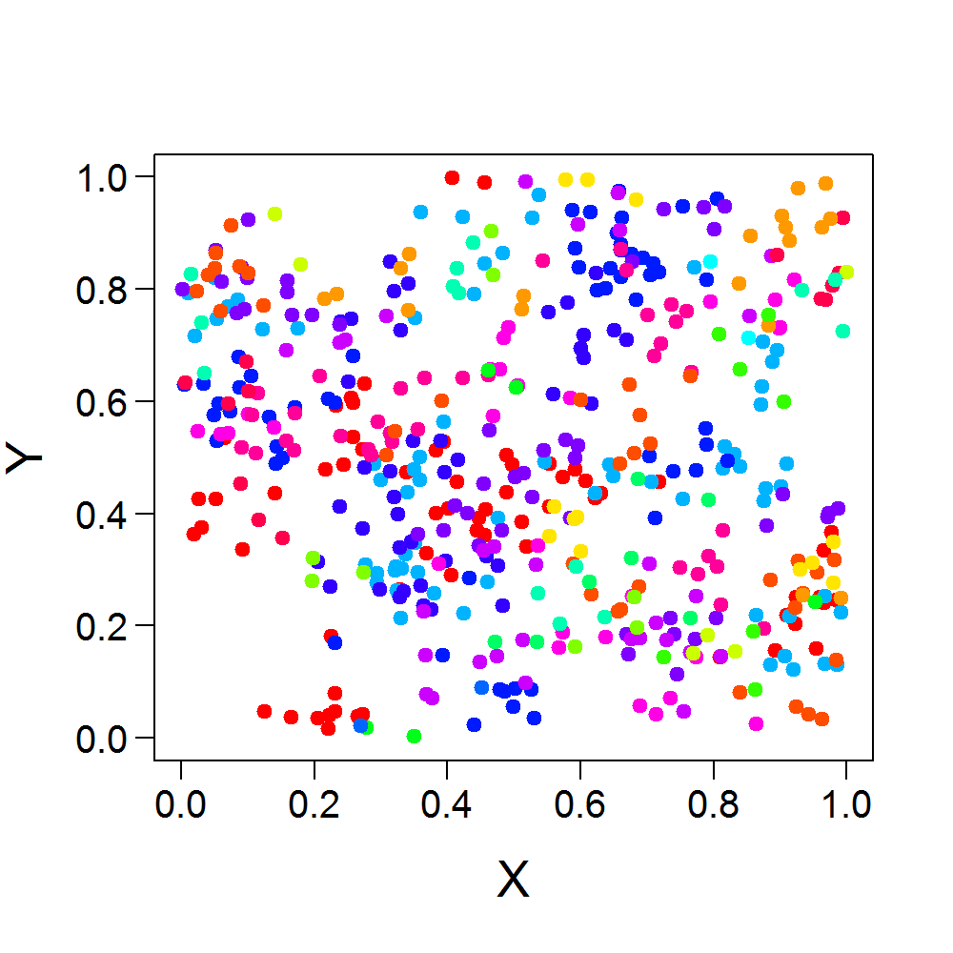
Learning from simulated data
Simulation: complete control
Change parameters
Test hypotheses

Slide 4
Learning from simulated data
Simulation: complete knowledge
Sampling
Species A: 10
Species B: 5
Species C: 1
Species D: 1
Sampling
Scaling
Heterogeneity
Interpretations & Conclusions

Slide 5
Scale and Sampling effect on Species Area Relationships
Degraded Community
Pristine Community
Small Effect
Large effect
10
Species Richness
8
6
4
2
0
0 30 60 90 120 150 180
Area Sampled
Chase and Knight 2013 Ecology Letters

Slide 6

Spatial analysis of scale-dependent biodiversity changes
Biodiversity across scales
Number of individuals
Species relative abundances
Spatial distribution
(e.g. aggregation)
Biodiversity drivers (Land use, climate, invaders, …)
package mobsim

Slide 7
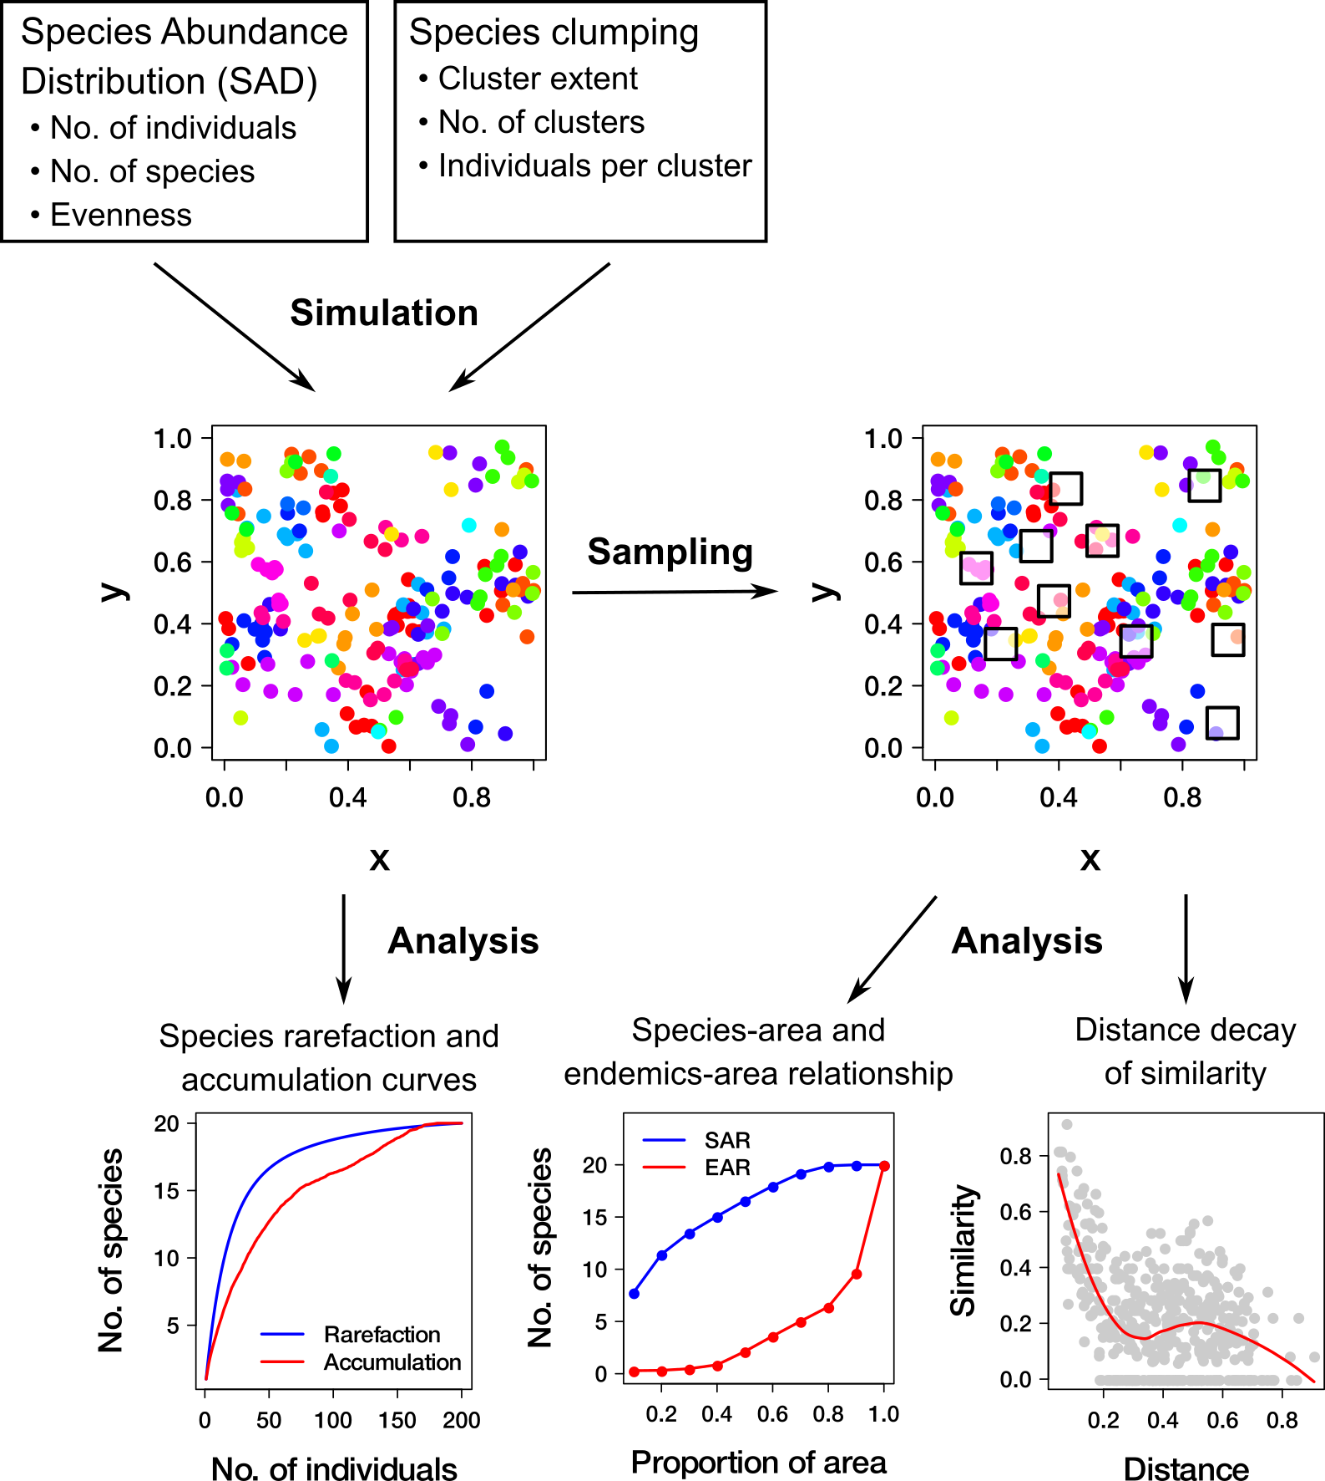
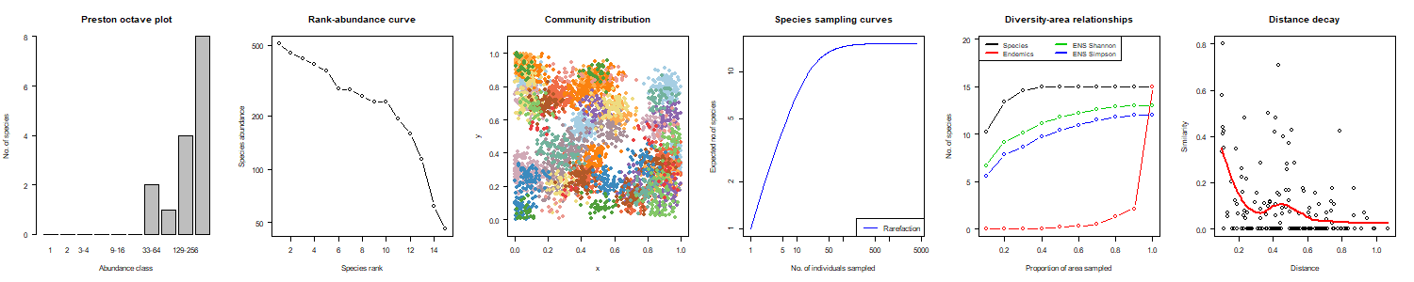
package mobsim
https://github.com/MoBiodiv/mobsim
Aims
Interactive illustration of Measures of Biodiversity
Sensibilization to their sensitivity to sampling
Showing the shiny MOBsim and feedback

Slide 8
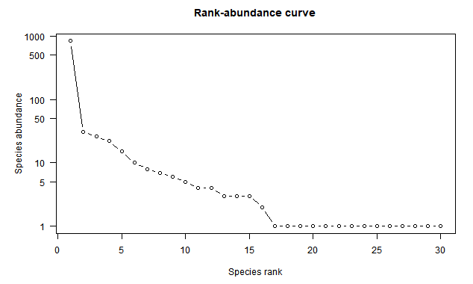
Exercise #1: Biodiversity components
5 minutes
Imagine a realistic community
Forest, bushes, prairie, (ants and termites, small mammals), etc
Using biodiversity components
Species richness (S)
Total abundance (N)
Species abundance distribution (SAD)
Draw your expectations for the rank abundance curve with pen and paper
Use mobsim: SAD - Population simulation to simulate this community
Get familiar with the different SAD types and their parameters
Verify your expectations

Slide 9
Exercise #2: Biodiversity spatial distribution
5 minutes
Imagine a realistic spatial distribution for your community
Intraspecific aggregation (clumping)
Number of mother points
Mean distance to mother points
Draw or describe your expectations as a map (one dot = one individual)
Use mobsim: Space - Distribution simulation to simulate this community
Get familiar with the different cluster types and their parameters. Try giving different parameter values to the species.
Verify your expectations

Slide 10
Exercise #3: Biodiversity components
15 minutes
How do biodiversity components
Total abundance (N)
Species abundance distribution (SAD)
Intraspecific aggregation (clumping)
Influence the measured biodiversity
Rarefaction curve (spec_sample_curve)
Species-area relationship (divar)
Draw your expectations with pen and paper
Use mobsim: Space - Distribution simulation [Exercise 3] to familiarize with these graphical representations of biodiversity sampling tools
Verify your expectations + ecological interpretation

Slide 11
Exercise #3 part 2: Biodiversity components & Biodiversity scaling-relationships 15 minutes
How do biodiversity components
Total abundance (N)
Species abundance distribution (SAD)
Intraspecific aggregation (clumping)
And sampling
Influence the measured biodiversity
Rarefaction curve (spec_sample_curve)
Species-area relationship (divar)
Draw your expectations with pen and paper
Use mobsim: Basic sampling to familiarize with the sampling tools
Verify your expectations + ecological interpretation
What is the best sampling design? Why?
Briefly present your results to the group

Slide 12
Exercise #4: Detection of biodiversity changes across scales
How is the detection of biodiversity changes influenced by the choice of sampling scale and biodiversity index?
Simulate two different communities
Forest vs. Prairie. Forest (species poor, low densities (trees) mixed with clumped and abundant species (bushes and understory), etc) Vs. Prairie (species rich, high densities, low aggregation)
Reference / control
Biodiversity change
Before vs. after a perturbation ; just after a perturbation vs. long after perturbation
Sample both communities in the same way (sample_quadrats)
Apply different sampling designs: vary sample plot size, area and total sampling effort
Calculate relative biodiversity changes (D_{ref}/D_{change} – 1)
Species richness (vegan::specnumber)
Shannon diversity (vegan::diversity)
Simpson diversity / PIE (vegan::diversity)

Slide 13
Exercise #4: Detection of biodiversity changes across scales
How do your conclusions on biodiversity change with sampling and index used?
What does that mean for biodiversity research?

