Slide 1
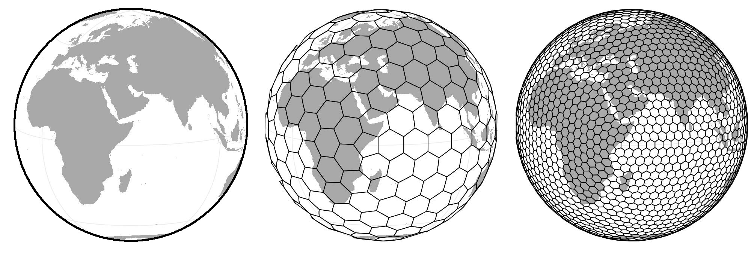
Global patterns of biodiversity
Petr Keil
Postdoc at iDiv, Leipzig, Germany

Slide 2
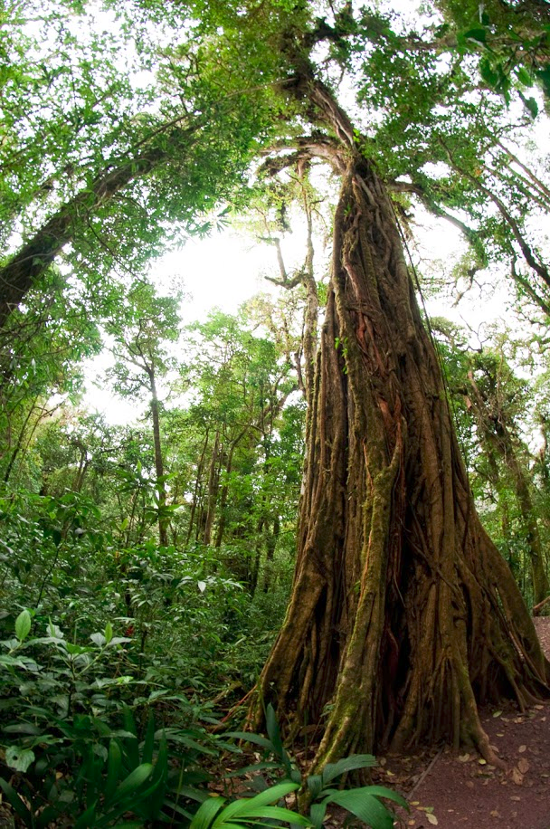
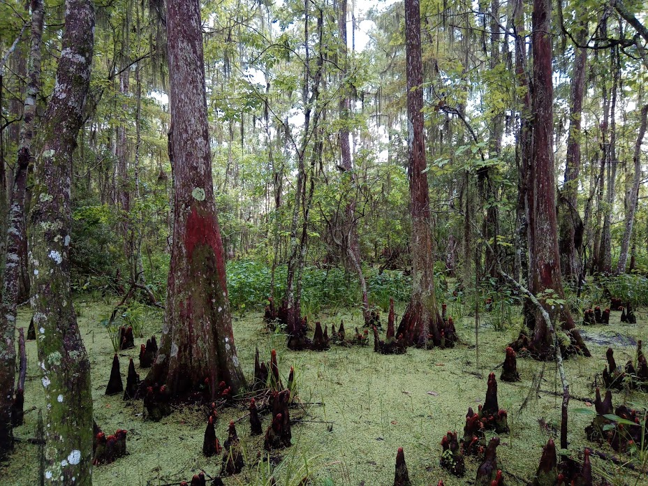
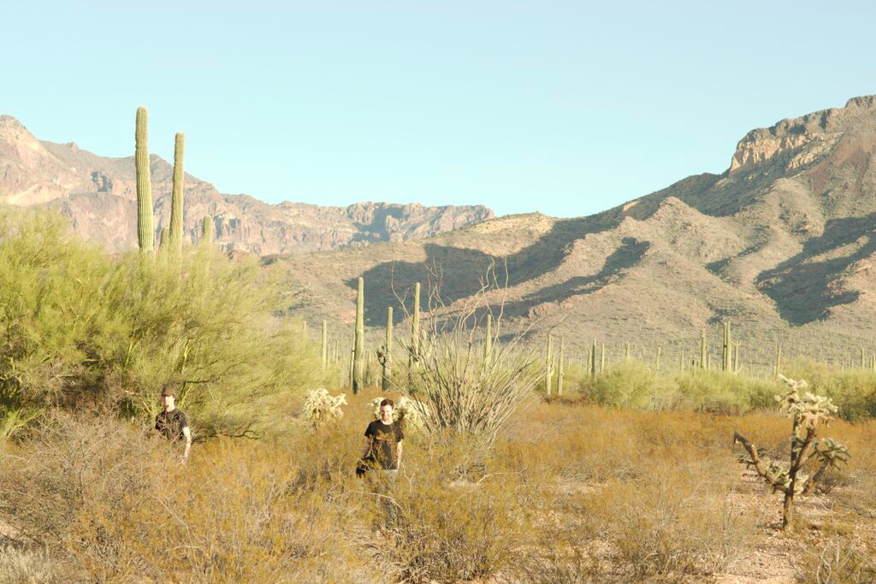

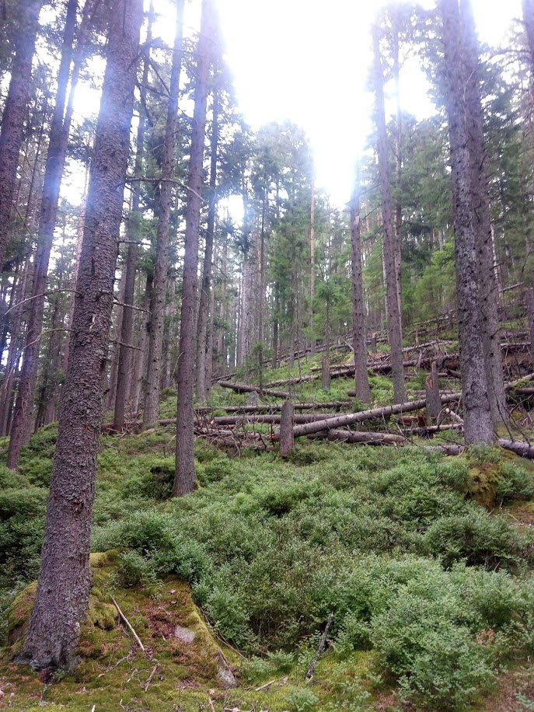
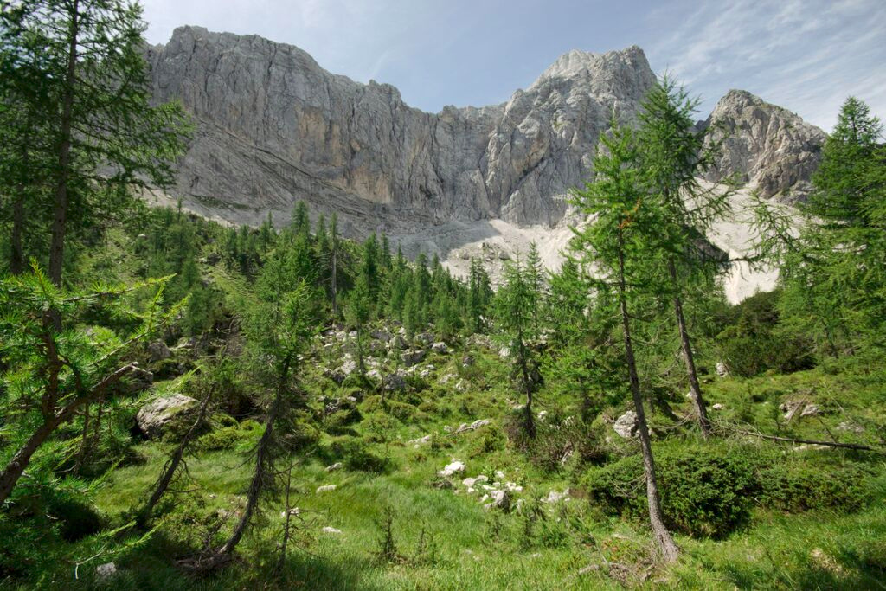
Where on Earth is biodiversity? What drives it?

Slide 3
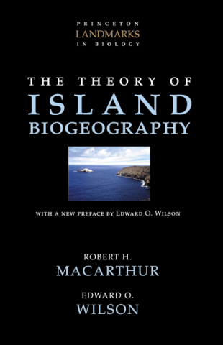
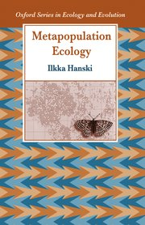
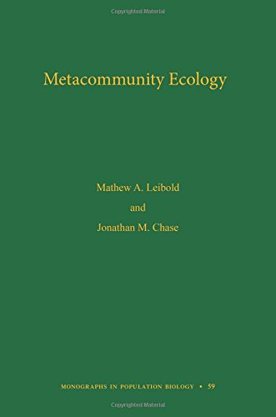
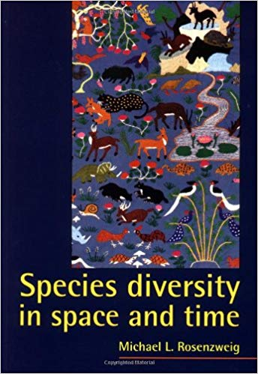

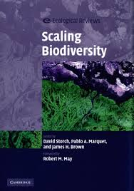

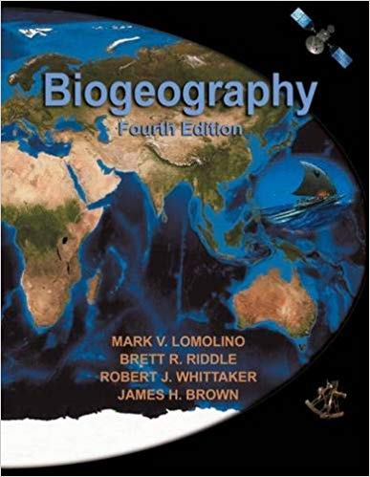
Macroecology

Slide 4
Overview
Species’ geographic range
Species richness and its patterns
Endemism and its patterns
Scale-dependency of the patterns

Slide 5
Species geographic range

Slide 6
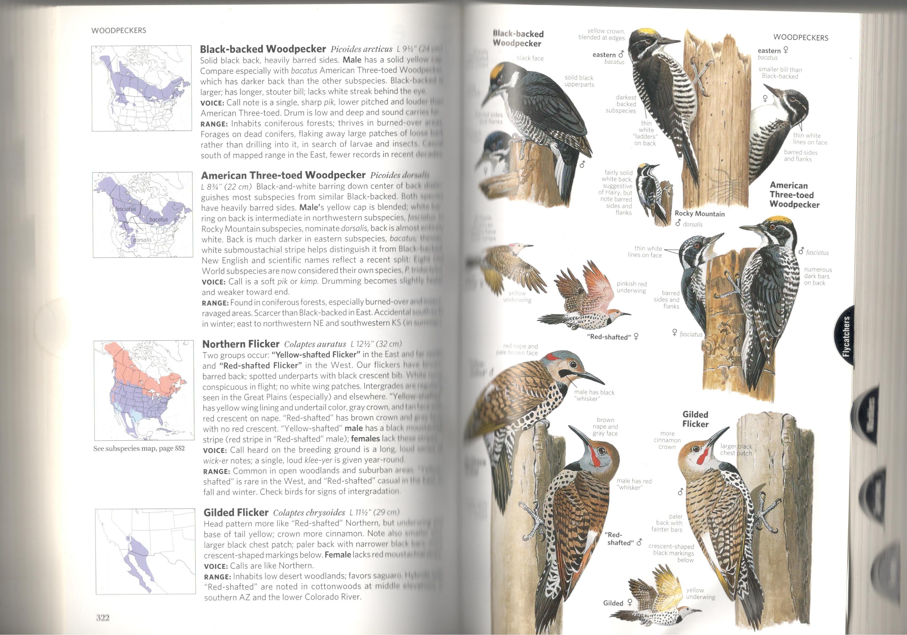
Geographic range – expert range maps

Slide 7
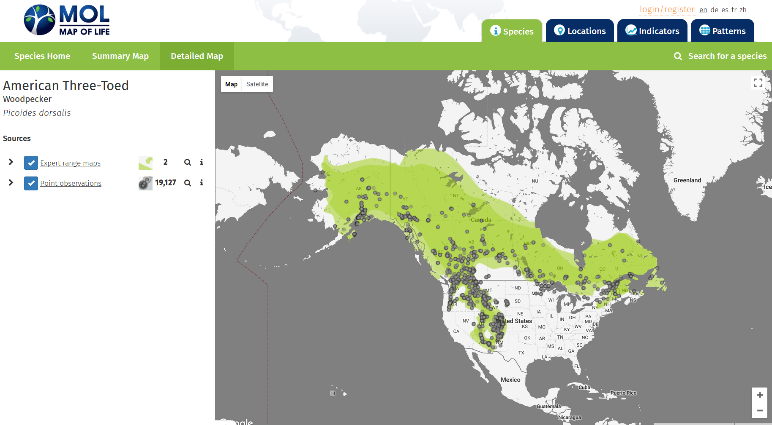
Geographic range – point observations

Slide 8

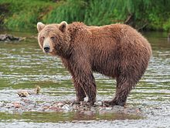
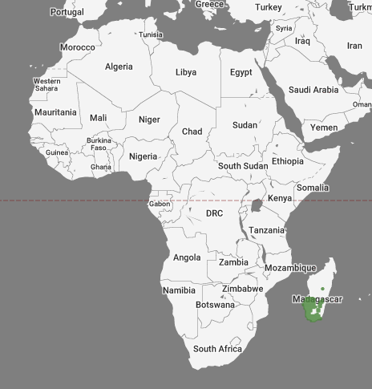
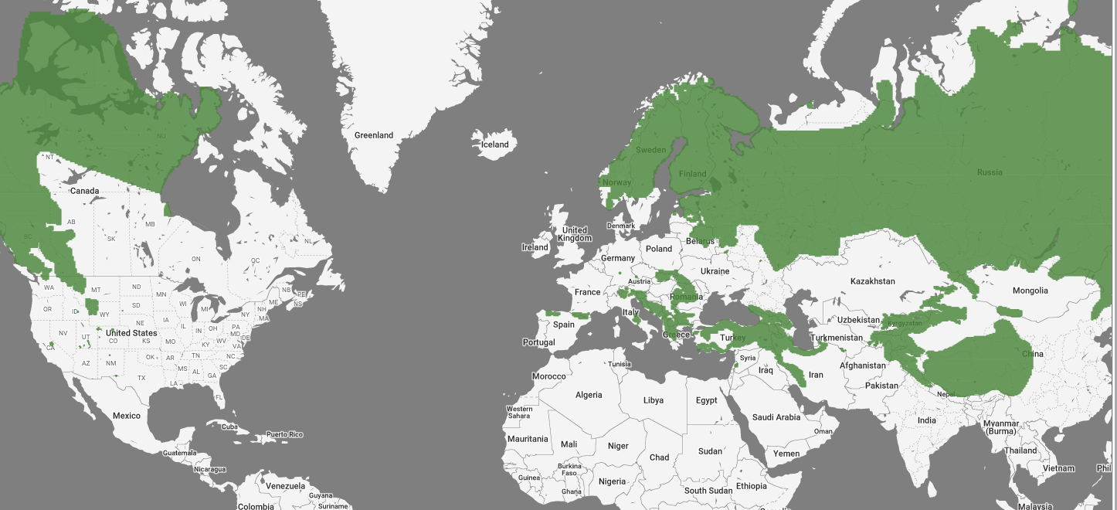
Endemic vs widespread species

Slide 9
Geographic range
Geographic range size is a fundamental quantity in basic macroecology, macroevolution, and biogeography.
Are species rare or widespread?
Is a species an invasive alien?
Where are the areas with many rare species?
Are geographic ranges shrinking or expanding?

Slide 10
Geographic range
Geographic range size is a key predictor of extinction risk (Purvis et al. 2000 Proc R Soc B, Thomas et al. 2004 Nature).
Key quantity in IUCN Red List criteria.

Slide 11
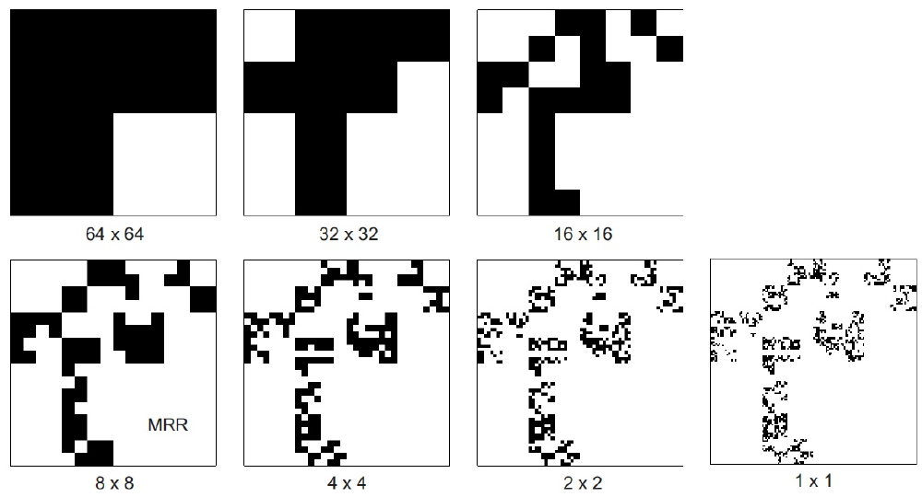
Estimation of range size
Range size
Log Cell area [km²]

Slide 12
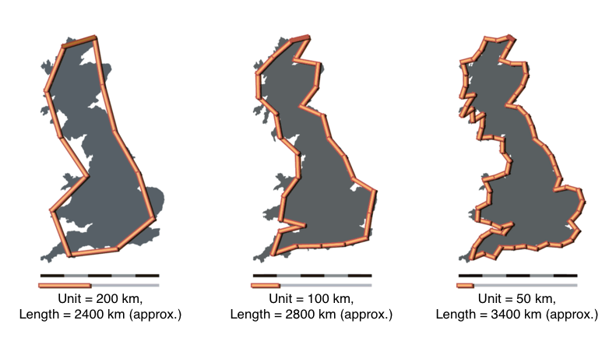
Estimation of range size

Slide 13
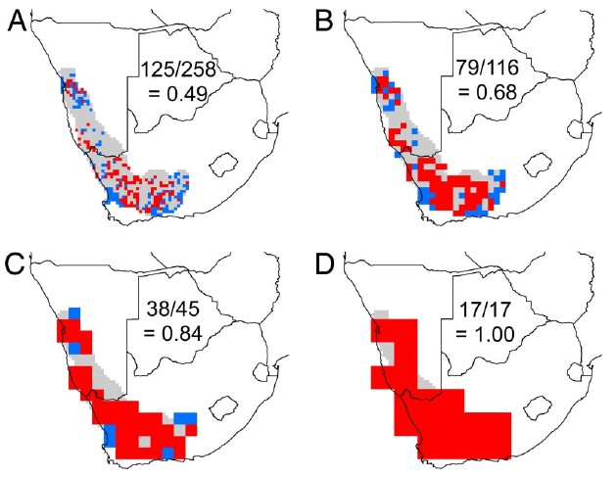
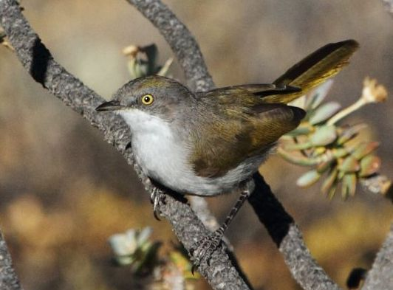
Estimation of range size
Eremomella gregalis
Hurlbert & Jetz (2007) PNAS

Slide 14
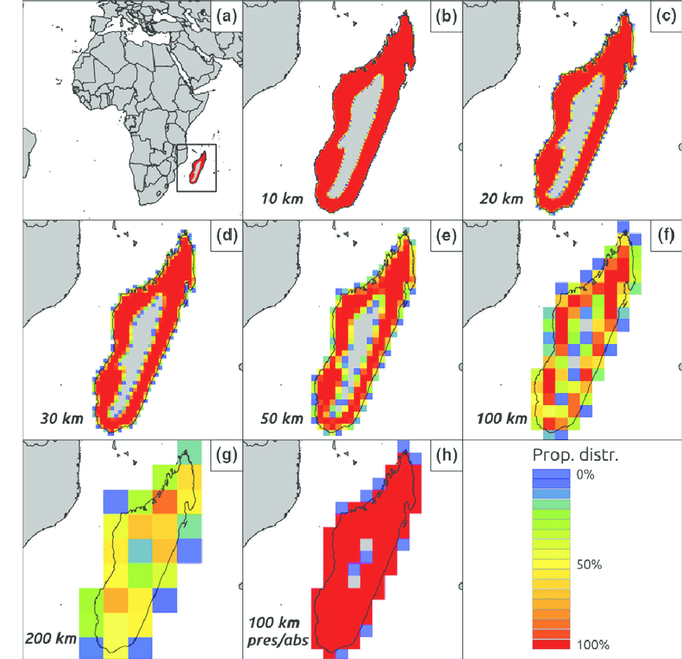
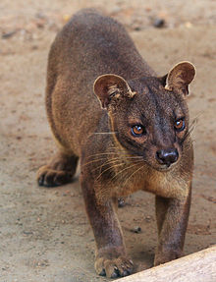
Estimation of range size
Fossa (Cryptoprocta ferox)
DiMarco et al. (2016) J. Appl. Ecol.

Slide 15
Species richness

Slide 16
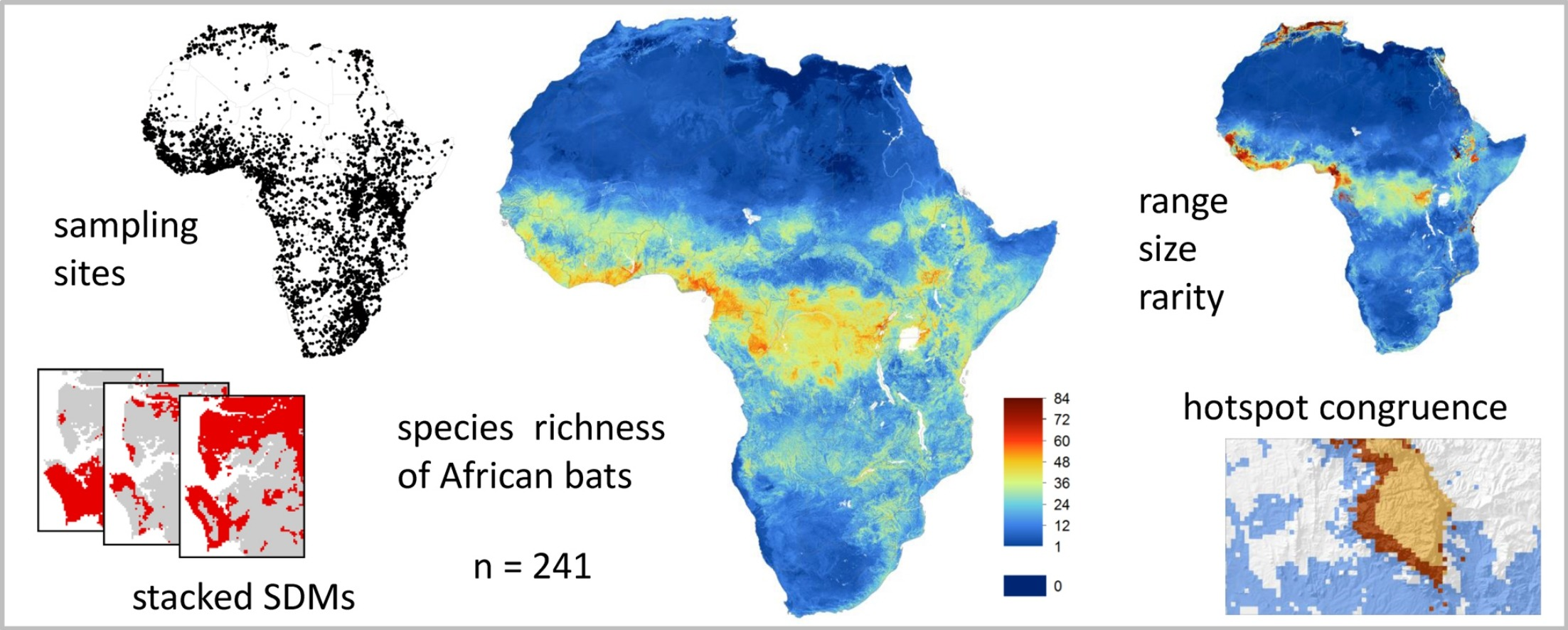
Stacking species ranges
Herkt et al. (2016) Ecol. Modelling.

Slide 17
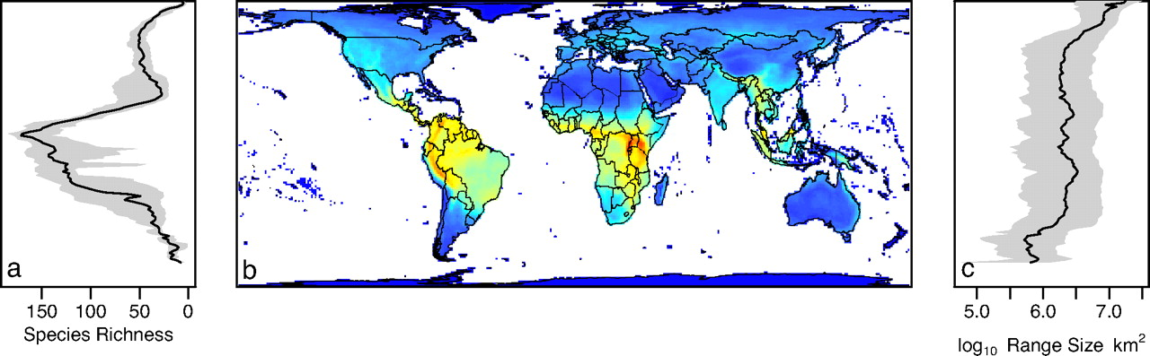
Global richness maps for well-mapped groups
Mammals
Davies et al. (2008) PNAS

Slide 18
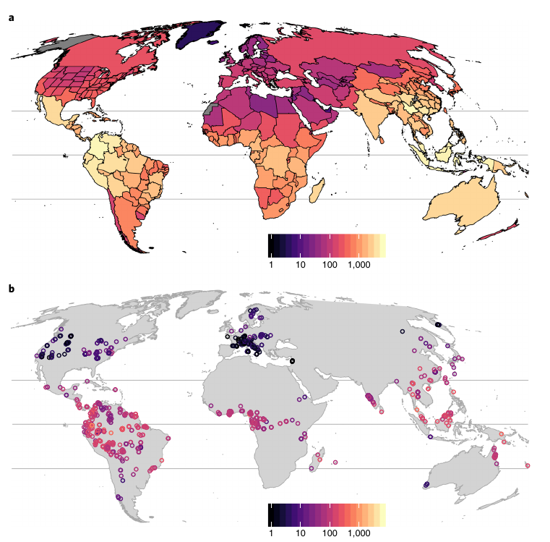
Global richness of trees
Keil & Chase (2019) Nature Ecol. Evol.

Slide 19
Endemism

Slide 20
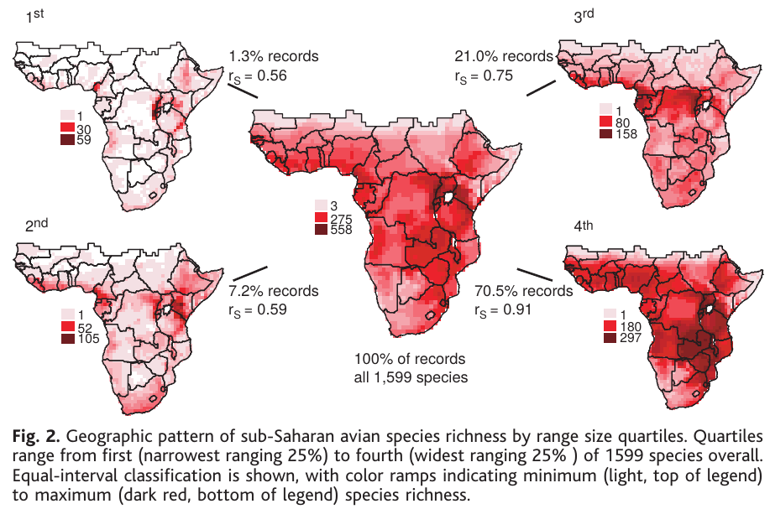
Richness patterns for different range size groups
Rare species
Widespread sp.
Jetz (2002) Science

Slide 21
“Weighted endemism” or “index of endemism richness”
For a given location with S species:
where A_{i} is the range size of species i
Kier & Barthlott (2001) Biodivers. Conserv.

Slide 22
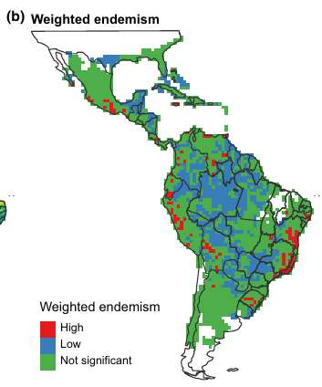
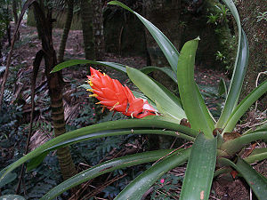
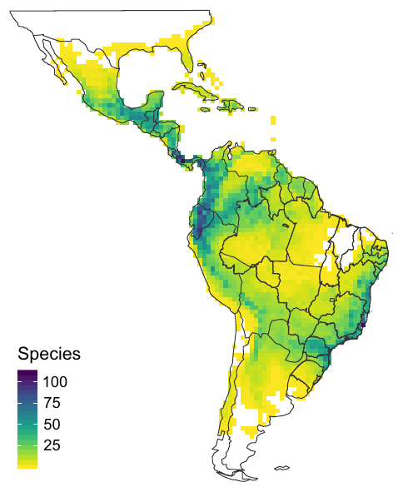
“Weighted endemism” or “index of endemism richness”
Zizka et al. (2020) Divers. Distrib.

Slide 23
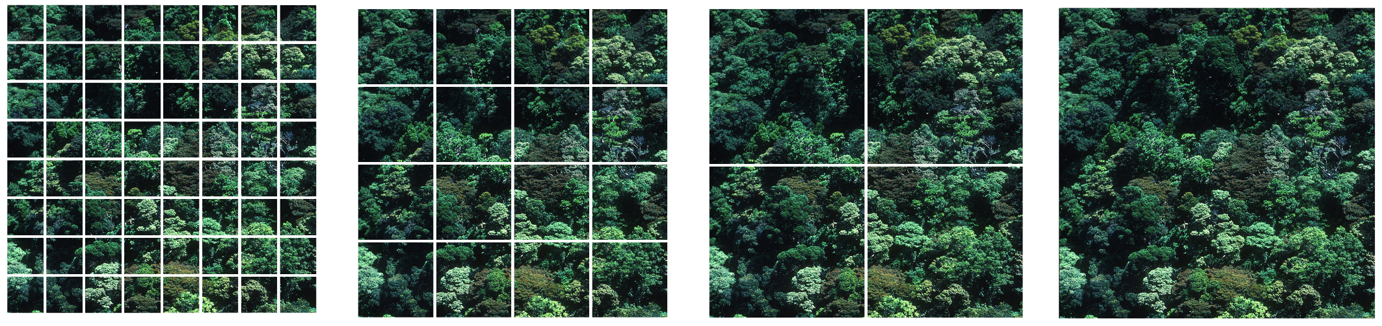
Grain = resolution = area of observational unit

Slide 24
Species richness is grain dependent
# of species
Area
Arrhenius (1921) J. Ecol.

Slide 25
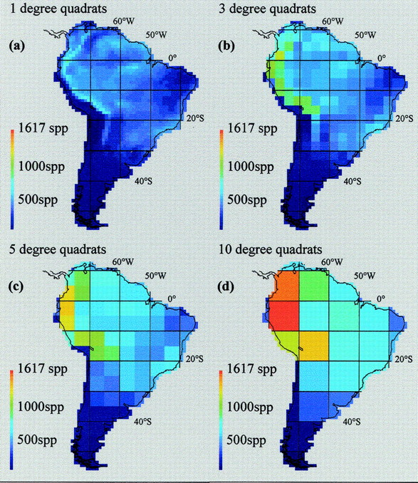
Spatial patterns of species richness are grain-dependent
2
2
Rahbek & Graves (2001) PNAS

Slide 26
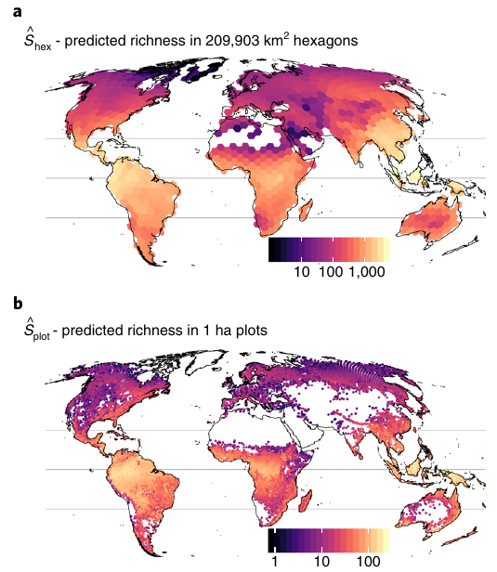
Predicted species richness at any grain
Keil & Chase (2019) Nature Ecol. Evol.

Slide 27
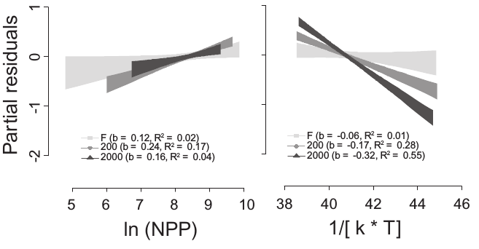
Environmental predictors of richness are grain-dependent
Species richness
(partial residuals)
Temperature (rescaled)
Belmaker & Jetz (2010) Glob. Ecol. Biogeogr.

Slide 28
Our goals today

Slide 29
Main questions for today
How many rare and widespread species are there?
Where on Earth is biodiversity high/low?
Where on Earth is endemism high/low?
What causes this variation?

Slide 30

Data source

