Slide 1


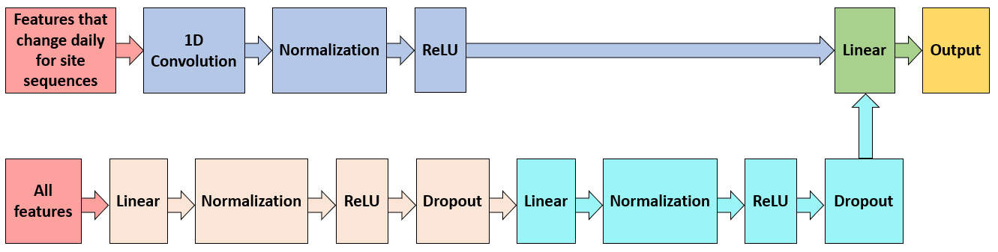
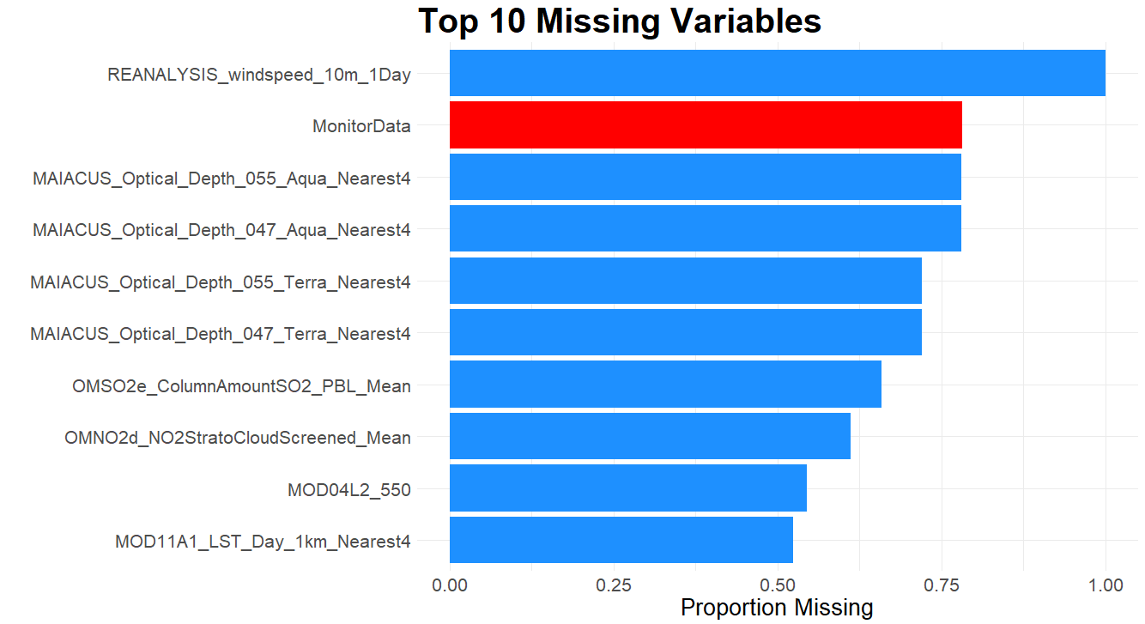
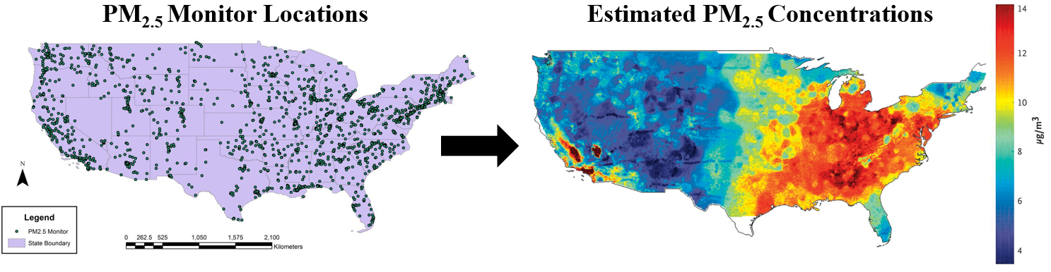
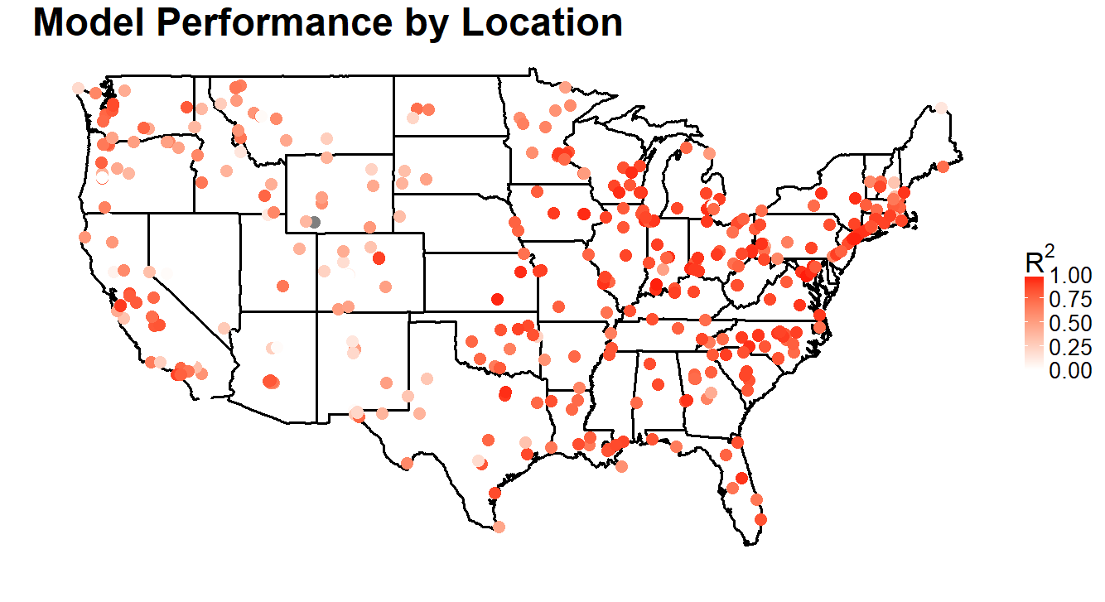
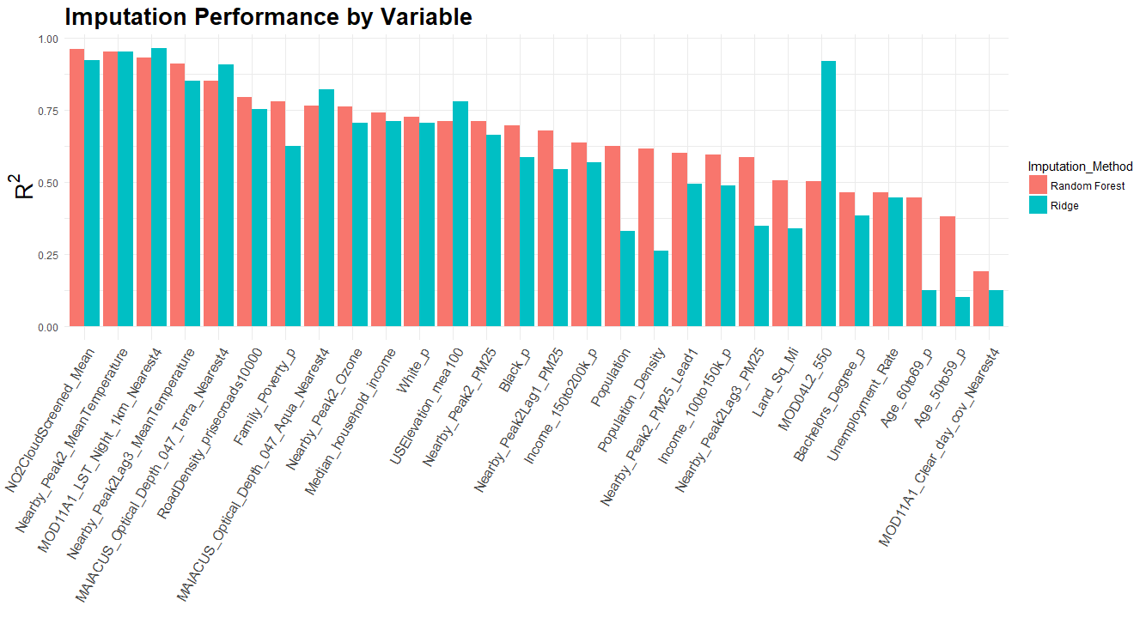
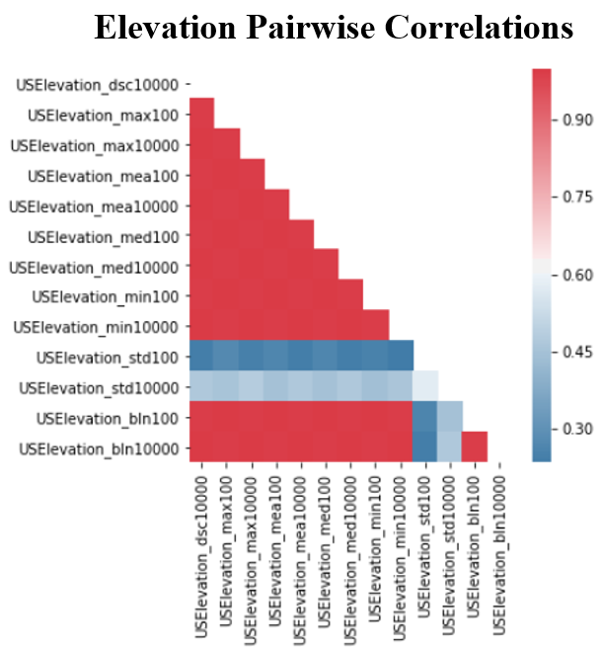
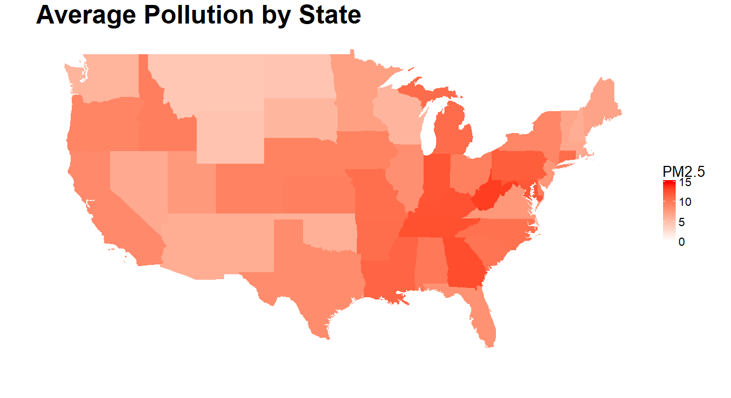
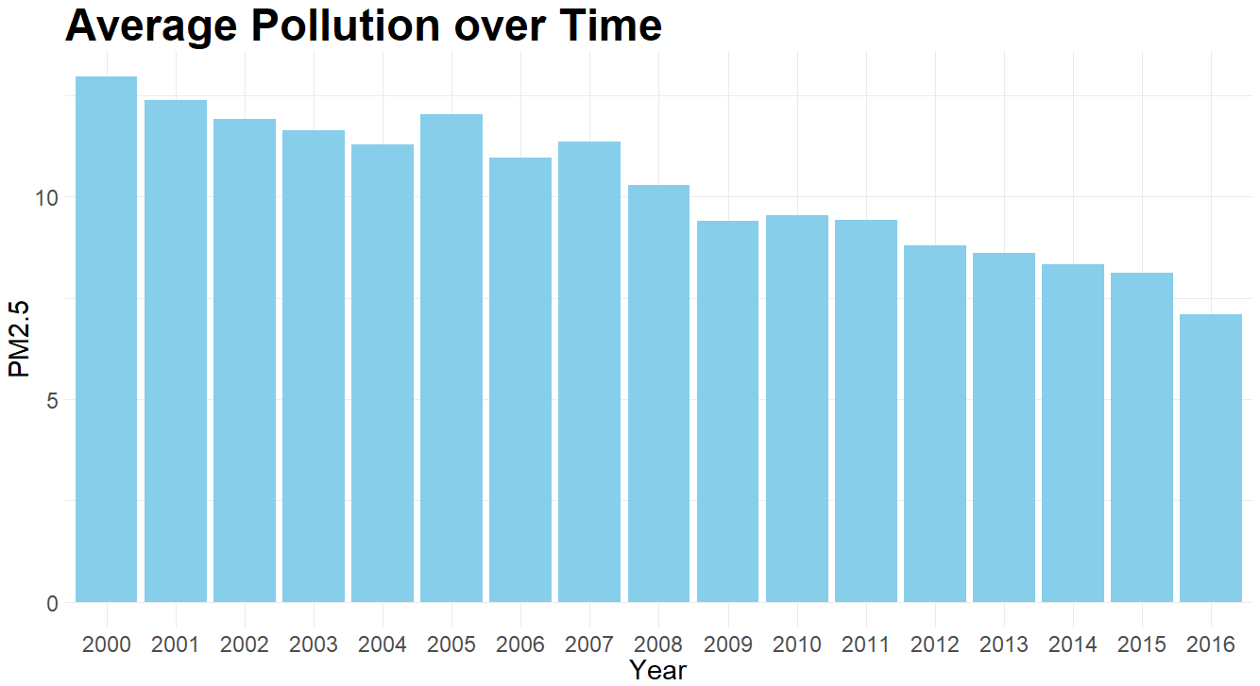
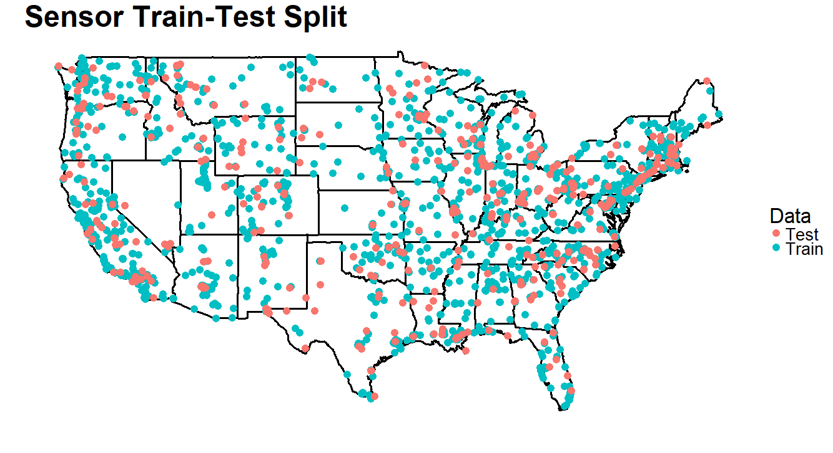
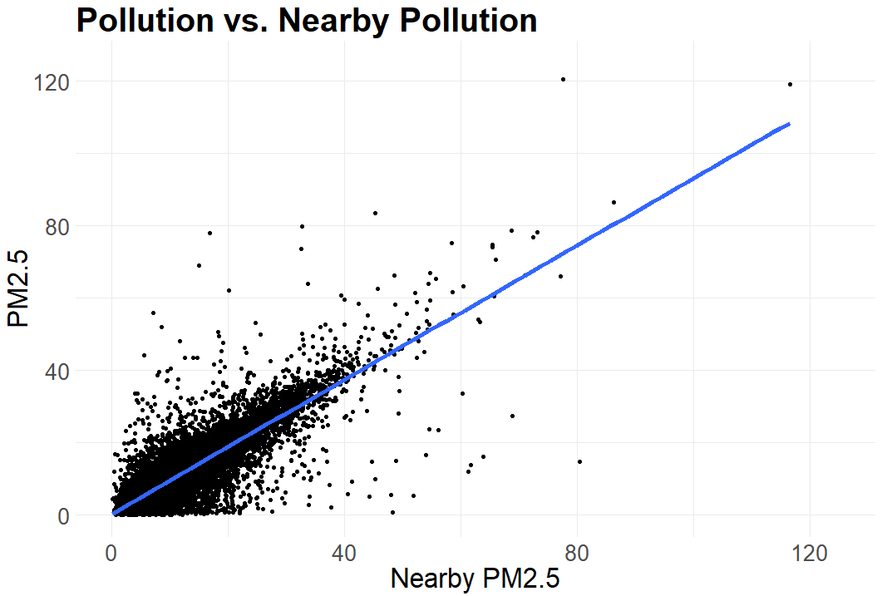
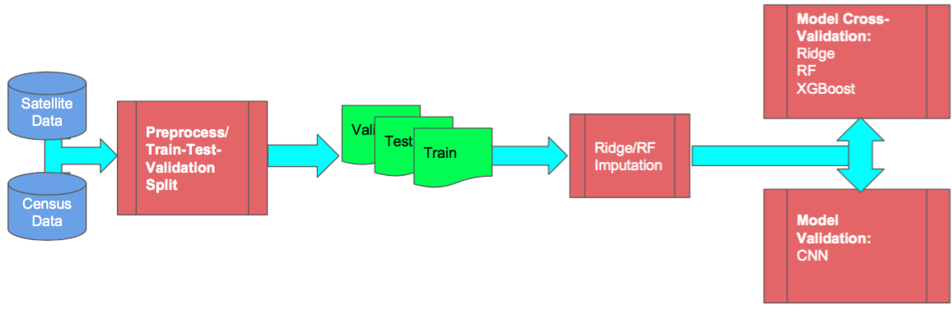
Modeling Air Pollution
Members: Keyan Halperin, Christopher Hase, Justin Lee, Casey Meehan Mentor: David Sondak Partner: Harvard School of Public Health
Background
Imputing Missing Data
Modeling
PM_{2.5} – fine particles with a diameter of 2.5 μm or less – is measured at approximately 2,000 air pollution monitors located throughout the US. However, these monitors are costly to operate and thus, sparsely distributed. Consequently, the air quality is not known for many locations throughout the country. This is problematic for public health studies since we cannot estimate the overall effect that pollution has on health if we do not know what the pollution is in many areas with any degree of certainty.
A major obstacle that we had to overcome was the amount of missing data. Many of the variables and almost all observations had some missing data. Even PM_{2.5} itself was often missing since the monitors do not measure pollution each day. Below is a graph of the top 10 most missing variables with PM_{2.5} monitor data highlighted in red.
Because consecutive days are likely to be related in ways that are relevant for predicting pollution, we decided to implement a CNN. In particular, we used a kernel width of size 3 so that features from the previous day, current day, and the following day are used for predicting pollution for the current day. We are still in the process of tuning the CNN, but our best result so far is an R² of 0.775.
Thus, using pollution data from these sparsely distributed sensors along with several other types of data, our goal was to fit a model that accurately interpolates pollution throughout the US. With this, it would be possible to create of a continuous map of pollution on the daily level, which could be used by researchers to establish causal relationships between pollution and health outcomes, among several other potential research applications.
We also implemented various standard machine learning models to compare their performances. Although random forest outperformed the other models, our best results came from an ensemble of random forest, XGBoost, and CNN.
Because of the volume of data that was missing and its potential importance for modeling PM_{2.5}, we could not afford to ignore it. After some research and experimentation, we decided to implement an iterative imputation algorithm called MissForest (Stekhoven & Bühlmann, 2012). Allowing for other supervised learning models to be used instead of random forest enabled us to compare two MissForest variations – one that used random forests as in the original paper and one that used ridge regressions. The scheme we created for evaluating the quality of our imputations indicated that our imputations were accurate. The random forest variation achieved a weighted R² of 0.717 and the ridge variation achieved a weighted R² of 0.774. Below is a plot of the imputation performance of both variations of this algorithm for each variable as measured by R².
On the left is the performance of our ensemble by location as measured by R². Unsurprisingly, the ensemble produces much more accurate predictions in regions with more sensors. This highlights the need to install more monitors in locations where monitors are sparse.
Data
Monitor Data
Pollution readings from approximately 2,000 PM_{2.5} sensors each day for the past 16 years.
Satellite Data
Various meteorological, geographical, and topographical variables collected from satellites and other instruments.
Discussion
US Census Data
Demographic variables on the ZIP Code level as collected by the US Census.
Because of the disproportionate importance of nearby PM_{2.5}, we believe that it is absolutely essential for more pollution monitors to be installed, especially in regions where there are few. We also have evidence to suggest that our imputation procedure provides high quality imputations, and since the procedure is quite easy to implement, we recommend that HSPH use it in the future.
Going forward, in addition to continuing to improve model performance, we believe that an important task is to quantify the uncertainty of the PM_{2.5} predictions. This would be important because (1) it would give more insight into model performance in areas that are far away from sensors (2) it would allow for more accurate variance estimates of any associated causal effects and (3) it could be used in determining which locations should be prioritized for new sensor installations. Gaussian process regression may be a good tool for quantifying the prediction uncertainty.
Because of the high number of variables, we decided to perform variable selection. Having extraneous or redundant variables not only increases the computation time, but it can also harm the predictive performance of machine learning models. To reduce dimensionality, for each set of highly correlated features, we removed all but one. We also removed variables that had non-significant partial correlations with PM_{2.5} after controlling for nearby PM_{2.5}. On the right you can see a set of variables for which there were many high pairwise correlations.
Exploratory Data Analysis
Baseline Model
Software Package
We also conducted a thorough exploratory data analysis to gain insights that would help us in modeling. Most notably, we discovered that PM_{2.5} has strong spatial and temporal dependencies. Below are plots of average PM_{2.5} levels by state and average PM_{2.5} levels over time that demonstrate this.
After pre-processing and imputation, we tuned our models using K-fold cross-validation on a random 80% of the sensor site sequences and reserved the remaining sensors to test the performance of our models.
The scripts written for this project were all run on Harvard’s Odyssey Research Computing Cluster, and instructions for running our code were written with Odyssey in mind. This is because of the substantial amount of RAM and processing power needed to load and fit models on the nearly 20 GB of pollution data. Python and R scripts for pre-processing and imputation as well as model validation, training, and testing were wrapped in Bash scripts formatted to be scheduled using Slurm. All code was made available on a GitHub repository so that we could turnover our work to HSPH for use and continued development.
We also explored the relationship between each feature and PM_{2.5}. By far, the feature that had the highest correlation with PM_{2.5} was nearby PM_{2.5}, with a correlation of about 0.857. Thus, there is strong evidence to suggest that we should implement models that take into account both spatial and temporal relationships.
Because of the very high correlation between PM_{2.5} and nearby PM_{2.5}, we decided that our baseline model should be a simple linear regression with nearby PM_{2.5} as the only feature. Despite its simplicity, this model performs surprisingly well with a test R² of 0.712. Above is a scatterplot of the relationship between PM_{2.5} and nearby PM_{2.5} on a random 1% subset of the data.
Notes:
1

