Slide 1
Data Mining in Sports
Chase Dickerson and Jacob Schaum

Slide 2
Data Mining
Data Mining is important in sports because of the amount of information there is about every player, team, or sport and the need to be able to understand that data.
Data mining is used to process all of that information and deliver it into a useful format for recruiters, commentators, and teams to look at.

Slide 3
Cy Young Award predicting
One way data mining has been used in sports is to predict baseball’s Cy Young Award winners.
Using data collected from 1967 to 2006 seasons, a model was created using a Bayesian classifier.
The Bayesian classifier was accurate at predicting the winners 80% of the time, which was similar to how the previous static statistic models predicted the winners.
The advantage of using a Bayesian classifier was the ability for it to learn and accept new data in the future.

Slide 4
NCAA winner prediction competition
In 2015 Kaggle hosted a competition to predict NCAA winners.
The first stage of the competition was to take data from previous seasons and predict the winning team.
Those who met a certain accuracy threshold moved to stage 2 where they were to predict the winner for the current season.
The competition was sponsored by HP and the winner received $15,000.

Slide 5
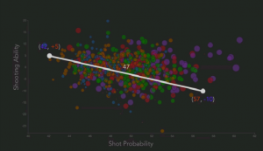
Basketball Example
Each bubble represents an NBA player.
The X-axis is their shot probability and the Y-axis is their shooting ability.
Instead of just knowing that a player makes 47% of his shots, using this data, scientists can determine can compare it to the average shot percentage of 49%, and determine the player is 2% more inaccurate than the average player.

Slide 6
Other Examples
Some other examples of ways data mining is used:
Recruitment - Looking at all high school/college players stats and outputting the players that meet certain criteria.
Game-day decisions
Player evaluation
Rule changes - NFL’s addition to the “kickoff touchback” rule was a result of thorough data mining

Slide 7
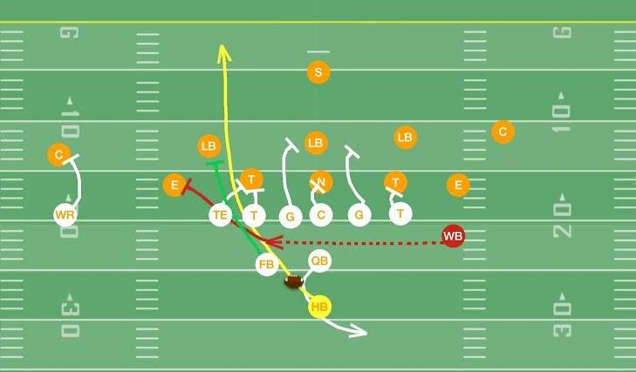
Our Implementation
Prediction of play type for NFL
Using classification to classify whether a play type will be a run or a pass

Slide 8
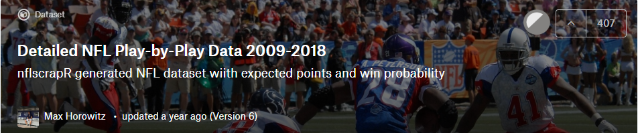
Dataset Used
Used dataset Detailed NFL Play-by-Play Data 2009-2018 from Kaggle
(https://www.kaggle.com/maxhorowitz/nflplaybyplay2009to2016#NFL%20Play%20by%20Play%202009-2016%20(v3).csv)
Dataset included 102 columns
Lots and lots of data

Slide 9
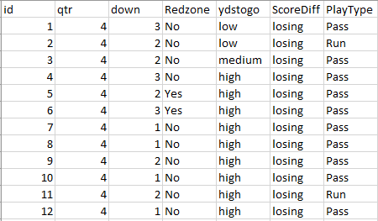
Preprocessing the data
Did not need to use all 102 columns of data to predict play type
Did not use all rows of data
Columns used to help classify
Quarter
Down
Redzone
Yards to go (to get a first down)
Whether the team was winning, losing, or tied
Play type

Slide 10
Preprocessing Cont.
Yards to go was initially given with the actual yard amount left to get a first down (Numerical data)
Needed it to be categorial to work
Used scale to change the yard number to low, medium, high, very high
1-3 = low
4-7 = medium
8-11 = high
12+ = very high

Slide 11
Preprocessing Cont.
Redzone was determined by the yard line the team was on provided within the dataset
If a team was within 20 yards of goal line, Redzone is set to yes, otherwise Redzone is set to no
ScoreDiff column was changed to losing, tied, or winning based off the score difference given with the original dataset
Other notes on preprocessing
Removed all 4th downs
Removed all play types not pass or run from PlayType column

Slide 12
Splitting Dataset
We split our dataset into two datasets based off what down the team was on
Made dataset with just 3rd downs to try and to predict what play type would be used when it really mattered
Used a dataset with all downs (excluding 4th still) to try and predict play type on any given down

Slide 13
Demo with Scikit Learn

Slide 14
Cites
https://dl.acm.org/citation.cfm?id=1229658
https://www.kaggle.com/c/march-machine-learning-mania-2015
http://www.pitt.edu/~kpele/kdd2017-tutorial.html
https://blogs.ams.org/mathgradblog/2017/02/25/science-moving-dots/

