Slide 1
ENGI 301 Voice-Activated Trash Can Proposal
February 19, 2024
Chase Alvarado

Slide 2
Background Information
What?
A small trash can that can operate using simple voice commands
Only “Open” and “Close”
Device should respond with a beep
Need: USB Microphone, Servo Motor, and Buzzer
Similar?
Found a motion activated trash can:
used arduino and a motion sensor
https://www.hackster.io/will-su/touchless-automatic-motion-sensor-trash-can-bbeed1
How Will It Improve?
Voice-activated rather than motion
Want device to give feedback to user
Why?
Want to give the device to my grandma

Slide 3
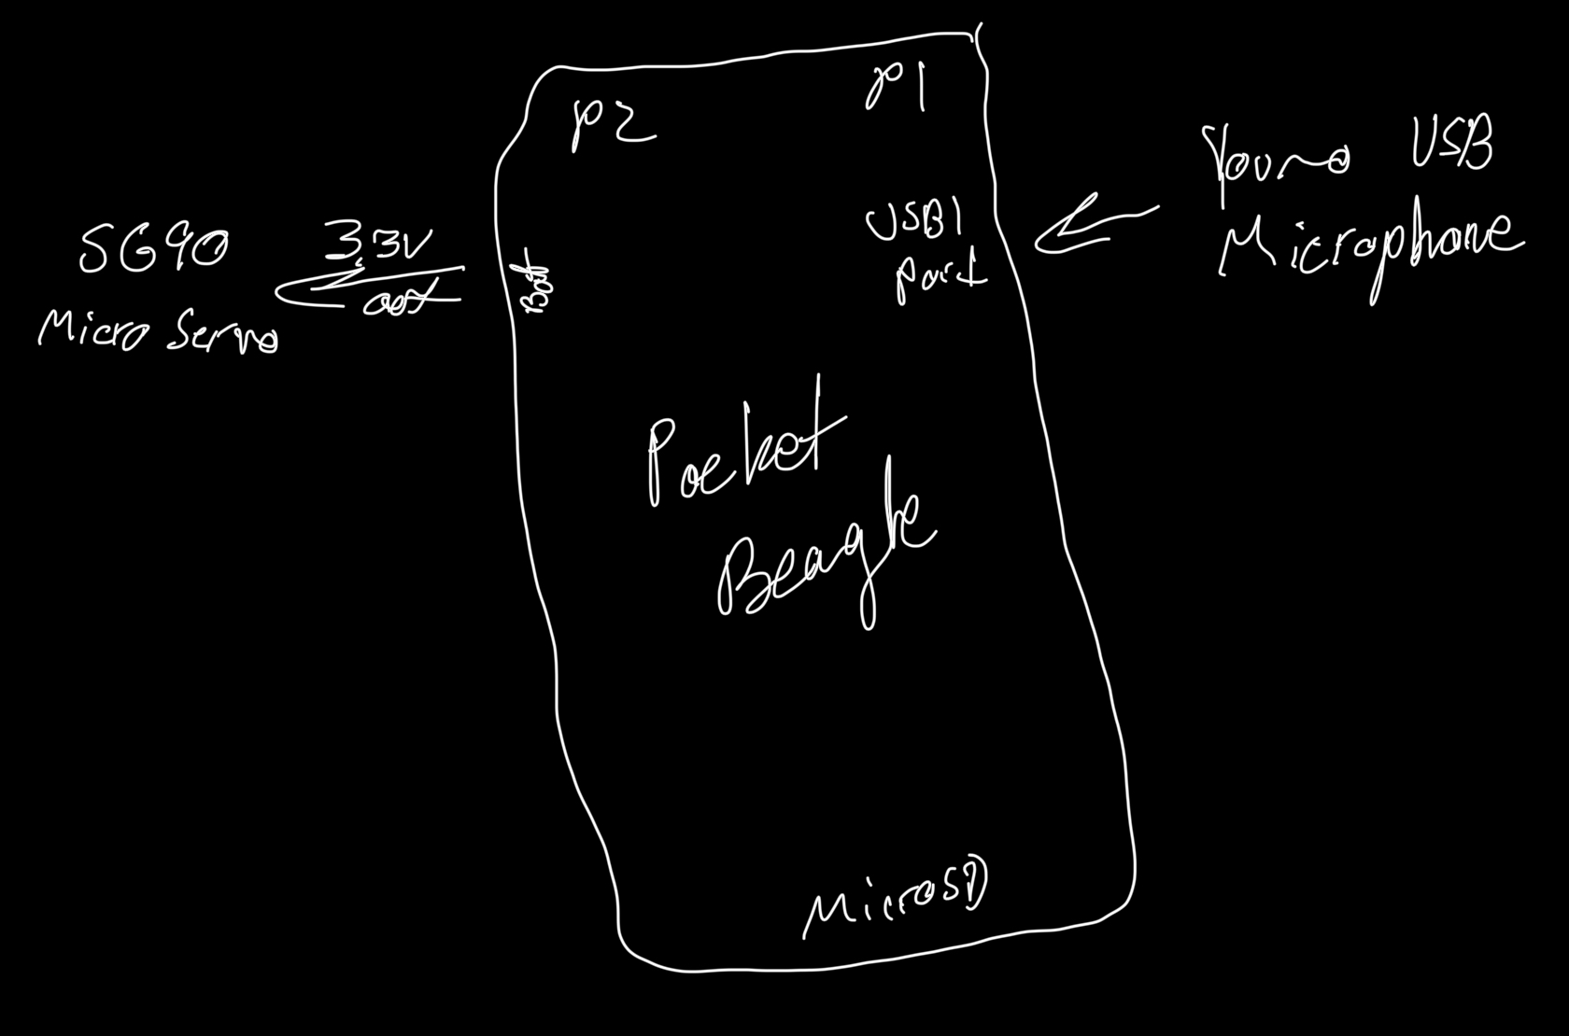
System Block Diagram

Slide 4
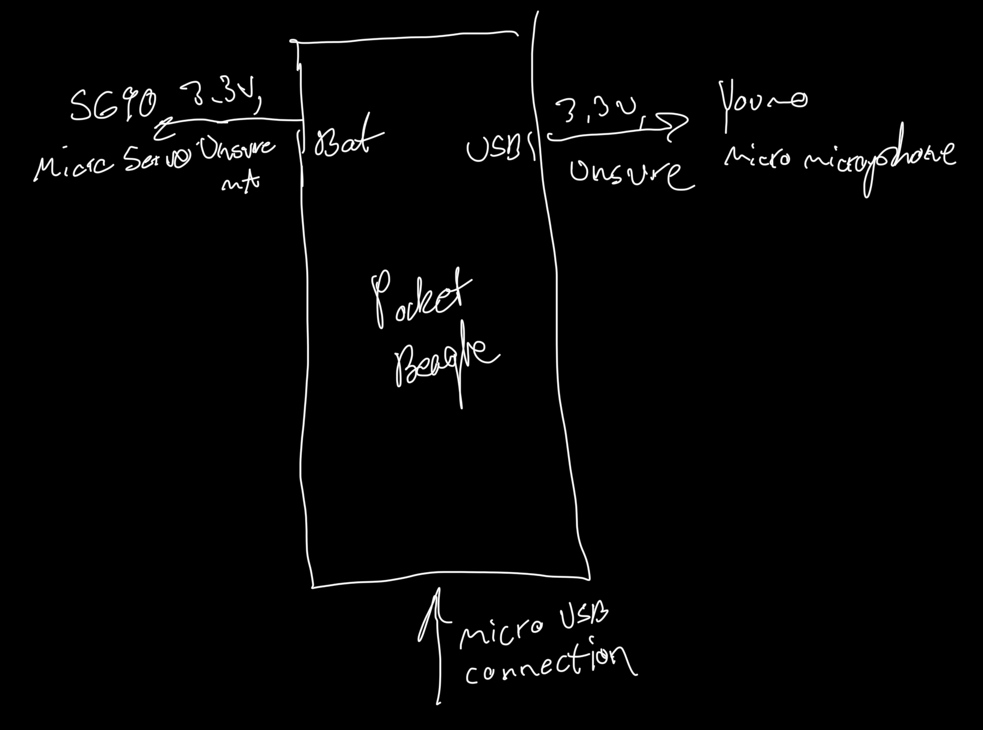
Power Block Diagram
3.3V output via bat to Micro Servo
3.3V output via USB1 to microphone

Slide 5
Components / Budget
Component | ENGI301 to Buy? | Cost
Trash Can | Yes | $17
Buzzer | No
USB Microphone | Yes | $8
Servo Motor | No
LEDs | No
Limit Switches (x12) | Yes | $5.49
USB Type A Female Adapter | Yes | $8.59
TOTAL: |  | $39.08
Notes:
Trash Can: https://www.amazon.com/Superio-Plastic-Gallon-Bathroom-Bedroom/dp/B098YKMVWV/?th=1
Buzzer: https://www.adafruit.com/product/1536
USB Mic: https://www.amazon.com/gp/product/B01MQ2AA0X
Servo Motor: https://www.amazon.com/Dorhea-Arduino-Helicopter-Airplane-Walking/dp/B07Q6JGWNV
Limit Switches: https://www.amazon.com/MXRS-Hinge-Momentary-Button-Switch/dp/B07MW3W79B/
Adapter: https://www.amazon.com/SinLoon-Female-Motherboard-Header-Adapter-Dual/dp/B0878S6BD5/

