Slide 1
Hitting History: Exploring the MLB Hit Streak Record Through Simulations in Python
By Chase Cardon

Slide 2

Research Question
Was Joe DiMaggio’s hit streak record of 56 games an exceptional occurrence or an expected, probable occurrence?
Background
Ideation
Technicalities

Slide 3
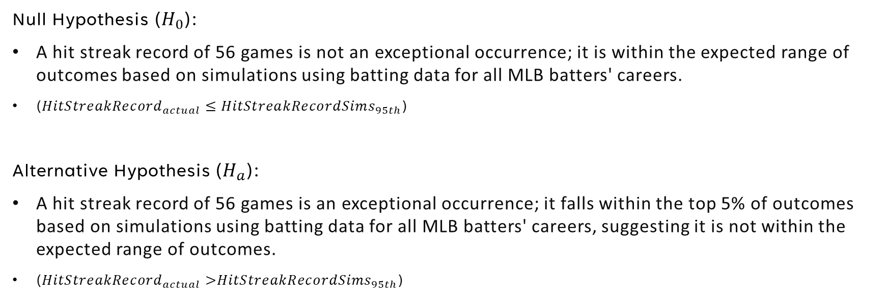
Hypotheses For Part 1
Null Hypothesis ($H_{0}$):
A hit streak record of 56 games is not an exceptional occurrence; it is within the expected range of outcomes based on simulations using batting data for all MLB batters' careers.
(${HitStreakRecord}_{actual}$ ≤${ HitStreakRecordSims}_{95th}$)
Alternative Hypothesis ($H_{a}$):
A hit streak record of 56 games is an exceptional occurrence; it falls within the top 5% of outcomes based on simulations using batting data for all MLB batters' careers, suggesting it is not within the expected range of outcomes.
(${HitStreakRecord}_{actual}$ >${HitStreakRecordSims}_{95th}$)

Slide 4
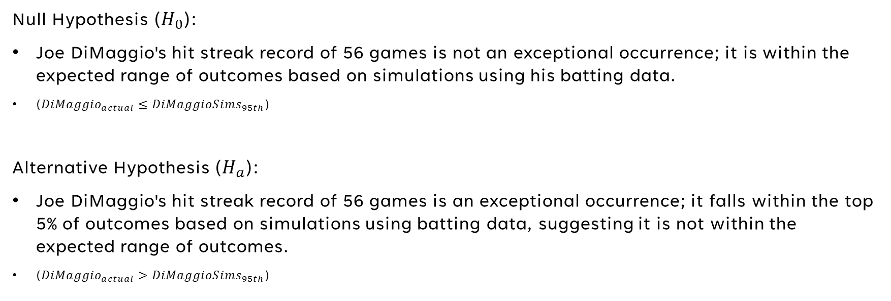
Hypotheses for Part 2
Null Hypothesis ($H_{0}$):
Joe DiMaggio's hit streak record of 56 games is not an exceptional occurrence; it is within the expected range of outcomes based on simulations using his batting data.
(${DiMaggio}_{actual}$ ≤${ DiMaggioSims}_{95th}$)
Alternative Hypothesis ($H_{a}$):
Joe DiMaggio's hit streak record of 56 games is an exceptional occurrence; it falls within the top 5% of outcomes based on simulations using batting data, suggesting it is not within the expected range of outcomes.
(${DiMaggio}_{actual}$ >${ DiMaggioSims}_{95th}$)

Slide 5
Methodology
Part 1
Part 2
Acquire batting stats for all MLB players from ‘pybaseball’
Necessary data: players’ career plate appearances (PA), career games played (G), and career hits (H)
Calculate players’ ‘hit%’ (H / PA) and ‘PA rate’ (PA / G)
Simulate batting history of MLB 1,000 times
For each MLB player:
Randomize hit success based on hit% for the length of their PA rate to simulate a single game
Repeat for the length of their G, filling a list of whether there was at least 1 hit or not
Record the player’s longest hit streak in his career
Acquire game by game data for Joe DiMaggio’s career from baseball-reference.com
Necessary data: hit totals from every game, career games played (G)
Calculate the percentage of his games where he had at least 1 hit (g_hit%)
Simulate Joe DiMaggio’s career 10,000 times
For the length of his G, randomize whether he got a hit or not in each game based on his g_hit%
Record the longest hit streak for each simulated DiMaggio career

Slide 6
Methodology; Notes and Limitations
Part 1
Part 2
Includes nearly every MLB batter
Simulate each PA as hit/no hit, repeat several times to simulate a game, repeat many times to simulate a career
Usage of PA rate was flawed
Only involves Joe DiMaggio
Simulate each game as hit(s)/no hit, repeat many times to simulate a career
Preferred, but would need game-by-game data for all MLB batters, to know in what percentage of games each player got at least one hit

Slide 7
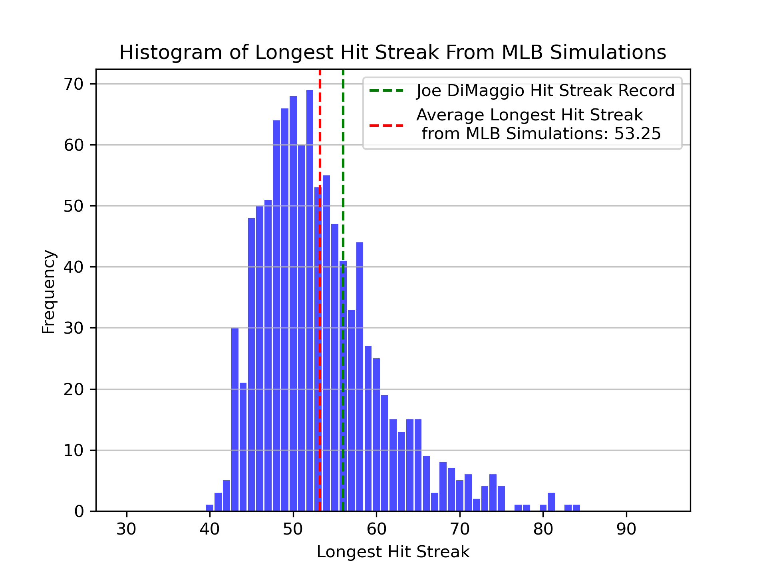
Results
Part 1
Mean: 53.25
Median: 52
Max: 84
Number of sims with hit streak record greater than 56: 268 (26.8%)
Because Joe DiMaggio’s actual hit streak record of 56 is only greater than or equal to 73.20% of the MLB sims’ longest hit streaks, we fail to reject the null hypothesis that it was not an exceptional occurrence.
7

Slide 8
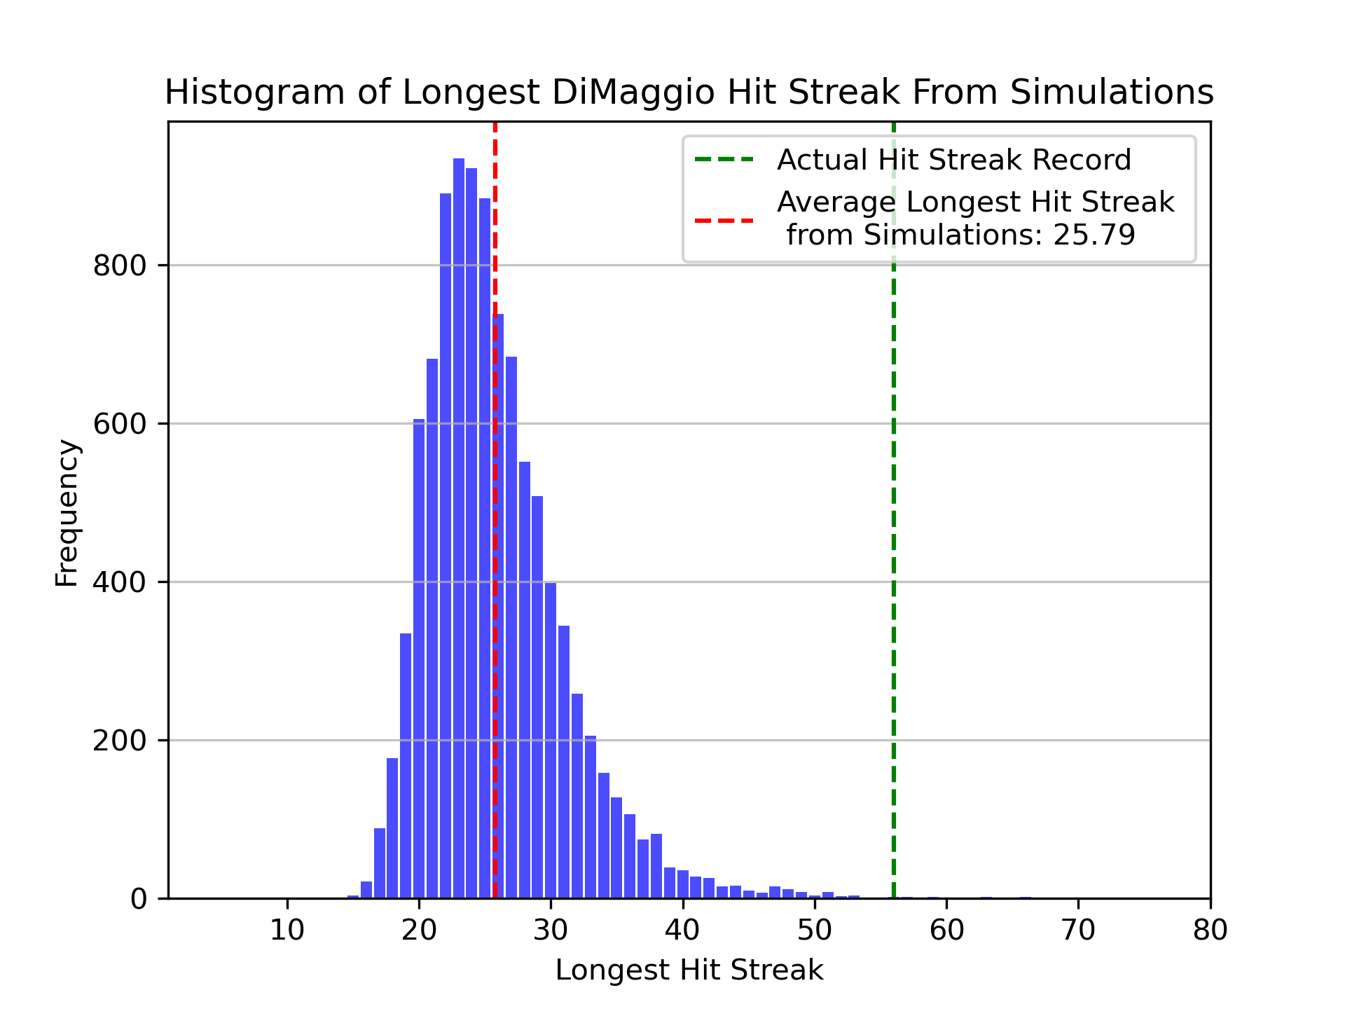
Results
Part 2
Mean: 25.79
Median: 25
Max: 66
Number of sims with hit streak record greater than 56: 4 (0.04%)
Because Joe DiMaggio’s actual hit streak record of 56 is greater than or equal to 99.96% of the sims’ longest hit streaks, we reject the null hypothesis, concluding that it was an exceptional occurrence.
8

Slide 9
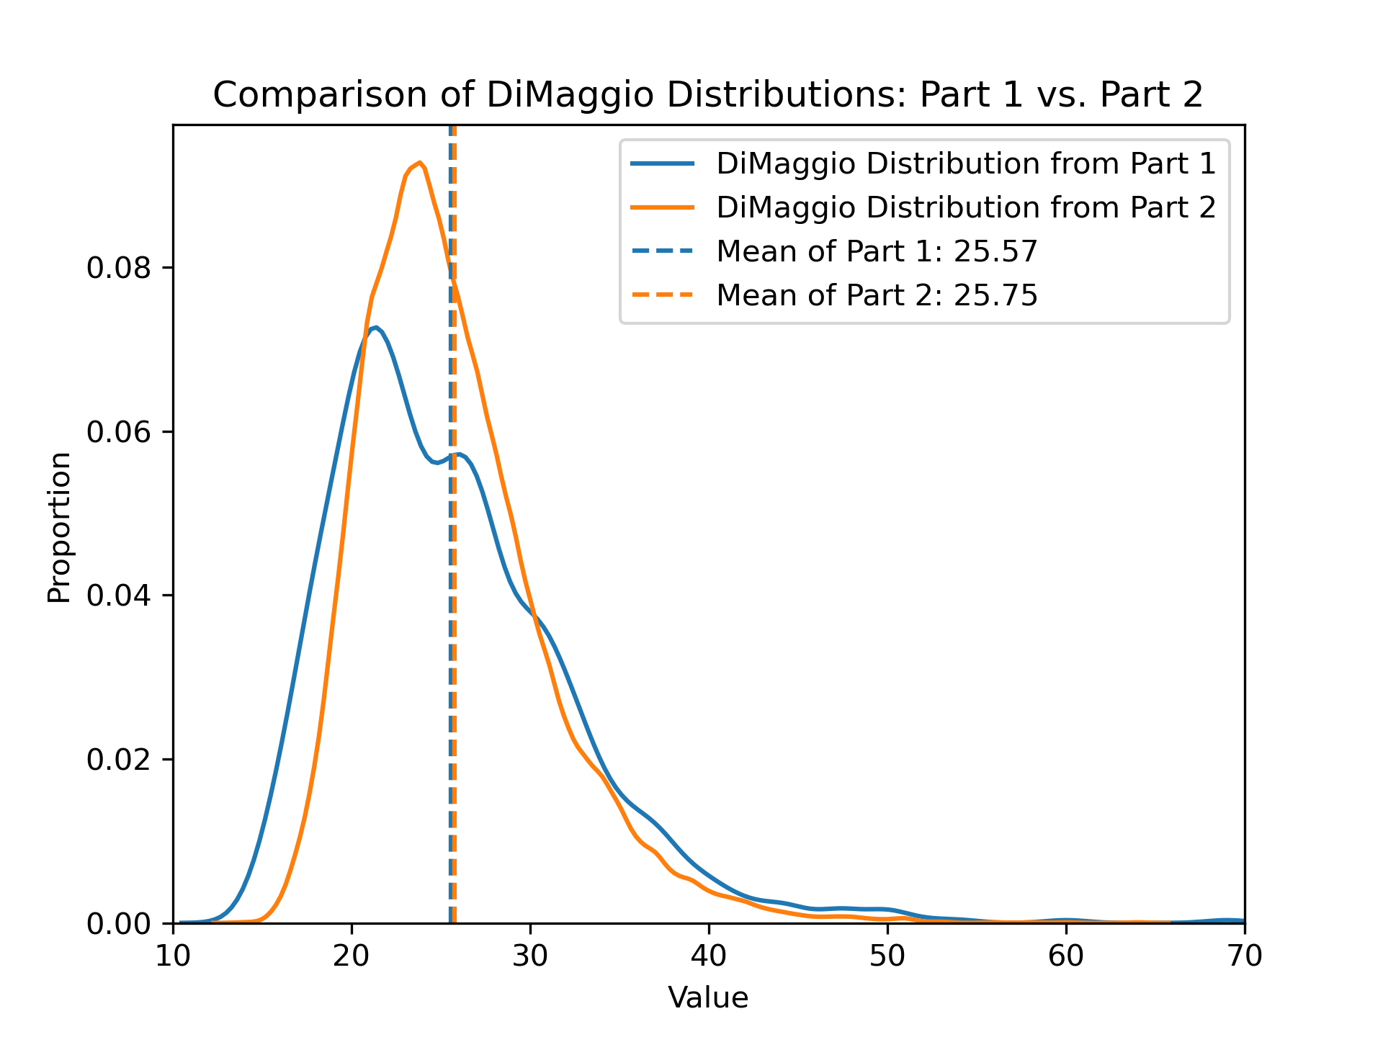
Results, cont.
Name
1. Ross Barnes
2. Cal McVey
3. Ty Cobb
4. Ed Delahanty
T5. Dave Orr
T5. Willie Keeler
7. George Sisler
8. Al Simons
T9. Lip Pike
T9. Cap Anson
…
T27. Joe DiMaggio
Hit Record Count
94
57
43
27
25
25
24
21
20
20
8
9

Slide 10
Next Steps
Replicate Part 2 procedure with game-by-game data for all players to generate more accurate simulations
Decrease the required number of PA to be included in the simulations
Increase the number of simulations

Slide 11
Conclusion

