Slide 1
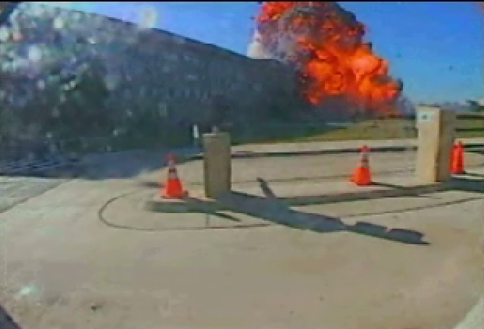
Terrorism
Analyzing data on events from 1970 – 2018
Phyllis Summers, Chase Farnsworth, kyle Brown, victor watson

Slide 2
Contents
Etymology
Project Description, Approach and Considerations
Why Global Terrorism Topic
Key Questions
Visualizations
Observations

Slide 3
Etymology
Terrorism is, in the broadest sense, the use of intentionally indiscriminate violence as a means to create terror among masses of people; or fear to achieve a financial, political, religious or ideological aim. It is used in this regard primarily to refer to violence against peacetime targets or in war against non-combatants. The terms "terrorist" and "terrorism" originated during the French Revolution of the late 18th century but gained mainstream popularity during the U.S. presidency of Ronald Reagan after the 1983 Beirut barracks bombings and again after the 2001 September 11 attacks and the 2002 Bali bombings.

Slide 4
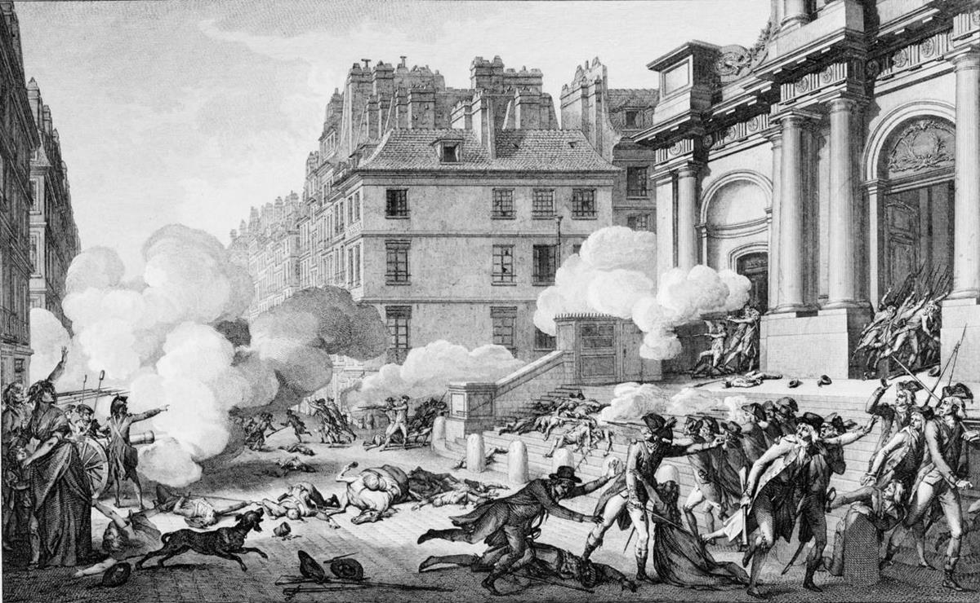
Why Global Terrorism
In considering different topics of interest in the group, we all have been affected by news of terrorist events.
We desired to understand the occurrences globally and understand the locations where terrorism is occurring.
A good data source of Global Terrorist events was available

Slide 5
Project Description, Approach and considera-tions
Project Description
Identify correlated topics and investigate data related to Global Terrorism ranging from 1970 through 2017 reported incidents.
Approach and Considerations
Develop key questions around identified topic
Identify other key data to investigate in correlation with Global Terrorism
Identify sources of data
Identify appropriate visualization techniques for parameters related to the data to answer questions
Clean Data
Create the visualizations

Slide 6
Key questions
Questions to answer:
Is there a correlation between tech advances and increase in terrorism
Is there a correlation between Happiness index and terrorism based on country
Where is it most common
Is it increasing in frequency in areas
Is there a clustering of events over timeline and location
Are attacks getting more frequent between large events
What are the weapons used in terrorism over time
What are the attack types of terrorism over time
Is there a correlation between tech advances and increase in terrorism
Is there a correlation between Happiness index and terrorism based on country
Stretch question - Is there a correlation between education level and terrorism based on country

Slide 7
Walk through of research and outcomes
Leveraged Kagel for Terrorist Data
Leveraged Wikipedia and World Happiness Data for Happiness Index
Used multiple documents for technology advancements to derive technology advance information
Used Jupyter notebook for reading in the csv files and cleansing data.
Used gmaps for heat map presentation
Visualizations (included in this presentation)

Slide 8
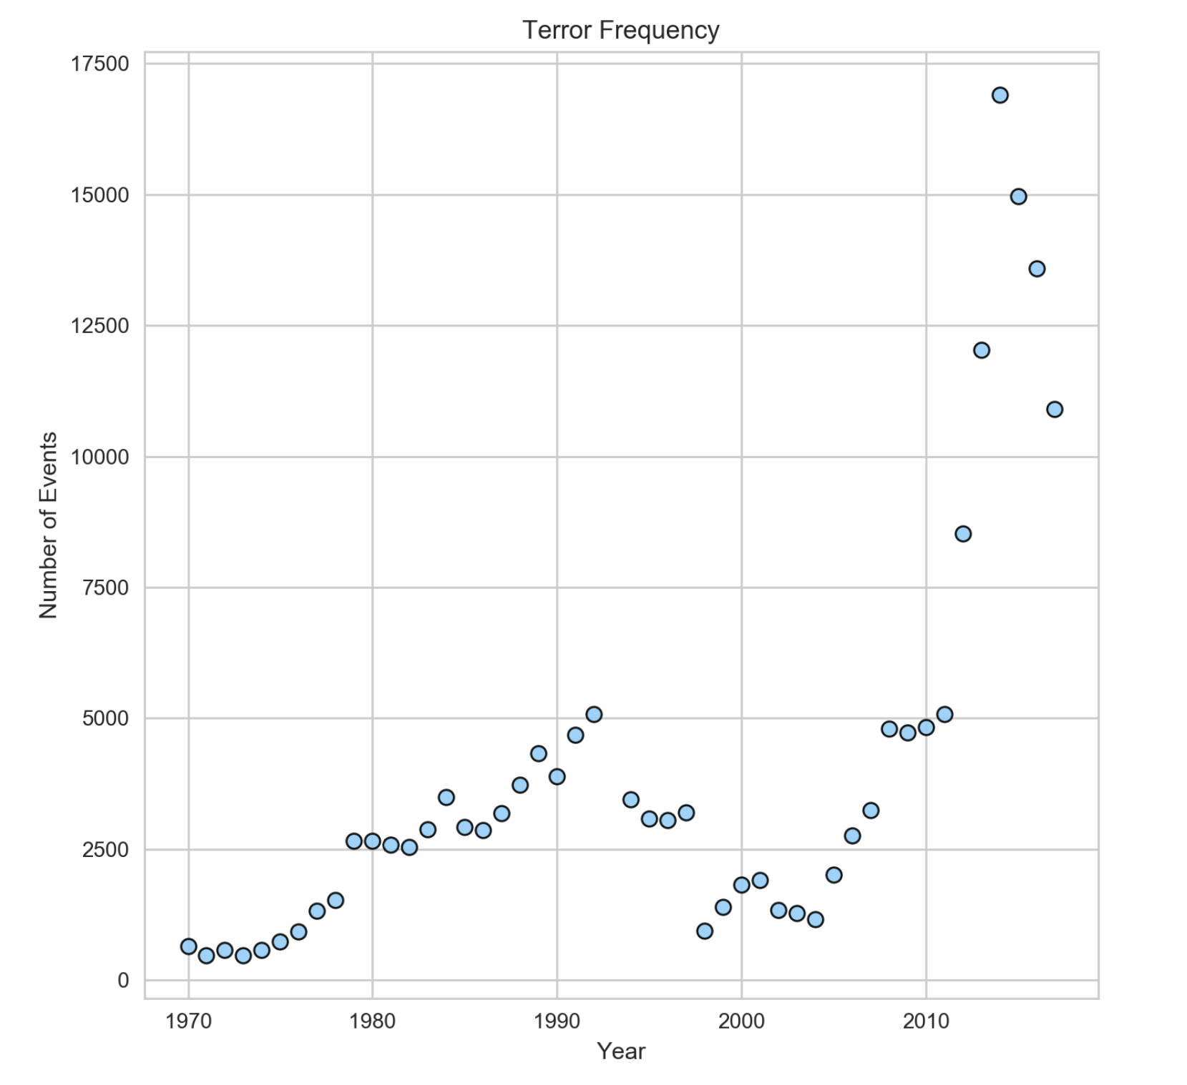
Terror event frequency by year

Slide 9
Total events per region

Slide 10
Total events per region

Slide 11
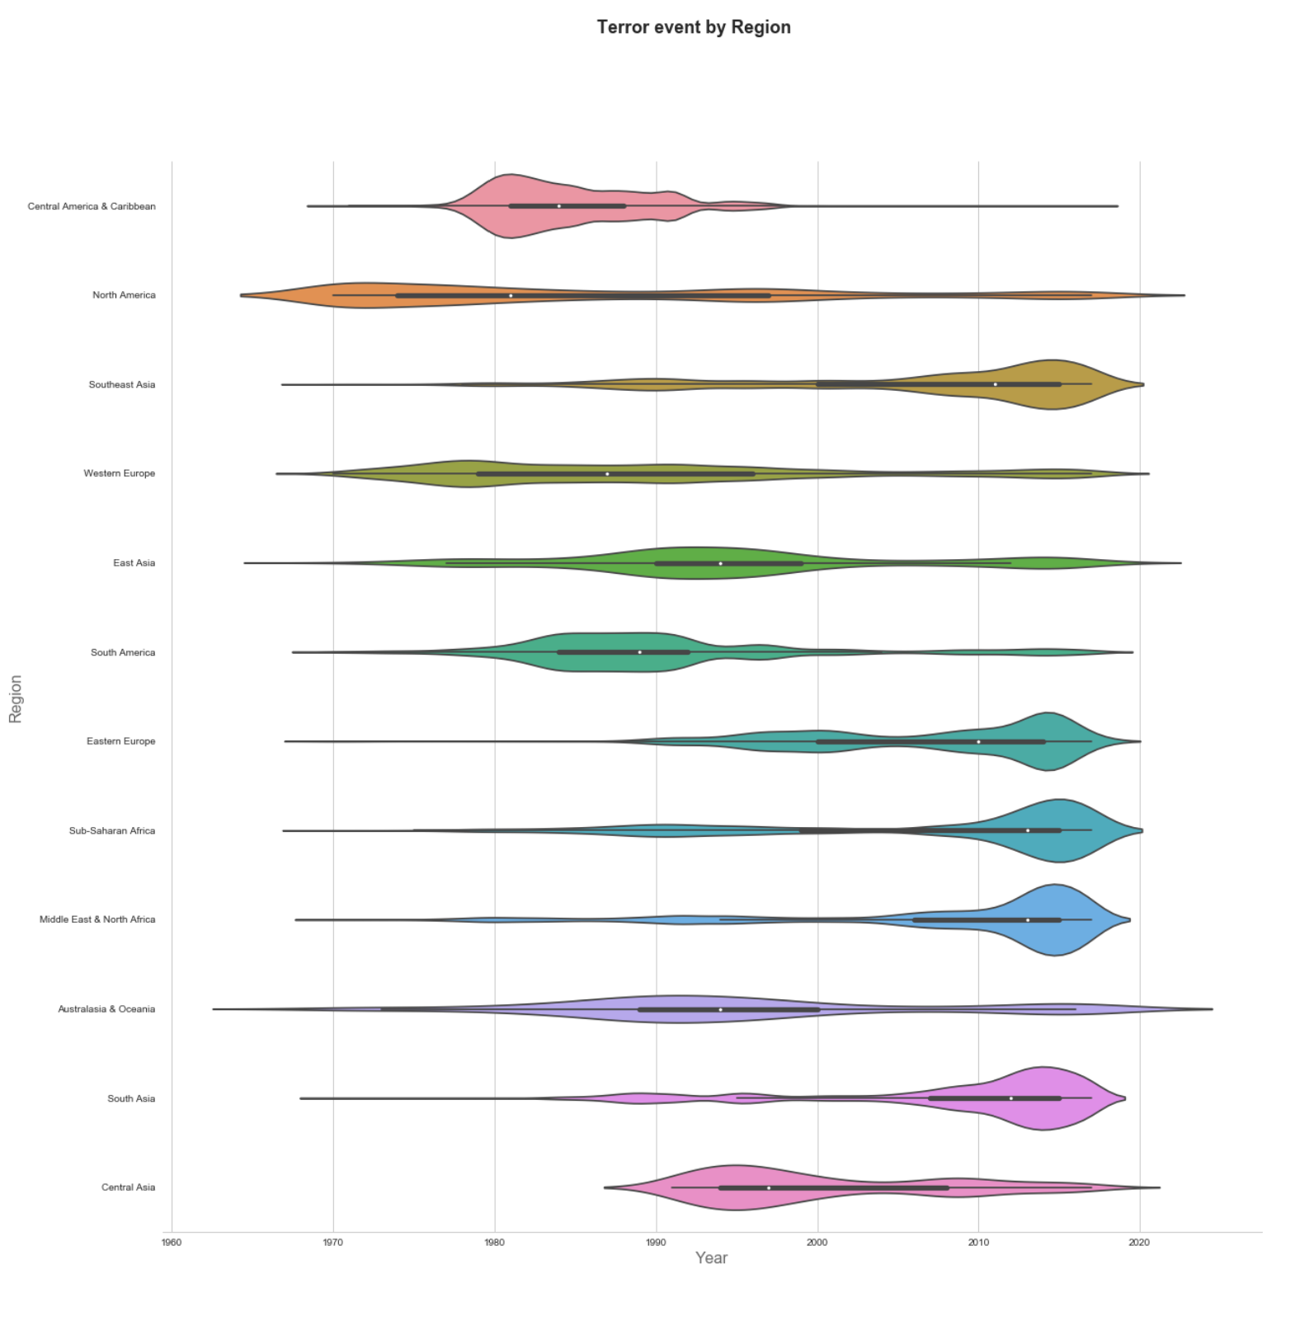
Terror event by region

Slide 12
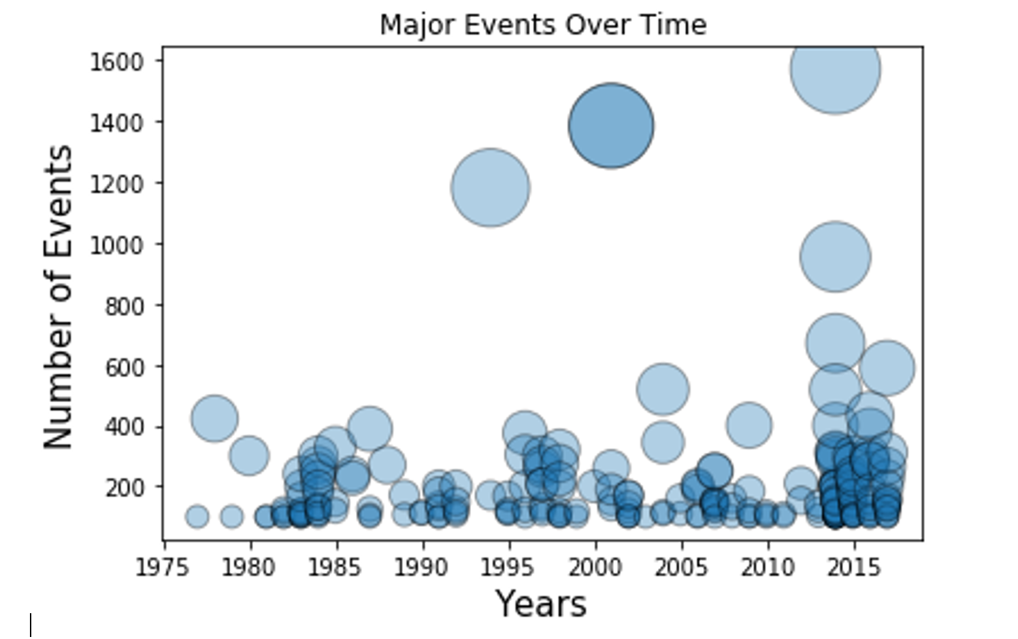
Major events over time

Slide 13

Perpetrators
Notes:
Consider talking about:
Non-state groups
State sponsors
State terrorism

Slide 14
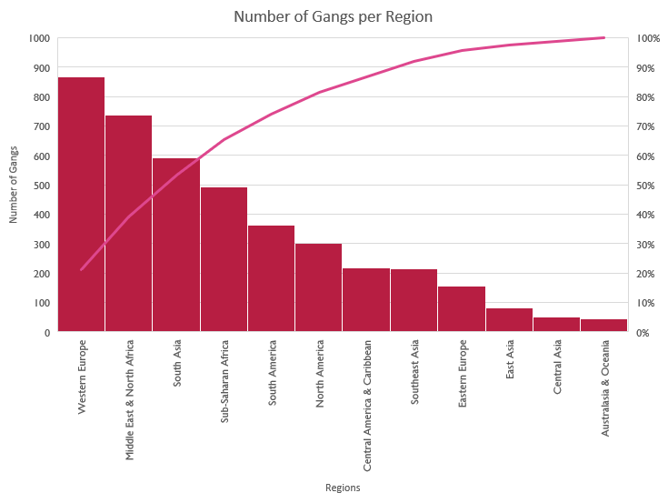
Gangs per region

Slide 15
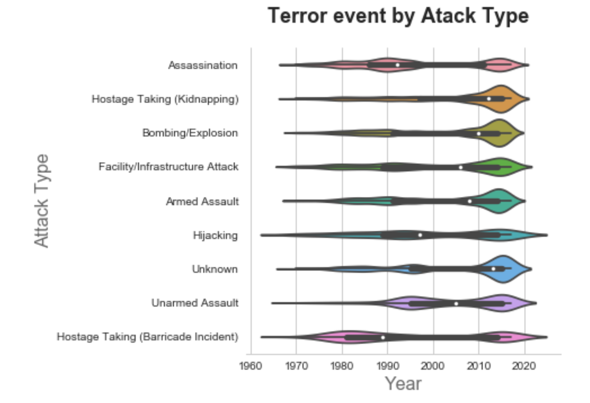
Terror event by attack type

Slide 16
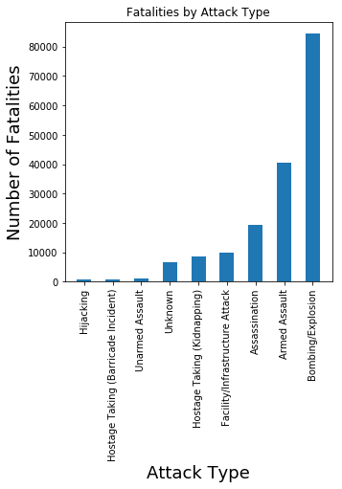
Fatalities by attack type

Slide 17
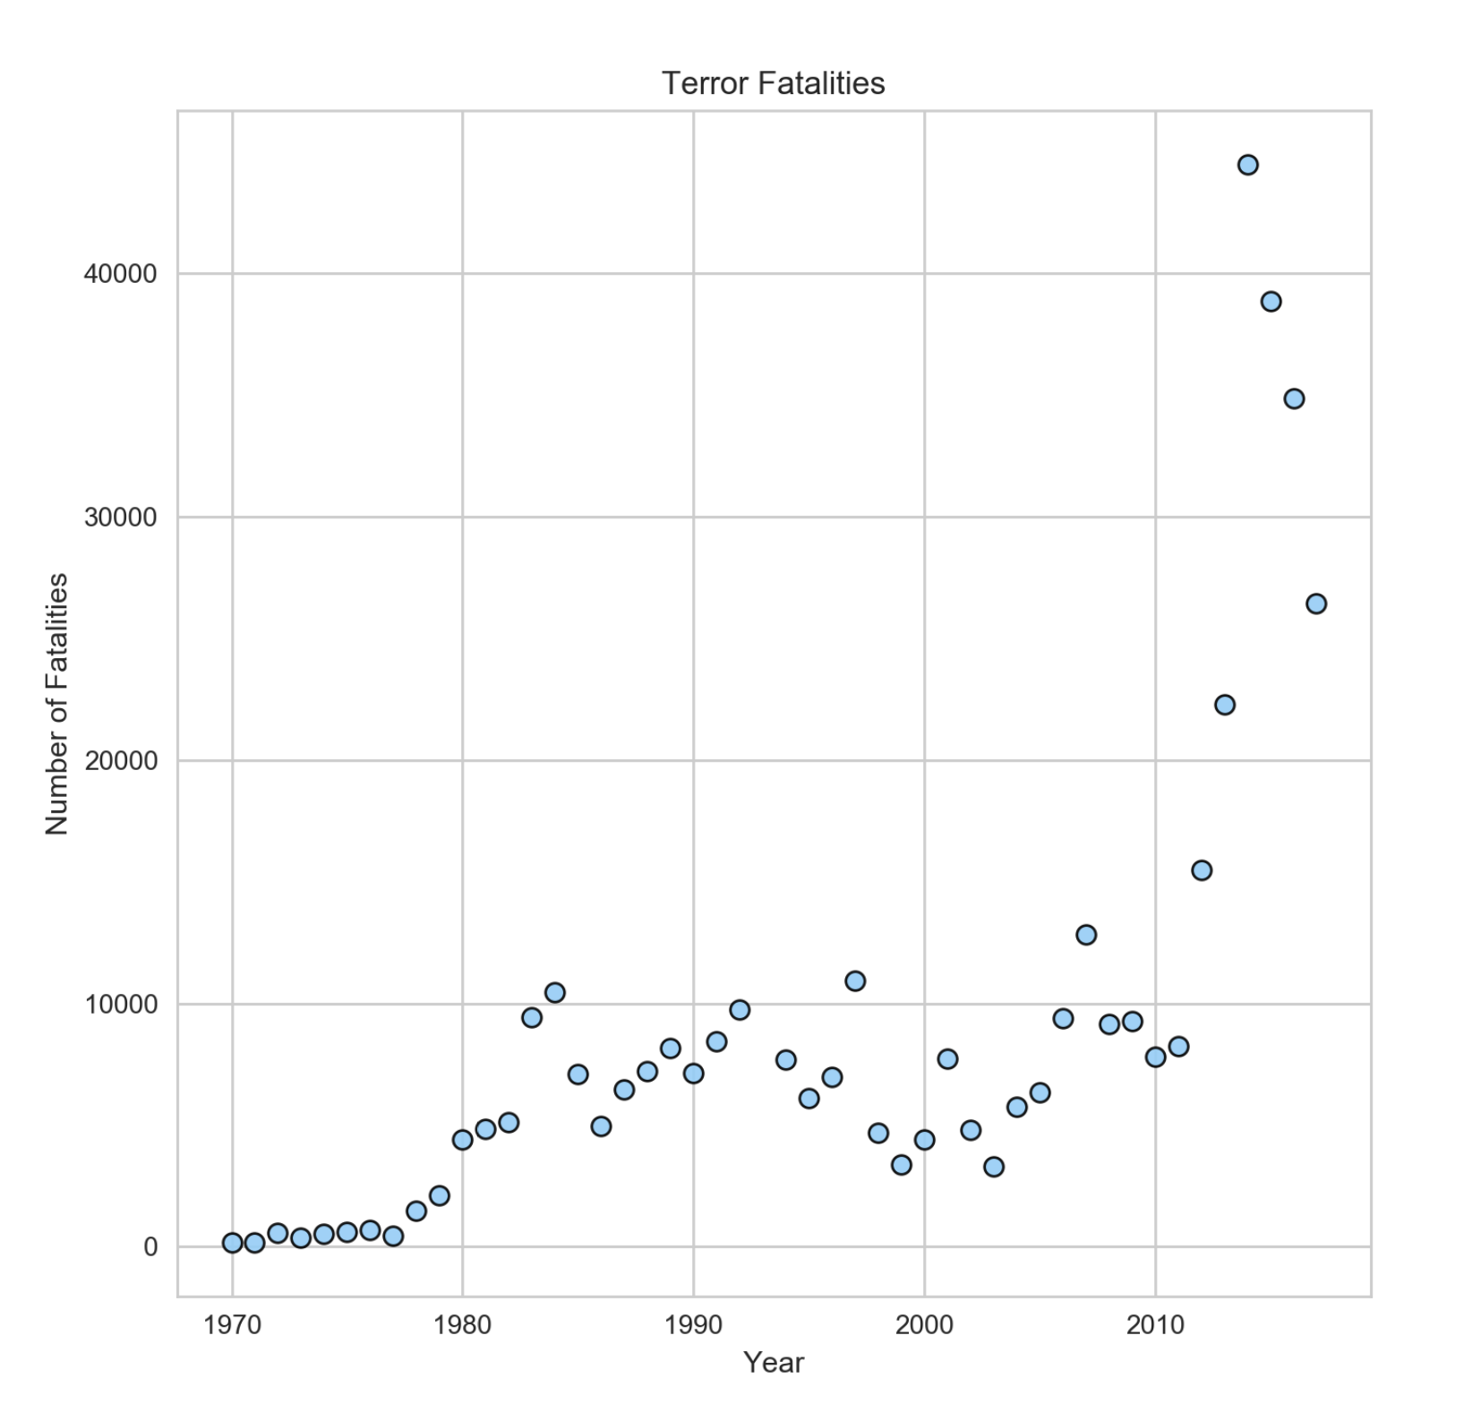
Terror event fatalities by year

Slide 18
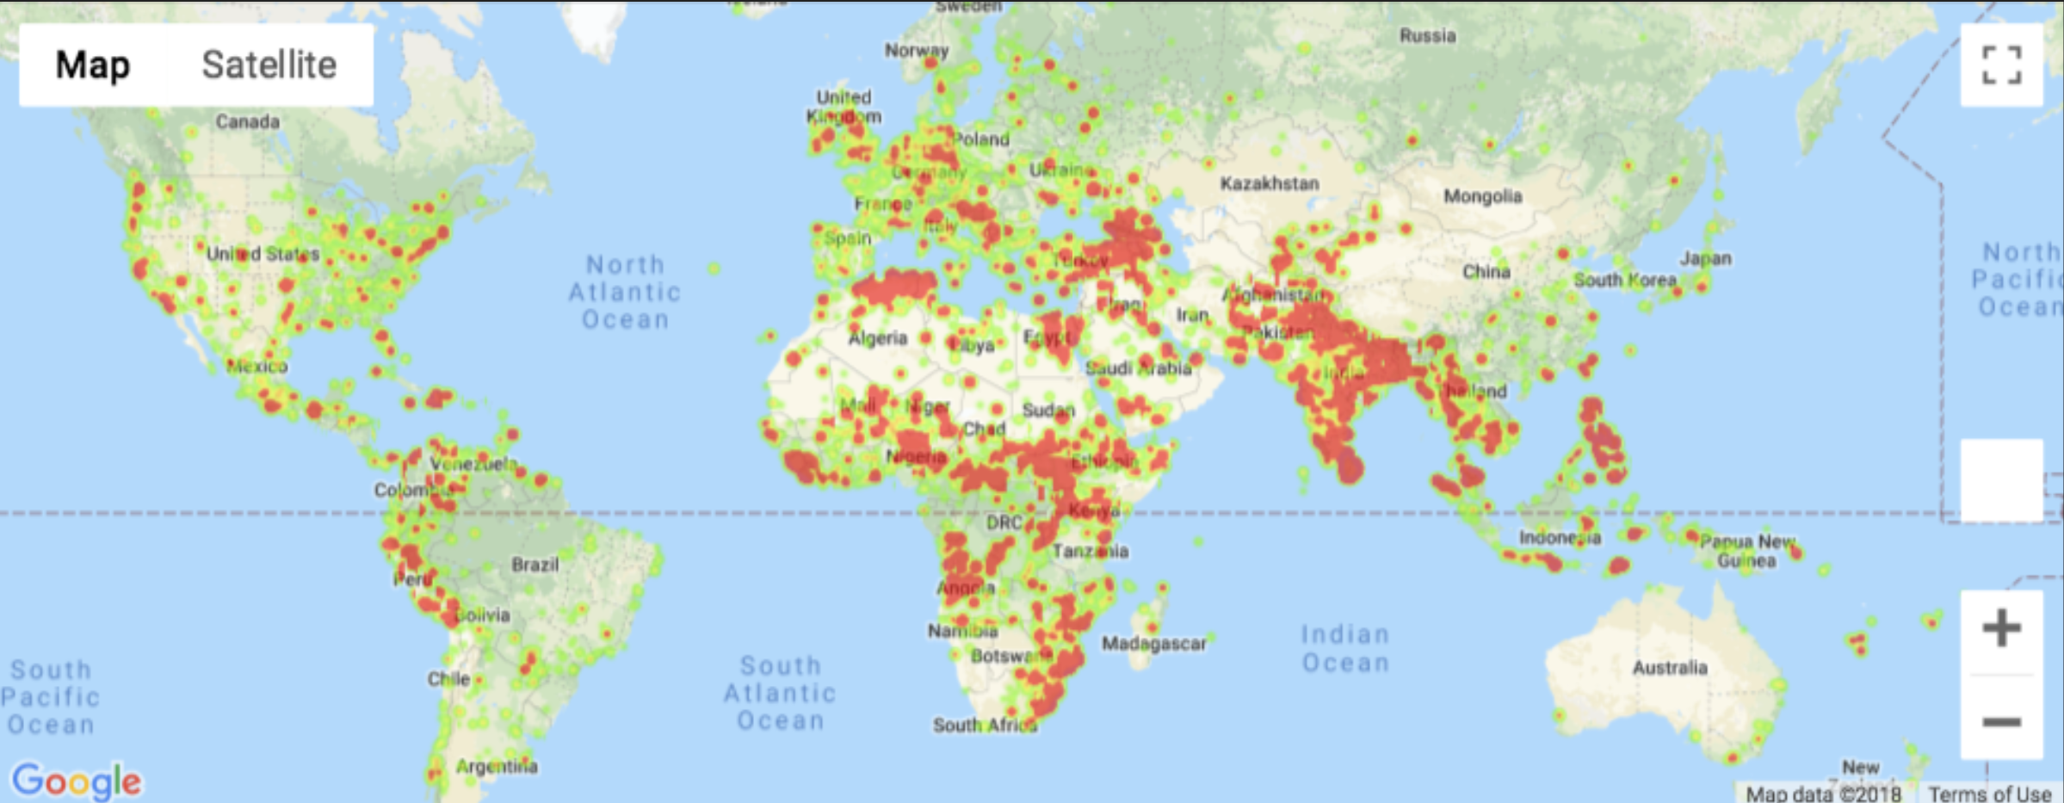
Terror event fatality heat map

Slide 19
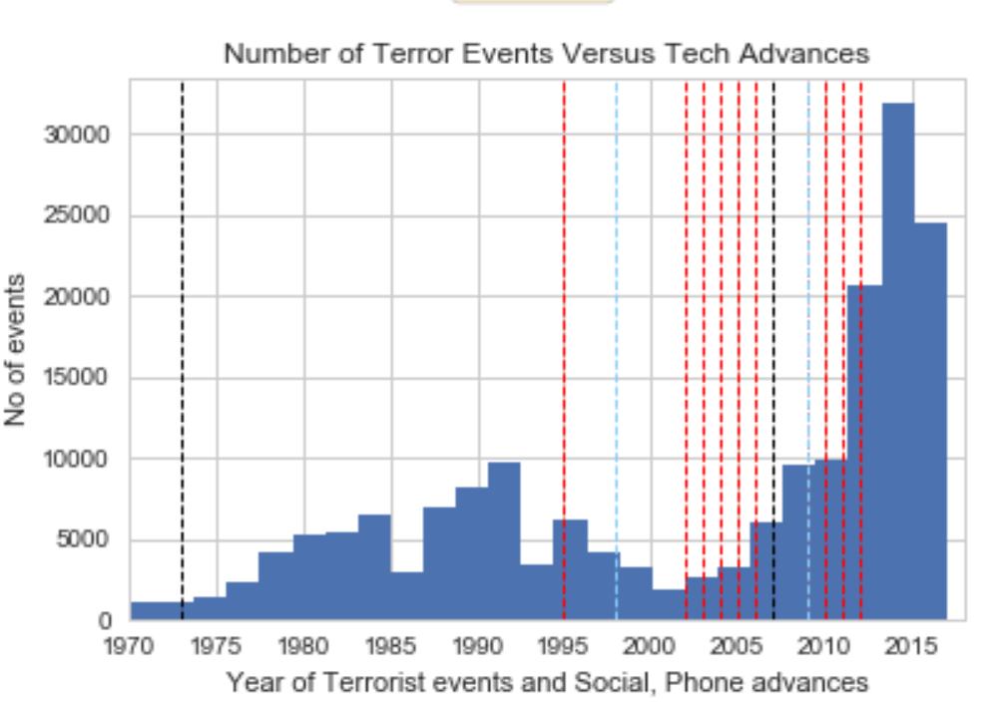
Terror event versus tech advances

Slide 20
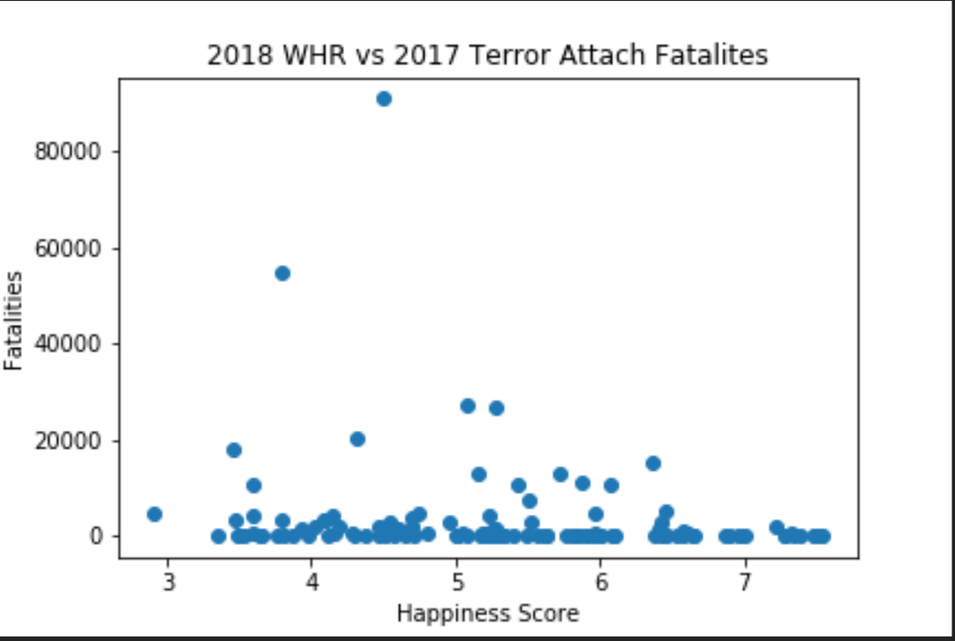
2018 World happiness reports versus 2017 terror attack fatalities

Slide 21
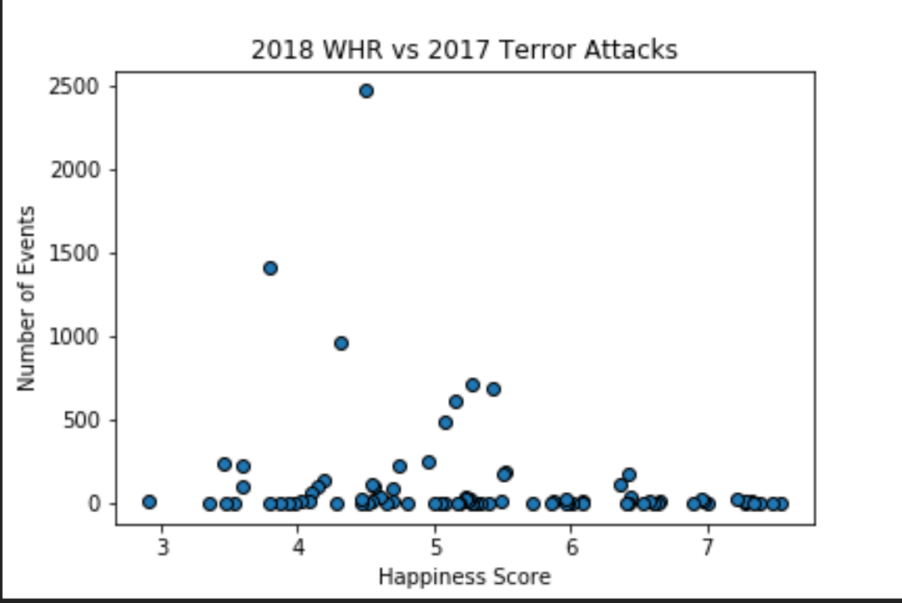
2018 World happiness reports versus 2017 terror attack

Slide 22
observations
Where is it most common
Middle East & North Africa over the last 48 years has significantly more events than other regions, followed by South Asia.
Is it increasing in frequency in areas; and clustering of events over timeline and location
Central America and Caribbean appear to have peaked in events prior to 2000. This would warrant some investigation into this region to see if they were doing anything specific to reduce occurrences.
Middle East and North Africa appear to be maintaining a lead in terms of number of events as well as fatalitites involved.
What are the weapons used in terrorism over time
Hostage taking(barricade) has been applied over time in number
Bombing, hostrage taking(kidnapping), and armed assault is increasing in number in the later 2000’s
Are attacks getting more frequent between large events
Attacks are increasing in frequency and number of kills are increasing along with the frequency
Is there a correlation between tech advances and increase in terrorism
Techknowlogy advancements are interesting, but no obvious correlation is present.
Is there a correlation between Happiness index and terrorism based on country
There is no apparent correlation. Country appears to be more relevant than Happiness score.
Western Europe leads in number of gangs while trailing the leading regions in number of occurrences, fatalities, etc.

Slide 23
Works cited
Kaggle.com - https://www.kaggle.com/ecodan/global-terrorism-db - Global Terrorism Database
Happiness Index –
Raw Data – http://worldhappiness.report/ed/2018/
Simplified Data - https://en.wikipedia.org/wiki/Human_Development_Index

