Slide 1
Finite Sample Inference of Individual Treatment Effects
Chase Mathis

Slide 2
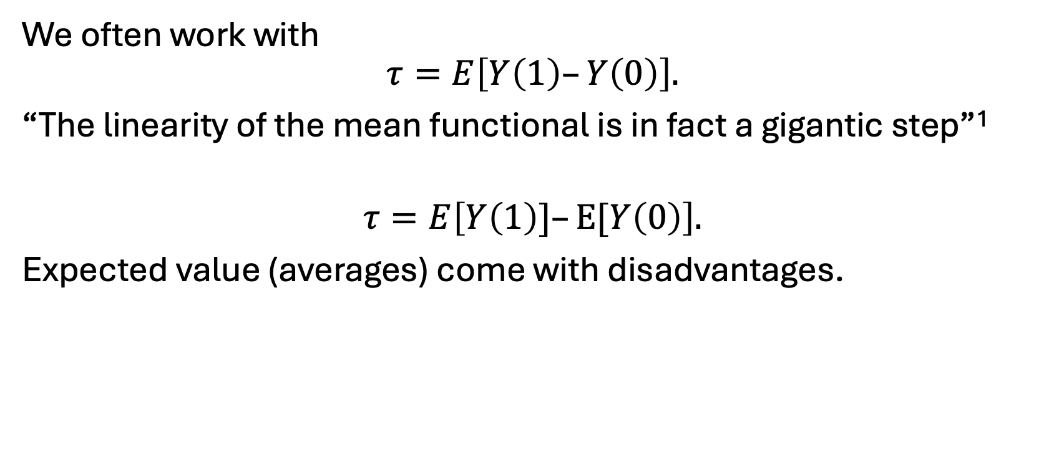
Beyond Averages: Treatment Heterogeneity
We often work with
$$τ=E\left[Y\left(1\right)–Y\left(0\right)\right].$$
“The linearity of the mean functional is in fact a gigantic step”¹
$$τ=E\left[Y\left(1\right)]–E[Y\left(0\right)\right].$$
Expected value (averages) come with disadvantages.

Slide 3
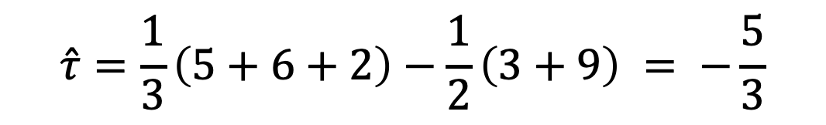
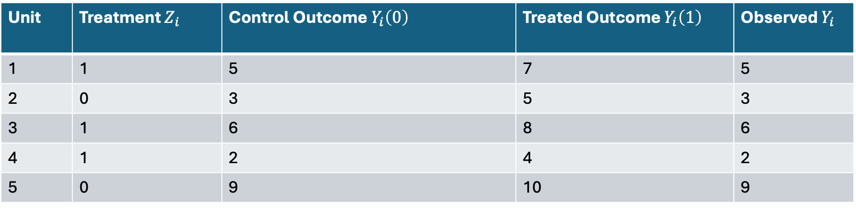
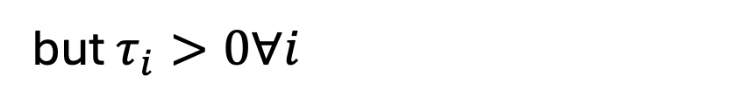
Everyone Benefits But Not On Average
Unit | Treatment $Z_{i}$ | Control Outcome $Y_{i}\left(0\right)$ | Treated Outcome $Y_{i}\left(1\right)$ | Observed $Y_{i}$
1 | 1 | 5 | 7 | 5
2 | 0 | 3 | 5 | 3
3 | 1 | 6 | 8 | 6
4 | 1 | 2 | 4 | 2
5 | 0 | 9 | 10 | 9
$$\hat{τ}=\frac{1}{3}\left(5+6+2\right)−\frac{1}{2}\left(3+9\right) = −\frac{5}{3}$$
but $τ_{i}>0∀i$

Slide 4
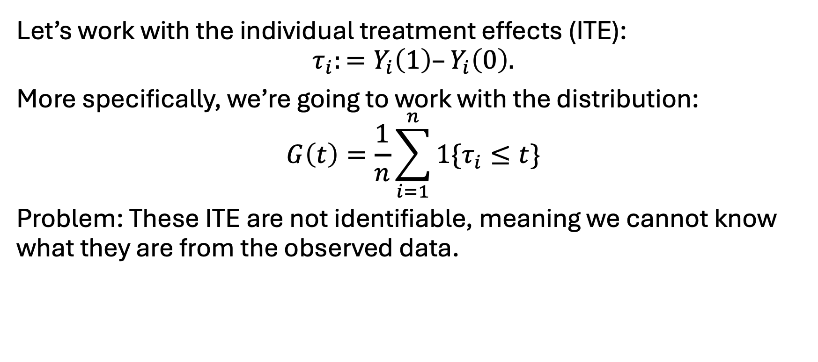
Individual Treatment Effects
Let’s work with the individual treatment effects (ITE):
$$τ_{i}:=Y_{i}\left(1\right)–Y_{i}\left(0\right).$$
More specifically, we’re going to work with the distribution:
$$G\left(t\right)=\frac{1}{n}\sum_{i=1}^{n}{1\{τ_{i}}≤t\}$$
Problem: These ITE are not identifiable, meaning we cannot know what they are from the observed data.

Slide 5
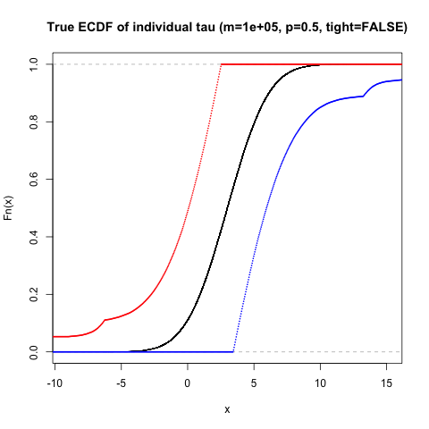
Partial Identification
While we do not know exactly what G(t) is, it cannot be anything.
We will work toward getting to the figure on the right.
Black band is the true distribution G(t).
Red and Blue bands are simultaneous confidence bands for this curve G(t)f.

Slide 6
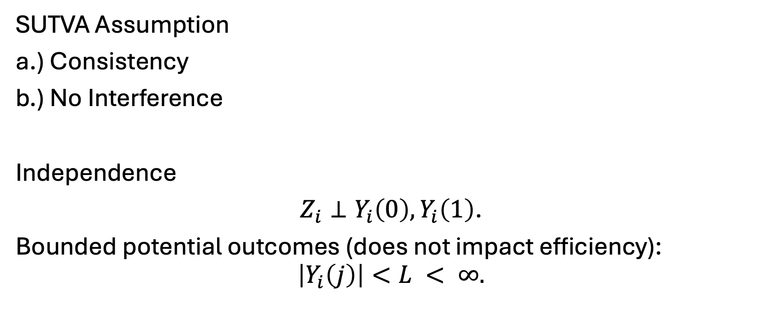
Assumptions For Our Work
SUTVA Assumption
a.) Consistency
b.) No Interference
Independence
$Z_{i}⊥Y_{i}\left(0\right),Y_{i}\left(1\right)$.
Bounded potential outcomes (does not impact efficiency):
$$\left|Y_{i}\left(j\right)\right|<L < ∞.$$

Slide 7
Related Work & Previous Efforts

Slide 8
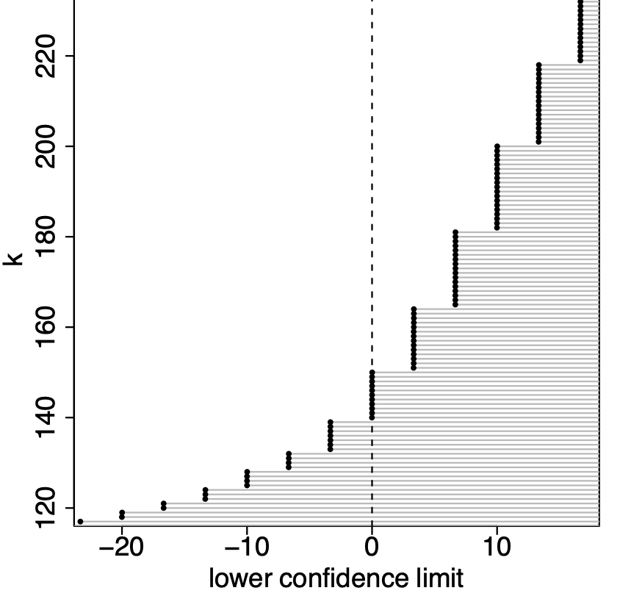
Randomization Inference (Xinran Li’s Neyman Talk)
Use randomization inference
Constructive and worst case
Many tuning steps

Slide 9
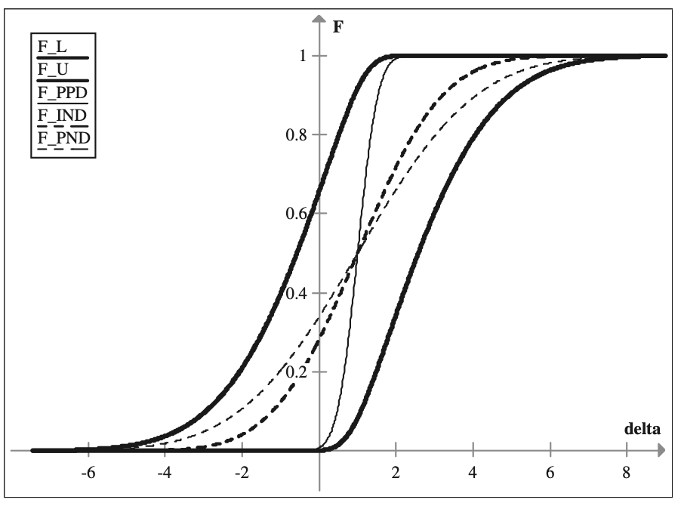
Economics
Yanqin Park & Sang Soo Park
Focus on asymptotics and parametric assumptions
No current finite sample, distribution free, analogues.

Slide 10
Conditional Average Treatment Effect
“Estimate $\hat{τ}\left(x\right)$from samples, use $\hat{τ}\left(x\right)$ to identify subgroups” – Bin Yu
Metalearner
S-learner [Hill 2011, Green-Kern 2012]
T-learner
X-learner
R-learner
Tree-based methods
Causal tree
Causal Forest

Slide 11
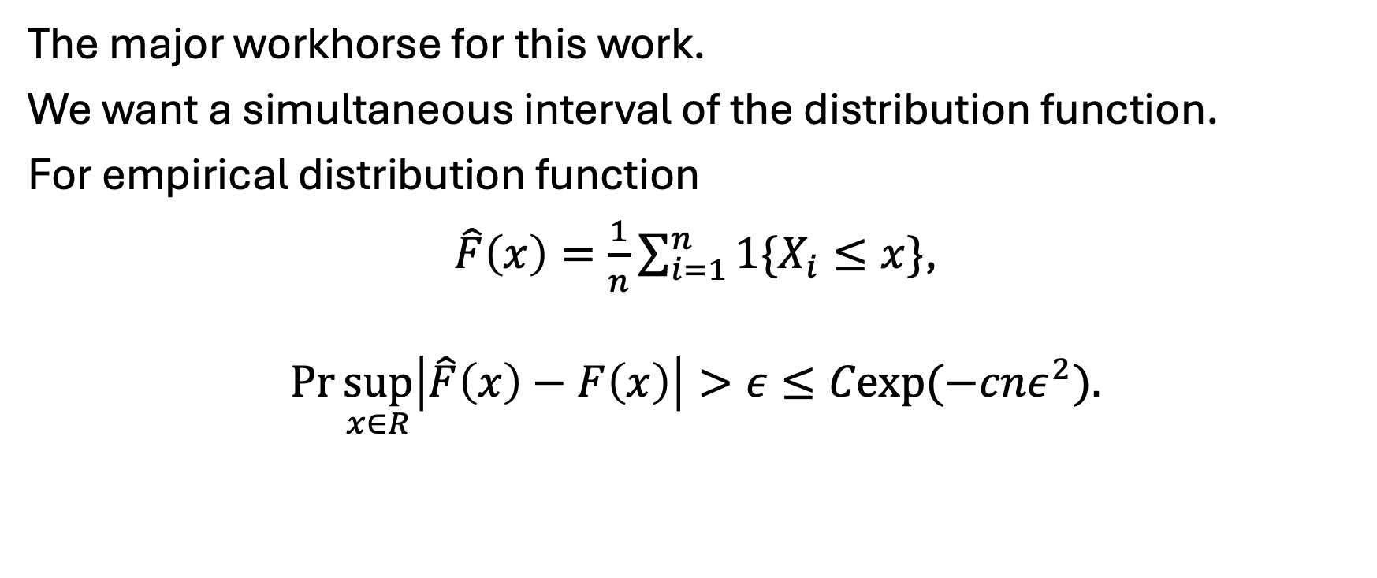
Dvoretky-Kiefer-Wolfowitz Inequality
The major workhorse for this work.
We want a simultaneous interval of the distribution function.
For empirical distribution function
$\hat{F}\left(x\right)=\frac{1}{n}\sum_{i=1}^{n}{1\{X_{i}≤x\}}$,
$$\operatorname{Pr}{\sup_{x∈R}\left|\hat{F}\left(x\right)−F\left(x\right)\right|>ε}≤Cexp(−cnε^{2}).$$

Slide 12
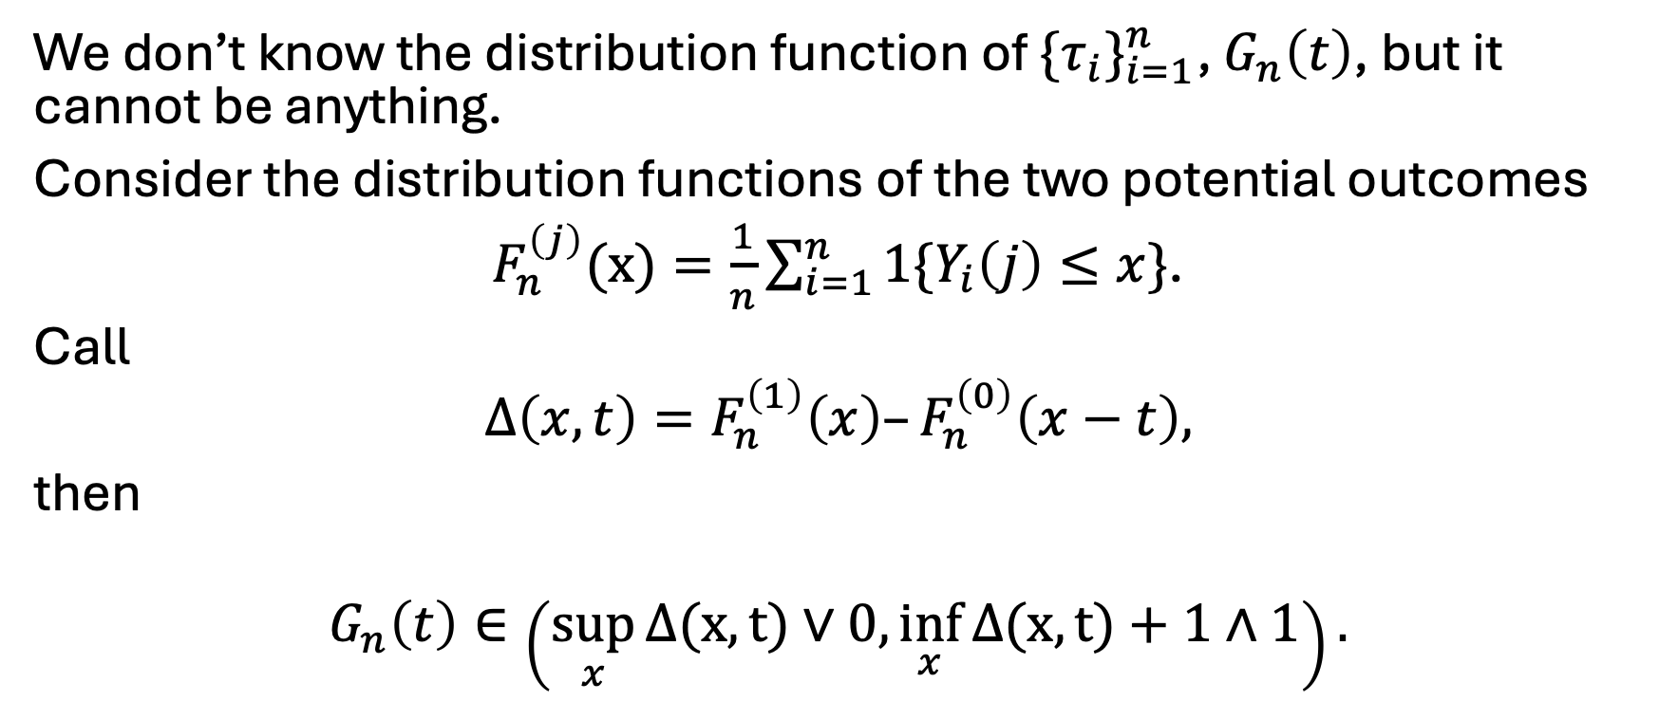
Makarov Bounds
We don’t know the distribution function of $\{τ_{i}\}_{i=1}^{n}$, $G_{n}\left(t\right)$, but it cannot be anything.
Consider the distribution functions of the two potential outcomes
$F_{n}^{\left(j\right)}(x)=\frac{1}{n}\sum_{i=1}^{n}{1\{Y_{i}\left(j\right)≤x\}}$.
Call
$$Δ\left(x,t\right)=F_{n}^{\left(1\right)}\left(x\right)–F_{n}^{\left(0\right)}\left(x−t\right),$$
then
$$G_{n}\left(t\right)∈\left(\sup_{x}{Δ(x,t)}∨0,\inf_{x}{Δ(x,t)}+1∧1\right).$$

Slide 13
Intuition of Method
If we knew the marginal distribution function, we could partially identify the treatment effect distribution.
We don’t know the marginal distribution functions exactly.
But we can estimate them with observables.
So, estimate the distribution function with observables, create a uniformly valid confidence interval.
Deduce that if the true marginal distributions are in this band, then the treatment effect distribution is in the constrained step from before.
Notes:
Do animations

Slide 14
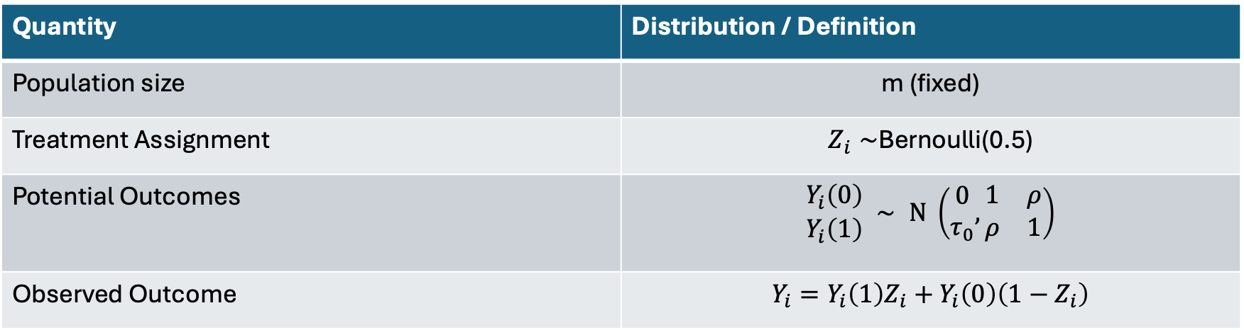
Synthetic Data Experiments
Quantity | Distribution / Definition
Population size | m (fixed)
Treatment Assignment | $Z_{i}∼$Bernoulli(0.5)
Potential Outcomes | $$\begin{matrix}Y_{i}\left(0\right) \\ Y_{i}\left(1\right)\end{matrix} ∼ N \left(\begin{matrix}0 \\ τ_{0}\end{matrix},\begin{matrix}1 & ρ \\ ρ & 1\end{matrix}\right)$$
Observed Outcome | $$Y_{i}=Y_{i}\left(1\right)Z_{i}+Y_{i}\left(0\right)\left(1−Z_{i}\right)$$

Slide 15
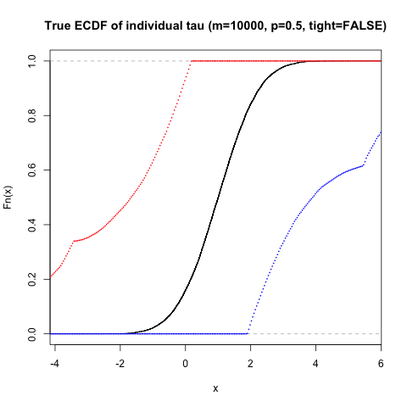
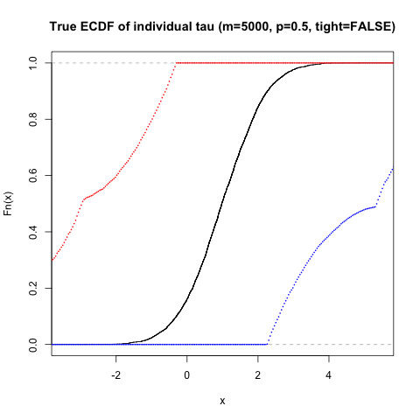
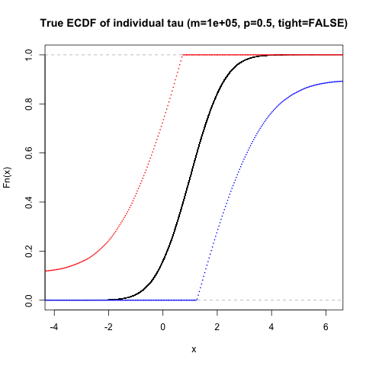
Confidence Bands

Slide 16
Comparing with Randomisation Inference (RI)

Slide 17
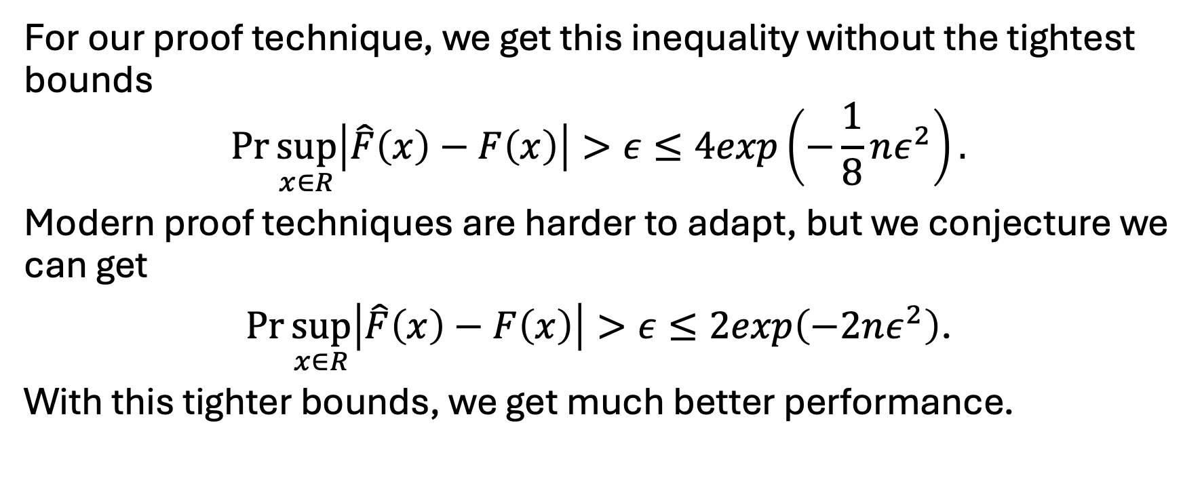
Conjecture With Tight Bounds
For our proof technique, we get this inequality without the tightest bounds
$$\operatorname{Pr}{\sup_{x∈R}\left|\hat{F}\left(x\right)−F\left(x\right)\right|>ε}≤4exp\left(−\frac{1}{8}nε^{2}\right).$$
Modern proof techniques are harder to adapt, but we conjecture we can get
$\operatorname{Pr}{\sup_{x∈R}\left|\hat{F}\left(x\right)−F\left(x\right)\right|>ε}≤2exp\left(−2nε^{2}\right)$.
With this tighter bounds, we get much better performance.

Slide 18
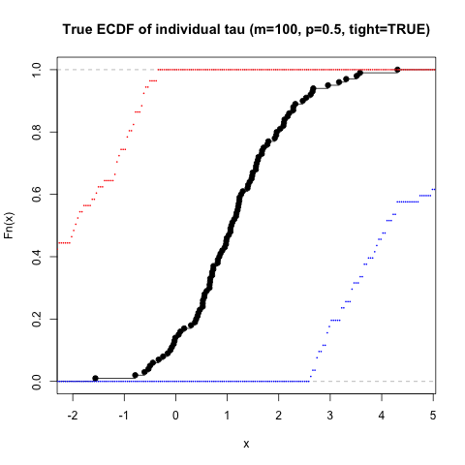
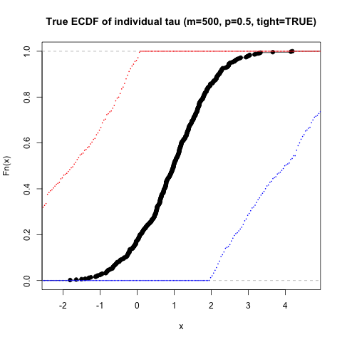
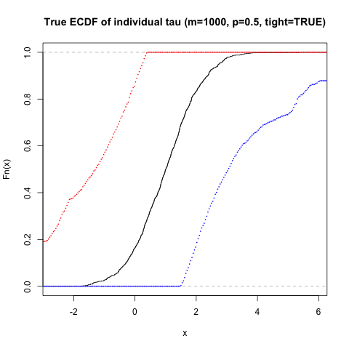
Tighter Confidence Bands
Better widths for much less sample size m = 100, 500, and 1000.

Slide 19
Comparing with RI (Tighter Bounds)

Slide 20
Conclusion
In this presentation we
Confidence regions for distribution of ITE that are
Finite sample exact
Closed form
Stronger than previous efforts in randomization inference
A stronger tool for inference of ITE helps with analysis of heterogeneous treatments.
Work on strengthening the DKW bound for stronger inference.

