Slide 1
Financial Alerts System Presentation
Chase Cabrera

Slide 2
Contents
Code Organization and Structure
Requirements
Overview
Testing
Given Additional Time

Slide 3

Requirement Overview
Alert Logic:
Implement a Python application using Flask, Django, or FastAPI.
Process Mock Financial Transactions and evaluate them against user-defined thresholds
Trigger and store alerts when threshold are exceeded

Slide 4
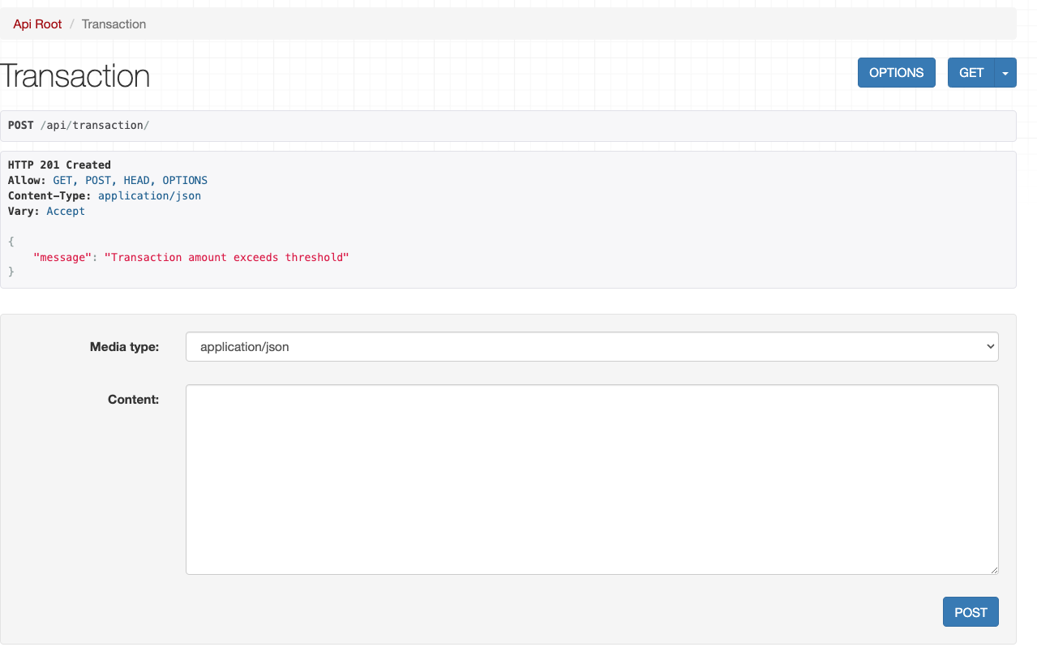
Process Mock Transactions

Slide 5
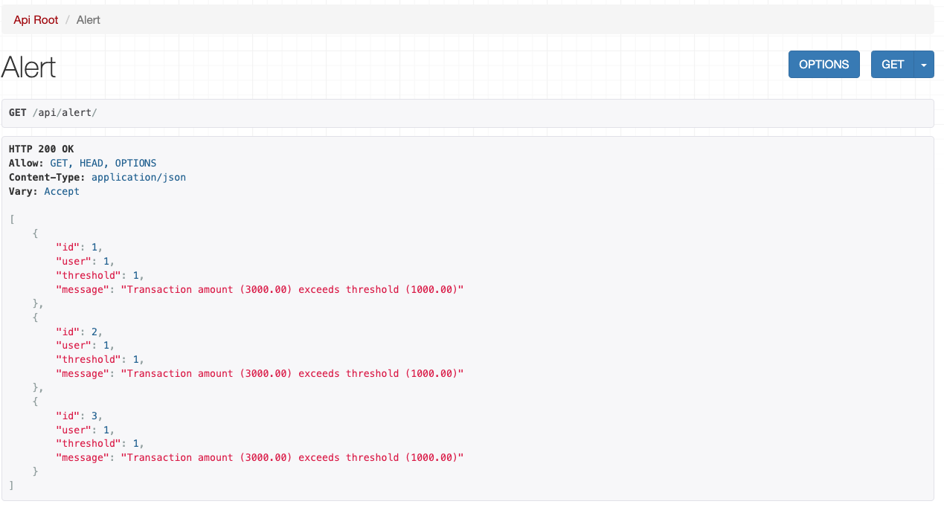
Trigger and Store

Slide 6
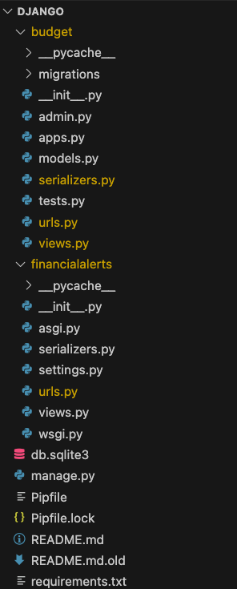

Code Organization and Structure

Slide 7
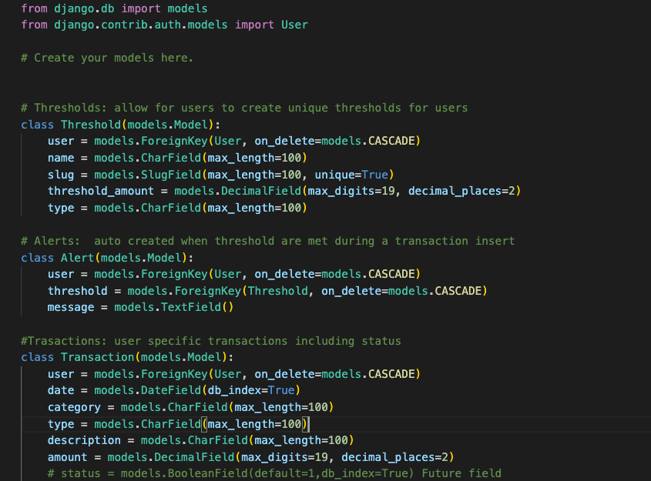
Code Organization and Structure - Models.py

Slide 8
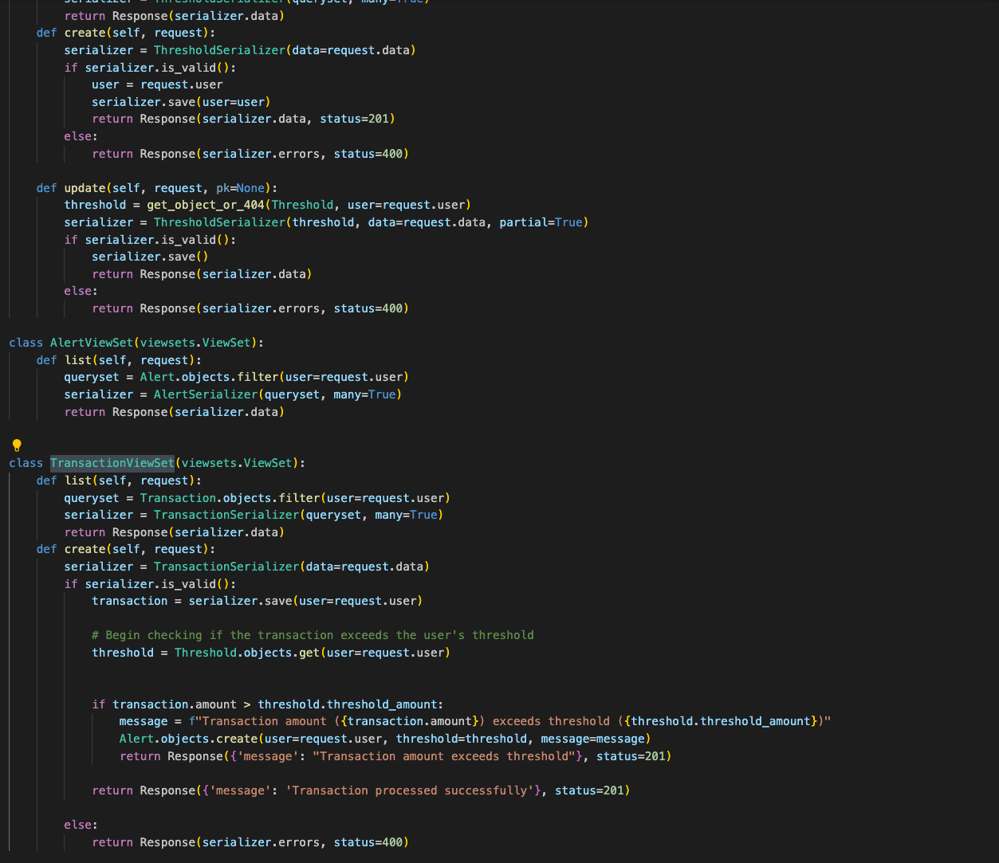
Code Organization and Structure - Views.py

Slide 9

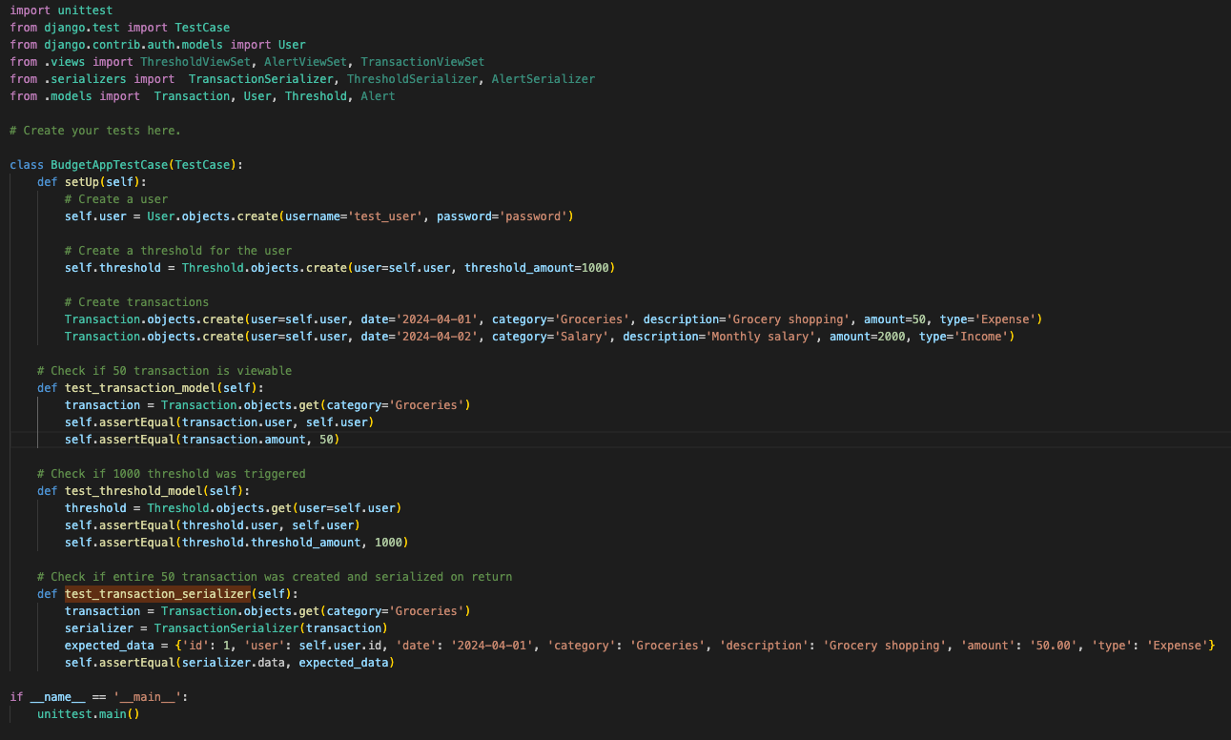
Testing

Slide 10

Given Additional Time
Create the following models TransactionType, ThresholdType, TransactionCategory this would help in production env in searching for specific filtering
Build in pagination, searching, ordering
Add operator to ThresholdType allowing for greater than, equal to or less than logic to be applied to thresholds
More Robust Testing of alerts and error
Error handling
Notes:
Consider talking about:
The guiding principle versus the profession
Implementation frameworks
DSDM
Prince2

Slide 11
Bonus
## Steps to Deploy on Production
1.) Stand Up Postgres DB RDS in AWS
2.) Setup pgadmin
3.) Adjust DJANGO settings to utilizing a production settings.py instead of the dev and ensure the production settings are routed to the Postres DB on AWS, adjust security settings
4.) Dockerize the django app, including necessary dependencies and configuration in the Dockerfile and building the Docker image
5.) Secure application: Configure IAM roles, security groups and VPC and leverage AWS Secrets to manage credentials
6.) Container orchestration with ECS
Setup ECS cluster
Create an ECS task definition for Django application
7.) Push Docker Image to ECR
Create a repository in ECR to store the Docker Image and Push Docker Image
8.) Deploy to AWS
Use ECS to deploy Dockized Django application
Configure auto-scaling policies and health checks
9.) Load Balancer, DNS & SSL
Setup DNS records to point domain to AWS resources, load balancer
10.) Site should be functional at this point but as an added step Redis cache could be used as a state cache
11.) Bonus, setup CDN on S3 and leverage CloudFrount for any images/videos
Notes:
Consider talking about:
The guiding principle versus the profession
Implementation frameworks
DSDM
Prince2

Slide 12
Questions?
Notes:
Consider talking about:
The guiding principle versus the profession
Implementation frameworks
DSDM
Prince2

Slide 13

Thank you!

