Slide 1

Final Projects

Slide 2


Slide 3
Review
The Browser
Dev Tools
Server Side
HTML
CSS
JavaScript
jQuery
Bootstrap
SEO
Heroku
Git
GitHub
Templating Engines
Sessions
Writing tests
Node.js
Express.js
Creating APIs
MVC
User Authentication
ORM (Sequelize)
Laravel
Databases
MySQL
MongoDB
API Interaction
APIs (Consuming)
JSON
AJAX
Real Time Cloud Database via Firebase
Algorithms
Design Patterns
CS Fundamentals
Cutting Edge Development
React.js

Slide 4
Admin Items

Slide 5
What’s Left
Final Projects
Remaining Topics
  Java
  Computer Science Algorithms
Lightning Talks:
  ?
Job Workshops
Demo Day!!!!

Slide 6
Big News!
No homework from now till the end!
(With a small caveat)

Slide 7

Never Stop Learning!
The key to hireability and relevance is to constantly be learning.
The field is always changing and there is never a point where you can call it quits.
Stick with it! It’s a craft that you continue to hone with time.

Slide 8
Final Projects

Slide 9
Your Challenge

Slide 10
Your Challenge
You have plenty of time to work on this.
You have ALL the skills you need.
You have a team of skilled developers.
You have experts willing to help.
No excuses. Time to prove yourself.

Slide 11
Expectations

Slide 12
Expectations
We expect whatever you build to have utility
We expect you to have market or real-world research that evidences your idea has REAL value to people.
We expect you to have done research on other web / mobile applications in your domain.
We expect you to put serious time and thought into this.
We expect you to report problems you are facing along the way.
We expect you to utilize some form of project management system.
We expect you to dig deep into documentation and external resources to learn what you need.

Slide 13
Requirements

Slide 14
Coding Requirements (but not really requirements)
Must use ReactJS or Angular in some way (even if minimal)
Must use a Node and Express Web Server
Must be backed by a MySQL or MongoDB Database with a Sequelize or Mongoose ORM
Must have both GET and POST routes for retrieving and adding new data
Must be deployed using Heroku (with Data)
Must utilize at least two libraries, packages, or technologies that we haven’t discussed
Must allow for or involve the authentication of users in some way
Must have a polished frontend / UI
Must have folder structure that meets MVC Paradigm
Must meet good quality coding standards (indentation, scoping, naming)

Slide 15
But Honestly…
Do what you want. Talk to us first. Get our input.
But if you have an idea and want to run with it, we’re not going to stop you.
Remember:
No excuses. Time to prove yourself.

Slide 16
Deliverables

Slide 17
Project Updates
Instead of homework, you will be required to submit 4 Project Deliverables.
These will be due each Saturday from now until Presentation Day.
Deliverables #1 (2/23) – Plan, Design, and Research
Deliverables #2 (3/3) – Ready MVP (Working App!), Mini-Presentation
Deliverables #3 (3/10) – Project Polish, Functionality Push, Final Plan
Final Presentation (3/17) – Presentation Time!

Slide 18
Deliverable #1

Slide 19
Deliverable #1
By July 2, 2016 you must submit a detailed plan of action for your project.
In this plan, you will include:
An overview of the intended application and WHY you feel it’s valuable.
A set of DETAILED screen-by-screen design layouts with annotations describing all UI/UX components and all data relevant to the screen.
A breakdown of roles by group member.
A schedule for completion of various tasks.
A screenshot of your Jira, Trello, or Project Management Board that shows breakdown of tasks – assigned to group members with a schedule.

Slide 20
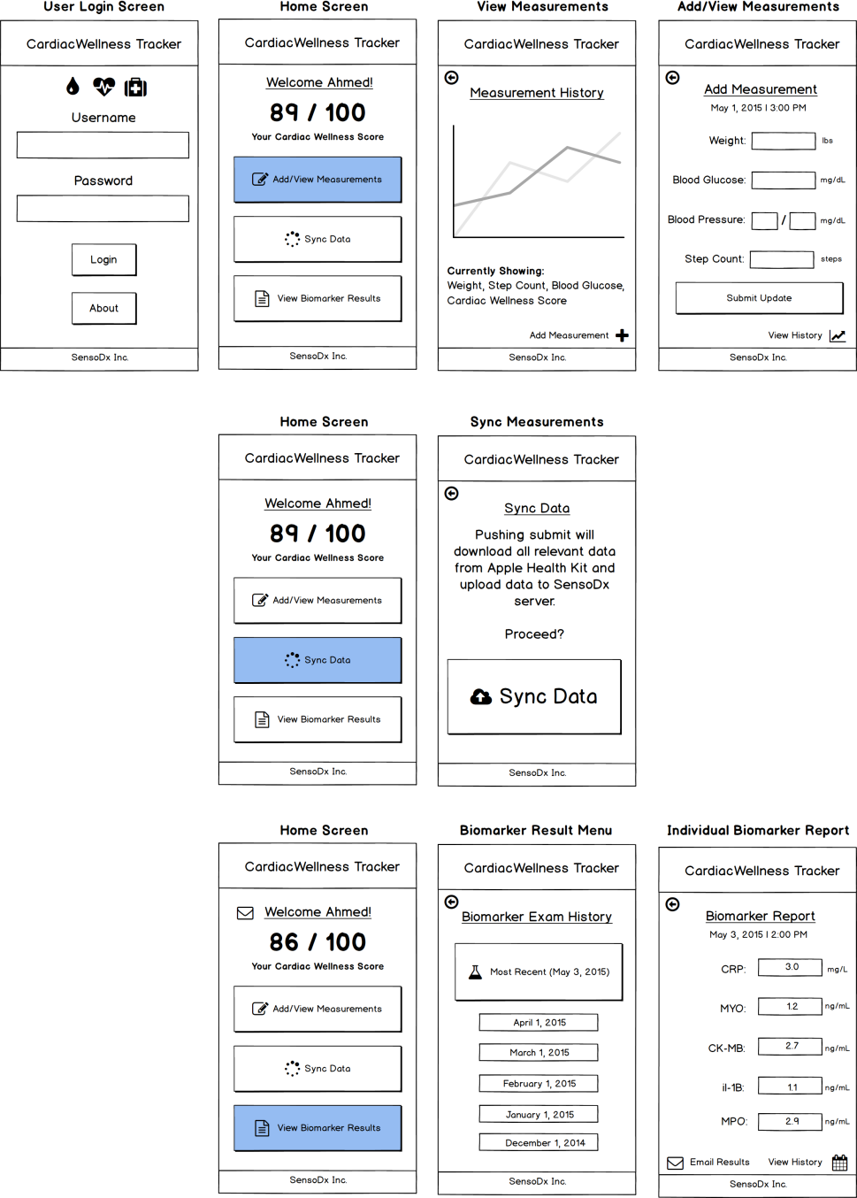
Example UI/UX Flow
Screen Map
This is intended to show you the order in which users would see screens. The three branches correlates with the three button options from the main menu.

Slide 21
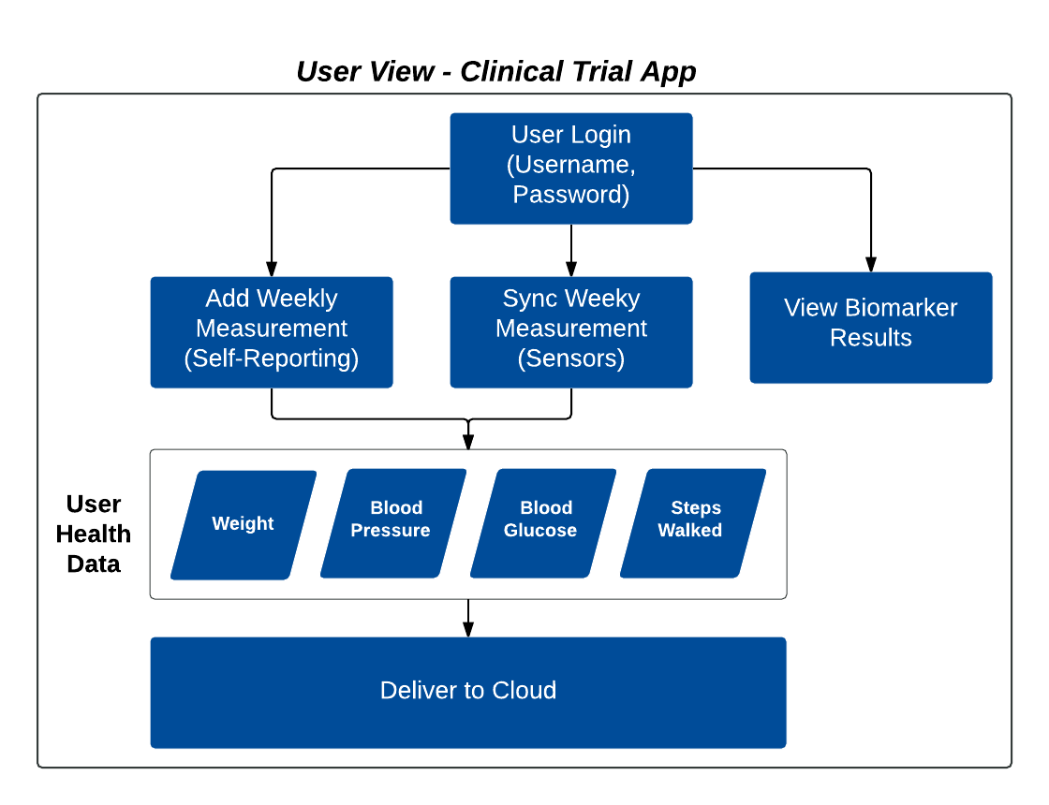
Example Data Flow

Slide 22
Questions

