Slide 1
Market Value of American Homes: A Regression Analysis
By Matthew C. Luey

Slide 2
American Homeownership
American real estate is the foundation our economy is built on.
The real estate market is changing.
What is causing these changes?
What factors influence the market value of a home?

Slide 3
2019 American Housing Survey (AHS)
 | Mean | StDev | Min | 25% | 50% | 75% | Max
MARKETVAL | 299682.035 | 169757.862 | 1040 | 174111.5 | 266864.5 | 398013.25 | 823457
MORTAMT | 1105.302 | 634.982 | -5376 | 646 | 993 | 1465 | 3259
HINCP | 105473.814 | 56982.115 | -5000 | 63000 | 98900 | 140000 | 272000
MAINTAMT | 995.088 | 1272.633068 | 0 | 206 | 512 | 1131 | 9998
d_GARAGE | 0.860 | 0.347 | 0 | 1 | 1 | 1 | 1
d_UNITSIZE1 | 0.047 | 0.211 | 0 | 0 | 0 | 0 | 1
d_UNITSIZE2 | 0.492 | 0.500 | 0 | 0 | 0 | 1 | 1
d_UNITSIZE3 | 0.316 | 0.465 | 0 | 0 | 0 | 1 | 1
d_UNITSIZE4 | 0.105 | 0.307 | 0 | 0 | 0 | 0 | 1
d_UNITSIZE5 | 0.040 | 0.196 | 0 | 0 | 0 | 0 | 1
d_NHQSCHOOL | 0.921 | 0.269 | 0 | 1 | 1 | 1 | 1
d_NHQSCRIME | 0.036 | 0.186 | 0 | 0 | 0 | 0 | 1
The AHS is a survey conducted by the US Census Bureau.
What is the meaning of this?

Slide 4
Limitations
Public User File (PUF)
Privacy
No access to location or demographic data

Slide 5
First Regression
Dep. Var. | No. Obs. | R Sq | Adj R Sq
Mkt Value | 20,816 | .441 | .441
 | Coefficient | Standard Error | T | P > |T| | Lower | Upper
Intercept | 32,430 | 5136.623 | 6.314 | 0.000 | 22,400 | 42,500
Income | 0.480 | 0.019 | 24.951 | 0.000 | 0.442 | 0.517
Mortgage | 133.2591 | 1.952 | 68.267 | 0.000 | 129.433 | 137.085
Maintenance | 8.3828 | 0.798 | 10.502 | 0.000 | 6.818 | 9.947
Garage | 22,920 | 2,437.363 | 9.403 | 0.000 | 18,100 | 27,700
Unit Size 2 | 10,630 | 4172.036 | 2.548 | 0.011 | 2454.759 | 18,800
Unit Size 3 | 36,570 | 4,433.292 | 8.249 | 0.000 | 27,900 | 75,900
Unit Size 4 | 65,660 | 5,225.360 | 12.565 | 0.000 | 55,400 | 75,900
Unit Size 5 | 87,600 | 7,052.627 | 12.421 | 0.000 | 73,800 | 101,000
Schools | 9,661.168 | 3,221.634 | 2.999 | 0.003 | 3,346.880 | 16,000
Market Value = B₀ + B₁(Income) + B₂(Mortgage) + B₃(Maintenance) + B₄(Garage) + B₅(Unit Size 2) + B₆(Unit Size 3) + B₇(Unit Size 4) + B₈(Unit Size 5) + B₉ (School) + E
This is a robust regression.
Crime was insignificant (p-value .358) in this regression.

Slide 6
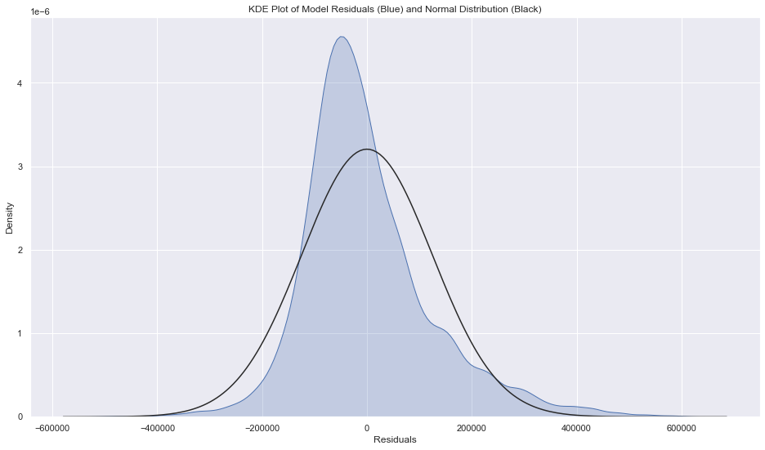
Assumption Testing
Variable | VIF
Income | 5.488404
Mortgage | 5.315279
Maintenance | 1.641236
Garage | 6.836869
Unit Size 2 | 6.656712
Unit Size 3 | 5.487752
Unit Size 4 | 2.687857
Unit Size 5 | 1.647726
School | 9.448698

Slide 7
Second Regression
Dep. Var. | No. Obs. | R Sq | Adj R Sq
Mkt Value | 20,816 | .154 | .154
 | Coefficient | Standard Error | T | P > |T| | Lower | Upper
Intercept | 144,300 | 6,678.695 | 21.602 | 0.000 | 131,000 | 157,000
Maintenance | 15.8507 | 0.961 | 16.486 | 0.000 | 13.966 | 17.735
Garage | 44,570 | 3,152.258 | 14.138 | 0.000 | 38,400 | 50,700
Unit Size 2 | 40,390 | 5,493.637 | 7.353 | 0.000 | 29,600 | 51,200
Unit Size 3 | 110,700 | 5,683.376 | 19.473 | 0.000 | 99,500 | 122,000
Unit Size 4 | 173,300 | 6,378.395 | 27.176 | 0.000 | 161,000 | 186,000
Unit Size 5 | 214,400 | 8,219.765 | 26.084 | 0.000 | 198,000 | 231,000
Schools | 18,290 | 4,064.488 | 4.501 | 0.000 | 10,300 | 26,300
Crime | -22,790 | 6,418.944 | -3.551 | 0.000 | -35,400 | -10,200
Market Value = B₀ + B₁(Maintenance) + B₂(Garage) + B₃(Unit Size 2) + B₄(Unit Size 3) + B₅(Unit Size 4) + B₆(Unit Size 5) + B₇(Schools) + B₈(Crime) + E
This is a robust regression.

Slide 8
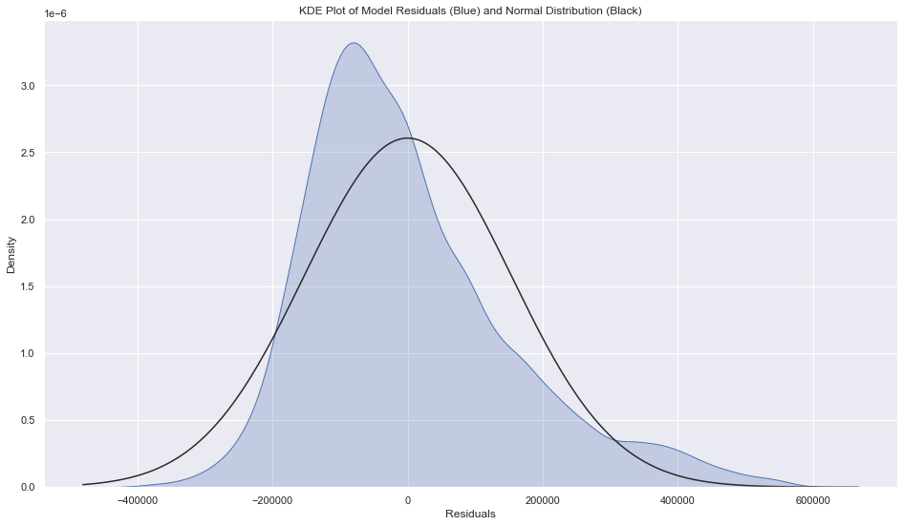
Assumption Testing
Variable | VIF
Maintenance | 1.612915
Garage | 6.664006
Unit Size 2 | 6.178655
Unit Size 3 | 4.763744
Unit Size 4 | 2.307228
Unit Size 5 | 1.476845
School | 9.260859
Crime | 1.043002

Slide 9
Conclusion
Characteristics of the property owners are important to determining market value. Why?
Income and mortgage payment
Different demographics in different neighborhoods
For future research, get access to demographic and location data

