Slide 1
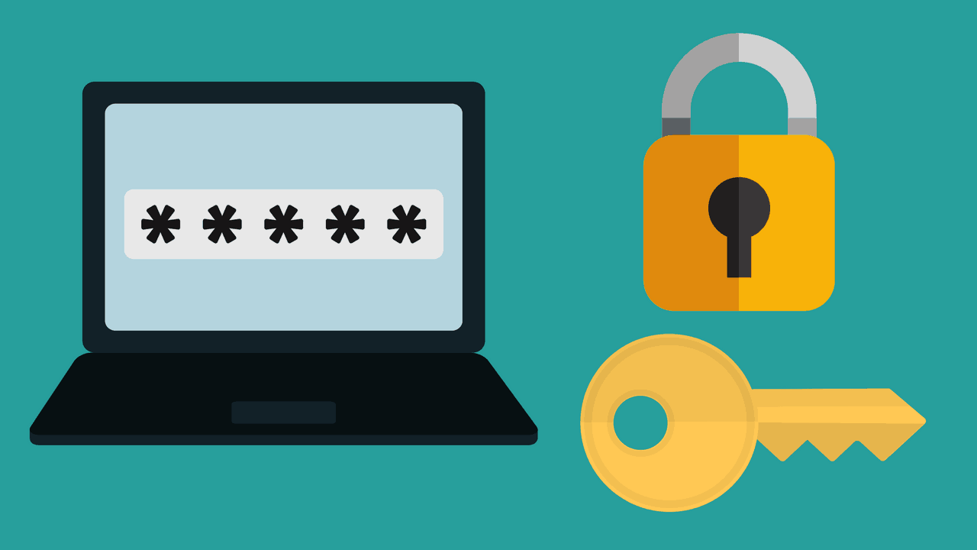
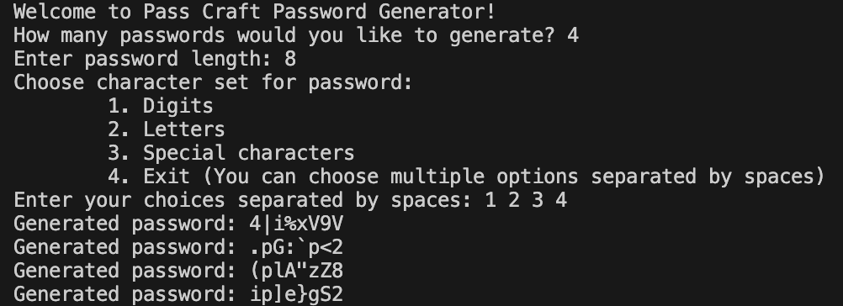
Pass Craft
A program that allows users to create however many passwords that they want with it being randomly generated.
By: Chase Miller

