Slide 1

DataVergence App
9/24/2026

Slide 2
What is DataVergence?
Origin’s data conversion product designed to demystify utility conversion

Slide 3
Current Process
Client
Sends legacy extracts
OriginDX
Upload and pre-load checks
OriginJS
Runs the load jobs
DataVergence Code
Validates, then loads
to OriginCIS
OriginBA
Error reports and configuration
Unreliable at high error volume*
Email and Files
Sent to the client
SQL Developer
Additional queries run by hand
Error Workbook
File Master List
Decisions log
@2026, Origin Utility, Inc / Proprietary & Confidential / Internal Use Only
Notes:
About 90 seconds.
Top row is the load.
The bottom is how we report on it. Extra SQL run by hand, three spreadsheets rebuilt every cycle, then email and files. OriginBA cannot be relied on when error volume is high.
Three costs: about 8 hours every week, versions drift between us and the client, and nothing is kept from one cycle to the next.

Slide 4
What is being solved?
S1
Core Issues
Problem
Solution
Multiple spreadsheets for errors, data decisions, and other conversion related items
DataVergence requires 3 unique Origin services: BA, JS, and DX.
OriginBA unreliable with high number of error rows
No error tracking over time
Origin spends time on routine validations each cycle
One, unified, source of truth for all project members
Integrate key Origin services into app
Use existing room on database to store ‘snapshots’ of a cycle’s pertinent statistics
Automated refresh of basic conversion checks
Additional statistics pulled faster
Accessible
Automated
Audited
@2026, Origin Utility, Inc / Proprietary & Confidential / Internal Use Only

Slide 5
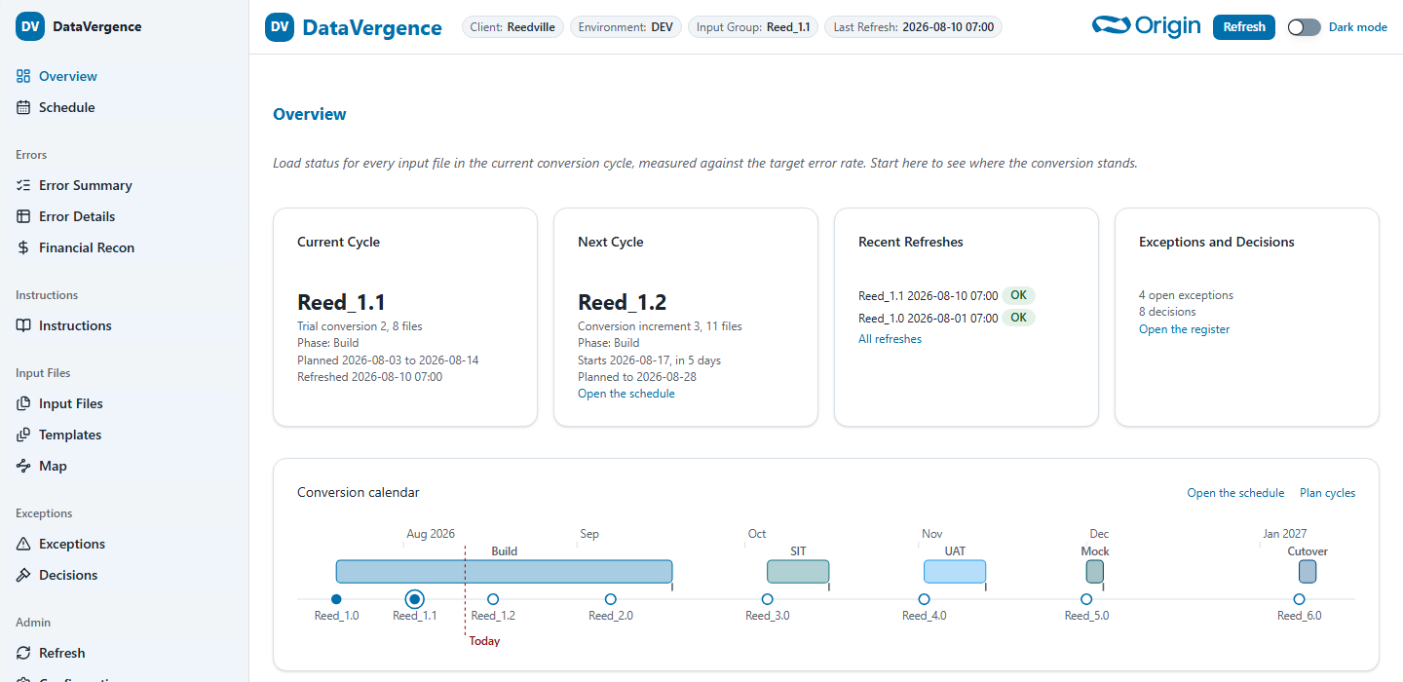
Future Process
DataVergence App
One place for Origin and the client
Client
Loads legacy extracts
OriginDX
Intake and pre-load checks
OriginJS
Runs the load jobs
DataVergence Code
Validates, then loads
to OriginCIS
1
One app for everything
Automatic snapshot
End of every load, saved
in the client's database
2
Automatic report refresh
Conversion Health
Errors and Trends
3
Clear and accurate view
Financial Recon
Project Management Artifacts
Schedule
DataVergence File Specs
@2026, Origin Utility, Inc / Proprietary & Confidential / Internal Use Only
Notes:
About 90 seconds.
OriginDX and OriginJS move into the app. The client uploads and runs pre-load checks there, and the load jobs start from the same place.
DataVergence Code validates and loads to OriginCIS. At the end of every load a snapshot saves automatically in the client's own database, and the app reads it.
OriginBA, the extra SQL by hand, the spreadsheets and the email step drop out. Origin and the client see the same numbers on the same day, and every cycle is kept side by side.

Slide 6
Roadmap
S2
Roadmap
1
2
3
4
5
Calculation Verification
Eric
Snapshot Table
and refresh
job build
Reed/Eric
Deployment into internal OCI
Reed/TA Team
UAT
Eric/Reed/QA Team
Odessa Pilot
@2026, Origin Utility, Inc / Proprietary & Confidential / Internal Use Only

