Slide 1
Course Overview CSCI 2400: Introduction to Computer Systems 1st Lecture, June 4, 2018
Summer 2018
Instructor: SANDESH DHAWASKAR SATHYANARAYANA
Email ID: sadh0344@Colorado.edu
Slides are adopted from CMU text book slides

Slide 2
Overview
Big Picture
Course theme
Five realities
How the course fits into the CS/ECE curriculum
Academic integrity
Logistics and Policies

Slide 3
Course Theme: (Systems) Knowledge is Power!
Systems Knowledge
How hardware (processors, memories, disk drives, network infrastructure) plus software (operating systems, compilers, libraries, network protocols) combine to support the execution of application programs
How you as a programmer can best use these resources
Useful outcomes from taking CSCI 2400
Become more effective programmers
Able to find and eliminate bugs efficiently
Able to understand and tune for program performance
Prepare for later “systems” classes in CS & ECE
Compilers, Operating Systems, Networks, Computer Architecture, Embedded Systems, Storage Systems, etc.

Slide 4
It’s Important to Understand How Things Work
Why do I need to know this stuff?
Abstraction is good, but don’t forget reality
Most CS and CE courses emphasize abstraction
Abstract data types
Asymptotic analysis
These abstractions have limits
Especially in the presence of bugs
Need to understand details of underlying implementations
Sometimes the abstract interfaces don’t provide the level of control or performance you need

Slide 5
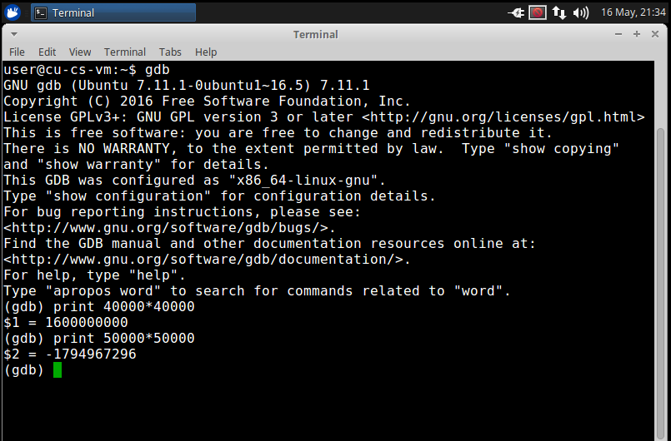
Great Reality #1: Ints are not Integers, Floats are not Reals
Example 1: Is x² ≥ 0?
Float’s: Yes!
Int’s:
40000 * 40000 --> 1600000000
50000 * 50000 --> ?
Example 2: Is (x + y) + z = x + (y + z)?
Unsigned & Signed Int’s: Yes!
Float’s:
(1e20 + -1e20) + 3.14 --> 3.14
1e20 + (-1e20 + 3.14) --> ??
Source: xkcd.com/571

Slide 6
Computer Arithmetic
Does not generate random values
Arithmetic operations have important mathematical properties
Cannot assume all “usual” mathematical properties
Due to finiteness of representations
Integer operations satisfy “ring” properties
Commutativity, associativity, distributivity
Floating point operations satisfy “ordering” properties
Monotonicity, values of signs
Observation
Need to understand which abstractions apply in which contexts
Important issues for compiler writers and serious application programmers

Slide 7
Great Reality #2: You’ve Got to Know Assembly
Chances are, you’ll never write programs in assembly
Compilers are much better & more patient than you are
But: Understanding assembly is key to machine-level execution model
Behavior of programs in presence of bugs
High-level language models break down
Tuning program performance
Understand optimizations done / not done by the compiler
Understanding sources of program inefficiency
Implementing system software
Compiler has machine code as target
Operating systems must manage process state
Creating / fighting malware
x86 assembly is the language of choice!

Slide 8
Great Reality #3: Memory Matters Random Access Memory Is an Unphysical Abstraction
Memory is not unbounded
It must be allocated and managed
Many applications are memory dominated
Memory referencing bugs especially pernicious
Effects are distant in both time and space
Memory performance is not uniform
Cache and virtual memory effects can greatly affect program performance
Adapting program to characteristics of memory system can lead to major speed improvements

Slide 9
Memory Referencing Bug Example
typedef struct {
int a[2];
double d;
} struct_t;
double fun(int i) {
volatile struct_t s;
s.d = 3.14;
s.a[i] = 1073741824; /* Possibly out of bounds */
return s.d;
}
fun(0) --> 3.14
fun(1) --> 3.14
fun(2) --> 3.1399998664856
fun(3) --> 2.00000061035156
fun(4) --> 3.14
fun(6) --> Segmentation fault
Result is system specific

Slide 10
Memory Referencing Bug Example
typedef struct {
int a[2];
double d;
} struct_t;
fun(0) --> 3.14
fun(1) --> 3.14
fun(2) --> 3.1399998664856
fun(3) --> 2.00000061035156
fun(4) --> 3.14
fun(6) --> Segmentation fault
Explanation:
Critical State | 6
? | 5
? | 4
d7 ... d4 | 3
d3 ... d0 | 2
a[1] | 1
a[0] | 0
Location accessed by fun(i)
struct_t

Slide 11
Memory Referencing Errors
C and C++ do not provide any memory protection
Out of bounds array references
Invalid pointer values
Abuses of malloc/free
Can lead to nasty bugs
Whether or not bug has any effect depends on system and compiler
Action at a distance
Corrupted object logically unrelated to one being accessed
Effect of bug may be first observed long after it is generated
How can I deal with this?
Program in Java, Ruby, Python, ML, …
Understand what possible interactions may occur
Use or develop tools to detect referencing errors (e.g. Valgrind)

Slide 12
Great Reality #4: There’s more to performance than asymptotic complexity
Constant factors matter too!
And even exact op count does not predict performance
Easily see 10:1 performance range depending on how code written
Must optimize at multiple levels: algorithm, data representations, procedures, and loops
Must understand system to optimize performance
How programs compiled and executed
How to measure program performance and identify bottlenecks
How to improve performance without destroying code modularity and generality

Slide 13
Memory System Performance Example
void copyij(int src[2048][2048],
int dst[2048][2048])
{
int i,j;
for (i = 0; i < 2048; i++)
for (j = 0; j < 2048; j++)
dst[i][j] = src[i][j];
}
void copyji(int src[2048][2048],
int dst[2048][2048])
{
int i,j;
for (j = 0; j < 2048; j++)
for (i = 0; i < 2048; i++)
dst[i][j] = src[i][j];
}
4.3ms
81.8ms
2.0 GHz Intel Core i7 Haswell
Hierarchical memory organization
Performance depends on access patterns
Including how step through multi-dimensional array

Slide 14
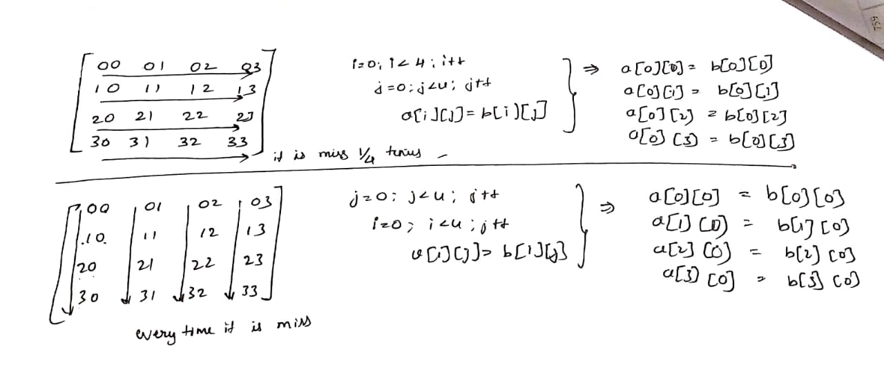
Explained Cache and memory movements

Slide 15
Great Reality #5: Computers do more than execute programs
They need to get data in and out
I/O system critical to program reliability and performance
They communicate with each other over networks
Many system-level issues arise in presence of network
Concurrent operations by autonomous processes
Coping with unreliable media
Cross platform compatibility
Complex performance issues

Slide 16
Course Perspective
Most Systems Courses are Builder-Centric
Computer Architecture
Design pipelined processor in Verilog
Operating Systems
Implement sample portions of operating system
Compilers
Write compiler for simple language
Networking
Implement and simulate network protocols

Slide 17
Course Perspective (Cont.)
Our Course is Programmer-Centric
By knowing more about the underlying system, you can be more effective as a programmer
Enable you to
Write programs that are more reliable and efficient
Incorporate features that require hooks into OS
E.g., concurrency, signal handlers
Cover material in this course that you won’t see elsewhere
Not just a course for dedicated hackers
We bring out the hidden hacker in everyone!

Slide 18
Textbooks
Randal E. Bryant and David R. O’Hallaron,
Computer Systems: A Programmer’s Perspective, Third Edition (CS:APP3e), Pearson, 2016
http://csapp.cs.cmu.edu
This book really matters for the course!
How to solve labs
Practice problems typical of exam problems
Brian Kernighan and Dennis Ritchie,
The C Programming Language, Second Edition, Prentice Hall, 1988
Still the best book about C, from the originators
Even though it does not cover more recent extensions of C

Slide 19
Course Components
Lectures
Labs (5-6)
The heart of the course
~10 days each
Provide in-depth understanding of an aspect of systems
Programming and measurement
Exams (midterm + finals + Quizzes)
Test your understanding of concepts & mathematical principles

Slide 20
Policies: Labs And Exams
Work groups
You can work in group of 3-4 on all lab assignments
Reason being is summer classes and less time will be there and hence group work is allowed. Usually in fall and spring terms individual work is allowed
Handing
Labs due at 11:55 pm and 10 days time will be given
Start early on labs as time will be very less and lots will be there
Exams
Final(Cumulative), Mid-term and Quizzes
Appealing grades
90-100 –A
85-90-A-
80-85-B+
75-80-B
70-75-B-
65-70- c
60-65-D

Slide 21
Other Rules of the Lecture Hall
Laptops: permitted
Electronic communications: forbidden
No email, instant messaging, cell phone calls, etc
Presence in lectures (2400): strongly encouraged (and can count in your favor for borderline grades)
If I know student has attended all classes and worked hard I might give upto 3% of credits
No recordings of ANY KIND

Slide 22
Policies: Grading
Exams (50%):
Quizzes (20%) - 4 Quizzes each 5 % mainly to prepare you for your exams.
midterm (10%) – See course plan – Really hard – Prepare well in advance hence dates are already published.
final (20%) – Entire material - Really hard
If Quizzes and lab assignments are done own well then midterm and finals are cake walk.
Labs (50%): weighted according to effort
Data Lab – 10%
Bomb Lab -10%
Attack Lab- 10%
Buffer Lab- 10%
Shell Lab- 10%
Malloc Lab – Not sure, if Extra credits

Slide 23
Programs and Data
Topics
Bit operations, arithmetic, assembly language programs
Representation of C control and data structures
Includes aspects of architecture and compilers
Assignments
L1 (datalab): Manipulating bits
L2 (bomblab): Defusing a binary bomb
L3 (attacklab): The basics of code injection attacks

Slide 24
The Memory Hierarchy
Topics
Memory technology, memory hierarchy, caches, disks, locality
Includes aspects of architecture and OS
Assignments
L4 (cachelab): Building a cache simulator and optimizing for locality.
Learn how to exploit locality in your programs.

Slide 25
Exceptional Control Flow
Topics
Hardware exceptions, processes, process control, Unix signals, nonlocal jumps
Includes aspects of compilers, OS, and architecture
Assignments
L5 (tshlab): Writing your own Unix shell.
A first introduction to concurrency

Slide 26
Virtual Memory
Topics
Virtual memory, address translation, dynamic storage allocation
Includes aspects of architecture and OS
Assignments
L6 (malloclab): Writing your own malloc package –(May or may not based on timeline)
Get a real feel for systems-level programming

Slide 27
Lab Rationale
Each lab has a well-defined goal such as solving a puzzle or winning a contest
Doing the lab should result in new skills and concepts
We try to use competition in a fun and healthy way
Set a reasonable threshold for full credit
Post intermediate results (anonymized) on Autolab scoreboard for glory!

Slide 28
Virtual Machine
Virtual machine downloads and instructions: https://foundation.cs.colorado.edu/vm
All should use VM from college as CS IT will supports labs which needs remote access
No other VM should be used and if used will not receive complete credits for the labs.
Do get this by Thursday as Data lab will be released.
See course syllabus for more information on each class break down and exams dates.

Slide 29
Lets see the syllabus copy now.

