Slide 1
Bits, Bytes and Integers – Part 1 CSCI 2400: Computer Systems 2nd Lecture June -5th 2018 Sandesh Dhawaskar Sathyanarayana Slides are adopted from CMU text book slides

Slide 2
Today: Bits, Bytes, and Integers
Representing information as bits
Bit-level manipulations
Integers
Representation: unsigned and signed
Conversion, casting
Expanding, truncating
Addition, negation, multiplication, shifting
Summary
Representations in memory, pointers, strings

Slide 3
Everything is bits
Each bit is 0 or 1
By encoding/interpreting sets of bits in various ways
Computers determine what to do (instructions)
… and represent and manipulate numbers, sets, strings, etc…
Why bits? Electronic Implementation
Easy to store with bistable elements
Reliably transmitted on noisy and inaccurate wires
0
1
0
1.1V
0.9V
0.2V
0.0V

Slide 4
For example, can count in binary
Base 2 Number Representation
Represent 15213₁₀ as 11101101101101₂
Represent 1.20₁₀ as 1.0011001100110011[0011]…₂
Represent 1.5213 X 10⁴ as 1.1101101101101₂ X 2¹³

Slide 5
Encoding Byte Values
Decimal
Hex
Binary
Byte = 8 bits
Binary 000000002 to 111111112
Decimal: 010 to 25510
Hexadecimal 0016 to FF16
Base 16 number representation
Use characters ‘0’ to ‘9’ and ‘A’ to ‘F’
Write FA1D37B16 in C as
0xFA1D37B
0xfa1d37b
0
0
0000
1
1
0001
2
2
0010
3
3
0011
4
4
0100
5
5
0101
6
6
0110
7
7
0111
8
8
1000
9
9
1001
A
10
1010
B
11
1011
C
12
1100
D
13
1101
E
14
1110
F
15
1111
15213: 0011 1011 0110 1101
3
B
6
D

Slide 6
Example Data Representations
C Data Type | Typical 32-bit | Typical 64-bit | x86-64
char | 1 | 1 | 1
short | 2 | 2 | 2
int | 4 | 4 | 4
long | 4 | 8 | 8
float | 4 | 4 | 4
double | 8 | 8 | 8
pointer | 4 | 8 | 8

Slide 7
Today: Bits, Bytes, and Integers
Representing information as bits
Bit-level manipulations
Integers
Representation: unsigned and signed
Conversion, casting
Expanding, truncating
Addition, negation, multiplication, shifting
Summary
Representations in memory, pointers, strings

Slide 8
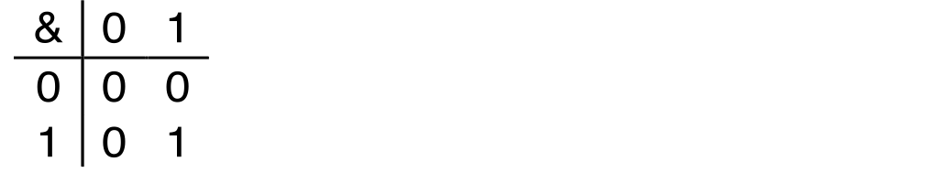
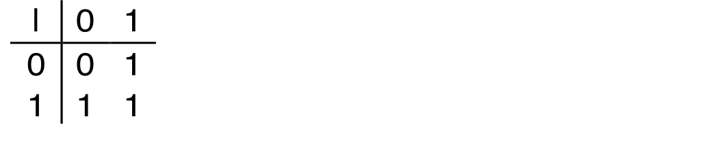
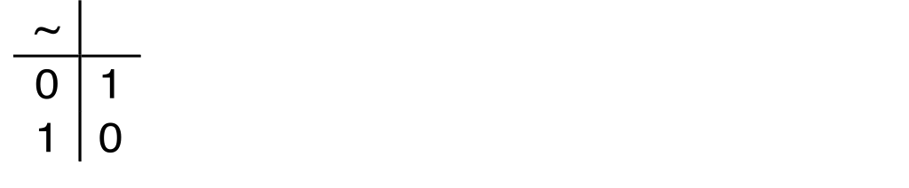
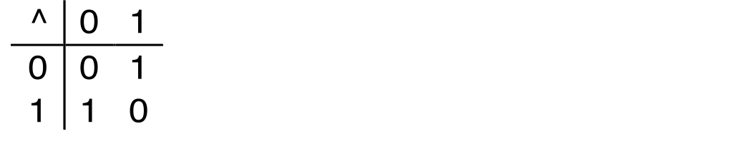
Boolean Algebra
Developed by George Boole in 19th Century
Algebraic representation of logic
Encode “True” as 1 and “False” as 0
And
A&B = 1 when both A=1 and B=1
Or
A|B = 1 when either A=1 or B=1
Not
~A = 1 when A=0
Exclusive-Or (Xor)
A^B = 1 when either A=1 or B=1, but not both

Slide 9
General Boolean Algebras
Operate on Bit Vectors
Operations applied bitwise
All of the Properties of Boolean Algebra Apply
01101001
& 01010101
01000001
01101001
| 01010101
01111101
01101001
^ 01010101
00111100
~ 01010101
10101010
01000001
01111101
00111100
10101010

Slide 10
Example: Representing & Manipulating Sets
Representation
Width w bit vector represents subsets of {0, …, w–1}
a_{j} = 1 if j ∈ A
01101001 { 0, 3, 5, 6 }
76543210
01010101 { 0, 2, 4, 6 }
76543210
Operations
& Intersection 01000001 { 0, 6 }
| Union 01111101 { 0, 2, 3, 4, 5, 6 }
^ Symmetric difference 00111100 { 2, 3, 4, 5 }
~ Complement 10101010 { 1, 3, 5, 7 }

Slide 11
Bit-Level Operations in C
Decimal
Hex
Binary
0
0
0000
Operations &, |, ~, ^ Available in C
Apply to any “integral” data type
long, int, short, char, unsigned
View arguments as bit vectors
Arguments applied bit-wise
Examples (Char data type)
~0x41 → 0xBE
~010000012 → 101111102
~0x00 → 0xFF
~000000002 → 111111112
0x69 & 0x55 → 0x41
011010012 & 010101012 → 010000012
0x69 | 0x55 → 0x7D
011010012 | 010101012 → 011111012
1
1
0001
2
2
0010
3
3
0011
4
4
0100
5
5
0101
6
6
0110
7
7
0111
8
8
1000
9
9
1001
A
10
1010
B
11
1011
C
12
1100
D
13
1101
E
14
1110
F
15
1111

Slide 12
Contrast: Logic Operations in C
Contrast to Bit-Level Operators
Logic Operations: &&, ||, !
View 0 as “False”
Anything nonzero as “True”
Always return 0 or 1
Early termination
Examples (char data type)
!0x41 → 0x00
!0x00 → 0x01
!!0x41→ 0x01
0x69 && 0x55 → 0x01
0x69 || 0x55 → 0x01
p && *p (avoids null pointer access)
Watch out for && vs. & (and || vs. |)…
one of the more common oopsies in
C programming

Slide 13
Shift Operations
Argument x
01100010
Left Shift: x << y
Shift bit-vector x left y positions
Throw away extra bits on left
Fill with 0’s on right
Right Shift: x >> y
Shift bit-vector x right y positions
Throw away extra bits on right
Logical shift
Fill with 0’s on left
Arithmetic shift
Replicate most significant bit on left
Undefined Behavior
Shift amount < 0 or ≥ word size
<< 3
00010000
00010000
00010000
Log. >> 2
00011000
00011000
00011000
Arith. >> 2
00011000
00011000
00011000
Argument x
10100010
<< 3
00010000
00010000
00010000
Log. >> 2
00101000
00101000
00101000
Arith. >> 2
11101000
11101000
11101000

Slide 14
Today: Bits, Bytes, and Integers
Representing information as bits
Bit-level manipulations
Integers
Representation: unsigned and signed
Conversion, casting
Expanding, truncating
Addition, negation, multiplication, shifting
Summary
Representations in memory, pointers, strings
Summary

Slide 15
Encoding Integers
Unsigned
Two’s Complement
short int x = 15213;
short int y = -15213;
Sign Bit
C short 2 bytes long
Sign Bit
For 2’s complement, most significant bit indicates sign
0 for nonnegative
1 for negative

Slide 16
Two-complement: Simple Example
-16 | 8 | 4 | 2 | 1
0 | 1 | 0 | 1 | 0
10 =
8+2 = 10
-16 | 8 | 4 | 2 | 1
1 | 0 | 1 | 1 | 0
-10 =
-16+4+2 = -10

Slide 17
Two-complement Encoding Example (Cont.)
x = 15213: 00111011 01101101
y = -15213: 11000100 10010011

Slide 18
Numeric Ranges
Unsigned Values
UMin = 0
000…0
UMax = 2^{w} – 1
111…1
Two’s Complement Values
TMin = –2^{w–1}
100…0
TMax = 2^{w–1} – 1
011…1
Minus 1
111…1
Values for W = 16

Slide 19
Values for Different Word Sizes
Observations
|TMin | = TMax + 1
Tmin=-Tmax-1
Asymmetric range
UMax = 2 * TMax + 1
C Programming
#include <limits.h>
Declares constants, e.g.,
ULONG_MAX
LONG_MAX
LONG_MIN
Values platform specific

Slide 20
Unsigned & Signed Numeric Values
Equivalence
Same encodings for nonnegative values
Uniqueness
Every bit pattern represents unique integer value
Each representable integer has unique bit encoding
⇒ Can Invert Mappings
U2B(x) = B2U⁻¹(x)
Bit pattern for unsigned integer
T2B(x) = B2T⁻¹(x)
Bit pattern for two’s comp integer
X
B2U(X)
B2T(X)
0000
0
0
0001
1
1
0010
2
2
0011
3
3
0100
4
4
0101
5
5
0110
6
6
0111
7
7
1000
8
–8
1001
9
–7
1010
10
–6
1011
11
–5
1100
12
–4
1101
13
–3
1110
14
–2
1111
15
–1

Slide 21
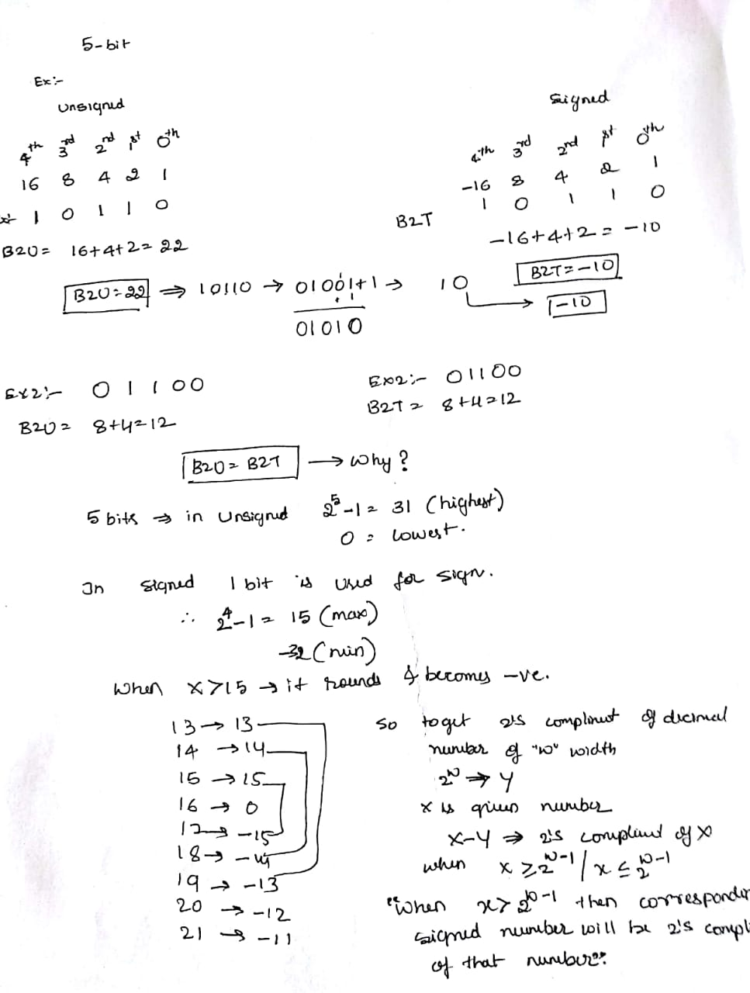
Example:

Slide 22
Conclusion notes
Given w as width, a number can be represented in both signed and unsigned.
If x is given number and w is width of bits given to represent them, as long as x fits in w width in both signed and unsigned version then signed and unsigned number of x is same , else signed version is the 2’s compliment of x.
Ex: x=13 for w=5 both signed and unsigned numbers of x same
X=17 here unsigned is 17 but signed is 2’s compliment which is -15.

Slide 23
Today: Bits, Bytes, and Integers
Representing information as bits
Bit-level manipulations
Integers
Representation: unsigned and signed
Conversion, casting
Expanding, truncating
Addition, negation, multiplication, shifting
Summary
Representations in memory, pointers, strings

Slide 24
Mapping Between Signed & Unsigned
Two’s Complement
Unsigned
T2U
x
T2B
B2U
ux
X
Maintain Same Bit Pattern
Unsigned
U2T
Two’s Complement
ux
U2B
B2T
x
X
Maintain Same Bit Pattern
Mappings between unsigned and two’s complement numbers: Keep bit representations and reinterpret

Slide 25
Mapping Signed ↔ Unsigned
Bits
0000
0001
0010
0011
0100
0101
0110
0111
1000
1001
1010
1011
1100
1101
1110
1111
Signed
0
1
2
3
4
5
6
7
-8
-7
-6
-5
-4
-3
-2
-1
Unsigned
0
1
2
3
4
5
6
7
8
9
10
11
12
13
14
15
T2U
U2T

Slide 26
Mapping Signed ↔ Unsigned
Bits
0000
0001
0010
0011
0100
0101
0110
0111
1000
1001
1010
1011
1100
1101
1110
1111
Signed
0
1
2
3
4
5
6
7
-8
-7
-6
-5
-4
-3
-2
-1
Unsigned
0
1
2
3
4
5
6
7
8
9
10
11
12
13
14
15
=
+/- 16

Slide 27
Relation between Signed & Unsigned
Two’s Complement
Unsigned
T2U
x
T2B
B2U
ux
X
Maintain Same Bit Pattern
w–1
0
ux
+
+
+
• • •
+
+
+
x
-
+
+
• • •
+
+
+
Large negative weight
becomes
Large positive weight

Slide 28
Conversion Visualized
2’s Comp. → Unsigned
Ordering Inversion
Negative → Big Positive
UMax
UMax – 1
TMax + 1
Unsigned
Range
TMax
TMax
2’s Complement Range
0
0
–1
–2
TMin

Slide 29
Signed vs. Unsigned in C
Constants
By default are considered to be signed integers
Unsigned if have “U” as suffix
0U, 4294967259U
Casting
Explicit casting between signed & unsigned same as U2T and T2U
int tx, ty;
unsigned ux, uy;
tx = (int) ux;
uy = (unsigned) ty;
Implicit casting also occurs via assignments and procedure calls
tx = ux; int fun(unsigned u);
uy = ty; uy = fun(tx);

Slide 30
Casting Surprises
Expression Evaluation
If there is a mix of unsigned and signed in single expression, signed values implicitly cast to unsigned
Including comparison operations <, >, ==, <=, >=
Examples for W = 32: TMIN = -2,147,483,648 , TMAX = 2,147,483,647
Constant₁ Constant₂ Relation Evaluation
0 0U
-1 0
-1 0U
2147483647 -2147483647-1
2147483647U -2147483647-1
-1 -2
(unsigned)-1 -2
2147483647 2147483648U
2147483647 (int) 2147483648U
0 0U == unsigned
-1 0 < signed
-1 0U > unsigned
2147483647 -2147483648 > signed
2147483647U -2147483648 < unsigned
-1 -2 > signed
(unsigned) -1 -2 > unsigned
2147483647 2147483648U < unsigned
2147483647 (int) 2147483648U > signed

Slide 31
Today: Bits, Bytes, and Integers
Representing information as bits
Bit-level manipulations
Integers
Representation: unsigned and signed
Conversion, casting
Expanding, truncating
Addition, negation, multiplication, shifting
Summary
Representations in memory, pointers, strings

Slide 32
Sign Extension
Task:
Given w-bit signed integer x
Convert it to w+k-bit integer with same value
Rule:
Make k copies of sign bit:
X ′ = x_{w–1} ,…, x_{w–1} , x_{w–1} , x_{w–2} ,…, x₀
k copies of MSB
w
X
• • •
• • •
X ′
• • •
• • •
k
w

Slide 33
Sign Extension: Simple Example
Positive number
Negative number
-16 | 8 | 4 | 2 | 1
0 | 1 | 0 | 1 | 0
-16 | 8 | 4 | 2 | 1
1 | 0 | 1 | 1 | 0
10 =
-10 =
-32 | 16 | 8 | 4 | 2 | 1
0 | 0 | 1 | 0 | 1 | 0
-32 | 16 | 8 | 4 | 2 | 1
1 | 1 | 0 | 1 | 1 | 0
10 =
-10 =

Slide 34
Larger Sign Extension Example
short int x = 15213;
int ix = (int) x;
short int y = -15213;
int iy = (int) y;
Decimal
Hex
Binary
x
15213
3B 6D
00111011 01101101
ix
15213
00 00 3B 6D
00000000 00000000 00111011 01101101
y
-15213
C4 93
11000100 10010011
iy
-15213
FF FF C4 93
11111111 11111111 11000100 10010011
Converting from smaller to larger integer data type
C automatically performs sign extension

Slide 35
Truncation
Task:
Given k+w-bit signed or unsigned integer X
Convert it to w-bit integer X’ with same value for “small enough” X
Rule:
Drop top k bits:
X ′ = x_{w–1} , x_{w–2} ,…, x₀
k
w
X
• • •
• • •
• • •
X ′
• • •
w

Slide 36
Truncation: Simple Example
No sign change
Sign change
-16 | 8 | 4 | 2 | 1
0 | 0 | 0 | 1 | 0
-16 | 8 | 4 | 2 | 1
0 | 1 | 0 | 1 | 0
2 =
10 =
 | -8 | 4 | 2 | 1
 | 0 | 0 | 1 | 0
 | -8 | 4 | 2 | 1
 | 1 | 0 | 1 | 0
2 =
-6 =
2 mod 16 = 2
10 mod 16 = 10U mod 16 = 10U = -6
-16 | 8 | 4 | 2 | 1
1 | 1 | 0 | 1 | 0
-16 | 8 | 4 | 2 | 1
1 | 0 | 1 | 1 | 0
-6 =
-10 =
 | -8 | 4 | 2 | 1
 | 1 | 0 | 1 | 0
 | -8 | 4 | 2 | 1
 | 0 | 1 | 1 | 0
-6 =
6 =
-6 mod 16 = 26U mod 16 = 10U = -6
-10 mod 16 = 22U mod 16 = 6U = 6

Slide 37
Summary: Expanding, Truncating: Basic Rules
Expanding (e.g., short int to int)
Unsigned: zeros added
Signed: sign extension
Both yield expected result
Truncating (e.g., unsigned to unsigned short)
Unsigned/signed: bits are truncated
Result reinterpreted
Unsigned: mod operation
Signed: similar to mod
For small (in magnitude) numbers yields expected behavior

Slide 38
Summary of Today: Bits, Bytes, and Integers
Representing information as bits
Bit-level manipulations
Integers
Representation: unsigned and signed
Conversion, casting
Expanding, truncating
Addition, negation, multiplication, shifting
Representations in memory, pointers, strings
Summary

