Slide 1
Virtual Memory: Systems CSCI 2400: Introduction to Computer Systems 18th Lecture, July 11th , 2018
Summer 2018
Instructor: SANDESH DHAWASKAR SATHYANARAYANA
Email ID: sadh0344@Colorado.edu
Slides are adopted from CMU text book slides

Slide 2
Review: Virtual Memory & Physical Memory
Physical memory
(DRAM)
Physical page
number or
disk address
Virtual address
Valid
VP 1
PP 0
PTE 0
0
null
VP 2
1
VP 7
VP 4
PP 3
1
0
1
0
null
Virtual memory
(disk)
0
PTE 7
1
VP 1
Memory resident
page table
(DRAM)
VP 2
VP 3
VP 4
VP 6
VP 7
A page table contains page table entries (PTEs) that map virtual pages to physical pages.

Slide 3
Translating with a k-level Page Table
Having multiple levels greatly reduces page table size
Page table base register
(part of the process’ context)
n-1
VIRTUAL ADDRESS
p-1
0
VPN 1
VPN 2
...
VPN k
VPO
the Level 1
page table
a Level 2
page table
a Level k
page table
...
...
PPN
m-1
p-1
0
PPN
PPO
PHYSICAL ADDRESS

Slide 4
Translation Lookaside Buffer (TLB)
A small cache of page table entries with fast access by MMU
TLB
2
PTE
VPN
3
Cache/
Memory
MMU
CPU
VA
PA
1
4
Data
5
Typically, a TLB hit eliminates the k memory accesses required to do a page table lookup.

Slide 5
Set Associative Cache: Read
Locate set
Check if any line in set has matching tag
Yes + line valid: hit
Locate data starting at offset
E = 2e lines per set
Address of word:
t bits
s bits
b bits
S = 2^{s} sets
CT tag
CI index
CO offset
data begins at this offset
v
tag
0
1
2
B-1
valid bit
B = 2^{b} bytes per cache block (the data)

Slide 6
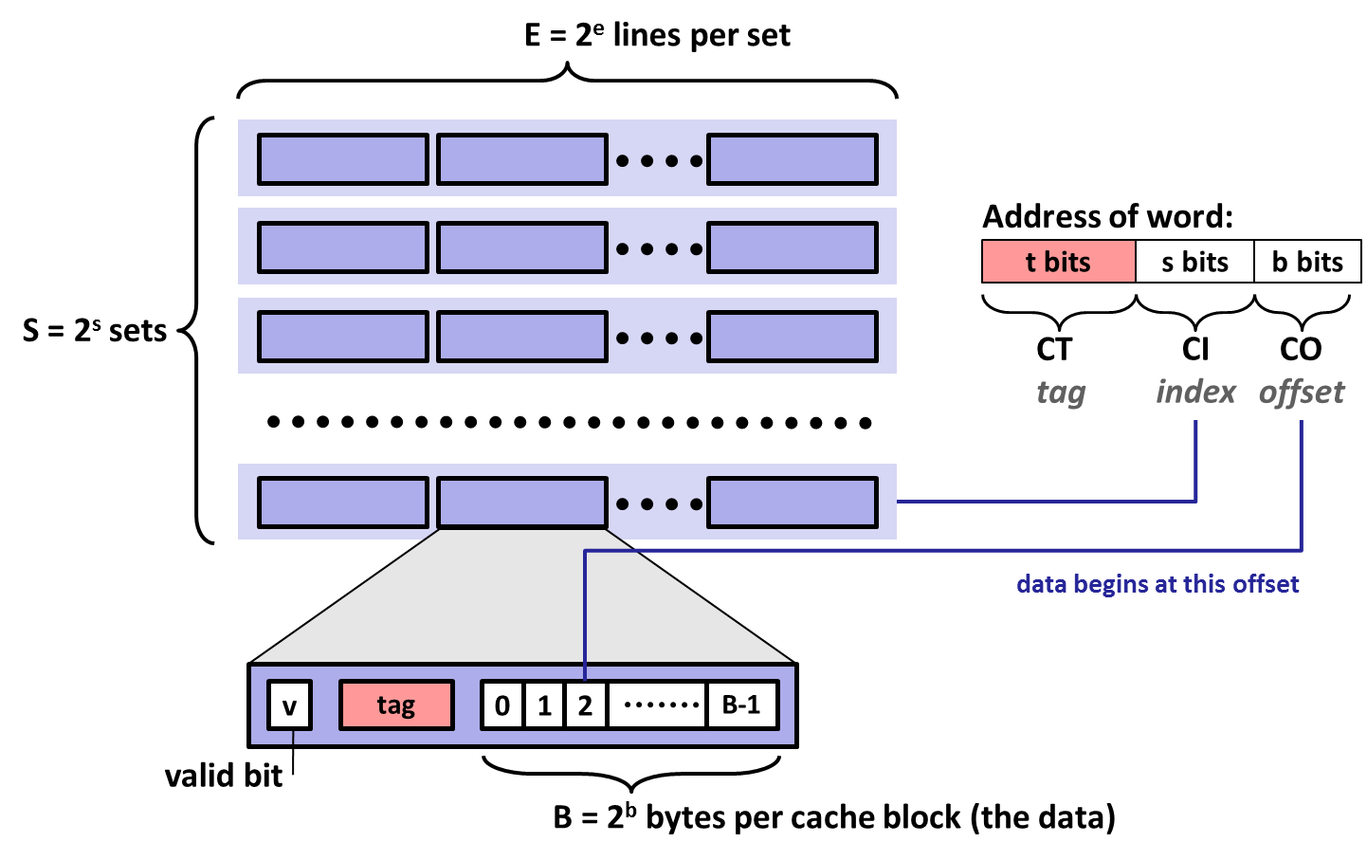
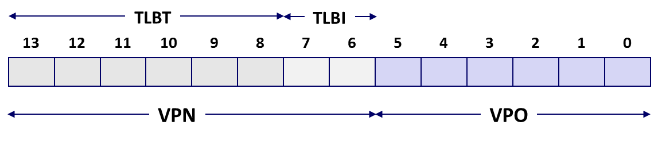
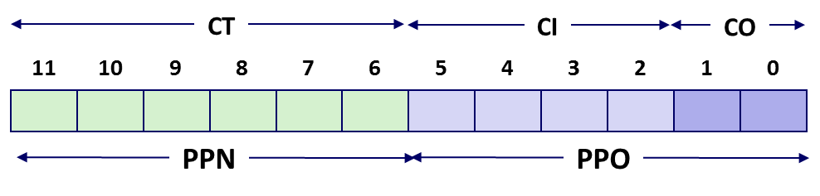

Review of Symbols
Basic Parameters
N = 2^{n} : Number of addresses in virtual address space
M = 2^{m} : Number of addresses in physical address space
P = 2^{p} : Page size (bytes)
Components of the virtual address (VA)
TLBI: TLB index
TLBT: TLB tag
VPO: Virtual page offset
VPN: Virtual page number
Components of the physical address (PA)
PPO: Physical page offset (same as VPO)
PPN: Physical page number
CO: Byte offset within cache line
CI: Cache index
CT: Cache tag
(bits per field for our simple example)

Slide 7
Today
Simple memory system example
Case study: Core i7/Linux memory system
Memory mapping

Slide 8
Simple Memory System Example
Addressing
14-bit virtual addresses
12-bit physical address
Page size = 64 bytes
13
12
11
10
9
8
7
6
5
4
3
2
1
0
VPN
VPO
Virtual Page Number
Virtual Page Offset
11
10
9
8
7
6
5
4
3
2
1
0
PPN
PPO
Physical Page Number
Physical Page Offset

Slide 9
Simple Memory System TLB
16 entries
4-way associative
TLBT
TLBI
13
12
11
10
9
8
7
6
5
4
3
2
1
0
0
0
0
0
1
1
0
1
VPN
VPO
VPN = 0b1101 = 0x0D
Translation Lookaside Buffer (TLB)
Set
Tag
PPN
Valid
Tag
PPN
Valid
Tag
PPN
Valid
Tag
PPN
Valid
Set
Tag
PPN
Valid
Tag
PPN
Valid
Tag
PPN
Valid
Tag
PPN
Valid
0
03
–
0
09
0D
1
00
–
0
07
02
1
0
03
–
0
09
0D
1
00
–
0
07
02
1
1
03
2D
1
02
–
0
04
–
0
0A
–
0
1
03
2D
1
02
–
0
04
–
0
0A
–
0
2
02
–
0
08
–
0
06
–
0
03
–
0
2
02
–
0
08
–
0
06
–
0
03
–
0
3
07
–
0
03
0D
1
0A
34
1
02
–
0
3
07
–
0
03
0D
1
0A
34
1
02
–
0

Slide 10
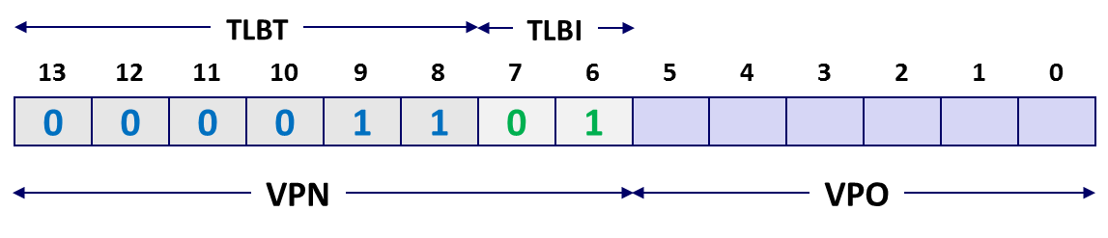
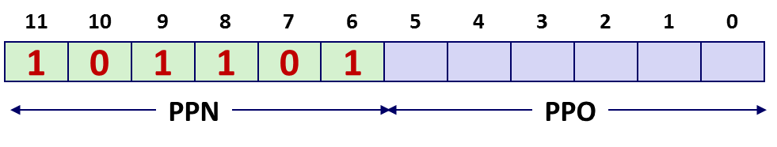
Simple Memory System Page Table
Only showing the first 16 entries (out of 256)
VPN
PPN
Valid
VPN
PPN
Valid
00
28
1
08
13
1
01
–
0
09
17
1
02
33
1
0A
09
1
03
02
1
0B
–
0
04
–
0
0C
–
0
05
16
1
0D
2D
1
0x0D → 0x2D
06
–
0
0E
11
1
07
–
0
0F
0D
1

Slide 11
Simple Memory System Cache
16 lines, 4-byte block size
Physically addressed
Direct mapped
V[0b00001101101001] = V[0x369]
P[0b101101101001] = P[0xB69] = 0x15
CT
CI
CO
11
10
9
8
7
6
5
4
3
2
1
0
1
0
1
1
0
1
1
0
1
0
0
1
PPN
PPO
Idx
Tag
Valid
B0
B1
B2
B3
Idx
Tag
Valid
B0
B1
B2
B3
Idx
Tag
Valid
B0
B1
B2
B3
Idx
Tag
Valid
B0
B1
B2
B3
0
19
1
99
11
23
11
8
24
1
3A
00
51
89
0
19
1
99
11
23
11
8
24
1
3A
00
51
89
1
15
0
–
–
–
–
9
2D
0
–
–
–
–
1
15
0
–
–
–
–
9
2D
0
–
–
–
–
2
1B
1
00
02
04
08
A
2D
1
93
15
DA
3B
2
1B
1
00
02
04
08
A
2D
1
93
15
DA
3B
3
36
0
–
–
–
–
B
0B
0
–
–
–
–
3
36
0
–
–
–
–
B
0B
0
–
–
–
–
4
32
1
43
6D
8F
09
C
12
0
–
–
–
–
4
32
1
43
6D
8F
09
C
12
0
–
–
–
–
5
0D
1
36
72
F0
1D
D
16
1
04
96
34
15
5
0D
1
36
72
F0
1D
D
16
1
04
96
34
15
6
31
0
–
–
–
–
E
13
1
83
77
1B
D3
6
31
0
–
–
–
–
E
13
1
83
77
1B
D3
7
16
1
11
C2
DF
03
F
14
0
–
–
–
–
7
16
1
11
C2
DF
03
F
14
0
–
–
–
–

Slide 12
Address Translation Example
Idx
Tag
Valid
B0
B1
B2
B3
Idx
Tag
Valid
B0
B1
B2
B3
Idx
Tag
Valid
B0
B1
B2
B3
Idx
Tag
Valid
B0
B1
B2
B3
Virtual Address: 0x03D4
VPN ___ TLBI ___ TLBT ____ TLB Hit? __ Page Fault? __ PPN: ____
Physical Address
CO ___ CI___ CT ____ Hit? __ Byte: ____
0
19
1
99
11
23
11
8
24
1
3A
00
51
89
0
19
1
99
11
23
11
8
24
1
3A
00
51
89
1
15
0
–
–
–
–
9
2D
0
–
–
–
–
1
15
0
–
–
–
–
9
2D
0
–
–
–
–
TLBT
TLBI
2
1B
1
00
02
04
08
A
2D
1
93
15
DA
3B
2
1B
1
00
02
04
08
A
2D
1
93
15
DA
3B
13
12
11
10
9
8
7
6
5
4
3
2
1
0
3
36
0
–
–
–
–
B
0B
0
–
–
–
–
3
36
0
–
–
–
–
B
0B
0
–
–
–
–
0
0
0
0
1
1
1
1
0
1
0
1
0
0
4
32
1
43
6D
8F
09
C
12
0
–
–
–
–
4
32
1
43
6D
8F
09
C
12
0
–
–
–
–
5
0D
1
36
72
F0
1D
D
16
1
04
96
34
15
5
0D
1
36
72
F0
1D
D
16
1
04
96
34
15
VPN
VPO
6
31
0
–
–
–
–
E
13
1
83
77
1B
D3
6
31
0
–
–
–
–
E
13
1
83
77
1B
D3
7
16
0x0F
0x3
0x03
Y
N
0x0D
7
16
1
11
C2
DF
03
F
14
0
–
–
–
–
1
11
C2
DF
03
F
14
0
–
–
–
–
Translation Lookaside Buffer (TLB)
Set
Tag
PPN
Valid
CT
CI
CO
Tag
PPN
Valid
Tag
PPN
Valid
Tag
PPN
Valid
Set
Tag
PPN
Valid
Tag
PPN
Valid
Tag
PPN
Valid
Tag
PPN
Valid
0
03
11
10
9
8
7
6
5
4
3
2
1
0
–
0
09
0D
1
00
–
0
07
02
1
0
03
–
0
09
0D
1
00
–
0
07
02
1
1
03
0
0
1
1
0
1
0
1
0
1
0
0
2D
1
02
–
0
04
–
0
0A
–
0
1
03
2D
1
02
–
0
04
–
0
0A
–
0
2
02
–
0
PPN
PPO
08
–
0
06
–
0
03
–
0
2
02
–
0
08
–
0
06
–
0
03
–
0
3
07
–
0
03
0D
1
0A
34
1
02
–
0
3
0
0x5
0x0D
Y
0x36
07
–
0
03
0D
1
0A
34
1
02
–
0

Slide 13
Address Translation Example: TLB/Cache Miss
Idx
Tag
Valid
B0
B1
B2
B3
Idx
Tag
Valid
B0
B1
B2
B3
Virtual Address: 0x0020
VPN ___ TLBI ___ TLBT ____ TLB Hit? __ Page Fault? __ PPN: ____
Physical Address
CO___ CI___ CT ____ Hit? __ Byte: ____
0
19
1
99
11
23
11
8
24
1
3A
00
51
89
1
15
0
–
–
–
–
9
2D
0
–
–
–
–
TLBT
TLBI
2
1B
1
00
02
04
08
A
2D
1
93
15
DA
3B
13
12
11
10
9
8
7
6
5
4
3
2
1
0
3
36
0
–
–
–
–
B
0B
0
–
–
–
–
0
0
0
0
0
0
0
0
1
0
0
0
0
0
4
32
1
43
6D
8F
09
C
12
0
–
–
–
–
5
0D
1
36
72
F0
1D
D
16
1
04
96
34
15
VPN
VPO
6
31
0
–
–
–
–
E
13
1
83
77
1B
D3
7
16
0x00
0
0x00
N
N
0x28
1
11
C2
DF
03
F
14
0
–
–
–
–
Page table
VPN
PPN
Valid
CT
CI
CO
00
28
1
11
10
9
8
7
6
5
4
3
2
1
0
01
–
0
1
0
1
0
0
0
1
0
0
0
0
0
02
33
1
03
02
1
PPN
PPO
04
–
0
0
0x8
0x28
N
Mem
05
16
1
06
–
0
07
–
0

Slide 14
Today
Simple memory system example
Case study: Core i7/Linux memory system- Read from book
Memory mapping

Slide 15
Today
Simple memory system example
Case study: Core i7/Linux memory system
Memory mapping

Slide 16
Memory Mapping
VM areas initialized by associating them with disk objects.
Called memory mapping
Area can be backed by (i.e., get its initial values from) :
Regular file on disk (e.g., an executable object file)
Initial page bytes come from a section of a file
Anonymous file (e.g., nothing)
First fault will allocate a physical page full of 0's (demand-zero page)
Once the page is written to (dirtied), it is like any other page
Dirty pages are copied back and forth between memory and a special swap file.

Slide 17
Review: Memory Management & Protection
Code and data can be isolated or shared among processes
0
Address
translation
0
Virtual Address Space for Process 1:
Physical
Address
Space (DRAM)
VP 1
VP 2
PP 2
...
N-1
PP 6
(e.g., read-only
library code)
Virtual Address Space for Process 2:
0
PP 8
VP 1
VP 2
...
...
N-1
M-1

Slide 18
Sharing Revisited: Shared Objects
Process 1
virtual memory
Physical
memory
Process 2
virtual memory
Process 1 maps the shared object (on disk).
Shared
object

Slide 19
Sharing Revisited: Shared Objects
Process 1
virtual memory
Physical
memory
Process 2
virtual memory
Process 2 maps the same shared object.
Notice how the virtual addresses can be different.
But, difference must be multiple of page size
Shared
object

Slide 20
Sharing Revisited: Private Copy-on-write (COW) Objects
Process 1
virtual memory
Physical
memory
Process 2
virtual memory
Two processes mapping a private copy-on-write (COW) object
Area flagged as private copy-on-write
PTEs in private areas are flagged as read-only
Private
copy-on-write
area
Private
copy-on-write object

Slide 21
Sharing Revisited: Private Copy-on-write (COW) Objects
Process 1
virtual memory
Physical
memory
Process 2
virtual memory
Instruction writing to private page triggers protection fault.
Handler creates new R/W page.
Instruction restarts upon handler return.
Copying deferred as long as possible!
Copy-on-write
Write to private
copy-on-write
page
Private
copy-on-write object

Slide 22
The fork Function Revisited
VM and memory mapping explain how fork provides private address space for each process.
To create virtual address for new process:
Create exact copies of current mm_struct, vm_area_struct, and page tables.
Flag each page in both processes as read-only
Flag each vm_area_struct in both processes as private COW
On return, each process has exact copy of virtual memory.
Subsequent writes create new pages using COW mechanism.

Slide 23
The execve Function Revisited
User stack
Private, demand-zero
To load and run a new program a.out in the current process using execve:
Free vm_area_struct’s and page tables for old areas
Create vm_area_struct’s and page tables for new areas
Programs and initialized data backed by object files.
.bss and stack backed by anonymous files.
Set PC to entry point in .text
Linux will fault in code and data pages as needed.
libc.so
.data
Memory mapped region
for shared libraries
Shared, file-backed
.text
Runtime heap (via malloc)
Private, demand-zero
Uninitialized data (.bss)
Private, demand-zero
a.out
Initialized data (.data)
.data
Private, file-backed
.text
Program text (.text)
0

Slide 24
Finding More Shareable Pages
Easy places to identify shareable pages
Child create via fork
Processes loading the same binary file
E.g., bash or python interpreters, web browsers, ...
Processes loading the same library file
What about others?
Kernel Same-Page Merging
OS scans through all of physical memory, looking for duplicate pages
When found, merge into single copy, marked as copy-on-write
Implemented in Linux kernel in 2009
Limited to pages marked as likely candidates
Especially useful when processor running many virtual machines

Slide 25
User-Level Memory Mapping
void *mmap(void *start, int len,
int prot, int flags, int fd, int offset)
Map len bytes starting at offset offset of the file specified by file description fd, preferably at address start
start: may be 0 for “pick an address”
prot: PROT_READ, PROT_WRITE, PROT_EXEC, ...
flags: MAP_ANON, MAP_PRIVATE, MAP_SHARED, ...
Return a pointer to start of mapped area (may not be start)

Slide 26
User-Level Memory Mapping
void *mmap(void *start, int len,
int prot, int flags, int fd, int offset)
len bytes
start
(or address
chosen by kernel)
len bytes
offset
(bytes)
0
0
Disk file specified by
file descriptor fd
Process virtual memory

Slide 27
Example: Using mmap to Copy Files
Copying a file to stdout without transferring data to user space
This code does not meet our coding standards.
#include "csapp.h"
void mmapcopy(int fd, int size)
{
/* Ptr to memory mapped area */
char *bufp;
bufp = mmap(NULL, size,
PROT_READ,
MAP_PRIVATE,
fd, 0);
write(STDOUT_FILENO,
bufp, size);
return;
}
/* mmapcopy driver */
int main(int argc, char **argv)
{
struct stat stat;
int fd;
/* Check for required cmd line arg */
if (argc != 2) {
printf("usage: %s <filename>\n",
argv[0]);
exit(0);
}
/* Copy input file to stdout */
fd = Open(argv[1], O_RDONLY, 0);
fstat(fd, &stat);
mmapcopy(fd, stat.st_size);
exit(0);
}
mmapcopy.c
mmapcopy.c

Slide 28
Some Uses of mmap
Reading big files
Uses paging mechanism to bring files into memory
Shared data structures
When call with MAP_SHARED flag
Multiple processes have access to same region of memory
Risky!
File-based data structures
E.g., database
Give prot argument PROT_READ | PROT_WRITE
When unmap region, file will be updated via write-back
Can implement load from file / update / write back to file

Slide 29
Summary
VM requires hardware support
Exception handling mechanism
TLB
Various control registers
VM requires OS support
Managing page tables
Implementing page replacement policies
Managing file system
VM enables many capabilities
Loading programs from memory
Forking processes
Providing memory protection

