Slide 1
MOVIE MASTER
AI-Powered Film Intelligence Platform
Explore, understand, and interact with movies
through the power of artificial intelligence.

Slide 2
What is Movie Master?
Movie Master lets users explore and interact with films through natural language — powered by AI that understands movies as deeply as a film critic.
Structured Data
Unstructured Data
Interactive AI
Movie metadata, ratings, and user preferences stored and queried efficiently.
Full movie transcripts processed and summarized by AI models.
Natural language chat, translation, and smart recommendations in one platform.

Slide 3





Core Features
Movie Search
AI Summarization
Search by name; retrieve metadata, transcripts, and AI-processed outputs instantly.
AI generates short summaries, detailed breakdowns, and character profiles from movie transcripts.
Chat with a Movie Expert
Translation
Ratings & Recommendations
Ask questions about plot, characters, and themes in a conversational AI chat interface.
Translate summaries and AI responses into other languages using Azure AI Translator.
Rate movies (Letterboxd-style) and receive AI-powered personalized recommendations.

Slide 4
How It Works — AI Pipeline
1
2
3
4
5
›
›
›
›
User Searches
Fetch Transcript
AI Summarizes
Cache & Store
Chat Ready
Enter a movie title in the search UI
Backend retrieves stored transcript
OpenAI generates summary & key facts
Summary saved for future requests
Chat UI initialized with movie context
AI Services Used:
Azure OpenAI (summarization, chat, recommendations) Azure AI Translator (multilingual support) Optional: Azure AI Search (semantic embeddings)

Slide 5




Meet the Team
Software Developer
Project Planner
AI Engineer
Code Reviewer
Howard Kong
Chase Balmer
Blake Rossi
Oscar Chen
API development
AI service integration
DB design
UI/UX & chat interface
Manage GitHub board
Project proposal & updates
Coordinate group
Prompt design
Model deployment
Summarization pipeline
Chat tuning
Verify code quality
Correctness & optimization
Testing

Slide 6
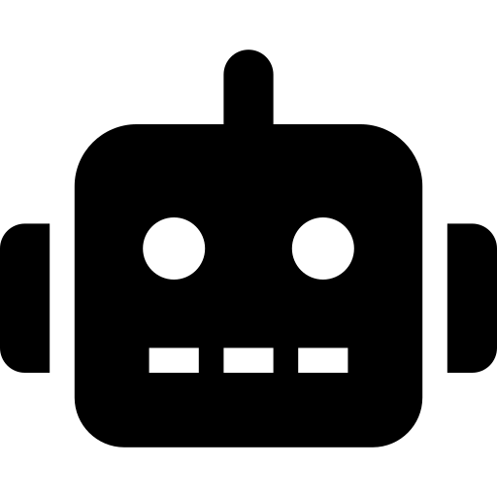
The AI Agent
Primary Role: Software Developer
Code Generation
Drafts features and starter code using project example repos as context, enabling rapid iteration.
UI Development
Develops user interface components including the chat interface and search UI.
Prompt Design
Assists with prompt engineering for AI service integration and API call patterns.
Debugging & Fixes
Suggests fixes when issues arise; team members review and validate all generated output.
Team members review, refine, and validate all AI-generated code to ensure correctness, performance, and alignment with project goals.

Slide 7

MOVIE MASTER
AI-Powered Film Intelligence Platform
🔍 Natural language movie search & discovery
🤖 AI-generated summaries from transcripts
💬 Per-movie AI chat expert interface
🌐 Multilingual summary translation
⭐ Ratings & personalized recommendations

