Slide 1

Neurofeedback:
Rhythms For Living
Susan Cheshire Brown Ph.D.
Valdeane W. Brown Ph.D.
Zengar Institute…Rhythms For Living
Victoria, BC Canada

Slide 2
What is Neurofeedback?
A Powerful and Cutting-Edge Technology For Healing and Growth: A Brain Gym!
Recently Embraced by Clinicians Yet Has A Long History
Research in Treating Addictions and ADD Put Neurofeedback on the Map
Clinical Effects Noted by Clinicians Has Widely Extended Its Use

Slide 3
Healing and the Brain: How Does It Work?
When We Give the Brain What it Works with Best: Information
The Brain Re-organizes Itself
And Symptoms Drop Away-
Physical and Emotional!

Slide 4
Neurofeedback as Healing Tool
Neurofeedback Is Different From Other Forms of Healing in Some Important Ways:
Neurofeedback is Biofeedback
Neurofeedback is Central
Neurofeedback is Learning

Slide 5
Biofeedback: Most Forms of Healing Aren’t...
They Do Not Receive Information From the System
So They Cannot Adjust to Changes in the System
e.g. Medication, Surgery, Physical Therapy, Chiropractic, Even Light and Sound Machines and CDs Designed to Stimulate Certain Brain Waves

Slide 6
Neurofeedback is Biofeedback...
With Biofeedback the System (Brain) Receives Ongoing Information About Itself and
Adjusts What It Does (It’s Healing), in Response to Itself, Moment by Moment
These Adjustments Are the Healing
And That’s How The Brain Heals Itself!

Slide 7
Neurofeedback is Central:
Older Forms of Biofeedback Were Powerful But Work Peripherally
Neurofeedback Works With City Central: Your Brain
Symptoms Can Be Physical or Emotional- It Doesn’t Matter! You Have Only One Nervous System….

Slide 8
Neurofeedback is Learning:
The Brain Learns How To Manage Itself Better
The Effects are Invisible and Effortless
The Effects Last: Once Your Brain Has Learned, It Can’t Not Know
Booster Sessions Quickly Get It Back On Course

Slide 9
What Information Do We Give The Brain?
Tones
Images Which Move or Change Color
Access to Games
In Response to What the Brain is Doing
So the Brain Can Know When It’s in the Zone and Stay There

Slide 10
Changes in Brainwaves Mean Changes in Brain Function
Changes in Brainwaves Mean a
Change in Biochemistry!

Slide 11
What Actually Happens In A Neurofeedback Session?
Evaluation of Your Goals and Symptoms
Sit in a Comfortable Chair in Front of a Computer Screen
Practitioner Hooks Up Sensors and Reads Brainwaves
Nothing is Put Into You

Slide 12
What Do You Do During the Session?
Nothing- You Have Already Done Your Part By Being There!
Relax, and Let The Image Move and the Tones Sound
Your Brain Is Doing The Work Without Your Conscious Effort

Slide 13
What Is The Practitioner Doing?
Plenty! Expertise Is Important
Practitioner Decides The Information That Is Important For Your Brain To Receive (Which Frequencies to Train)
Practitioner Trains Frequencies By Setting Thresholds

Slide 14
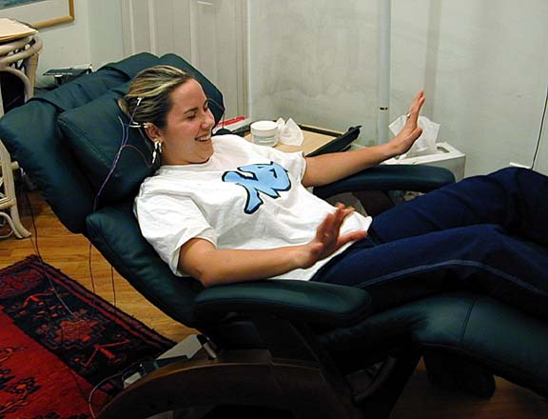

Slide 15
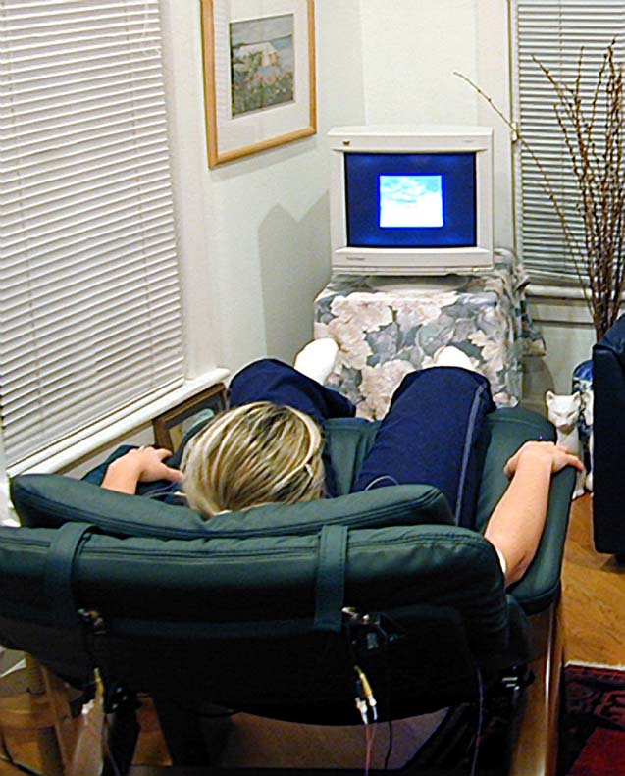

Slide 16
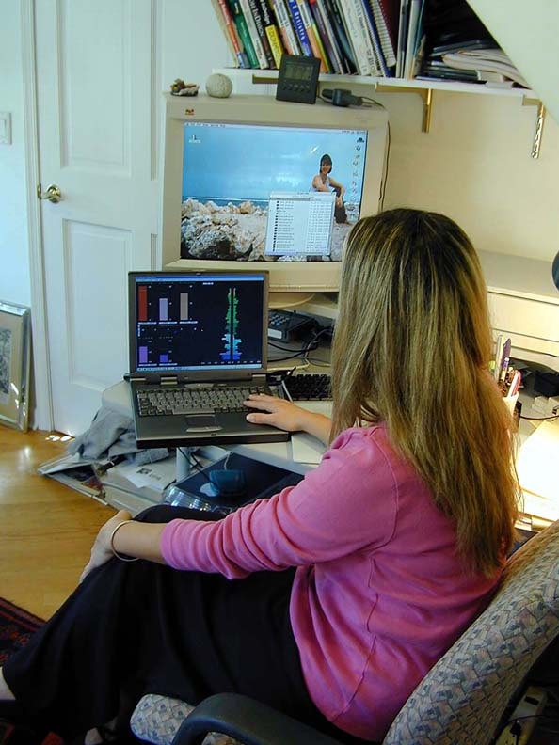

Slide 17
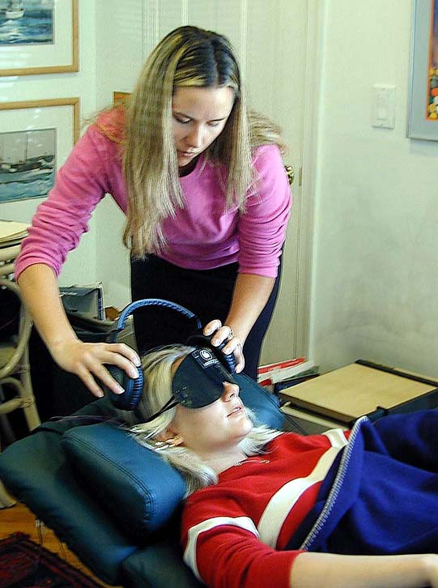

Slide 18
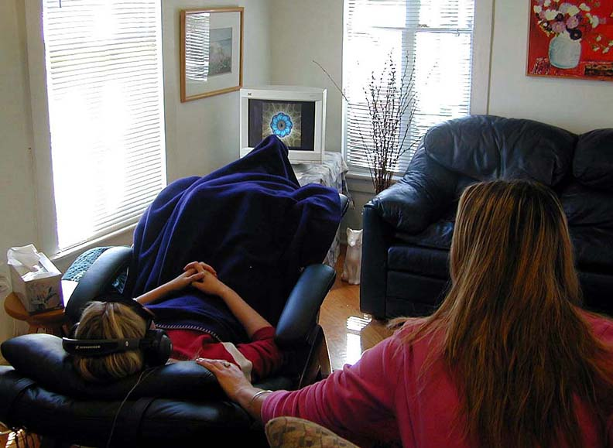

Slide 19
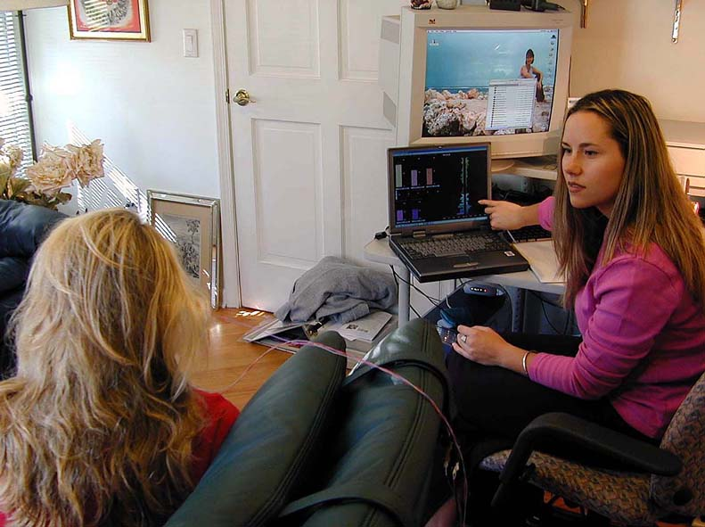

Slide 20
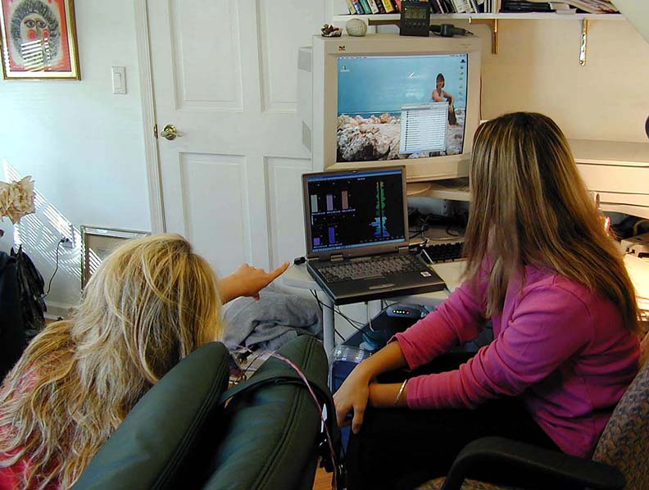

Slide 21
Is It “Just Relaxation…”?
Most Clients Thoroughly Enjoy the Training and Find It VERY Relaxing
But It’s Not Just Relaxation
All Life is States of Attention (Frequencies)
You Need Access To Them All and
To Be Able To Shift Fluidly From One State of Attention (Frequency) To Another

Slide 22
Frequencies, Attention and Brain Waves: … Say What??
Large Single Brainwave Divided into Individual Brain Wave Frequencies
Different Brain Wave Frequencies Do Different Things: Delta, Theta, Alpha, Beta and …..
Encouraging More or Less of These Different Frequencies Produces Different Healing Effects

Slide 23
But What If I Want to Lose Weight?
There Are Likely Both
Direct and Indirect Effects of Neurofeedback on the
Central Nervous System
Relevant to Weight Loss

Slide 24
Possible Direct Effects of Neurofeedback
Neurofeedback Re-establishes Basic Body Rhythms Such as Sleep-Wake Cycles and Appetite
Reduces Cravings
Probably Re-establishes Body Set Point
Effects on Appetite May Be Strengthened by Use of Certain Sensor Placements

Slide 25
“Indirect” Effects Relevant To Weight Management
Stabilization of Emotions
Stabilization of Physical Health
Reduction of Cravings
Makes Change Easier

Slide 26
Stabilization of Emotions
Eating for Emotional Reasons May Be Considered Falling Into“Black Holes”
These Black Holes are Carried in Certain Frequencies of Brain Wave Activity
Reduce the Amount (Amplitude) of These Frequencies, and the Black Holes Lessen
You Fall Into Them Less Often, and When You Do, It Is Easier To Get Out

Slide 27
What Are the “Black Holes”
Anxiety (Feeling Frightened, Stressed, Overwhelmed eg. Money Shortage)
Depression (Empty, Deprived, Not Allowing Yourself to Express Anger, Not Supporting Self, Lack of Meaning, Loneliness, etc.)
Self-Loathing (Negative Self Image, Guilt)
Binge Eating (Triggered by Emotions)

Slide 28
How Can Neurofeedback Help Reduce Black Holes?
Decreases Negative Thoughts by Reducing the “Worry” Frequency (23-38 Hz)
Increases Availability of Positive States by Increasing Alpha and Aura Rhythm (8-12 Hz)
Increases Self-Awareness (14 Hz)
Allows Stronger Sense of Self (40 Hz)
Undoes Old Traumas With Deep State Training (7 Hz e.g. Eating Disorders)

Slide 29
Stabilization of Physical Health
Effects We Have Seen:
Stabilization of Diabetes and Reduced Insulin Need
Reduction in Blood Pressure
Strengthening of Immune System
Eliminating Symptoms of PMS

Slide 30
Reduction of Cravings
Food
Alcohol
Sugar (the “Fast Fix”)
Tobacco

Slide 31
Facilitation of Change
Increased Emotional Stability
  Strength and Steadiness in Face of Difficulty
Increased Adaptive Flexibility
  Handling Challenges and Change
Increased Clarity to Know When Change is Needed

Slide 32
It’s a Virtuous Cycle-
An Increase in Feeling Good Leads to
An Increase in Feeling Good!

Slide 33
What Do Our Clients Notice?
Life Just Seems Easier-
(Optimal Flow and Function)
Life’s Yum and Yuck Becomes Clearer, So It’s Easier to Make Decisions
Changes Seem To Happen Effortlessly
De-abnormalize, Yet Retain Yourself.
They Say They Sleep Better, Head Feels Clearer, Feel Happier, Less Anxious etc...

Slide 34
To Sum Up … Neurofeedback:
Changes are Profoundly Simple
  Symptoms Fall Away and You Just Don’t Notice Them Anymore
Changes are Simply Profound
  Your Brain Shifts and Your Life Changes!

